Slide 1


Our Journey to Greatness
Institutional Effectiveness & Planning Updates
Prepared for the Board of Trustees, July 2026
CliftonStrengths
Good to Great
AchieveIt

Slide 2
Institutional Commitment
Vision: To be the best and first choice for education
Mission: To empower individuals through learning and to forge partnerships that grow communities.
PEOPLE + CULTURE
Build culture and belonging
Recognize expertise and draw out strengths
Connect people across the College
EVIDENCE + PLANNING
Strengthen data-informed practices
Align plans, measures, and resources
Turn learning into improvement

Slide 3
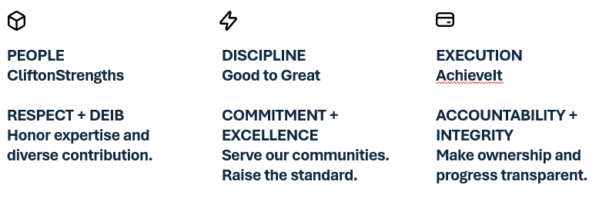
Living Our Core Values

Slide 4
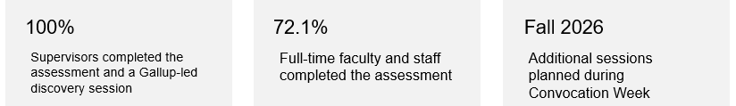
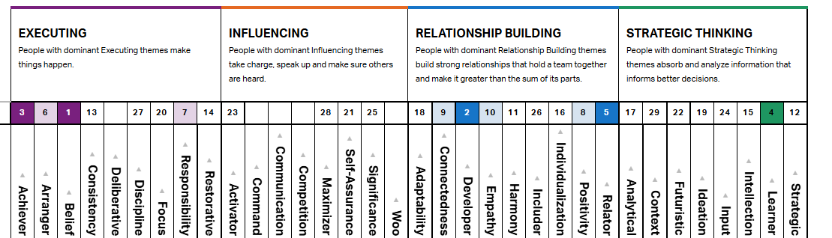
Gallup CliftonStrengths

Slide 5
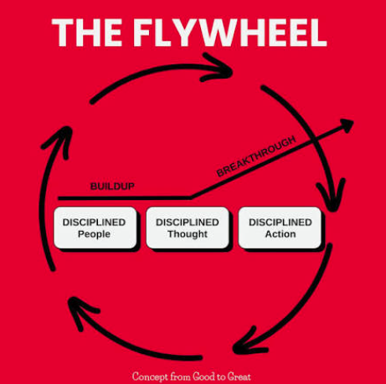
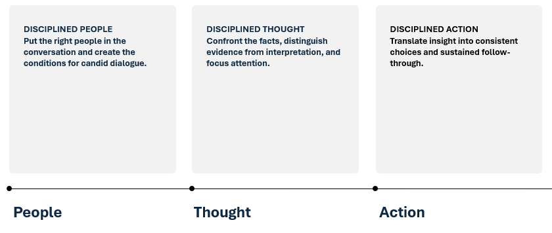
Good to Great Framework

Slide 6
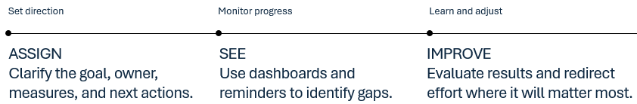
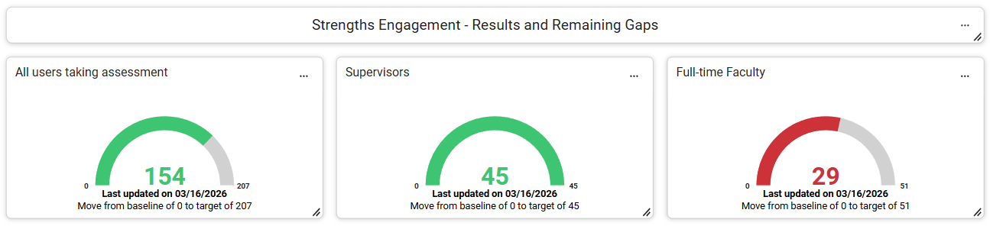
AchieveIt Platform

Slide 7
Questions / Discussion

