Slide 1

Student Profile Monitoring Report July 2017

Slide 2
Philosophy of Students
Student Success Mission:
The mission of the Student Success Division is to foster and enhance student learning, development, and goal attainment through student-centered programs, services and advocacy.
Find a way to SAY YES
High Tech/High Touch. Provide service that is both customer friendly and technology focused.
Wrap-Around Service. Ensures student is to focal point of service delivery.
Provide opportunities to connect faces to functions
Reduce the points at which a student can “exit” the enrollment process.
Meet students and their goals where they are by a stronger focus on goal identification, clarification and completion.

Slide 3
Student Demographics
 | SU16* | FA16* | SP17*
Total Enrollment | 876 | 2839 | 2934
FTE | 216 | 1591 | 1531
Gender (by percent)
Women | 63.7 | 58.5 | 60.1
Men | 36.3 | 41.5 | 39.9
Enrollment Status (by percent)
1-4 hours | 60.3 | 27.9 | 33.3
5-8 hours | 37.6 | 24.3 | 26.5
9-11 hours | 2.1 | 16.2 | 14.0
12+ hours | 0 | 31.6 | 26.2
*from Tenth Day report

Slide 4
Student Demographics
Race (by percentage) | SU16* | FA16* | SP17*
Asian | 1.5 | 0.9 | 0.9
American Indian | 1.0 | 0.5 | 0.5
African American | 13.7 | 14.6 | 14.2
Hispanic/Latino | 1.0 | 1.4 | 2.1
White | 78.1 | 77.2 | 76.7
Nat Hawaiian/Pacific Islander | 0.3 | 0.4 | 0.4
Unknown | 4.4 | 5.0 | 4.8
*from Tenth Day report

Slide 5
Student Demographics
Base Profile of Richland Students | FY14 | FY15 | FY16 | FY17
Total Enrollment* | 6093 | 5783 | 5300 | 4220
Average GPA | 2.63 | 2.66 | 2.68 | 2.62
Average Age | 26 | 26 | 24 | 25
*Degree seeking, from Argos Annual Enrollment (A1) Report; excludes ABE, ASE, ESL and VOCSK

Slide 6
Student Financial Need
Students Who apply for aid | FY15 | FY16 | FY17
Students Who indicate Richland on FAFSA (Free Application for Federal Student Aid) | 3898 | 3557 | 2965
Pell Grant Recipients | 1595 | 1470 | 1315
Pell Amount | $4,554,990 | $4,269,058 | $3,842,933
Student Employment (on Campus) | FY2016 | FY2017
Student Workers (Federal Work-Study) | 26 | 40
Student Workers (College Work-Study) | 43 | 49

Slide 7
Students with high needs
Student Support Services/TRIO focus
A focus on First Generation college student, low-income and/or student with disabilities.
FY16 data
Percentage of program cohort graduates: 35%
Percentage of program transfers: 40%
Percentage of good academic standing: just below 75% (GPA of 2.3 or higher).

Slide 8
Students with high needs
Continuous assessment of services which are scheduled to best meet student and programming demand
Students are often referred to specific tutor who has a teaching style or educational background that is more targeted to the student need
Students that exhibit a need for additional services based on instructor recommendation are offered additional access to tutoring
Services for students with specific testing needs or accommodations are coordinated through the Accommodations and Testing Specialist as well as Online Learning.
Delta Alpha Pi is an academic honor society founded to recognize high-achieving students with disabilities. Richland is one of less than 10 in Illinois and has inducted nearly 60 members since 2008.

Slide 9
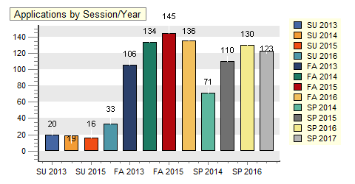
Students with high needs

Slide 10
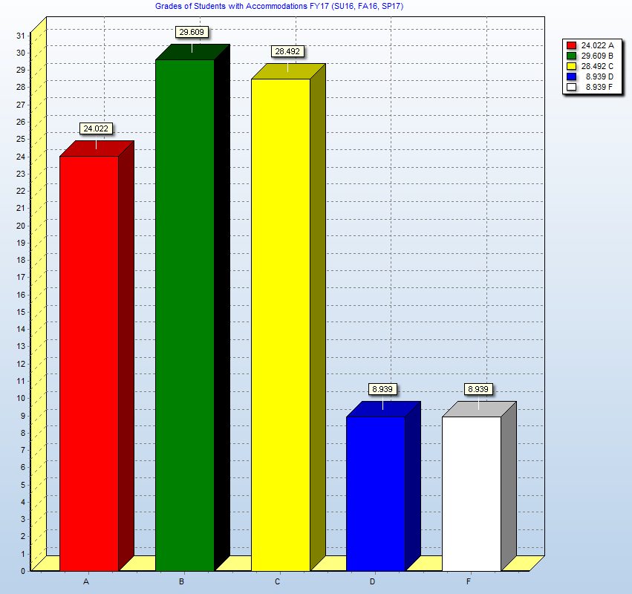
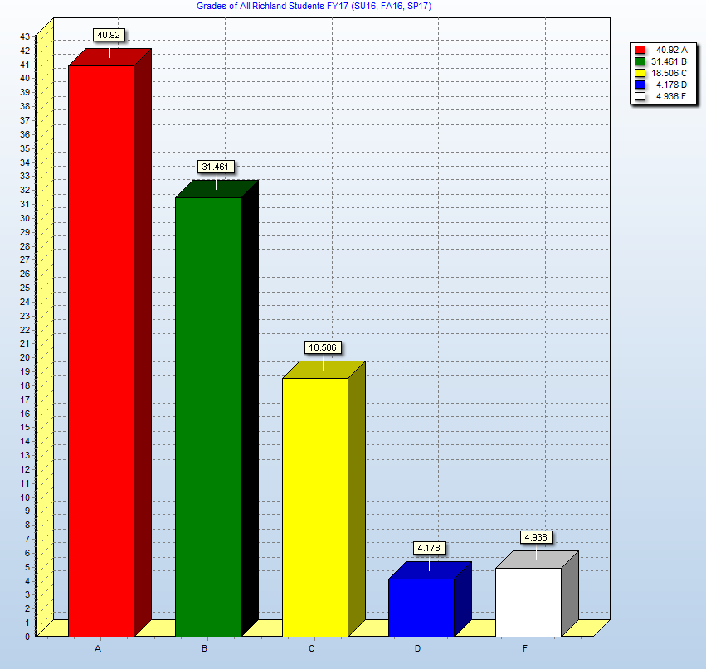
Students with high needs
Comparison of student with disabilities and all Richland Students

Slide 11
Student Activities Enhancing students’ educational experience through engagement in social, cultural, intellectual, wellness, leadership, service, and governance programs and organizations
40 Student Engagement sponsored programs and activities
Nearly 60 student organization sponsored programs and fundraisers
Approximately 275 students are members of student clubs and organizations
Over $4000 fundraised and donated by student organizations to local, national, and international charities
310 new students completing New Student Orientation
Nearly 30 students given the opportunity to travel to local, state, and regional conferences

Slide 12
Student Activities Enhancing students’ educational experience through engagement in social, cultural, intellectual, wellness, leadership, service, and governance programs and organizations
Improvements for next year-
Intramurals/recreation clubs
Increased health and wellness programming
Increased focus on student learning outcomes for co-curricular involvement
“I underwent a mass positive growth process at RCC, and I can honestly say that 85% of that process was a result of my involvement in co-curriculars. I’m more extroverted, more socially confident, I can lead a group of people, and I also know how to be a team player and work in group towards a common goal” –2017 Richland graduate

Slide 13
Student Satisfaction
Track using Noel-Levtiz Student Satisfaction Inventory.
We generally complete this every other year. The survey results are from 2014, with the next round to be completed this fall (2017)
Graduate Survey
Internship and Employer Satisfaction surveys

Slide 14
RCC was my…

Slide 15
National Comparisons
Higher Satisfaction vs. National Community Colleges
8. Classes are scheduled at times that are convenient for me.
15. I am able to register for classes I need with few conflicts.
7. Adequate financial aid is available for most students.
13. Financial aid awards are announced to students in time to be helpful in college planning.
20. Financial aid counselors are helpful.
39. The amount of student parking space on campus is adequate.
24. Parking lots are well-lighted and secure.
Lower Satisfaction vs. National Community Colleges
18. The quality of instruction I receive in most of my classes is excellent.
32. My academic advisor is knowledgeable about my program requirements.
40. My academic advisor is knowledgeable about the transfer requirements of other schools.
41. Admissions staff are knowledgeable.
23. Faculty are understanding of students' unique life circumstances.
36. Students are made to feel welcome on this campus.
42. The equipment in the lab facilities is kept up to date.

Slide 16
AQIP Institutions Comparison
Higher Satisfaction vs. AQIP Institutions
8. Classes are scheduled at times that are convenient for me.
69. There is a good variety of courses provided on this campus.
7. Adequate financial aid is available for most students.
31. The campus is safe and secure for all students.
68. On the whole, the campus is well-maintained.
13. Financial aid awards are announced to students in time to be helpful in college planning.
20. Financial aid counselors are helpful.
39. The amount of student parking space on campus is adequate.
24. Parking lots are well-lighted and secure.
Lower Satisfaction vs. AQIP Institutions
18. The quality of instruction I receive in most of my classes is excellent.
32. My academic advisor is knowledgeable about my program requirements.
6. My academic advisor is approachable.
5. The personnel involved in registration are helpful.
40. My academic advisor is knowledgeable about the transfer requirements of other schools.
41. Admissions staff are knowledgeable.
25. My academic advisor is concerned about my success as an individual.
23. Faculty are understanding of students' unique life circumstances.
36. Students are made to feel welcome on this campus.
42. The equipment in the lab facilities is kept up to date.

Slide 17
So far, how has your college experience met your expectations?

Slide 18
Graduate Survey
In order to understand the overall, summative experience of Richland students, program graduates (degrees and certificates) are surveyed at the completion of their program.
Graduates | FY15 | FY16 | FY17
Basic Certificate | 109 | 126 | 112
Advanced Certificate | 34 | 24 | 33
Certificate | 381 | 427 | 349
Associate in Applied Science | 152 | 146 | 127
Associate in Liberal Studies | 26 | 24 | 14
Associate in Engineering Science | 0 | 2 | 3
Associate in Arts | 74 | 97 | 87
Associate in Science | 75 | 71 | 54
Associate in Fine Arts | 0 | 1 | 2
Associate of Arts in Teaching | 1 | 0 | 0

Slide 19
Graduate Survey
Highlights from the 2017 Graduate Survey:
Gender Female – 79.66% Male – 20.34% | Type of student Primarily Day Student – 77.5% Primarily Evening Student – 11.67% Primarily Online Student – 10.83% Full time – 84% Part Time – 16%
Overall Academic Experience at Richland: Very Satisfied – 35.71% Satisfied – 50.79% Neutral – 7.14% Dissatisfied – 3.97% Very Dissatisfied – 2.38% | Quality of Instruction: Very Satisfied – 38.1% Satisfied – 49.21% Neutral – 7.94% Dissatisfied – 2.38% Very Dissatisfied – 1.59% N/A – 0.79%

Slide 20
Graduate Survey
Highlights from the 2017 Graduate Survey:
Class Size: Very Satisfied – 42.06% Satisfied – 46.03% Neutral – 9.52% Dissatisfied – 0.79% Very Dissatisfied – 1.59% | Availability of classes in your major field: Very Satisfied – 46.03% Satisfied – 39.68% Neutral – 8.73% Dissatisfied – 1.59% Very Dissatisfied – 2.38% N/A – 1.59%
Intellectual challenge of classes in your major field: Very Satisfied – 48.41% Satisfied – 38.10% Neutral – 7.14% Dissatisfied – 1.59% Very Dissatisfied – 2.38% N/A – 2.38%

Slide 21
Job Placement/Internships
Career Services currently tracks internships for all CTE programs except HIT and EMS as they manage their own internship program. The numbers below do not include those programs.
Fall 2016 Internships-19
Spring 2017 Internships-18
Summer 2017 Internships-26
Over 50% of the students completing internships remained employed with the employer after their internship agreement was completed.
Highest demand positions/degrees this past year were nursing and most variations of engineering technology.
Manufacturers in this area are concerned about the quantity of qualified candidates. Great opportunity for local individuals to finish a degree in 2 years with Richland and have guaranteed employment with great wages and benefits.

Slide 22
Employer Satisfaction
Recently Heavener, Beyers, & Mihlar, LLC hired 2 of our IT students and their quotes on those 2 students are:
He has really hit the floor running and taken a great deal of stress off my shoulders by handling the bulk of our troubleshooting. He is also setting up our reporting and monitoring systems which is a huge help! Richland did a great job preparing him for the work force!
He also is very well prepared for the job we hired him for! He is working with our document merge department in a programming capacity. It took him absolutely no time at all to learn the system and jump right in an begin setting up new documents! He is a great addition to our team!
Employers attending our annual career fair grew from 44 employers in 2016 to 61 employers in 2017.
Quote from a human resources person that recently worked with Career Services, “I think you are doing great things for the students at Richland. They needed someone for a long time that understands the needs of employers. This seems to be a good fit for you!”

Slide 23
Final Thoughts

