Slide 1

Student Success and Enrollment Monitoring Report, 2018
Isaac Zúñiga, Ed.D.

Slide 2
“An investment in knowledge pays the best dividends”
Benjamin Franklin

Slide 3
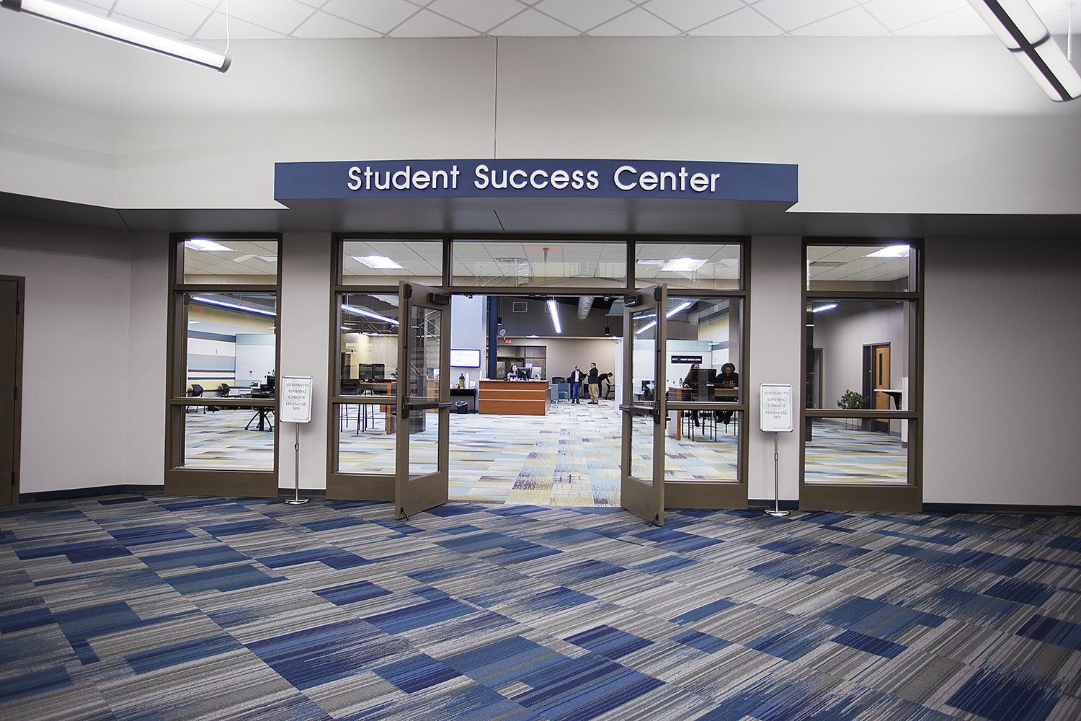

Slide 4

Guiding Principles
Students are central to the academic enterprise and are the focus of our action
Collaboration and cooperation between and among students, faculty, and staff are critical to meeting College targets
Connectedness to faculty and staff, both within and outside the classroom, is critical to student success; thus we all share the responsibility for facilitating these connections and eliminating barriers to them
Notes:
Went into effect April 2nd
All coaches operate from the same foundation, just work with different populations of students
3 different coaching positions
Enrollment Success Coach
Student Success Coach
Career & Completion Coach

Slide 5
Student Success Mission
To foster and enhance student learning, development, and goal attainment through student-centered programs, services, and advocacy.
Create an in-house “success coaching model”
Observe and build relationships with students
Assess student needs, personal and academic goals
Construct a process to determine what success is for the student
Help impact time of completion and retention
Notes:
Went into effect April 2nd
All coaches operate from the same foundation, just work with different populations of students
The goal is to
Ultimately
3 different coaching positions
Enrollment Success Coach
Student Success Coach
Career & Completion Coach

Slide 6
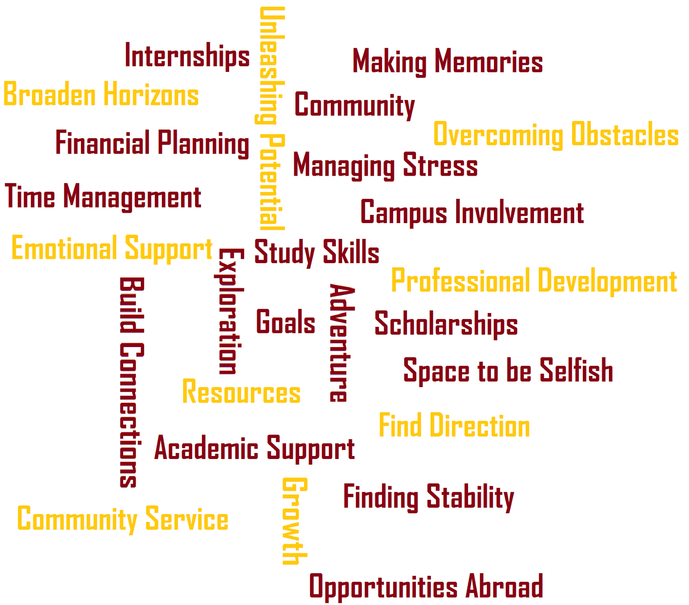
How does Coaching Impact Retention and Risk Taking?
Notes:
Went into effect April 2nd
All coaches operate from the same foundation, just work with different populations of students
3 different coaching positions
Enrollment Success Coach
Student Success Coach
Career & Completion Coach

Slide 7
Student Demographics
Notes:
Why this impact, I suspect the increase of our dual credit enrolment program
Decline if adult population in the district

Slide 8
Student Demographics
Notes:
61 women
39 men

Slide 9
Student Demographics
Notes:
White-79.8
African American – 12.3
Unknown-4.9
Hispanic Latino 1.5
Asian-1.2
American Indian-0.3

Slide 10

RCC Typical Student
Female in her early 20s, Caucasian, from Macon County. Taking day classes, receives some financial aid, who is pursuing a two year-degree.

Slide 11
Student Enrollment

Slide 12
Unduplicated Student Enrollment by Session

Slide 13
FTE by Session/YR

Slide 14

Target Population
Traditional Students
Nontraditional Students
Transfer Students
Feeder High Schools
Dual Credit and Dual Enrollment
Veterans
Community Members
Notes:
Traditional Students: Reach out to targeted high school juniors and seniors who are looking for an Associate’s degree, transfer opportunities, certificate or occupational programs.
Transfer: Target students who are interested in higher education savings for the first two years and who are interested in transfer opportunities.
Feeder high schools: Our enrollment coach we be focusing on forming relationships with DPS and the other 14 area high schools and guidance counselors.
Dual Credit and Dual Enrollment: Through our dual enrollment program, we would like to target rising juniors and also our senior populations to take college credit courses.
Veterans Affairs: Reach out to Veterans Affairs centers and military high schools to promote Associate’s degree, transfer opportunities, certificate and occupational programs
Community Members: work with clients in the community through community based agencies, government offices and agencies, and local businesses.

Slide 15
Implementation Strategies
High School Outreach: Reach out to and visit all Decatur-area public, private and alternative high schools.
HS Counselor Engagement: Forge new and build upon existing relationships with appropriate HS college counselors and/or other key stakeholders
Student Visits: Work with key contacts within the high schools to initiate workshops and informational sessions for their prospective students
Non-Traditional Outreach: Reach out to and build relationships with local community-based organizations, faith-based organizations, libraries and other key community bases
Campus Presence: In an effort to better familiarize oneself with the campus, build relationships with key faculty and staff members
Notes:
Traditional Students: Reach out to targeted high school juniors and seniors who are looking for an Associate’s degree, transfer opportunities, certificate or occupational programs.
Transfer: Target students who are interested in higher education savings for the first two years and who are interested in transfer opportunities.
Feeder high schools: Our enrollment coach we be focusing on forming relationships with DPS and the other 14 area high schools and guidance counselors.
Dual Credit and Dual Enrollment: Through our dual enrollment program, we would like to target rising juniors and also our senior populations to take college credit courses.
Veterans Affairs: Reach out to Veterans Affairs centers and military high schools to promote Associate’s degree, transfer opportunities, certificate and occupational programs
Community Members: work with clients in the community through community based agencies, government offices and agencies, and local businesses.

Slide 16


Questions

