Slide 1
Monitoring Report Information Technology

Slide 2


Overall Information Technology Status: Yellow

Slide 3
Questions that We Ask
Academic End-User Technology
Are we providing enough adequately-functioning computers for our students?
Do the audio-visual & classroom presentation systems allow our instructors to deliver their desired content in a reliable manner?
Are we providing the software that the students need to succeed?
Administrative End-User Technology
Are we providing adequately-functioning computers for our employees?
Are we providing the software that our employees need to perform their job duties?
Infrastructure
Does our hardwired network support our needs?
Does our wireless network support our needs?
Do our servers have adequate processing & storage capacity?
Telecommunications
Does our telephone system support our voice communication needs?
Do we have enough internet access capacity for our students, employees, and customers?

Slide 4
Notable Project Completions
Carroll Center
including: a new audio-visual back-end to support the active learning rooms -- partial replacement of the network “core” (including WiFi) -- addition of over 200 laptops
Student Success Center
including: relocation & reassignment of technology to support new processes in the Student Success area – upgraded network infrastructure & WiFi
Jenzabar CX migration to Linux
including: a completely uneventful transition from an operating system that we had been using for over 20 years – over 1,200 hours of testing logged by college staff
Law Enforcement Training Center
including: an entire facility’s IT infrastructure & the addition of over 60 laptops

Slide 5
Current Findings
Network & telecommunications infrastructure are meeting the College’s needs in most situations. Additional Wi-Fi improvements will be installed at the end of the semester.
Classroom audio-visual systems are meeting instructor’s needs
Classroom computers are in adequate supply, but the age of many workstations is causing difficulties in many academic areas.
The central student information & financial management system (Jenzabar CX) continues to meet most of our needs
Most academic & administrative users have access to the software they need
Aging computers are causing difficulties for some faculty & staff

Slide 6
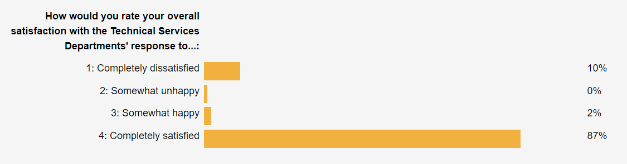
Current Findings
- Staff continue to provide the institution with the services needed to perform our core business functions

Slide 7
Challenges: Aging End-User Equipment
College trends over the last decade have resulted in a sizeable technology base relative to our enrollment.
Increased use of computerized (especially online) solutions in classrooms & offices has resulted in a more stringent set of minimum standards for computer equipment in a higher education environment (4-5 year replacement cycles for classrooms, 5-6 year cycles for offices).
The “deferred maintenance” that has accumulated due to the budgetary necessities of the past few years is the single most important IT challenge that needs to be addressed.

Slide 8
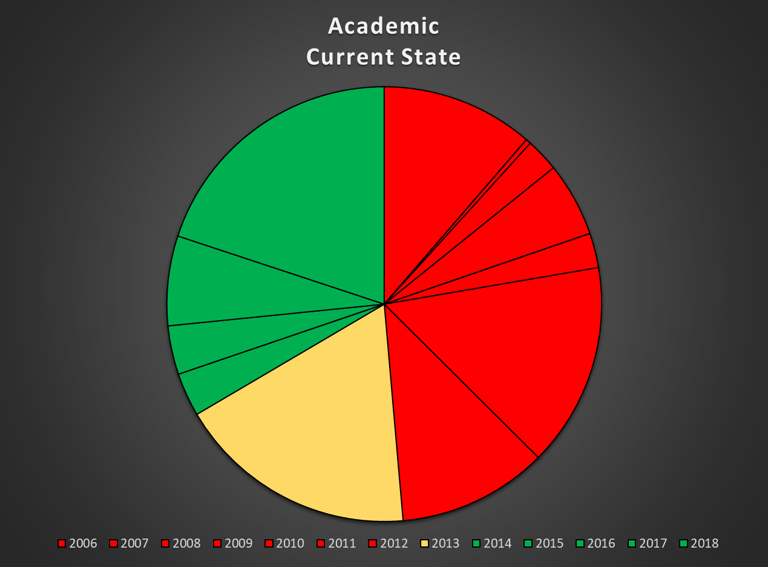
Challenges: Aging End-User Equipment
Currently, 529 (49%) of our classroom computers were purchased 6 or more years ago.
Purchase Year | Qty | Percent of total
2006 | 120 | 11.24%
2007 | 4 | 0.37%
2008 | 26 | 2.43%
2009 | 58 | 5.43%
2010 | 27 | 2.53%
2011 | 177 | 16.57%
2012 | 117 | 10.96%
2013 | 188 | 17.60%
2014 | 34 | 3.18%
2015 | 38 | 3.56%
2016 | 70 | 6.55%
2017 | 209 | 19.57%
2018 | 0 | 0.00%

Slide 9
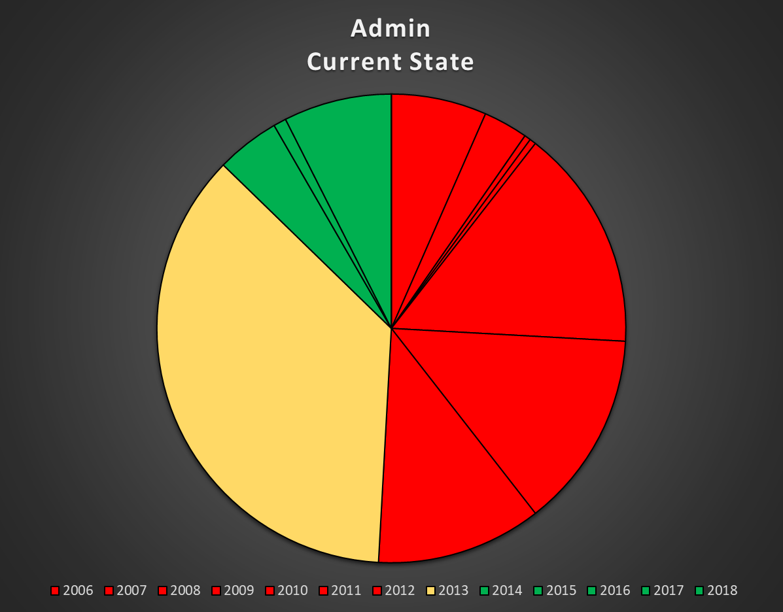
Challenges: Aging End-User Equipment
Similarly, 116 (50%) of our office computers were purchased 6 or more years ago.
Purchase Year | Qty | Percent of total
2006 | 15 | 6.6%
2007 | 7 | 3.1%
2008 | 1 | 0.4%
2009 | 1 | 0.4%
2010 | 35 | 15.4%
2011 | 31 | 13.6%
2012 | 26 | 11.4%
2013 | 83 | 36.4%
2014 | 10 | 4.4%
2015 | 0 | 0.0%
2016 | 2 | 0.9%
2017 | 17 | 7.5%
2018 | 0 | 0.0%

Slide 10
Challenges: Aging End-User Equipment
What are we doing to fix this?
Working through the College’s budgeting process & other funding sources to purchase replacement equipment for the lowest-ranked, most-used workstations
Identifying computers that can be decommissioned
Researching alternate options

Slide 11
Upcoming: The Next 12 Months
Jenzabar will be releasing the first modules for CX version 10 (we are currently running version 9). We will begin testing & integrating these modules into our environment once they are available.
Once the new Institutional Research Director & VP of Student Success are brought on board, we expect some new projects will be defined for those areas.
In the wake of our recent construction projects, additional wireless network configuration, installation, and balancing needs to be performed throughout the rest of the main campus.
Work to reduce our aging equipment, while also rebuilding classrooms that were converted during constructions & supporting further expansion at the LETC.

Slide 12
Questions?

