Slide 1
Monitoring Report
Information Technology

Slide 2

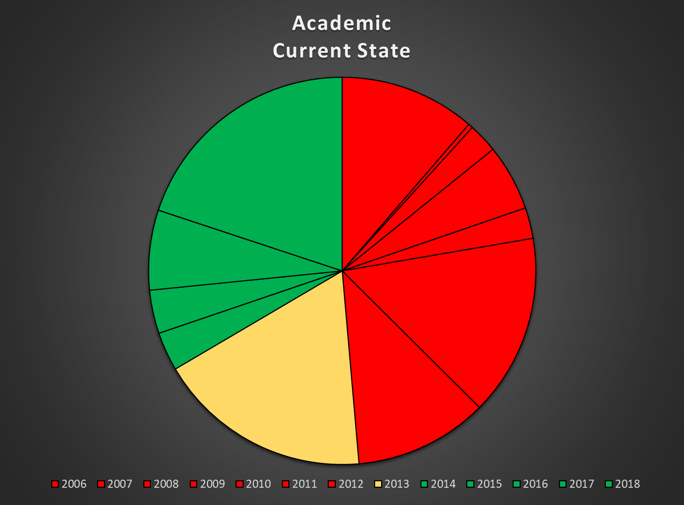
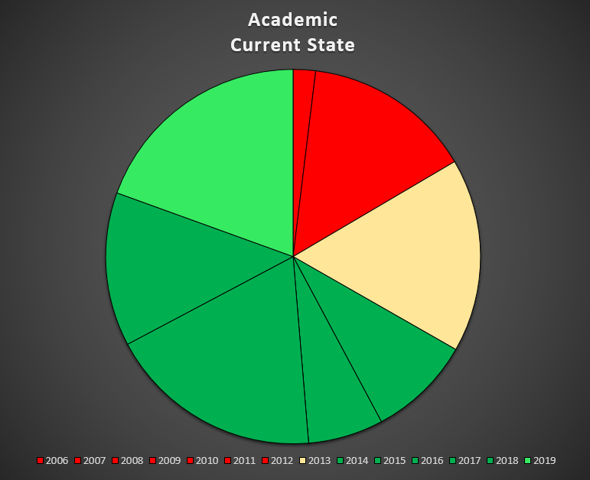
Things Are Improving!
April 2018
April 2019

Slide 3
Notable Project Completions
Richland Thrive
  Retention management system; designed to help identify at risk students and assist staff track & manage interventions for these students
Migration to Arc Media for video streaming
  Led by Accommodations & Online Learning – migration of approximately 1,200 videos to a lower cost service that also provided closed-captioning services
Electronic purchase requisitions
  25+ years of paper-based processes distilled down into an electronic system
Replacement or disposal of 19% of academic computers
Removal of over 200 student computers that were below usable standards

Slide 4
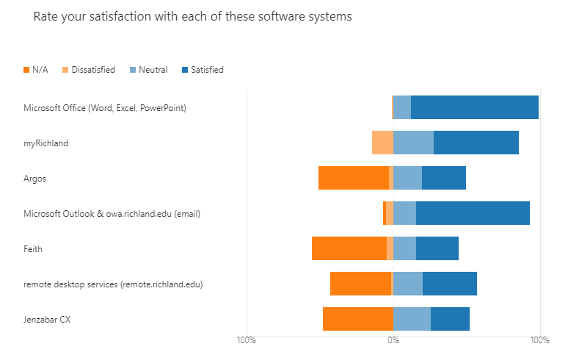
Positive Benchmarks
  Students & employees are largely satisfied with available software solutions

Slide 5
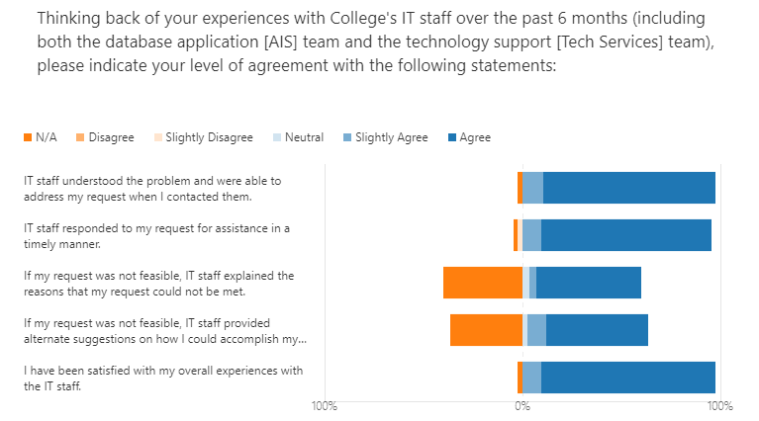
Positive Benchmarks
  …and also with the level of support provided by IT department staff

Slide 6
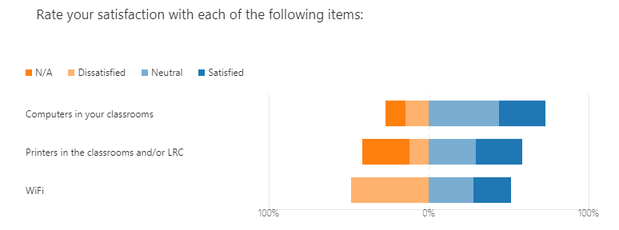
Challenges: Wireless Networking (WiFi)
  Bandwidth available for WiFi continues to be an issue on the main campus

Slide 7
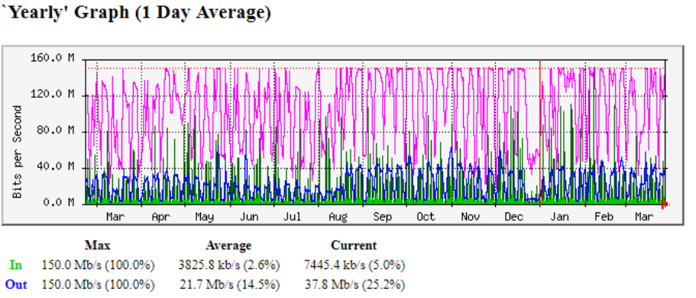
Challenges: Wireless Networking
  Bandwidth utilization is near capacity, with traffic restrictions currently enabled

Slide 8

Challenges: Aging End-User Equipment
28% of our academic computers are more than 6 years old (was 49% a year ago)
Purchase Year | Qty | Percent of total
2011 | 19 | 1.63%
2012 | 144 | 12.32%
2013 | 165 | 14.11%
2014 | 88 | 7.53%
2015 | 64 | 5.47%
2016 | 0 | 0.00%
2017 | 183 | 15.65%
2018 | 131 | 11.21%
2019 | 192 | 16.42%

Slide 9
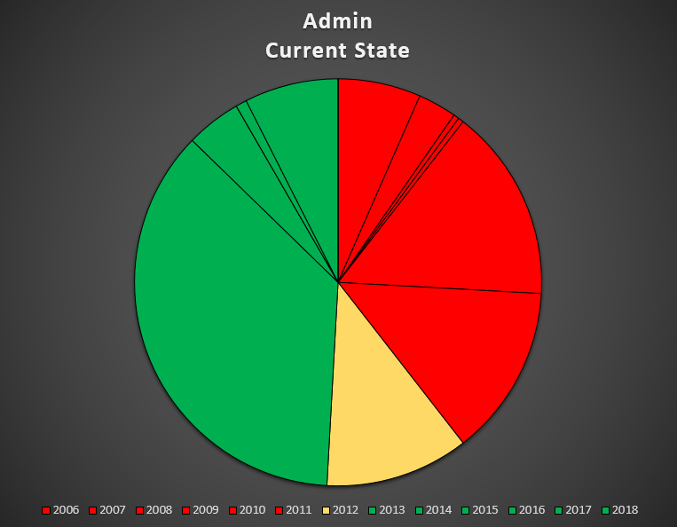
Challenges: Aging End-User Equipment
Aging for office computers is roughly the same as in 2018 (50%); replacements will be starting soon
Purchase Year | Qty | Percent of total
2006 | 15 | 6.6%
2007 | 7 | 3.1%
2008 | 1 | 0.4%
2009 | 1 | 0.4%
2010 | 35 | 15.4%
2011 | 31 | 13.6%
2012 | 26 | 11.4%
2013 | 83 | 36.4%
2014 | 10 | 4.4%
2015 | 0 | 0.0%
2016 | 2 | 0.9%
2017 | 17 | 7.5%
2018 | 0 | 0.0%

Slide 10
Upcoming: The Next 12 Months
Staff will continue to replace hardware as budget allows to improve conditions for students & employees
If funding is available in the 2019-2012 budget, we will work to increase network bandwidth to the main campus
Jenzabar has released the first modules for CX version 10. We will continue testing & begin to integrate these modules into our data processing environment.
Staff will be working to improve backup & disaster recovery processes to ensure that the college can continue to function in the aftermath of a critical event.

