Slide 1

Enrollment and Student Monitoring Report, 2019
Isaac Zúñiga, Ed.D.

Slide 2

Guiding Principles
Students are Central to the academic enterprise and are the focus of our action
Collaboration and Cooperation between and among students, faculty, and staff are critical to meeting College targets
Connectedness to faculty and staff, both within and outside the classroom, is critical to student success; thus we all share the responsibility and success for facilitating these Connections

Slide 3

Who is enrolled at Richland

Slide 4

Who is enrolled at Richland

Slide 5

Who is enrolled at Richland

Slide 6
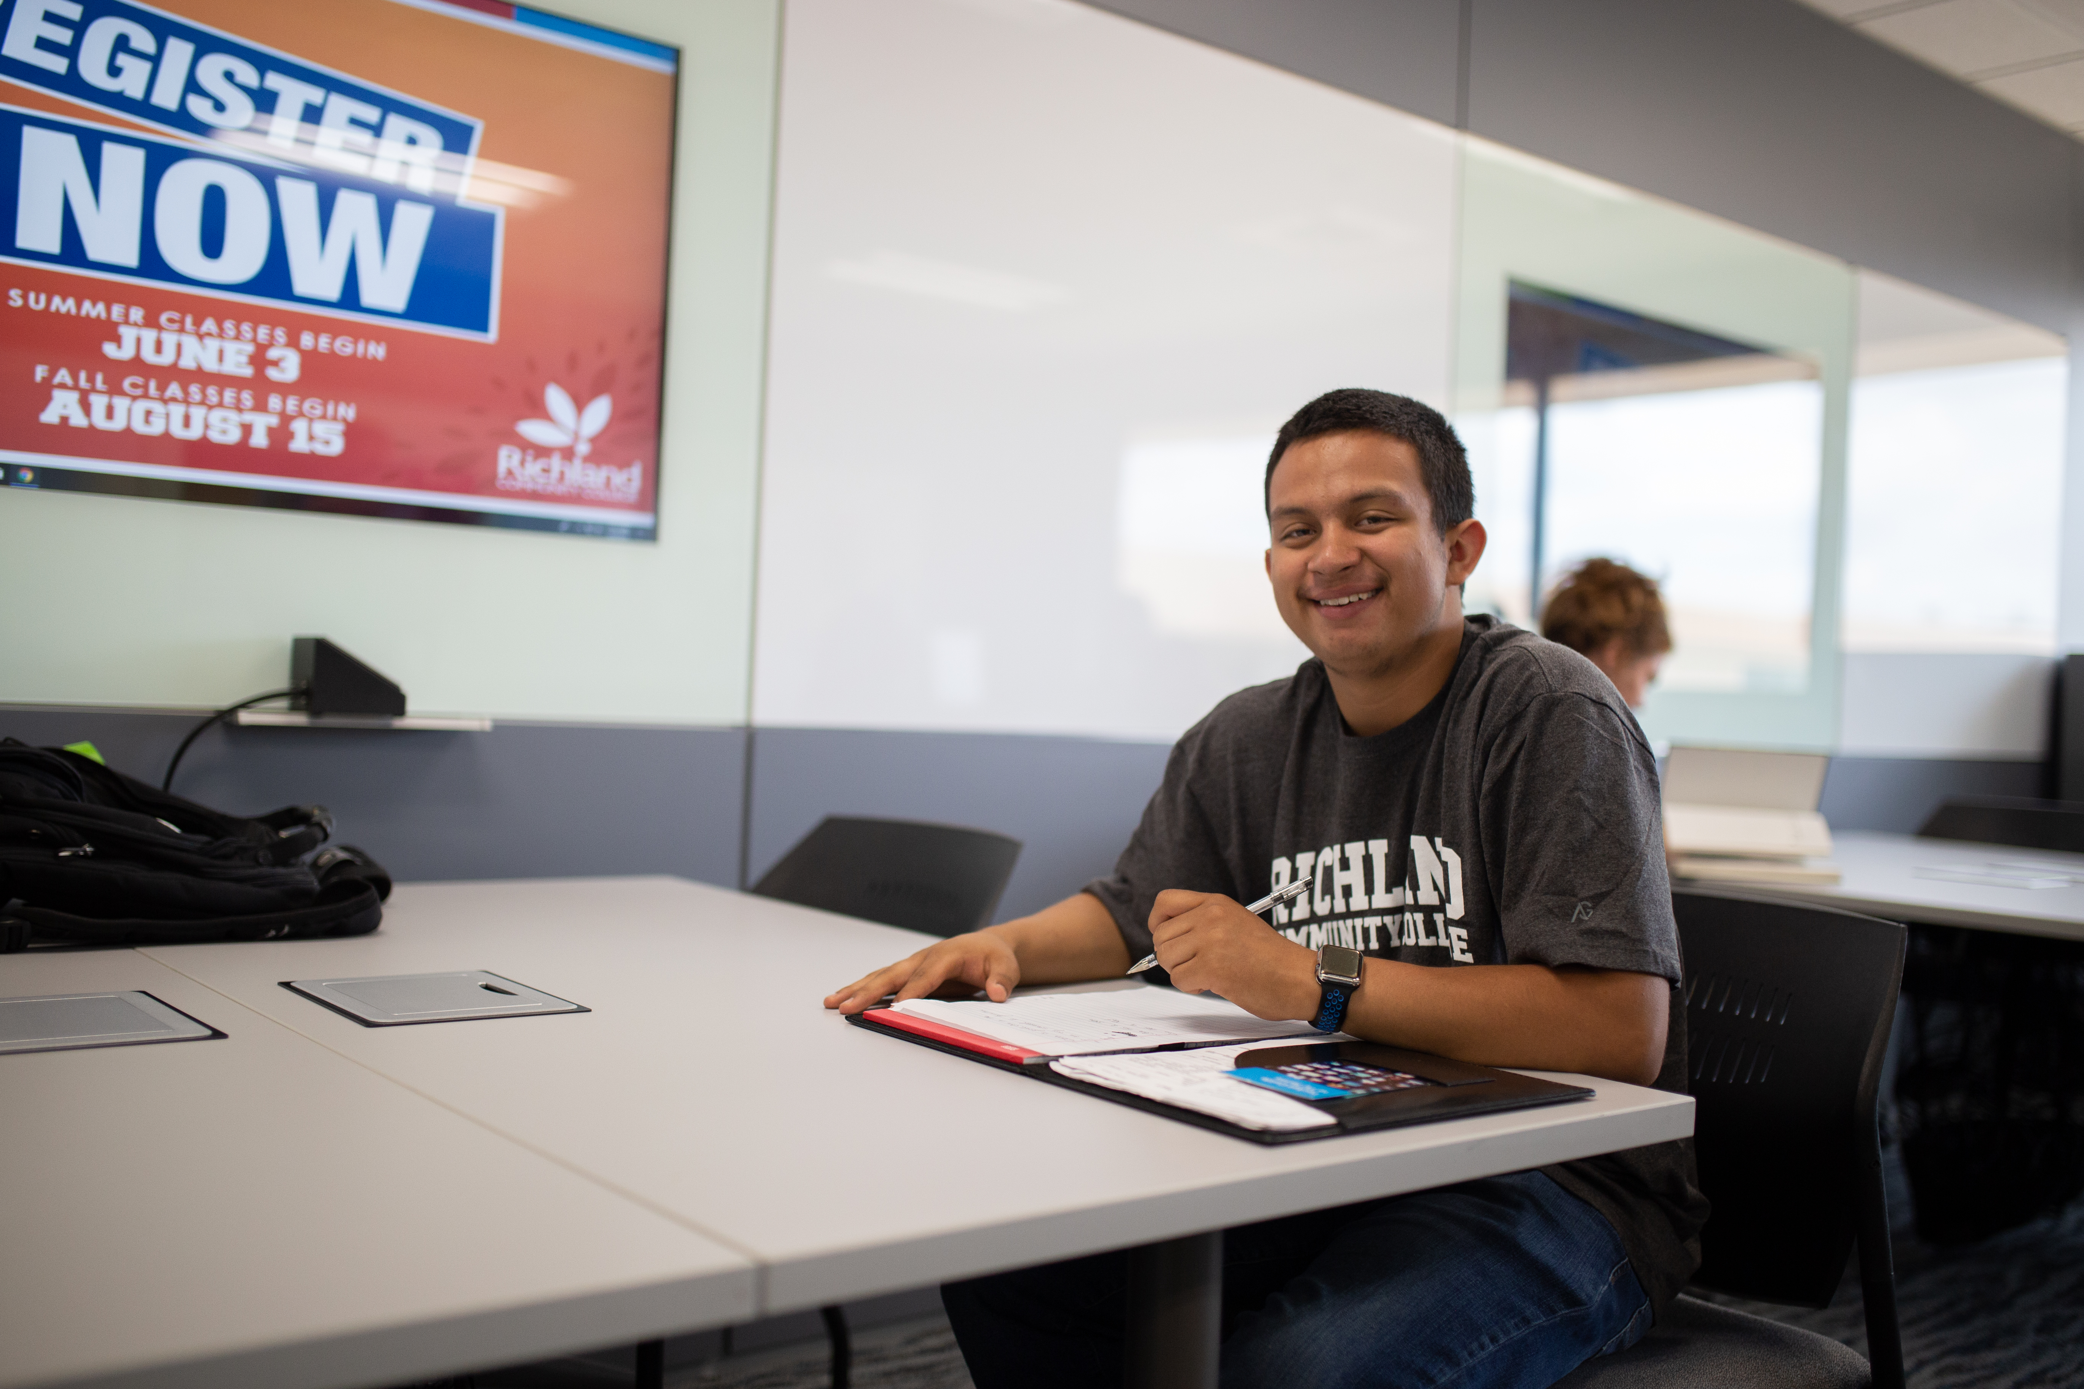
Who is enrolled at Richland

Slide 7

Who is enrolled at Richland

Slide 8
Student Voices
Location and academic programs
Coaches and faculty caring and supportive
Low student debt/affordability, small class sizes, foundation support
Student involvement (student clubs, sga, intramural sports)
Ability to transfer credit

Slide 9
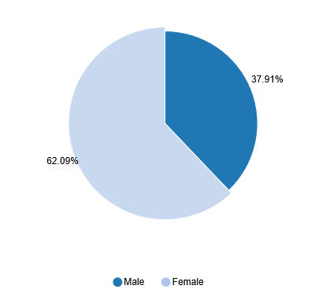
Current Student Demographics

Slide 10
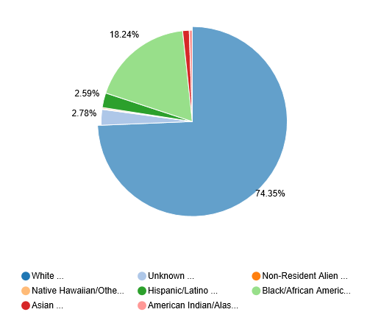
Student Demographics

Slide 11
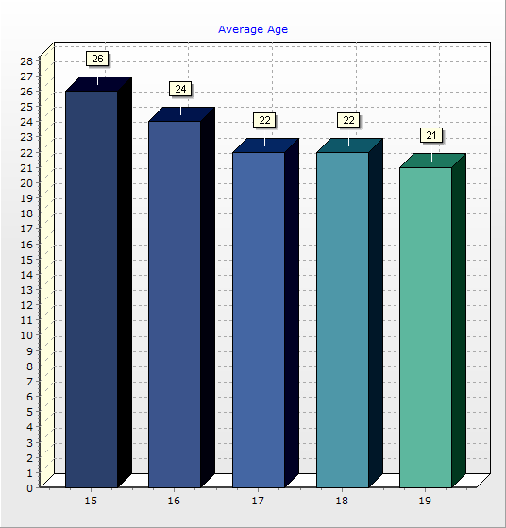
Current Student Demographics

Slide 12

RCC Typical Student
Female in her early 20s, Caucasian, from Macon County. Who is taking part-time classes (some online, some on campus) and receives some financial aid who is pursuing a two year-degree

Slide 13
Enrollment Data as of 7.15.19
We have 1763 students enrolled (target is 2513)
1150 (Part Time)
613 (Full time)
1197 (Female)
566 (Male)
1309 (Day Student)
306 (Evening Student)

Slide 14

Target Population
Traditional Students
Nontraditional Students
Transfer Students
Dual Credit and Dual Enrollment
Veterans
Community Members
Notes:
Traditional Students: Reach out to targeted high school juniors and seniors who are looking for an Associate’s degree, transfer opportunities, certificate or occupational programs.
Transfer: Target students who are interested in higher education savings for the first two years and who are interested in transfer opportunities.
Feeder high schools: Our enrollment coach we be focusing on forming relationships with DPS and the other 14 area high schools and guidance counselors.
Dual Credit and Dual Enrollment: Through our dual enrollment program, we would like to target rising juniors and also our senior populations to take college credit courses.
Veterans Affairs: Reach out to Veterans Affairs centers and military high schools to promote Associate’s degree, transfer opportunities, certificate and occupational programs
Community Members: work with clients in the community through community based agencies, government offices and agencies, and local businesses.

Slide 15
Of Note
29 days out to start of the fall semester
Coaches are booked up with appointments until the first week of August
We have walk in hours on Monday and Thursday
2pm-5pm
August 10th is our Saturday registration event drive
Notes:
Traditional Students: Reach out to targeted high school juniors and seniors who are looking for an Associate’s degree, transfer opportunities, certificate or occupational programs.
Transfer: Target students who are interested in higher education savings for the first two years and who are interested in transfer opportunities.
Feeder high schools: Our enrollment coach we be focusing on forming relationships with DPS and the other 14 area high schools and guidance counselors.
Dual Credit and Dual Enrollment: Through our dual enrollment program, we would like to target rising juniors and also our senior populations to take college credit courses.
Veterans Affairs: Reach out to Veterans Affairs centers and military high schools to promote Associate’s degree, transfer opportunities, certificate and occupational programs
Community Members: work with clients in the community through community based agencies, government offices and agencies, and local businesses.

Slide 16



