Slide 1
MACON COUNTY LAW ENFORCEMENT TRAINING CENTER
A partnership between the Illinois Law Enforcement Training & Standards Board
and Richland Community College

Slide 2
Basic Law Enforcement Academies
Scheduled in Calendar Year 2019
IDNR Academy Sunday, January 20, 2019 – Friday, April 26, 2019
RC19-04 Sunday, February 3, 2019 – Friday, May 10, 2019
RC19-05 Sunday, June 2, 2019 – Friday, September 6, 2019
RC19-06 Sunday, August 18, 2019 – Friday, November 22, 2019
IDNR Academy Tuesday, May 28, 2019 – Friday, August 30, 2019

Slide 3
Basic Corrections Academies
Scheduled in Calendar Year 2019
CC19-04 Sunday, May 19, 2019 – Friday, June 21, 2019
CC19-05 Sunday, October 6, 2019 – Friday, November 8, 2019
CC19-06 Wednesday, November 13, 2019 – Friday, December 20, 2019

Slide 6
70
2

Slide 9
Basic Law Enforcement Academies
Scheduled in Calendar Year 2020
RC20-07 January 20, 2020 – April 17, 2020
RC20-08 March 1, 2020 – June 5, 2020
RC20-09 May 10, 2020 – August 14, 2020
RC20-10 August 18, 2020 – November 24, 2020

Slide 10
Basic Corrections Academies
Scheduled in Calendar Year 2020
CC20-07 June 7, 2020 – July 10, 2020
CC20-08 September 20, 2020 – October 23, 2020

Slide 11
New Projects/Proposals
Fire Tower
Dive Pond
Veterans in Corrections
Academy Internships

Slide 12
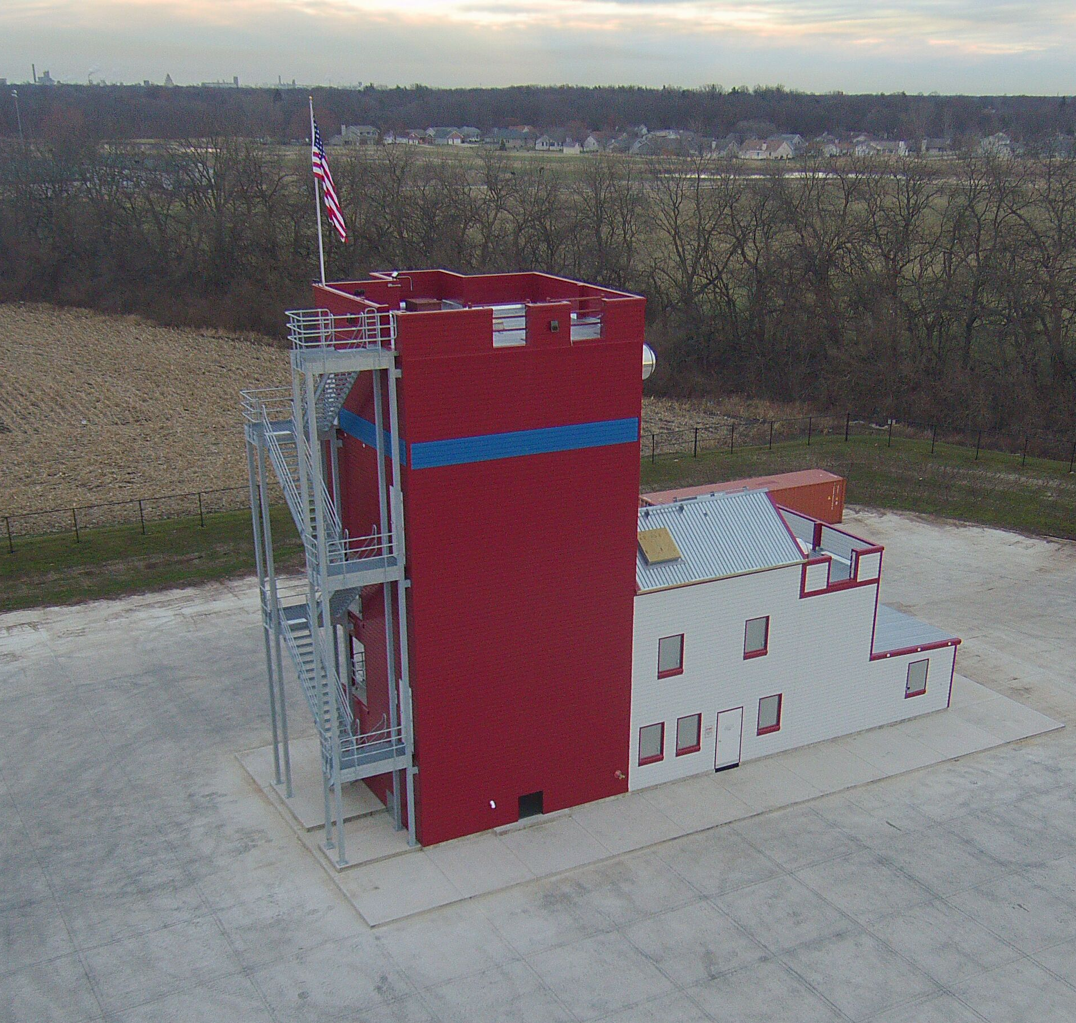
Fire Tower

Slide 13
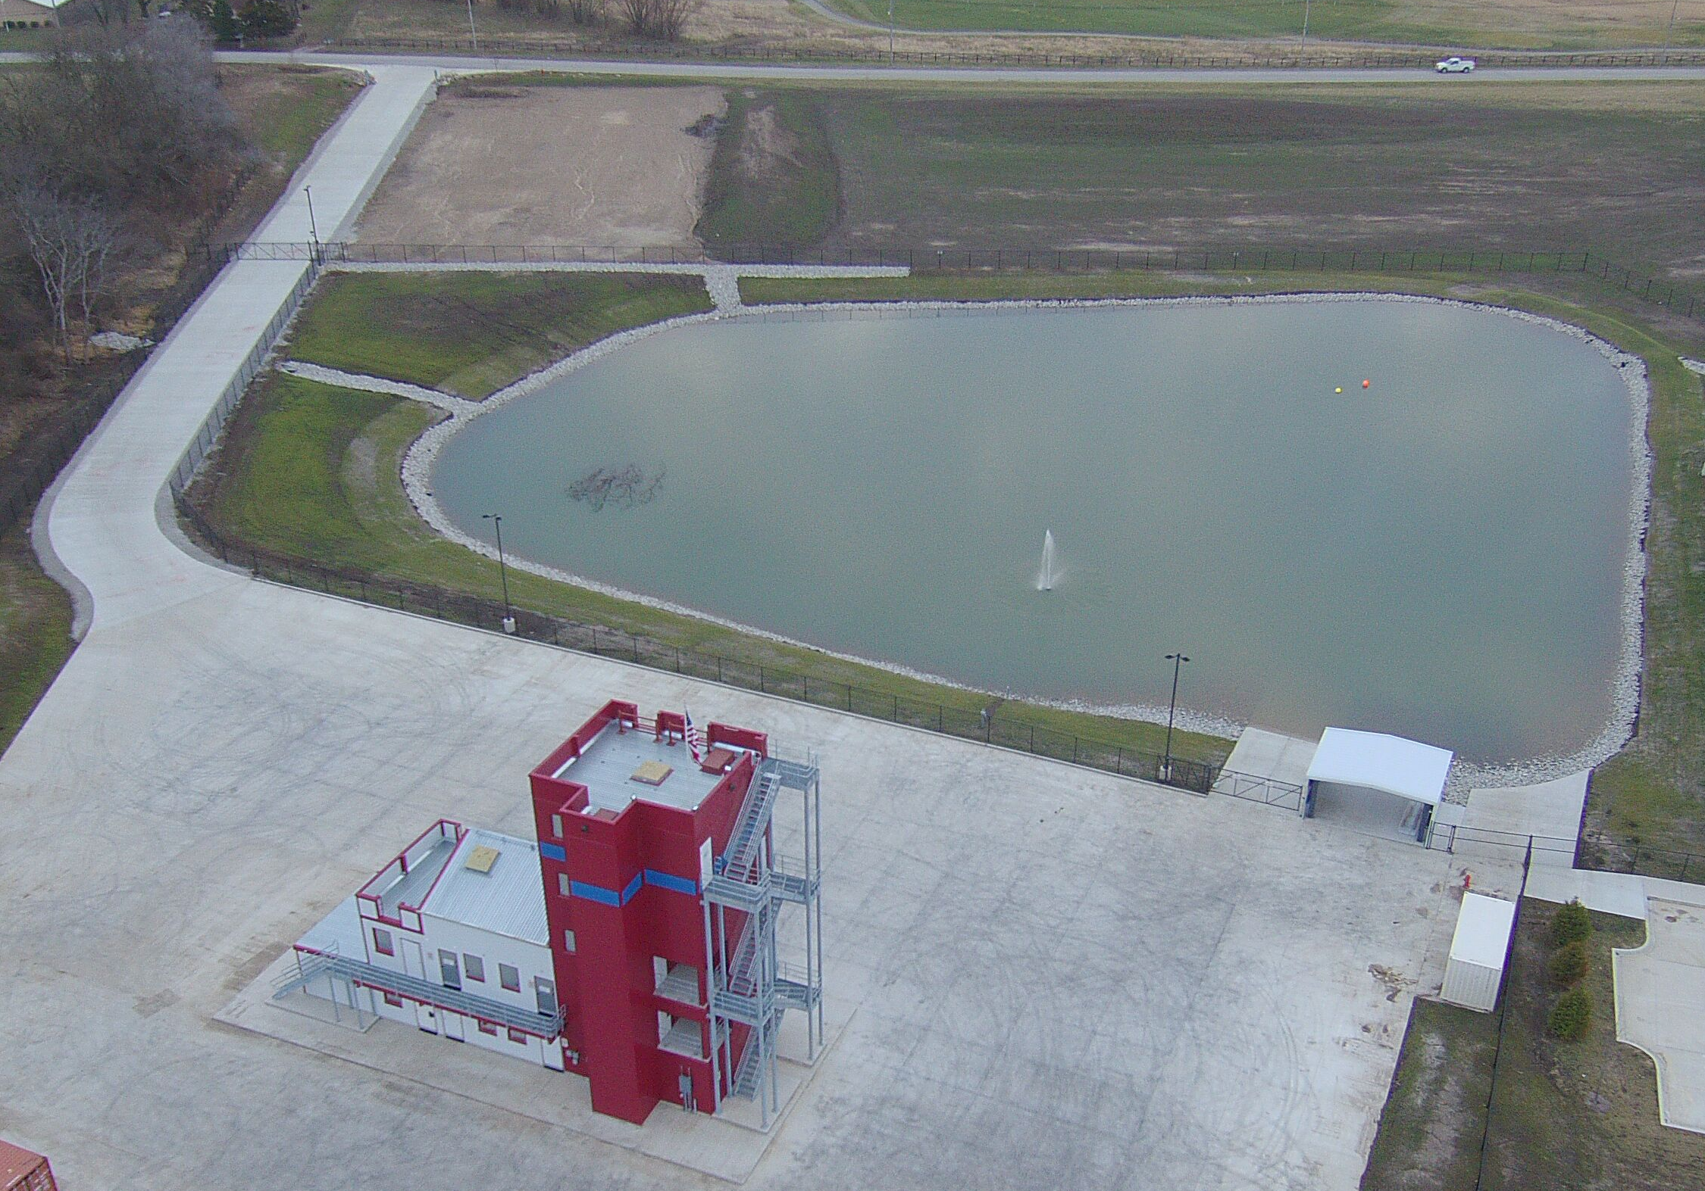
Fire Tower and Dive Pond

Slide 14


Slide 15
INTERNSHIP PROGRAM/PROPOSAL: This program has been developed in response to law enforcement administrators seeking highly educated and certified candidates available for service. It is ideal for college students seeking a career in law enforcement and wanting to compete at the highest level in the job market. Combining the education received through Western Illinois University (WIU) and the successful completion of our basic law enforcement training academy, will provide an intern with everything they need to compete in a very competitive job market.
This unique opportunity has been sanctioned by the Illinois Law Enforcement Training and Standards Board for the MCLETC to test on a trial basis. The MCLETC was given the opportunity to reach out to two major universities. We chose WIU due to your nationally recognized and awarded School of Law Enforcement and Justice Administration. WIU was an easy selection since it is recognized as a leader in Law Enforcement Education in the nation.
We have already built a partnership with you by hosting your students and providing a work-related internship. This proposal is to expand the program by allowing the internship program to consist of attending our actual certified academy.
We foresee this program being offered to university senior students deemed eligible to complete an internship. Upon a student submitting an application to WIU for an internship in the MCLETC BLEA, we would form a committee to review applications forwarded by WIU for consideration. Our committee would then select those chosen to participate, as well as an alternate list. If the selected intern(s) successfully pass a background investigation and medical exam, they would be allowed to participate in the academy. The MCLETC can set up the background investigation and exam. The expenses would be added to the base tuition cost.
The interns are integrated into the academy with newly hired sworn officers and will receive the same training. Upon successful completion of the academy they will receive their academy graduation certificate and be certified by the Academy Commander to take the State of Illinois Certification Exam for Law Enforcement Officers. The exam will remain ungraded until the intern is hired by a certified law enforcement agency within the State of Illinois. The academy and state certification do not necessarily transfer to outside states. The MCLETC will assist in marketing the intern to our agency partners.
Our tuition for the BLEA is $6274. We are a direct reimbursement academy, meaning our rates have been reviewed and approved by the ILETSB. Our tuition for the Academy Internship Program would remain at $6274, plus the additional background investigation, medical exam, and Academy uniforms. We estimate these additions to cost $800 - $1000. Each law enforcement agency sending a police recruit to our BLEA conduct their own background investigation and pay for the medical exam. They also pay us directly for the Academy uniforms. The tuition for our BLEA includes course instruction and all materials, use of an academy laptop, all required ammunition, on campus residential lodging with all linens and towels supplied, three full meals a day, and 24 hour supervision.
As you are aware, if the intern is a military veteran, they may still have benefits available to pay for this training. The MCLETC is a certified academy through the Veterans Administration.
This proposal is a work in progress and open to discussion regarding the details. Please feel free to reach out to us with any questions or concerns. We look forward to hearing from you and hope to make this successful for WIU and the MCLETC!

Slide 16
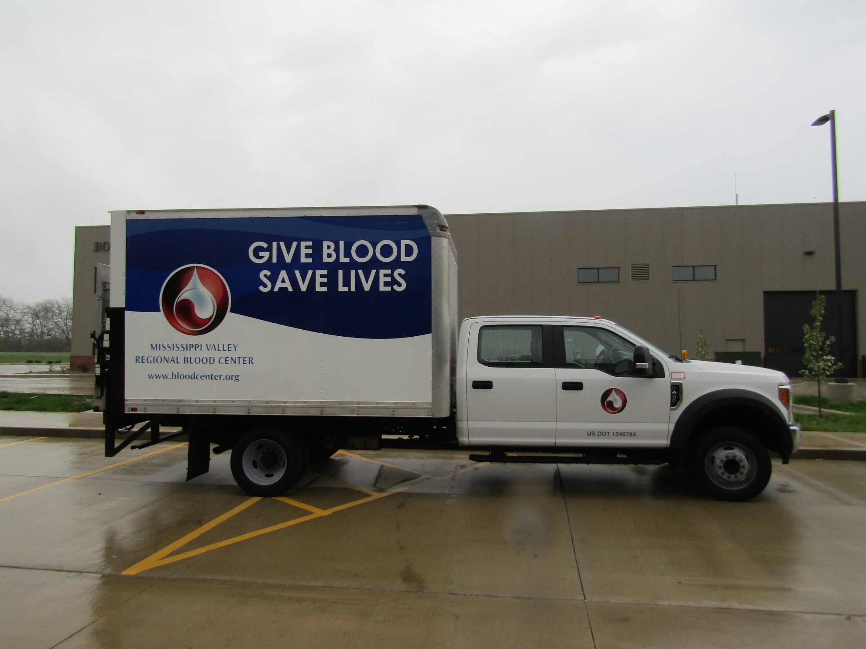
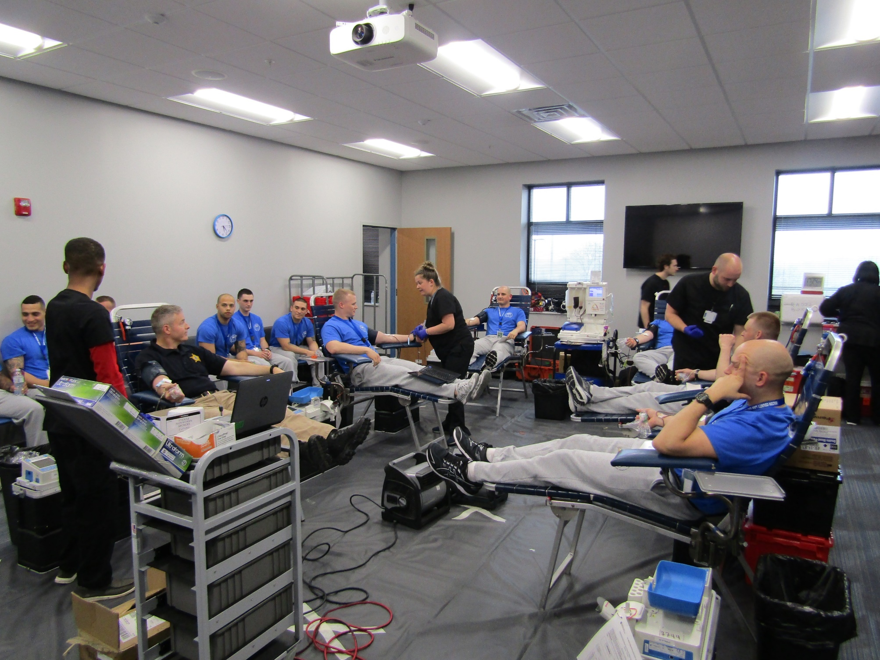
Special Projects- RC19-04

Slide 17
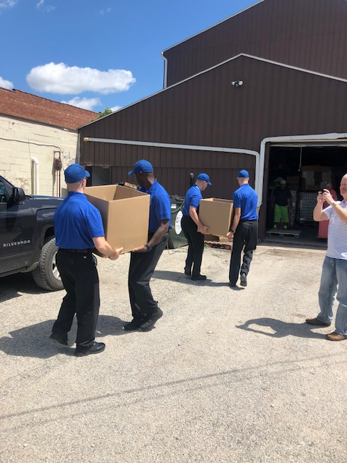
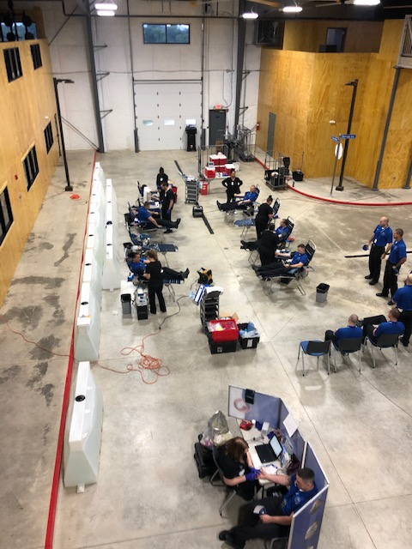
Special Projects- RC19-05

Slide 18
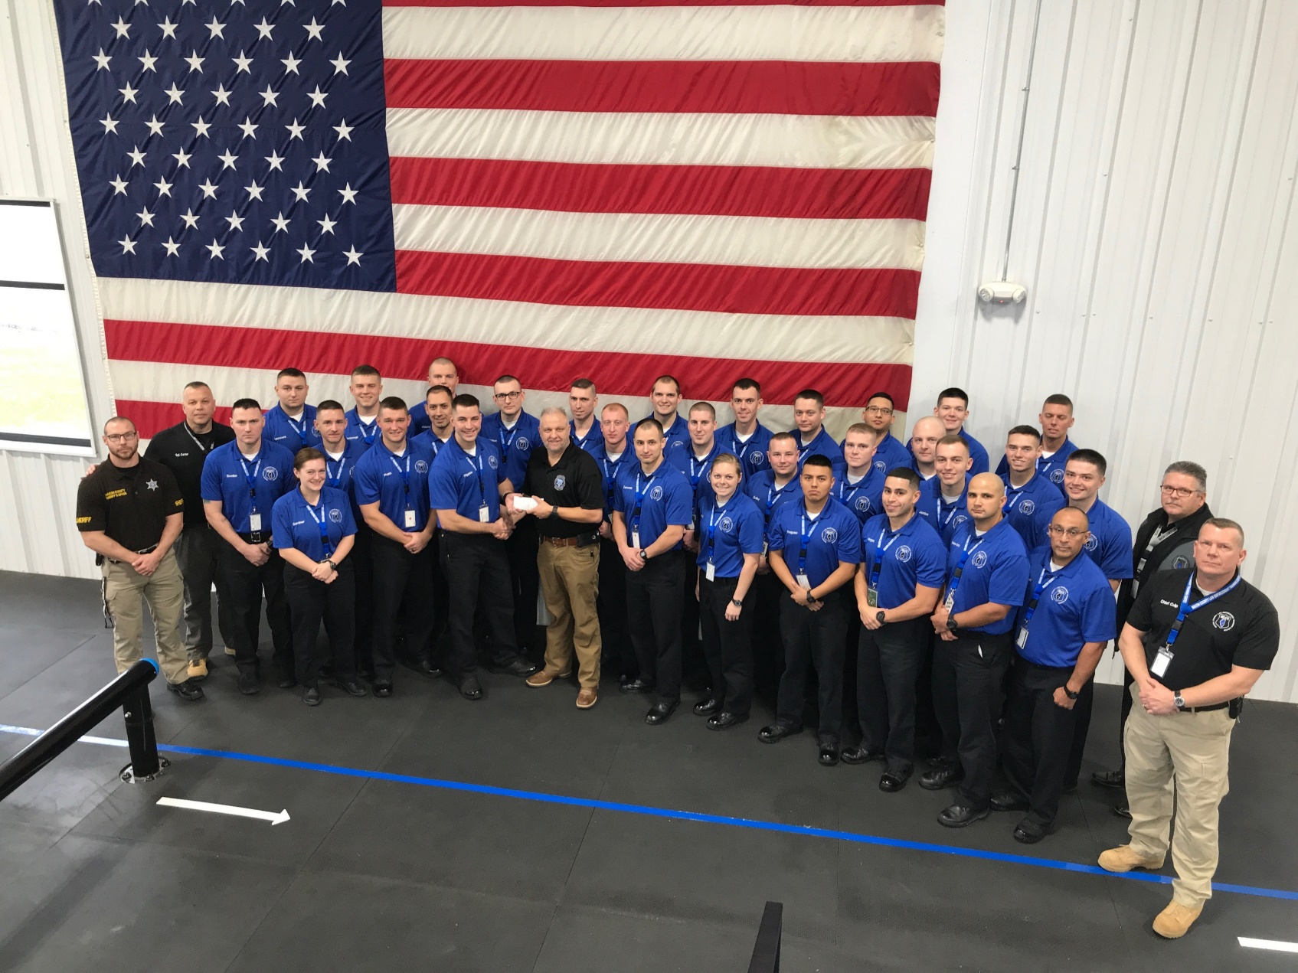
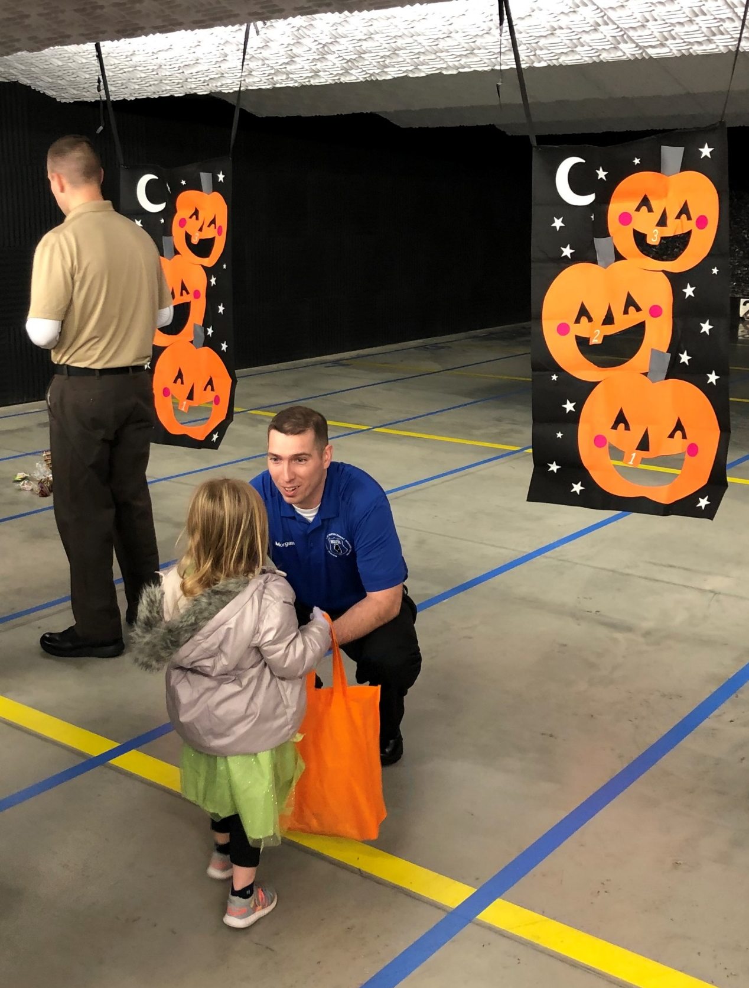
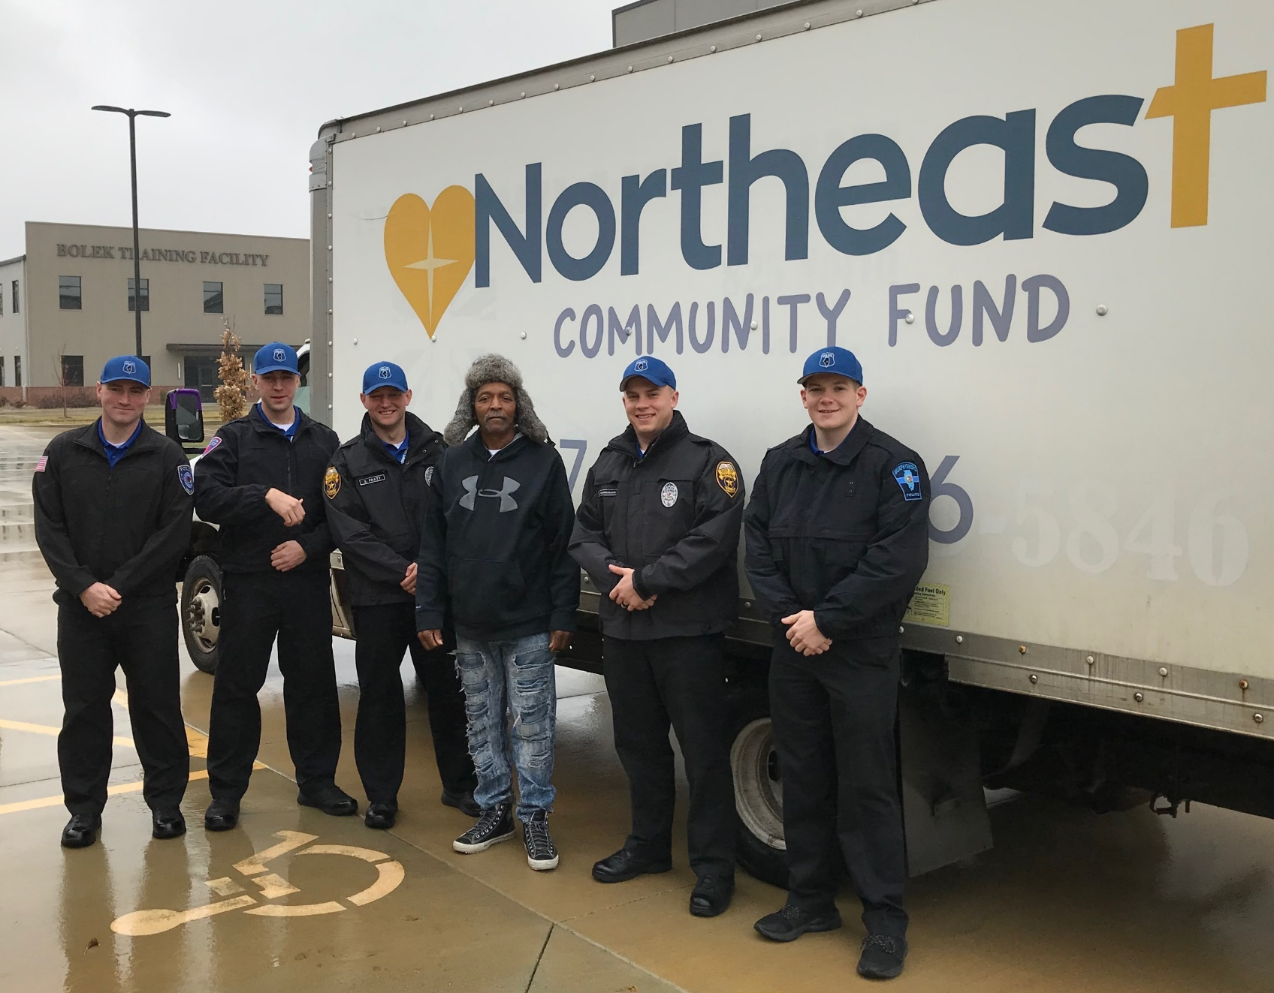
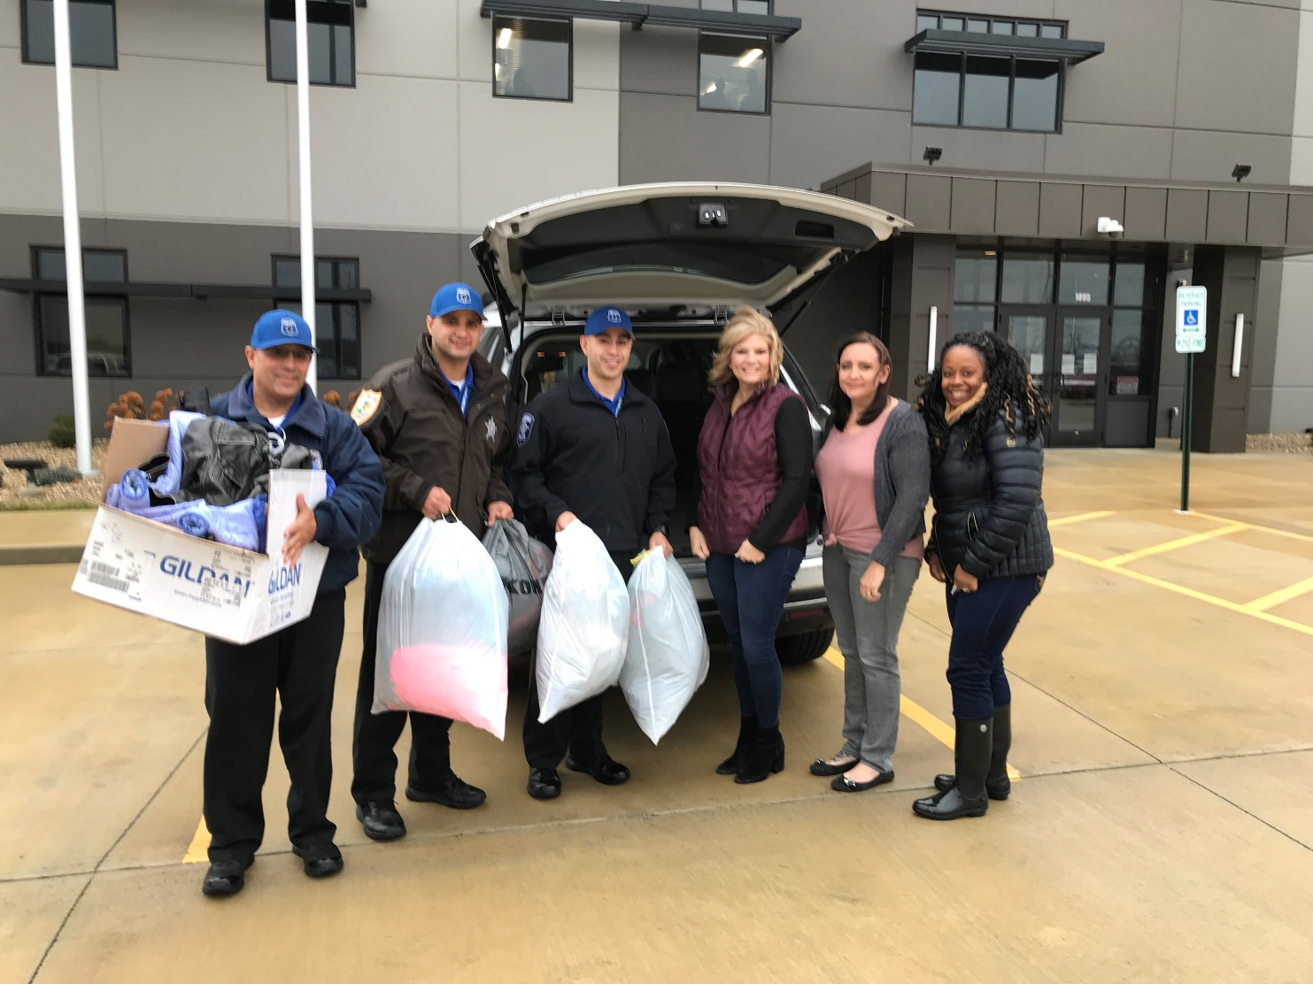
Special Projects- RC19-06

Slide 19
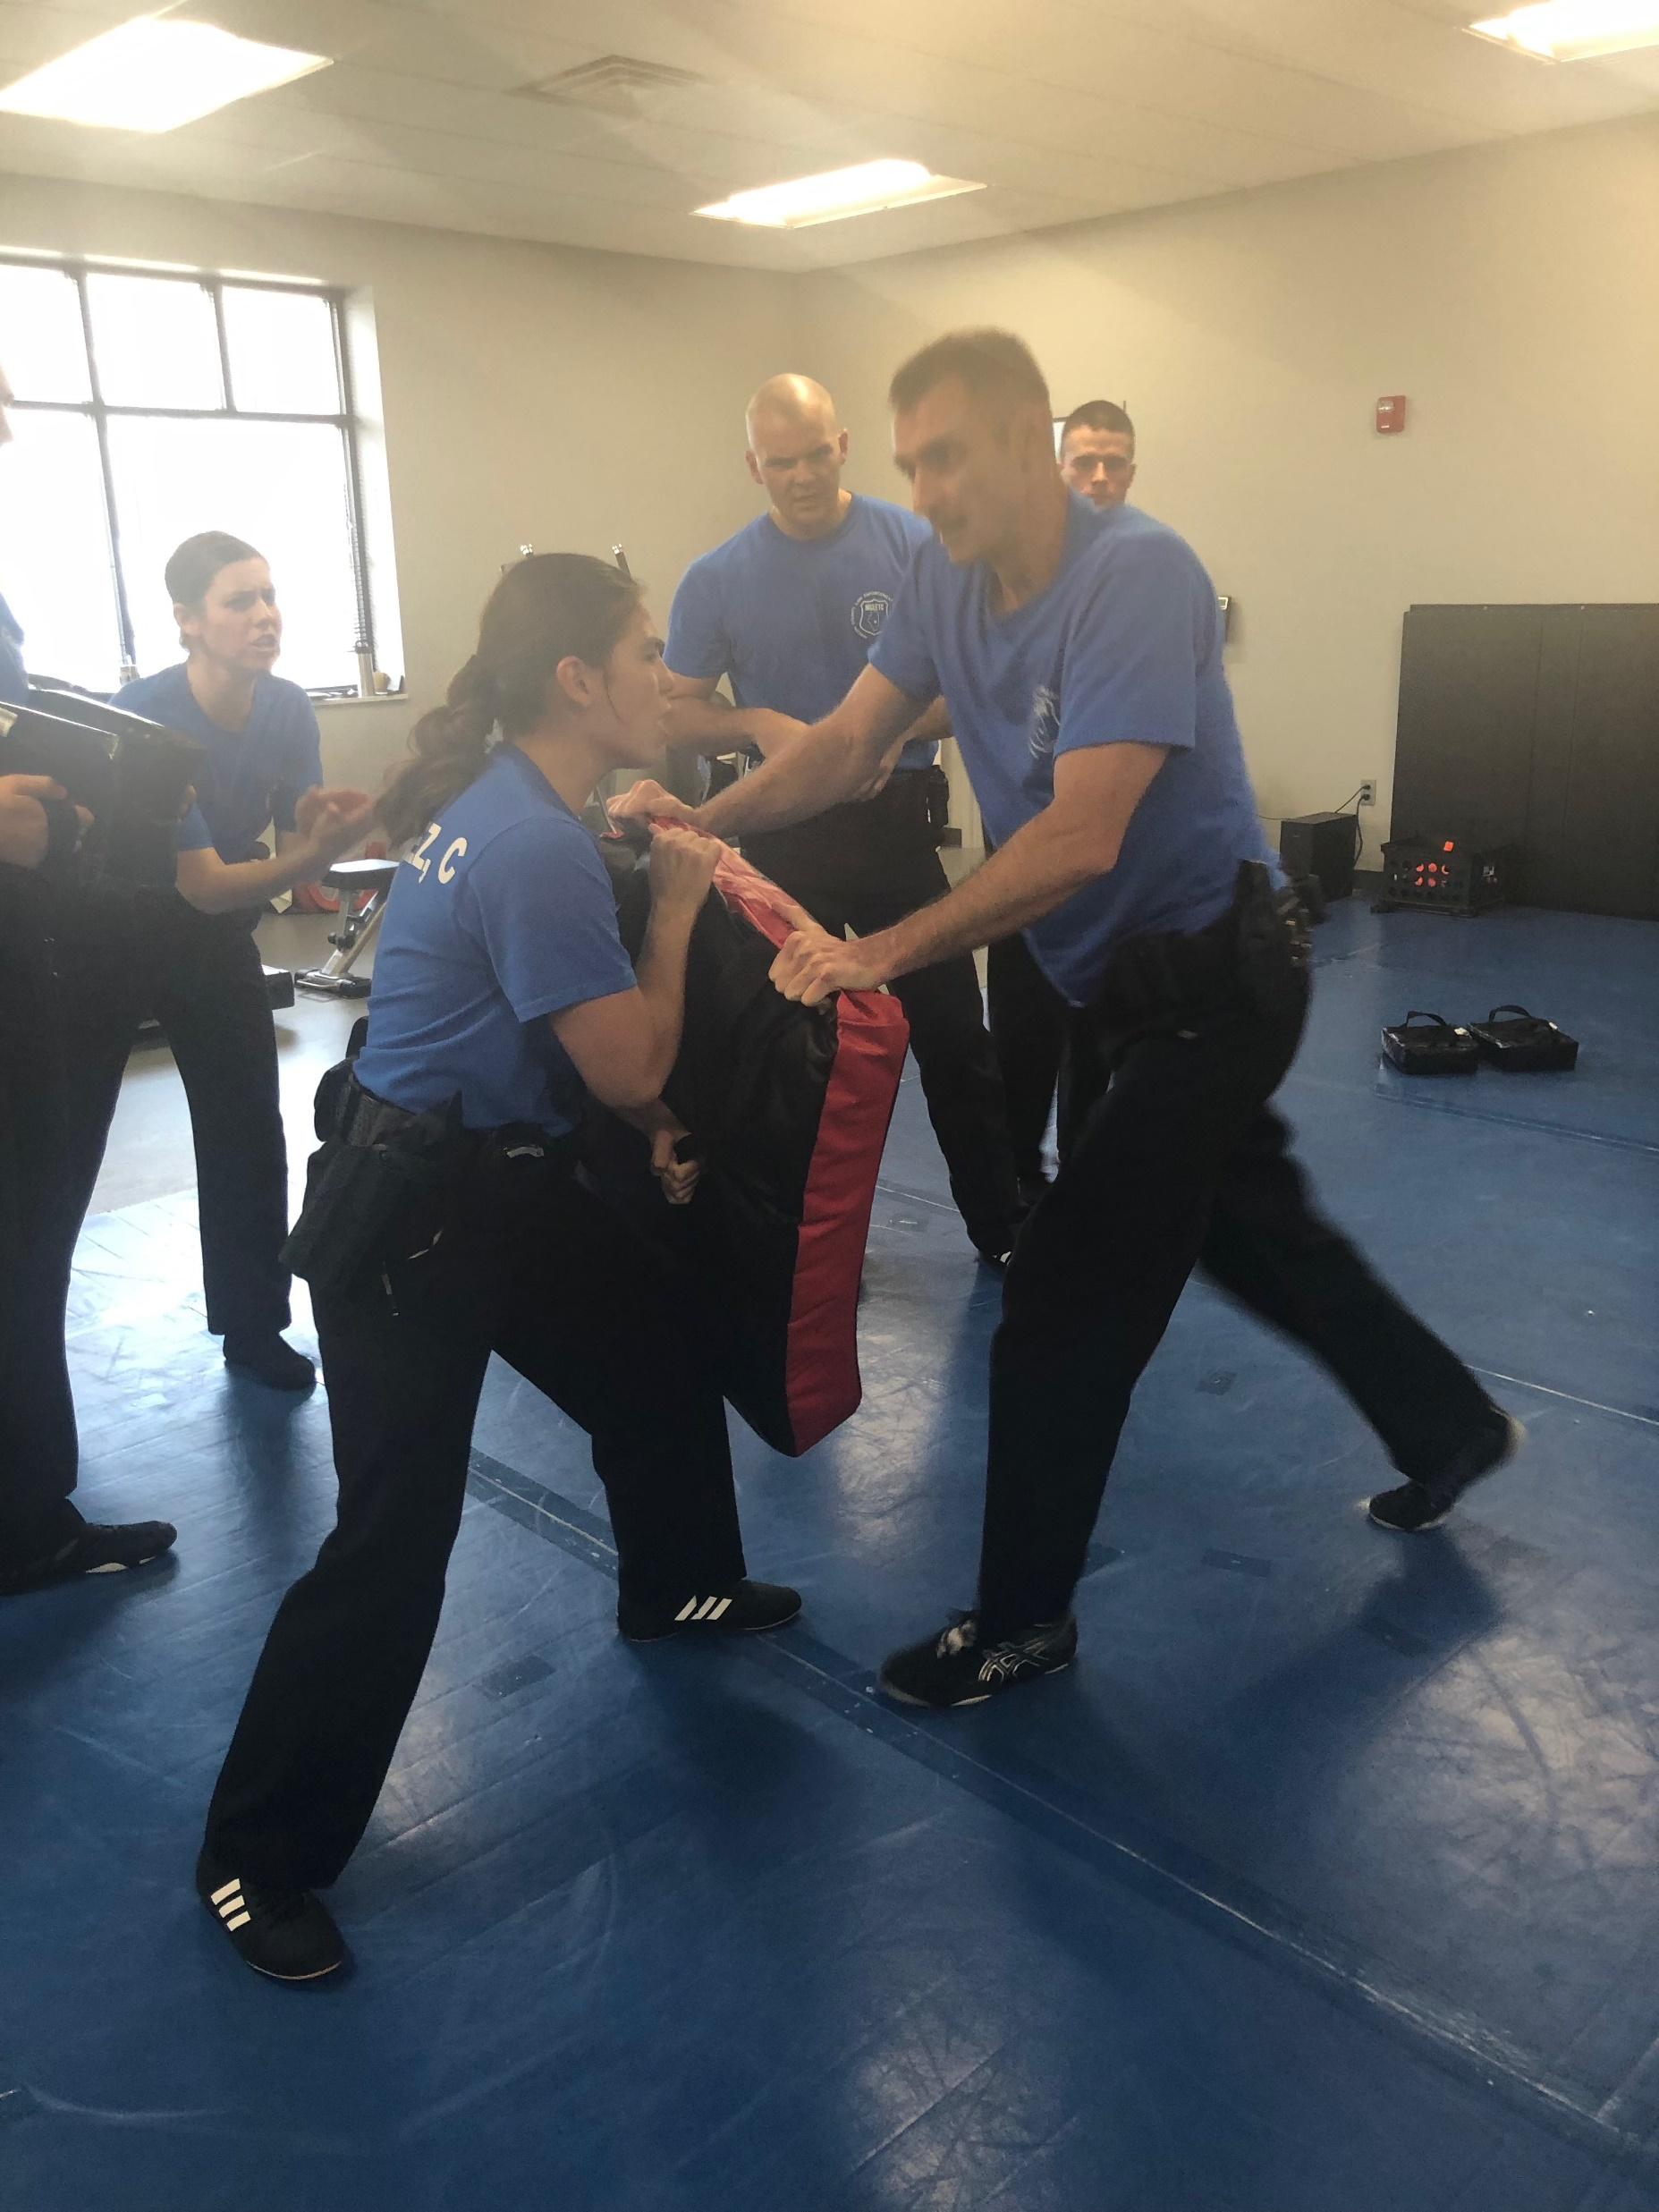

Slide 20
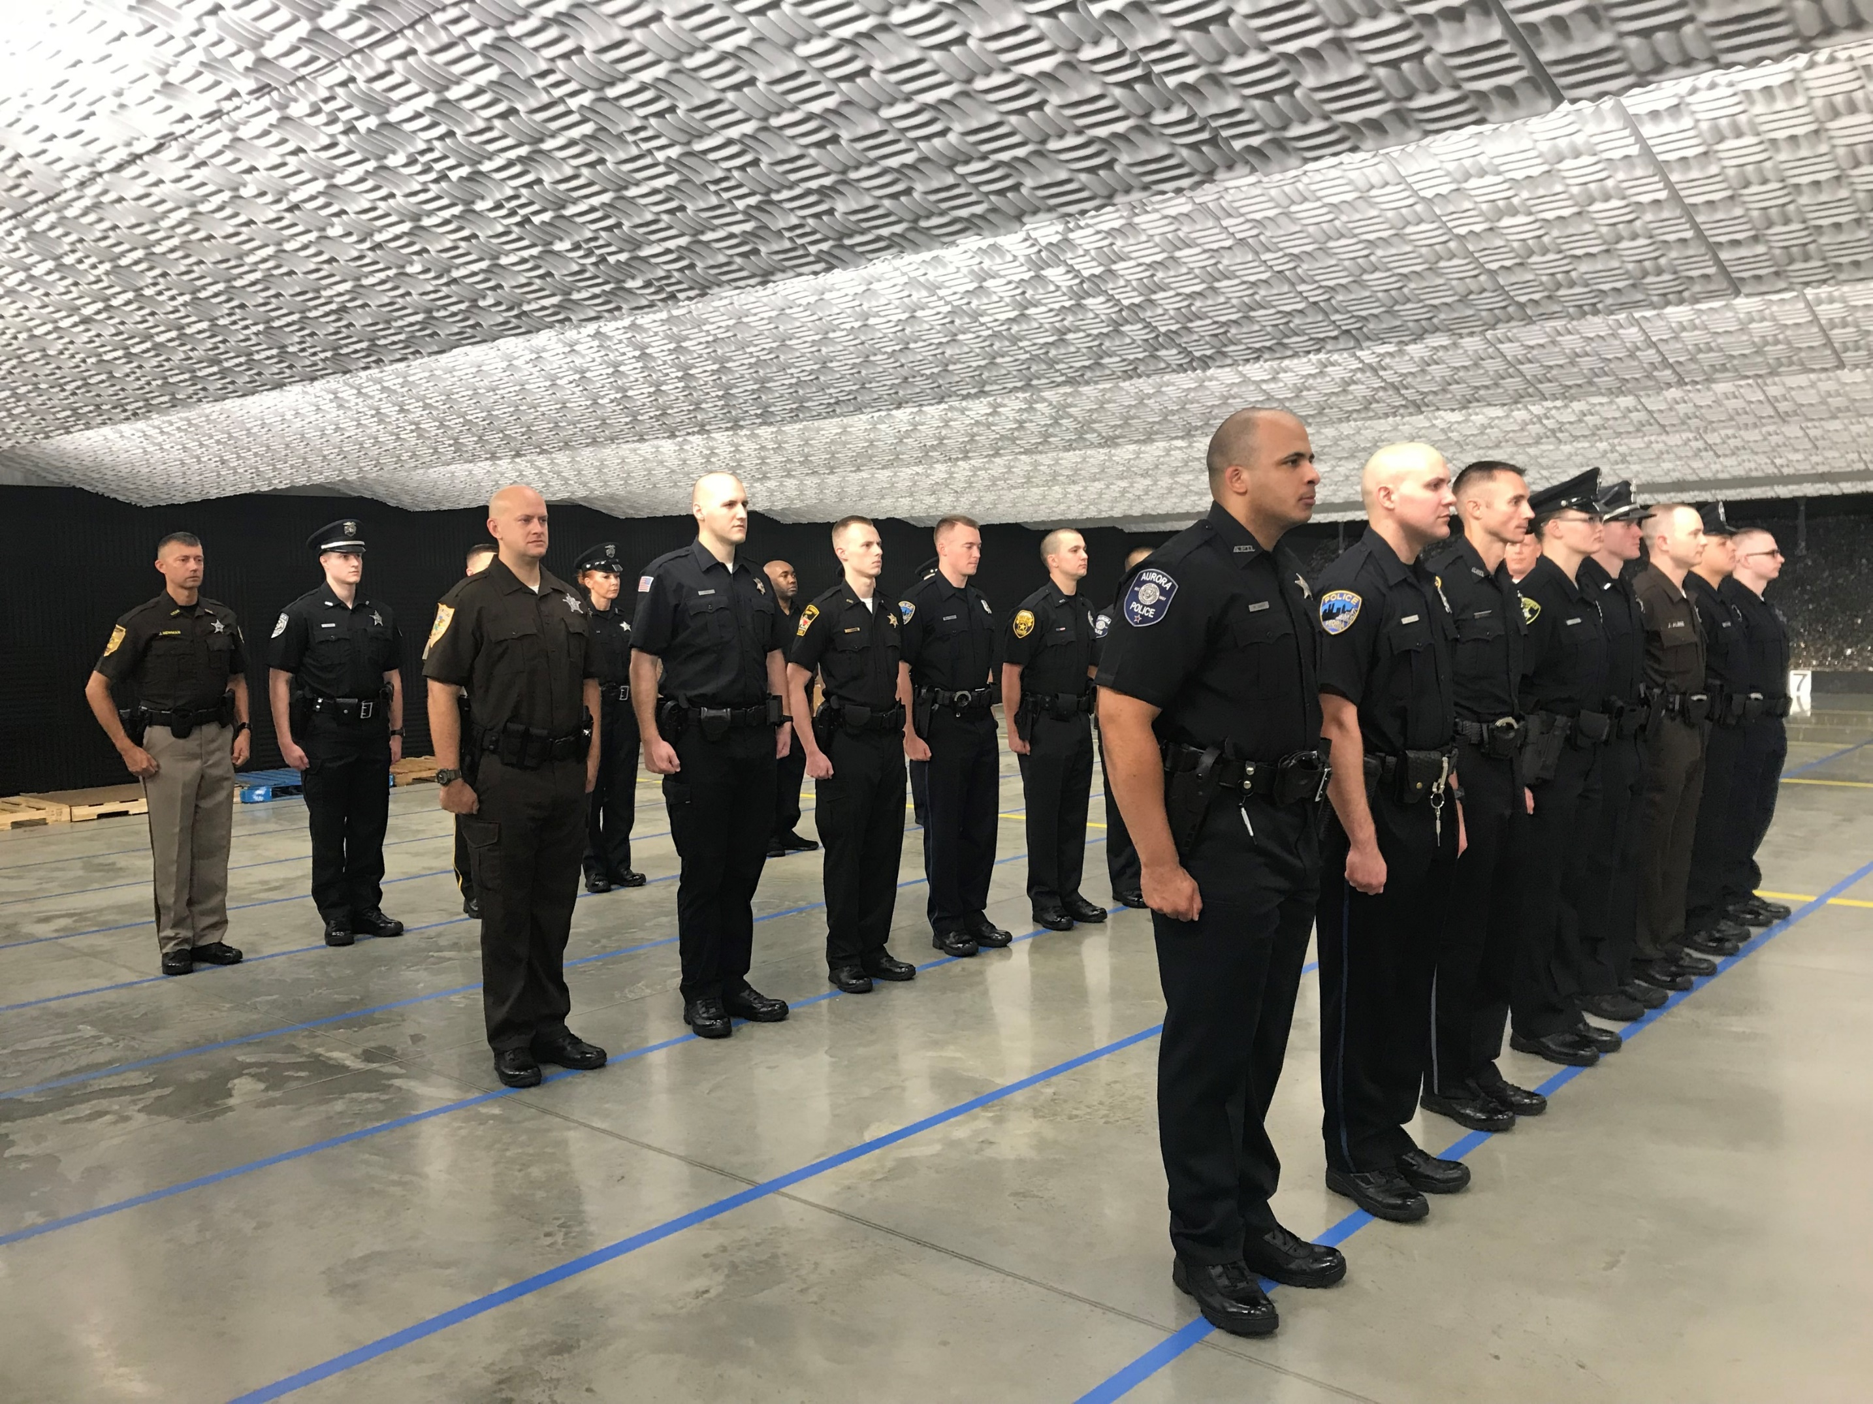

Slide 21
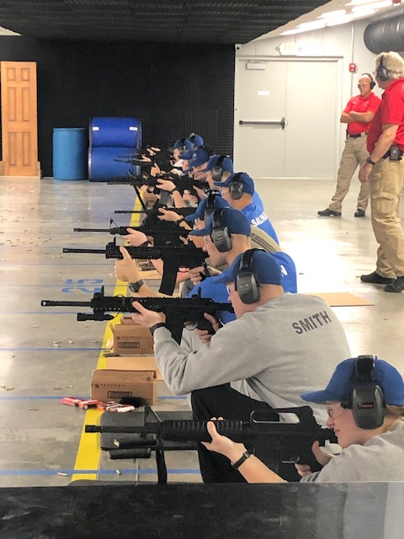

Slide 22
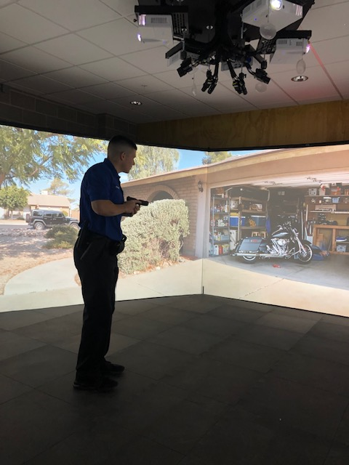

Slide 23
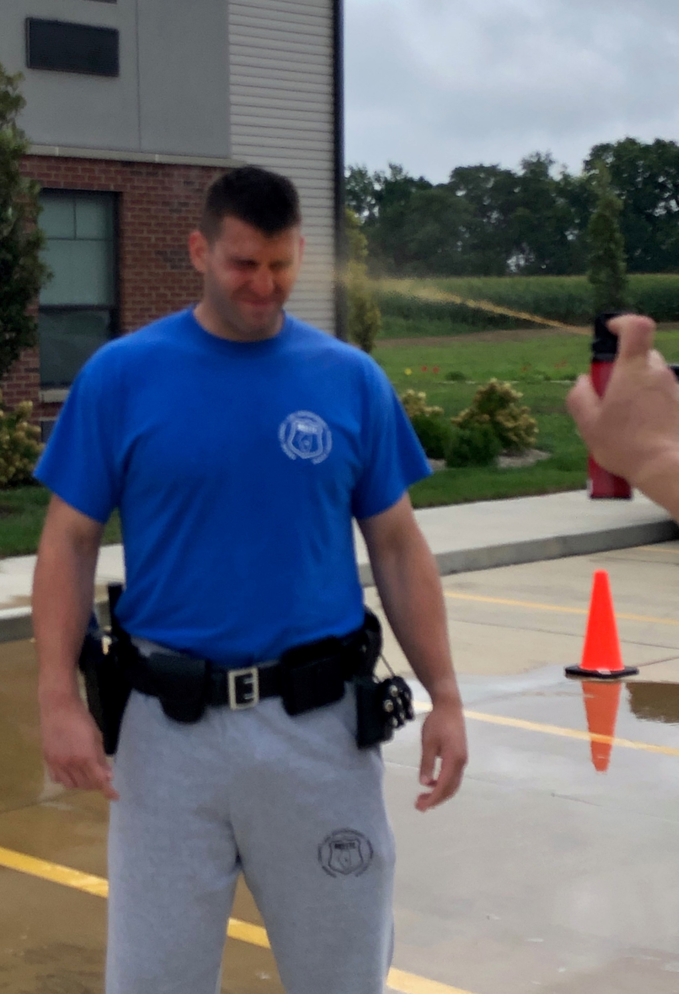
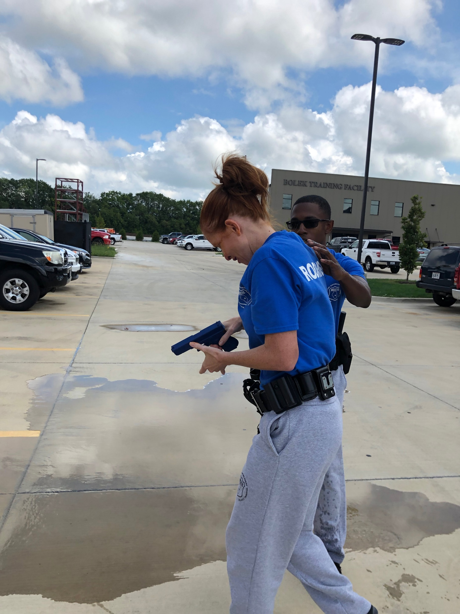

Slide 24
Police Executive Research Forum
https://www.policeforum.org/suicidebycop#Scenarios

Slide 25

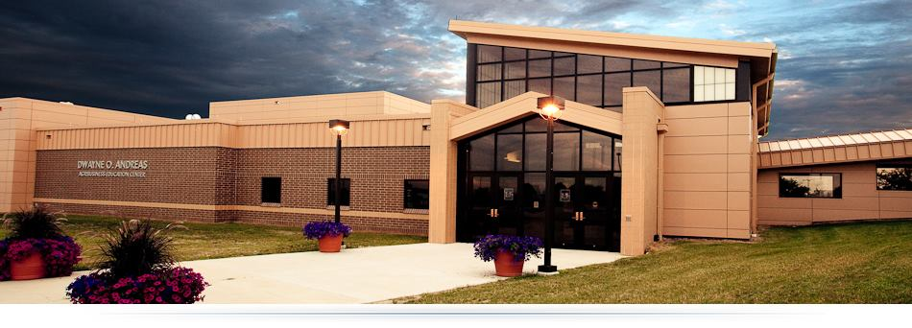
Heartland Technical Academy
80 Criminal Justice students visited and toured the MCLETC on October 11, 2019

Slide 26
Updated Tuition Reimbursement Information
NEW INFORMATION: Unfortunately, Direct Reimbursement from ILETSB is temporarily suspended due to fiscal concerns regarding the ILETSB budget. Effective immediately Agencies must pay the Academy directly and request reimbursement from the ILETSB before the end of the appropriate fiscal year. The MCLETC will invoice your agency for the tuition, wearables and any electives, if applicable. We will send one invoice after we receive each complete Recruit(s) packet for an agency (to secure your spots, packets are due by COB 02/17/20, unless other arrangements have been made). In order to complete one invoice, we need the *Wearables Form with the packet or sooner(preferably sooner, by COB 02/07/20) AND the **Elective Courses Form as well. The total payment will not be due until the Friday of week 3 of the Academy, March 20, 2020 (if you need an extension, please contact me directly). Refunds are prorated weekly if your Recruit does not complete the Academy and can be sent in the form of a check OR credited for future Recruit tuition.

Slide 27
Tad A. Williams
Commander
Macon County Law Enforcement
Training Center
1095 Rotary Way
Decatur, IL 62521
217-875-7211, ext. 1603
217-855-4738 mobile
twilliams@richland.edu

