Slide 1

Fall 2020
Student Profile Report
Presented by:
Dr. Z

Slide 2
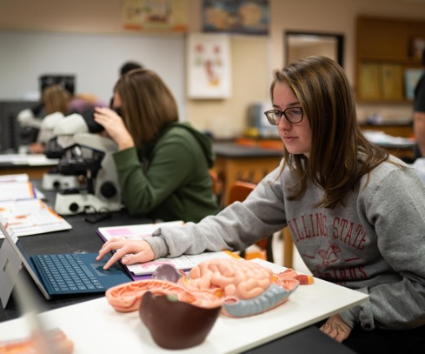


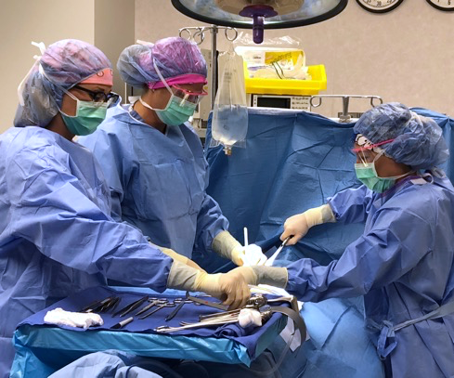



Slide 3

National College Enrollment Trends
The COVID-19 challenge is unprecedented; its scale still is not understood
College enrollment in the U.S. has decreased for the ten consecutive years, according to new data released by the National Student Clearinghouse Research Center
Adult learners aged 25 and older aren’t enrolling in community colleges at the rates they used to
The number of high school graduates is declining

Slide 4

Why do colleges lose students?
Financial problems
Conflict with work and family commitments
Increasingly failing courses
Lack of student support/technology
Mental Illness

Slide 5


Slide 6

RCC Typical Student
Female in her early 20s, Caucasian, from Macon County. Who is taking part-time classes (some online, some on campus) and receives some financial aid who is pursuing a two year-degree

Slide 7
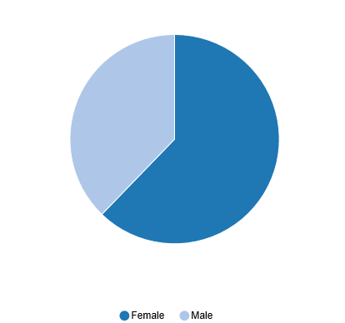
Current Student Demographics
FA20
30% male
70% female

Slide 8
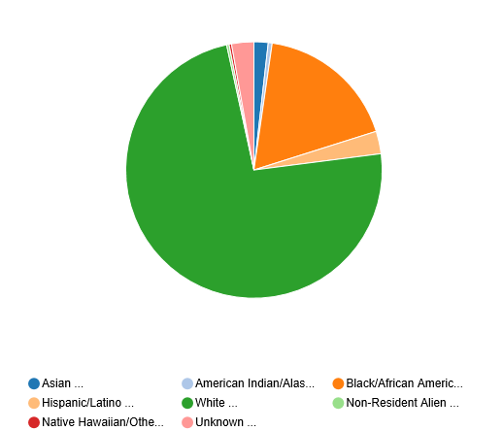
Current Student Demographics
FA20
Notes:
Chart found in Argos
Path: Student.ICCB.Enrollment-Semester (E1).Dashboard
Charts tab
Select Fiscal Year/Session

Slide 9



