Slide 1

Student Profile Report
Presented by
Dr. Z

Slide 2
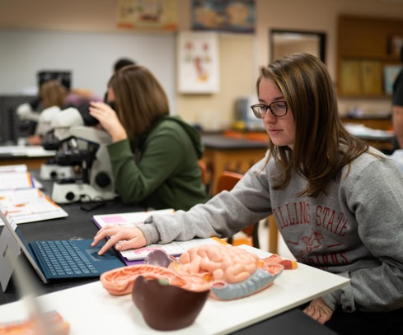
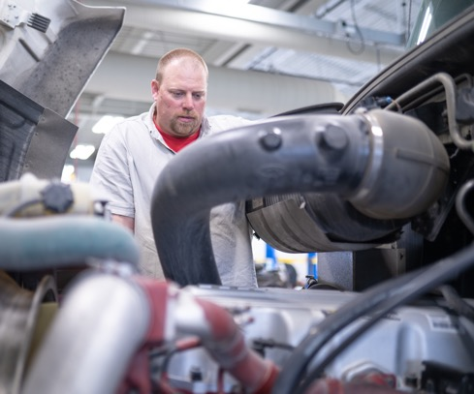

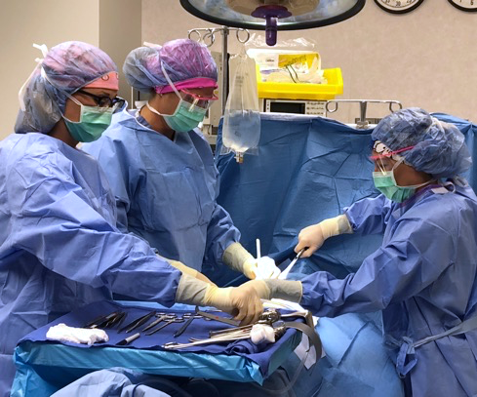
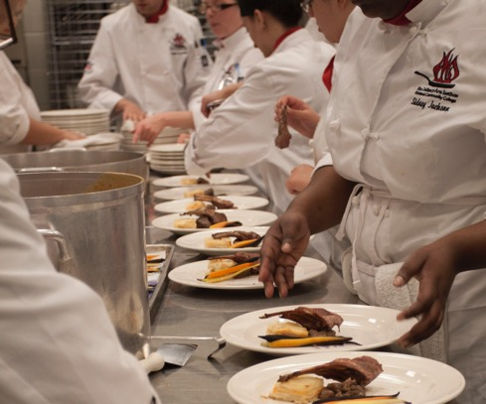


Slide 3

Coaching Update
Since March 15 2020, Success Coaches have had 2,512 virtual meetings with students
Texting has been the most effective way to communicate to students
Connecting with & building relationships with students— is KEY

Slide 4
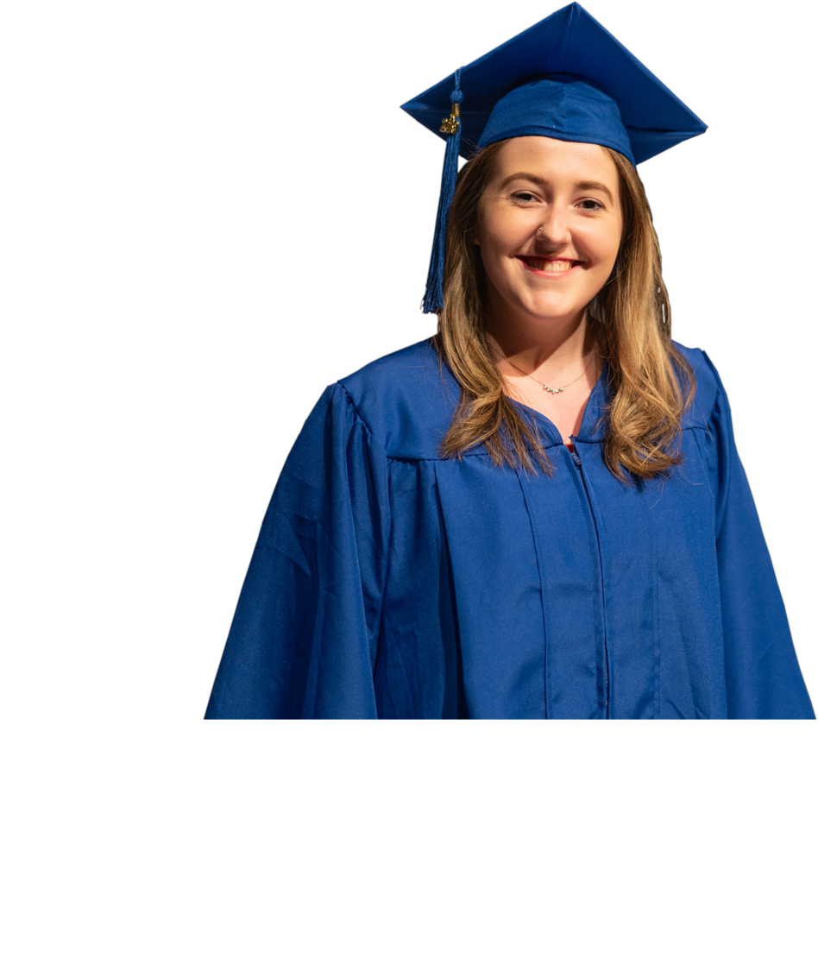
RCC Typical Student
Female in her early 20s, Caucasian, from Macon County. Who is taking part-time and receives some financial aid who is pursuing a two year-degree

Slide 5
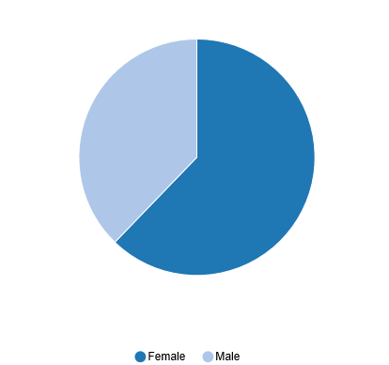
SP21
32% male
62% female

Slide 6
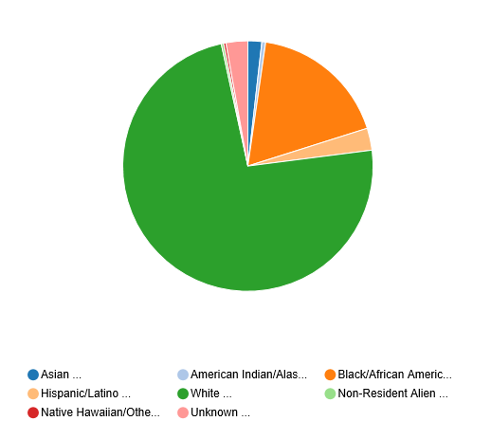
Sp21

Slide 7
Local College Headcount Trends
Parkland College -28.4%
Heartland College -27.4%
Lake Land College -15.9%
Richland College -14.7%
Notes:
Translates to 78.8% of reaching our budget

Slide 8
Enrollment Update
We are 29 days from the start of the spring semester
Coaches have 65 appointments between now and the start of Spring
We have two registrations drive events on January 6th and 9th

Slide 9


Slide 10



