Slide 1
Financial Overview
Board of Trustees Meeting
May 18, 2021

Slide 2

Trying Times
During a Global Pandemic How Does RCC……
Achieve our Mission & Vision to be the best and first choice for education, while empowering individuals through learning?
Change the delivery method for student instruction?
Keep students engaged in learning as they struggle with Covid related issues?
Predict enrollments and expenses as everything we thought we knew changes?

Slide 3
FY 2021 Revenues: Budget to Projected-Operating Funds

Slide 4
Where Will FY2021 Finish?
FY 2021 Credit Hours
 | Budget | Actual | Actual to Budget
Summer | 4,255 | 3,997 | -258
Fall Tuition | 15,821 | 16,334 | 513
Spring Tuition | 16,075 | 14,550 | -1,526
Dual Credit/HTA/Transfer Acad | 1,338 | 1,726 | 388
 | 37,489 | 36,607 | -888
Semester | Budget | Actual
Summer 2020 | -5% | -6%
Fall 2020 | -18% | 3.2%
Spring 2021 | -10% | -9.5%
Overall | -11% | -12%
FY 2021 Tuition Revenue
 | Budget | Actual | Actual Vs Bdgt
Summer Tuition | 739,012 | 693,642 | -45,370
Fall Tuition | 2,503,151 | 2,764,796 | 261,645
Spring Tuition | 2,432,101 | 2,443,834 | 11,733
Dual Credit/HTA/Transfer Acad | 186,000 | 239,998 | 53,998
 | 5,860,264 | 6,142,270 | 282,006

Slide 5
Credit Hour Assumptions In 2021
Tuition Type | Assumption | Actual | Cost / Credit Hr.
Online | 40% | 77% | $175
In Person/Standard | 60% | 23% | $139
Students did not have to pay for $36 difference. CARES Act Funds were utilized.

Slide 6
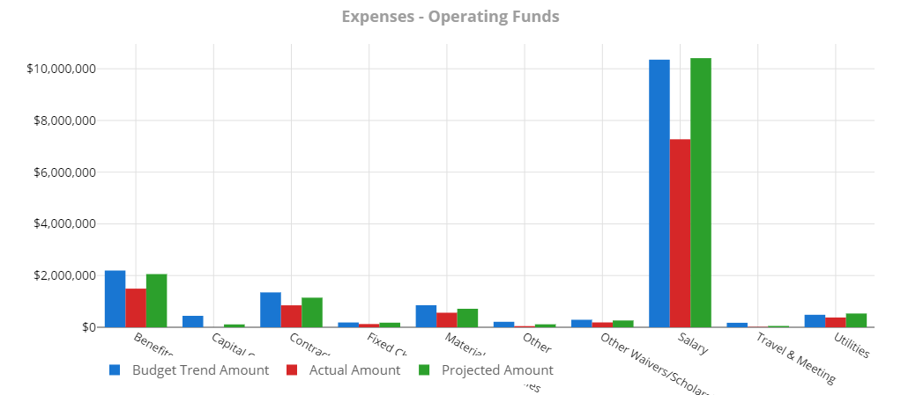
FY 2021 Expenditures: Budget/Actual/Projected-Operating Funds
*Actual as of 3/31/21

Slide 7
Where Will FY2021 Finish?
Revenues
 | Budget | Projected | Actual Over (Under) Budget
Total Revenues Education Fund | 15,414,746 | 14,658,478 | (756,268)
Total Revenues O & M Fund | 1,992,550 | 2,741,983 | 749,433
Total Revenues | 17,407,296 | 17,400,461 | -6,835
$1,608,625 Projected to Fund Balance
$874,032 - Budgeted to Fund Balance
Expenses
 | Budget | Projected | Actual Over (Under) Budget
Total Expenses Education Fund | 15,414,746 | 14,015,531 | -1,399,215
Total Expenses O & M Fund | 1,992,550 | 1,776,305 | -216,245
Total Expenses | 17,407,296 | 15,791,836 | -1,615,460

Slide 8

Corona Virus Stimulus Funds
 | Source | RCC | Students | Total
CARES Act | Federal | 888,177 | 682,755 | 1,570,932
GEER Act | State | 314,597 | 0 | 314,597
CURES Act | State | 75,300 | 0 | 75,300
CRRSAA (CARES 2) | Federal | 2,623,763 | 682,755 | 3,306,518
ARP | Federal | 2,901,459 | 2,976,864 | 5,878,323
Total |  | 6,803,296 | 4,342,374 | 11,145,670

Slide 9





Corona Virus Stimulus Funds
How Funds Have Been Spent
Technology Upgrades & Replacement | 75,908
Instructional Equipment & Supplies | 29,937
PPE & Disinfection Protocols | 79,477
Providing Internet Access to Student/Faculty | 63,325
Technology to Students | 295,126
Reimbursements (Tuition, Rent Etc.) | 66,079
Payroll for Time during Shut Down | 177,008
Vaccination Events | 15,699
Total Institutional Spend | 1,137,571
Grants To Students | 1,365,510
Notes:
$1,278,074 Institution Portion with out CRSSA and ARP

Slide 10

State of the College Finances
 | 2021 Projected*
Beginning Fund Balance
Education Fund | 7,355,269
O&M Fund | 921,856
Profit / (Loss)
Education Fund | 642,947
O&M Fund | 965,681
Ending Fund Balance
Education Fund | 7,998,216
O&M Fund | 1,887,537
*Projected as of 3/31/2021
Strategic Plan Goal 4a:
Create a Fund Balance Reserve Equal To 6 Month’s Expenditures

Slide 11
FY 2022 Budget Assumptions
Credit Hours
  Summer 2021: Flat – 85% Online
  Fall 2021: 5% Down – 25% Online
  Spring 2021: 5% Down – 25% Online
Property Tax: 2% Increase from Prior Year
State Grants: Flat Funding

Slide 12
QUESTIONS?

