Slide 1
Facilities Monitoring Report October 19, 2021
Richland Board of Trustee

Slide 2
Master Plan 2018
Master Plan Phase I
Complete 12/31/2021
Estimated Final Cost $11,000,000 million
SCOPE: The scope of this project consists of renovating approximately 46,000 Sq.Ft. of the first floor south and second floor west wings. The cost includes furnishings and technology.

Slide 3
Master Plan Phase II
Selected BLDD to provide architectural and engineering design services August 2021
Scope: This plan will include renovations all areas in the first floor West wing from the Center Core area which equates to approximately 51,900 square feet.
Budget: An initial construction budget including construction, design, furnishing, and technology is estimated at $14,600,000.

Slide 4
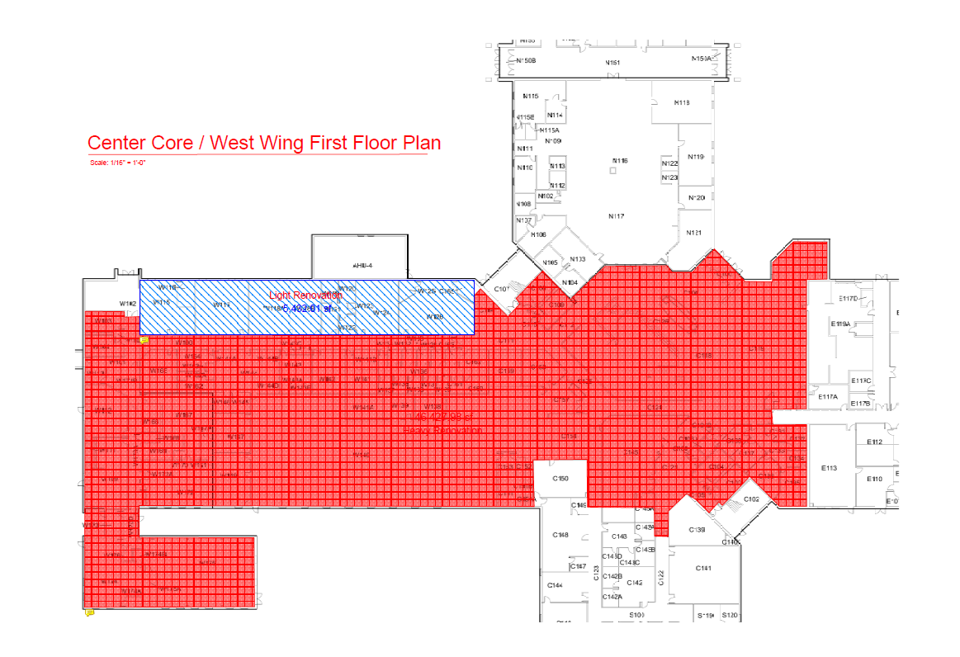
Master Plan Phase II

Slide 5
Agriculture Program
Partnership with FBi Buildings for the demonstration structure for a 144’x80’ exterior shell
Final design to be bid separately in January 2022
Scope : Construct a stand-alone facility including classrooms, offices, study space, and large lab space. A greenhouse and head house will be included in the final design.
Budget:
Exterior Shell $300,000
Interior including furnishing and technology
Total Project cost: $3,500,000

Slide 6
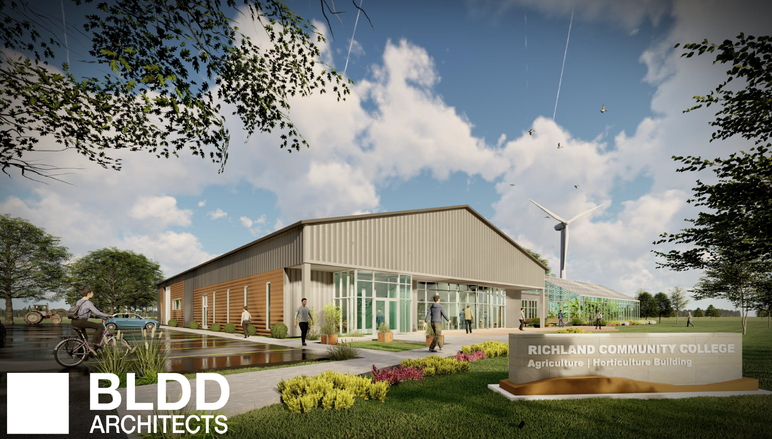
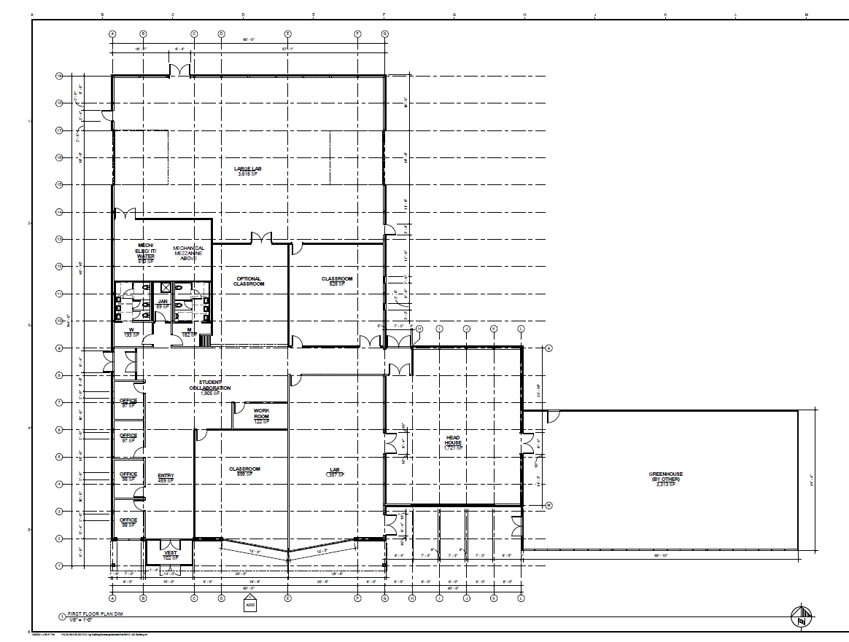
Agriculture Building

Slide 7
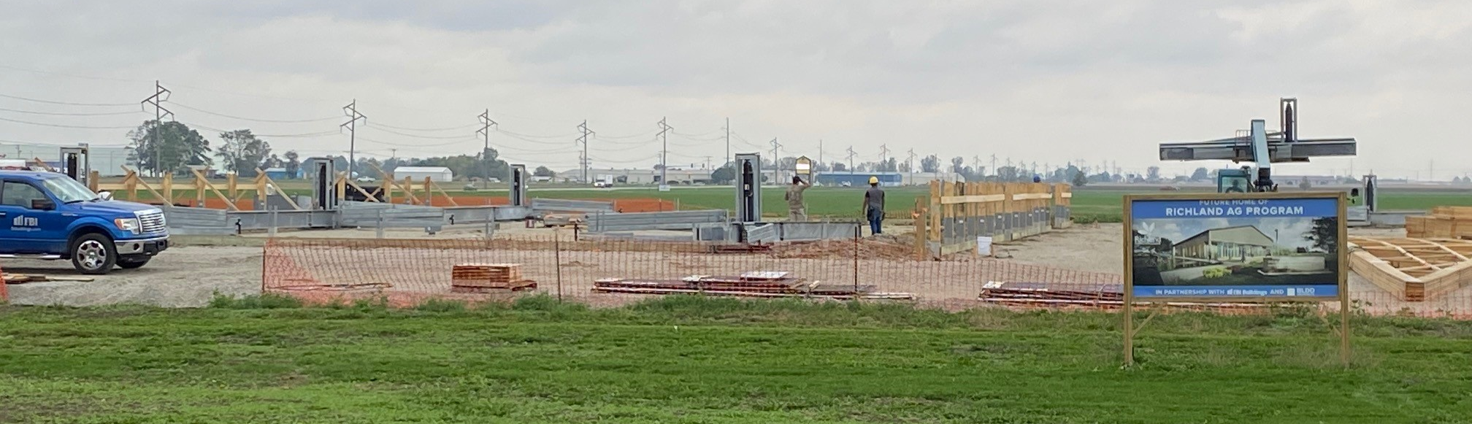
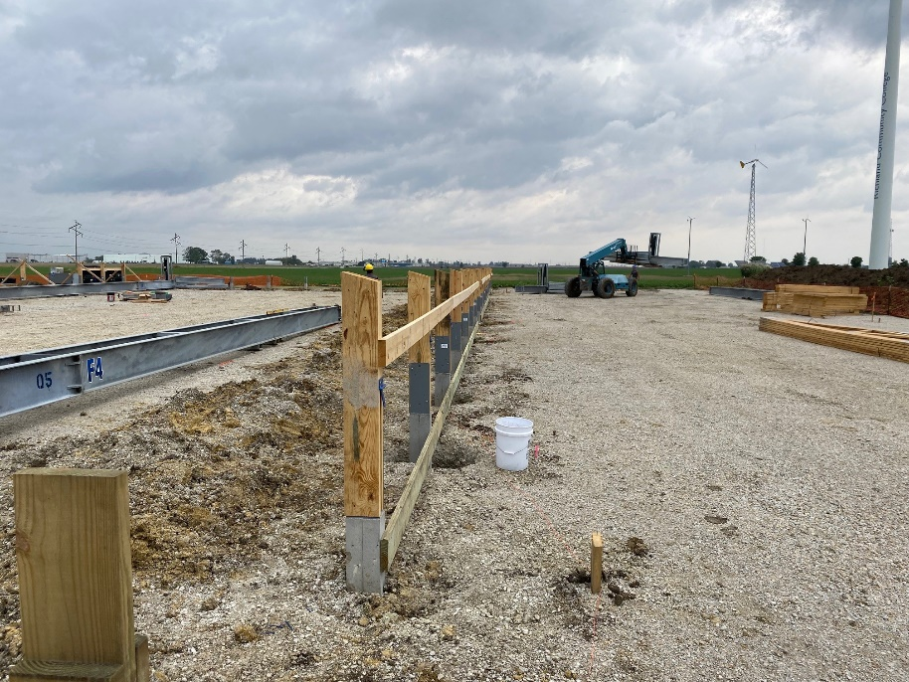
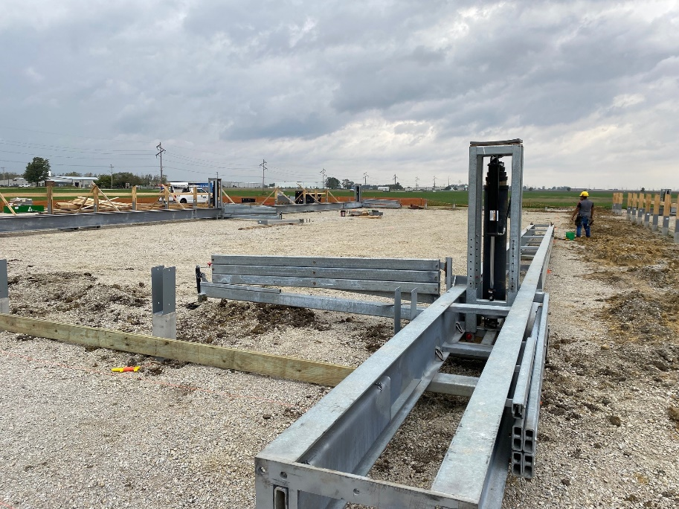
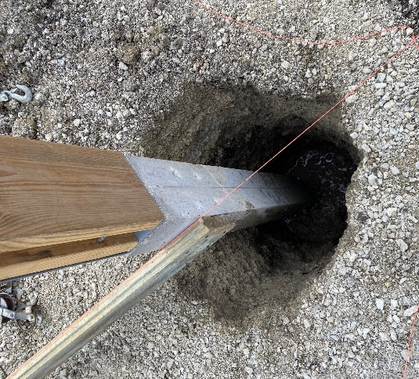
Agriculture Building

Slide 8
CDL Minority Mentoring Teamsters
Richland received an appropriation in the FY21 State Budget:
PA 101-0638 Section 35. The sum of $15,315,000, or so much thereof as may be necessary, is appropriated from the Capital Development Fund to the Capital Development Board for the Illinois Community College Board for costs associated with facility improvements at Richland Community College.
The Project is pending Release of Funds

Slide 9
CDL Minority Mentoring Teamsters

Slide 10
CDL Minority Mentoring Teamsters

Slide 11
CDL Minority Mentoring Teamsters

Slide 12
CDL Minority Mentoring Teamsters

Slide 13
CDL Minority Mentoring Teamsters

Slide 14
CDL Minority Mentoring

Slide 15
State Funded Deferred Maintenance Projects
Roof Repairs and Repainting
Scope: Replace roofing on Scherer Industrial Tech, repaint South Wing Maintenance Buildings roofs
Budget: Total Project $859,653; State share $644,740; Richland share $ 214,913
Henson-Robinson Company from Springfield is the low bidder and has been awarded the contract at a total cost of $473,259.

Slide 16
State Funded Deferred Maintenance Projects
Richland Shilling Community Education Center and Bistro
Scope:
This project includes the following: Replace Theater Seating, theater flooring, upgrade Bistro 537 lighting to include dimming capability, paint / patch theater interior finishes, upgrade lighting controls in theater, replace Shilling Lobby lighting, and replace corridor lighting that wraps around theater.
Budget : Total Project Cost - $748,650; State Share - $561,487; Richland Share - $187,163
BLDD was selected by the CDB and is in the design development phase of this project.

Slide 17
Other Facilities Projects
Bistro 537 Patio Improvements
Scope: Install wind breaks and shade structure at the Bistro patio. Included in this project is installations of glass wind-break walls on top of the existing brick wall, erect two pergola’s to create a shade structure over the seating area
Budget: $137,600
Bistro Patio Concept

Slide 18
Other Projects for Future Consideration
Projects that will be considered for future funding total $2.6 million
These are larger projects that address deferred maintenance, campus renewal, structural integrity, moisture protection, and wayfinding.
The scope for these projects range from renovating the Nursing Labs to replacing sinks and toilet partitions, to sealing joints in the parking lots.
Potential Funding Source
Annual Budget | 157,833
PH&S | 516,800
Capital | 1,407,000
State Deferred Maintenance | 590,000
Total | $2,671,633

Slide 19
Funding Summary
 | Total Cost/Estimate | Funding Source
Project Funding |  | Fund Balance | Budget | State | PH&S
Master Plan II | 14,600,000 | 3,600,000
Ag Building | 3,500,000 | 3,500,000
Roofing Project Deferred Maintenance | 473,259 |  |  | 354,944 | 118,315
Shilling Education Center - Deferred Maintenance | 748,650 |  | 187,163 | 561,487
Bistro Patio Improvements* | 137,600 |  | 137,600
CDL-Minority Mentoring-Teamsters | 15,315,000 |  |  | 15,315,000
Total | 34,774,509 | 7,100,000 | 324,763 | 16,231,431 | 118,315

Slide 20
Funding Summary
Master Plan Phase II & Ag Building
Current (10/18/2021) Fund Balance Available |  | 7,100,000
Less Ag Building |  | 3,500,000
Available for Master Plan II |  | 3,600,000
Estimated Amount to Bond |  | 11,000,000

