Slide 1

Enrollment and Student Monitoring Report, 2021

Slide 2



Slide 3
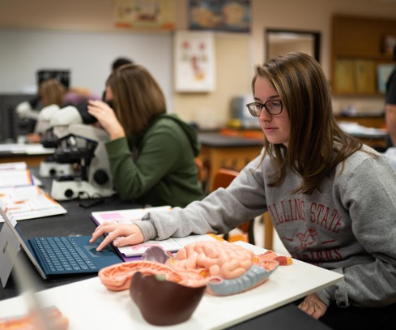


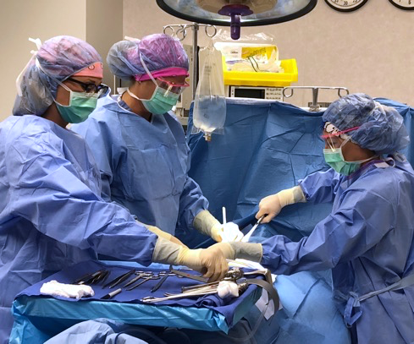
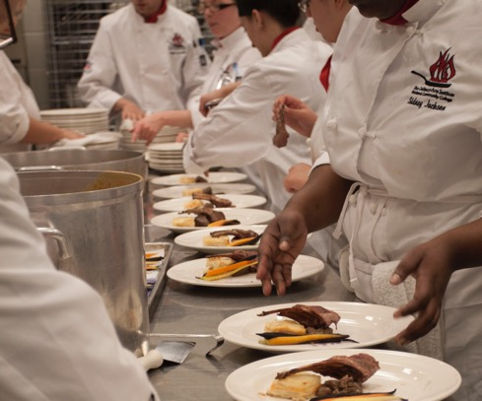


Slide 4

We are still in an unprecedented time in education!

Slide 5
Presentation Areas
National and Local Enrollment Trends
Update on Fall Enrollment
Campus Enrollment Initiatives & Activities
Recommendations on how the BOT can help!

Slide 6
National Community College Enrollment Trends
This past year was largest one-year enrollment decline for community colleges in a decade
Experts believe will take community colleges years to recover from these losses
Economic uncertainties are still present but most colleges like us are moving back to a more formal in person modality

Slide 7
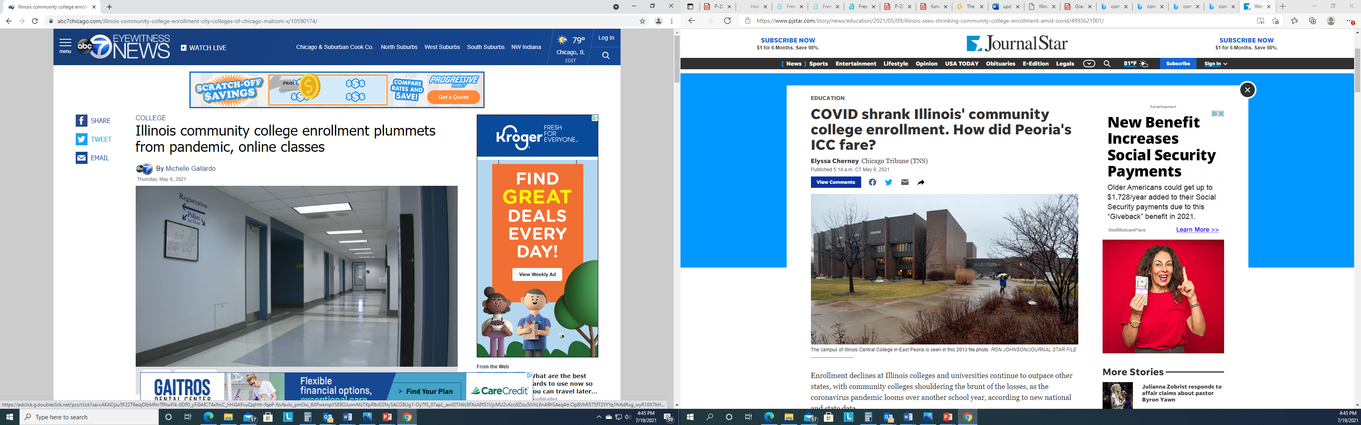

Slide 8
State Enrollment Trends
Statistics from the Illinois Community College Board show that compared to 2020, enrollment was down 14% in Spring 2021
As our state population continues to shrink community colleges will continue to see sharper enrollment declines
Illinois remains the third fastest shrinking state, a trend that has been happening for over a decade now. Crime, the weather, and taxes were cited as the most common reasons by the people who left
Our regional comparison institutions are reporting between a 9-15 decrease enrollment for the fall 2021 term

Slide 9
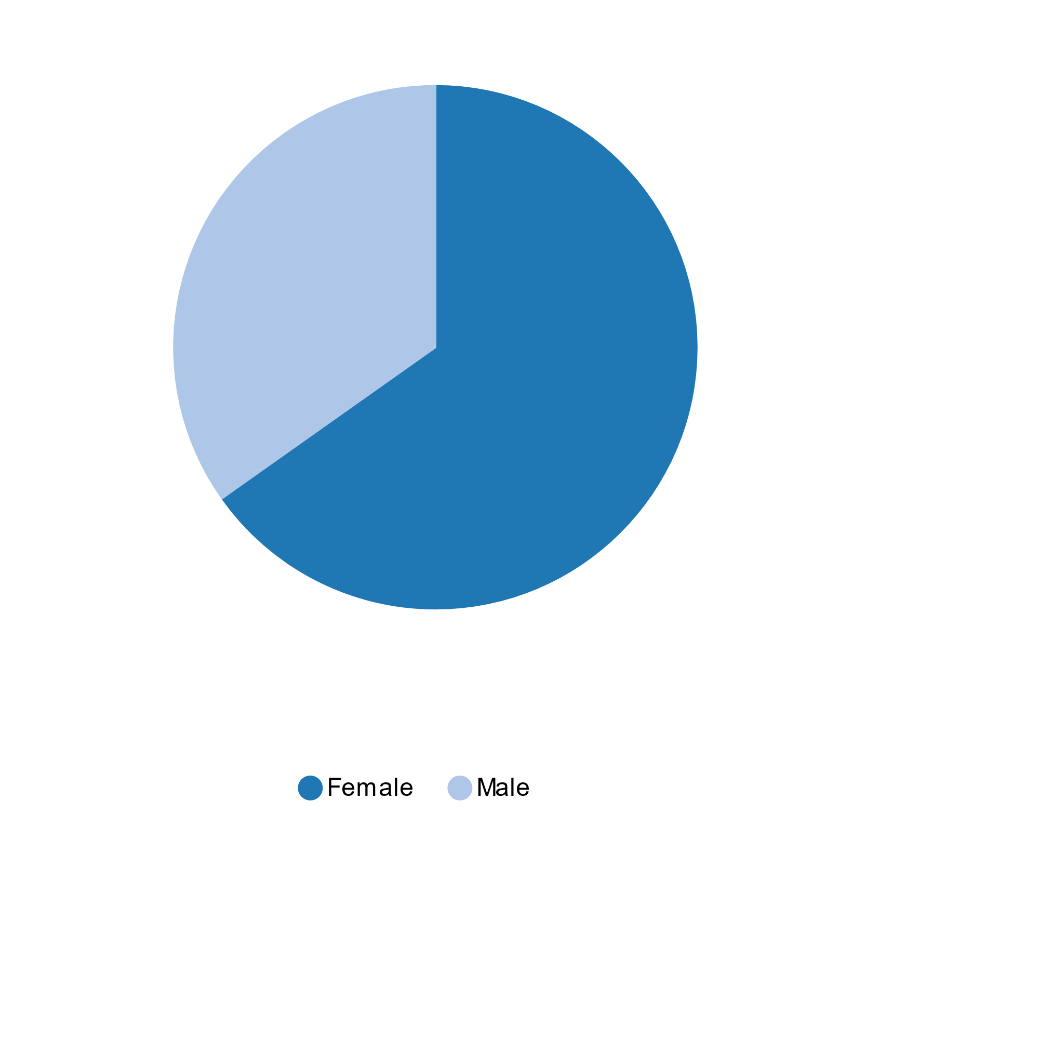
Current Student Demographics
35%
Male
65%
Female
Notes:
SP21
775 Males (35%)
1452 Female (65%)
Losing males used to be
Chart found in Argos
Path: Student.ICCB.Enrollment-Semester (E1).Dashboard
Charts tab
Select Fiscal Year/Session

Slide 10
Current Student Demographics
* FY21 data is preliminary and will be finalized at the end of July 2021
Notes:
Excludes Adult Ed & Vocational Skills Programs
Chart found in Argos
Path: Student.
ICCB.Enrollment-Annual (A1).Dashboard
Chart tab
Select Fiscal Year

Slide 11
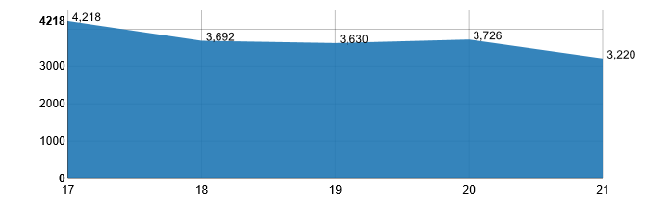
Current Student Annual Enrollment
* FY21 data is preliminary and will be finalized at the end of July 2021
Notes:
Excludes Adult Ed & Vocational Skills Programs
Chart found in Argos
Path: Student.ICCB.Enrollment-Annual (A1).Dashboard
Chart tab
Select Fiscal Year

Slide 12
Fall Enrollment Summary
22 days out for the start of the fall semester
Currently trending down -3.45% in headcount and -7.18% in credit hours
We are currently trending up in new students 29% or (68) in comparison from same time last year
Coaches are booked up with appointments until the first week of August
We have several registration events scheduled

Slide 13
There’s still a lot more work to do!

Slide 14
Foster Student Success and Completion
Strengthen Richland’s relationship with service area stakeholders
Increase Student Retention
Increase Student Completion

Slide 15
Activities
Continue to enhance/strengthen our relationships with local K-12 communities (city and county)
Working towards strengthening our student onboarding process (student intakes and appointments)
Identifying and addressing student basic need barriers (financial, food insecurities, mental health)
Moving forward in developing a guided pathways model and framework to keep students (supported, on track, to complete)

Slide 16

Enrollment Initiatives
Working on enhancing our brand
Hiring key personnel
Growing our social media presence
Finalizing call and text campaigns
Hosting Campus Registration Events

Slide 17



Slide 18
What can you do to help with enrollment?
Talk about our wonderful programs and affordability (tuition FT=$1800 PT $900)
Talk about upcoming registration events
Continue to invite team members to events and activities
Share college post on social media

Slide 19
Together we can!

Slide 20



