Slide 1

Workforce Development
Monitoring Report
CY ’20
February 2021

Slide 2

2019 Data
CPR-240 students
OSHA-337 students
Technical Training-182 students
CDL-66 students
Highway Construction-11 completers
Industrial Job Skills-25 completers
Open Enrollment NC-1,209 registrations
Facility Rental Headcount-11,483 people
Traffic Safety-546 individuals
2020 Data
CPR-71 students
OSHA-133 students
Technical Training-66 students
CDL-36 students
Highway Construction-5 completers
Industrial Job Skills-13 completers
Open Enrollment NC- 474 registrations
Facility Rental Headcount- 3,478 people
Traffic Safety-307 individuals

Slide 3

COVID issues and outcomes:
  CDL was shutdown for several months with the DMV being closed
  Open-enrollment classes refunded in the spring and very few running in summer and fall.
  Facility usage was stopped for several months during the COVID shutdown and limited numbers later.
  Contract training was difficult due to not only college COVID restrictions, but the employer’s restrictions.
  Traffic Safety shutdown for 2 months and then limited in numbers after resuming.
  Highway was about to start a class when COVID hit and shut everything down.
  Positives:
  Richland was still able to deliver some OSHA classes virtually since we are a partner of the National Safety Education Center. So Barry delivered OSHA 30 for a few locations across the state.
  CDL now conducts the permit training class virtually via Canvas

Slide 4

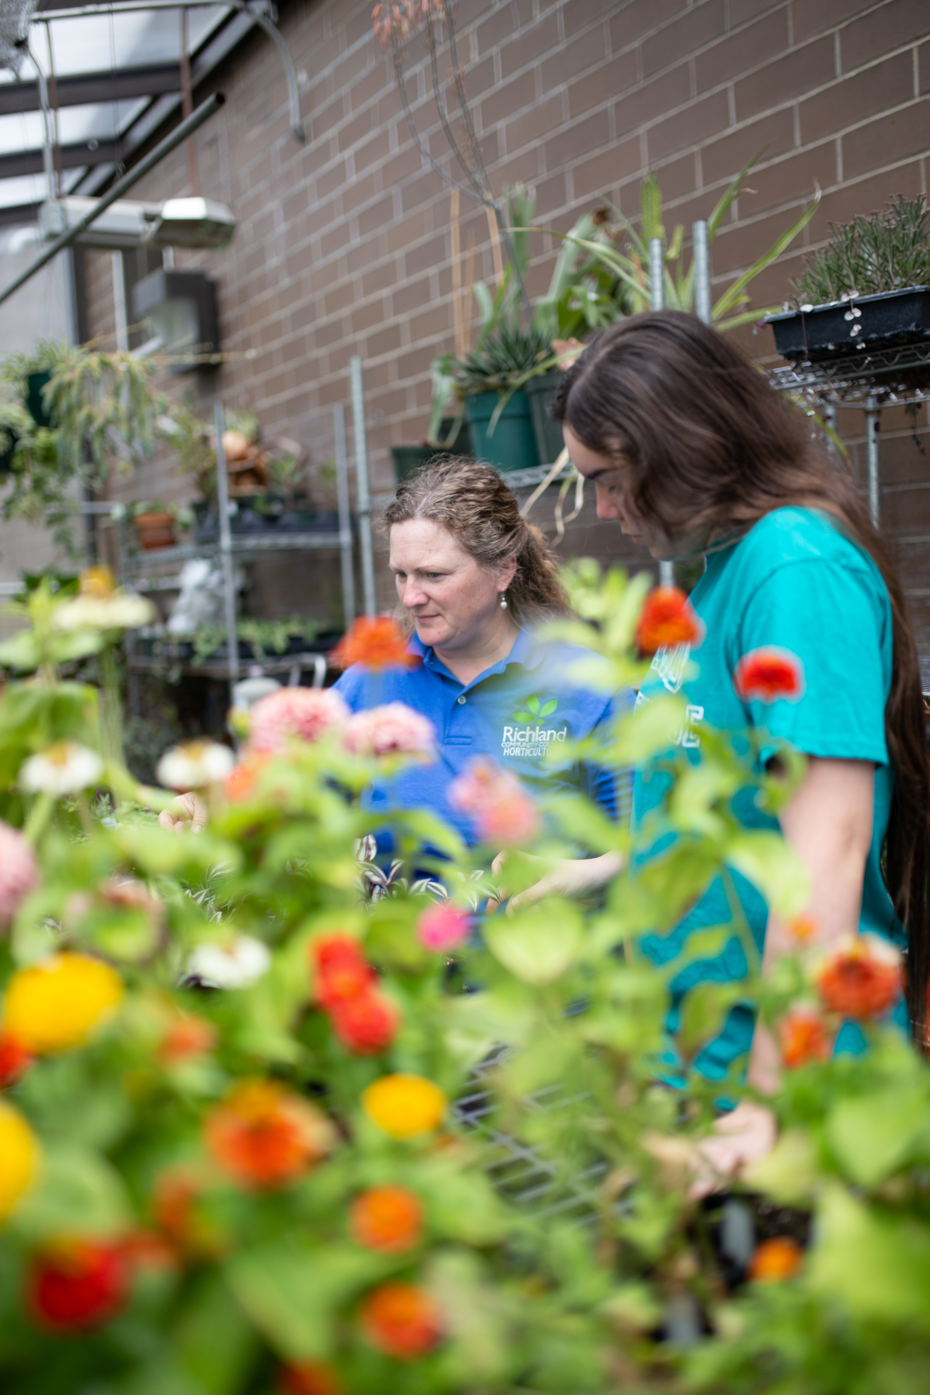
Partnerships
  RCC Agriculture developed 2 new internship opportunities for Ag students.
  HVAC students now service Pepsi vending machines and Pepsi places a sticker stating the machine is maintained by Richland HVAC.
  Rush Trucking/Diesel Truck Tech/CDL
  Crossings Healthcare/Workforce Investment Solutions
  National Center for Construction Education Resources-Accredited Training Sponsor
  ADM Process Controls
  Austin Industries/Workforce Investment Solutions
  National Council for Workforce Education

Slide 5
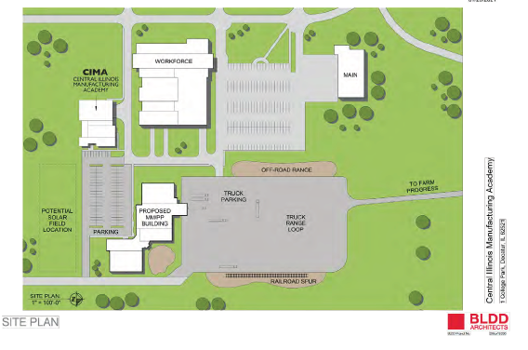
Partnerships-Developments
  Teamsters/EnRich/MMPP
    $15 million facility
    Teamsters trainings
    Entrepreneurship
    CDL
    Skilled Trades
  CIMA
    $8.7 million facility and equipment
    Industrial Maintenance
    Smart Manufacturing
    Process Operations

Slide 6
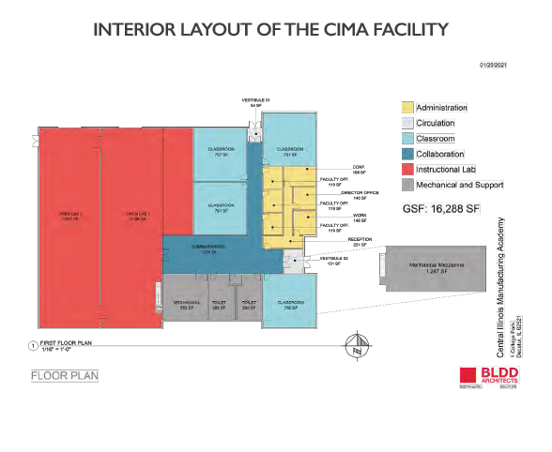
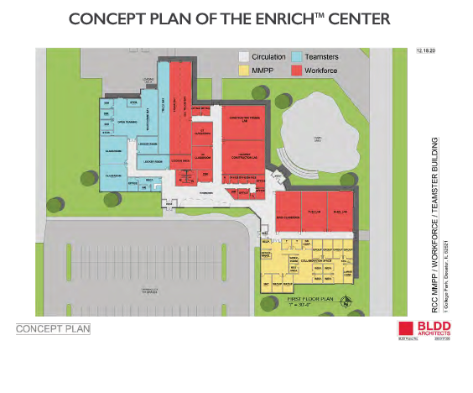

Slide 8
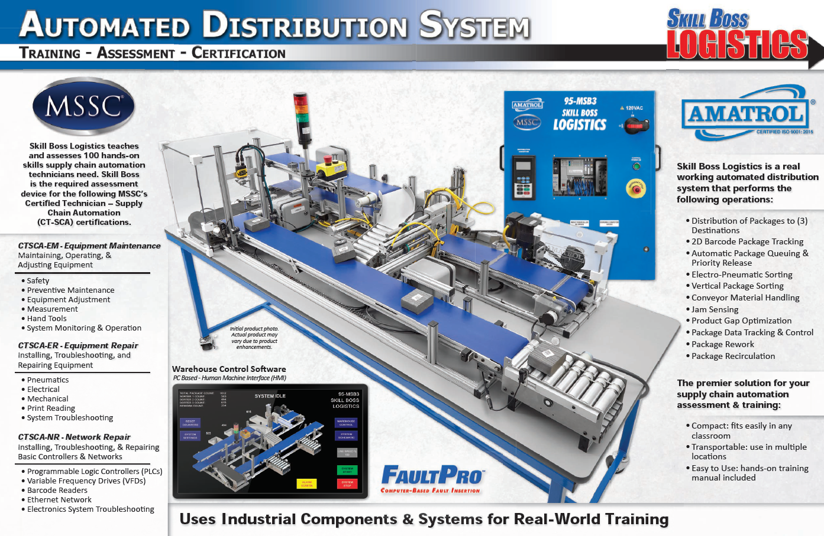

Slide 9
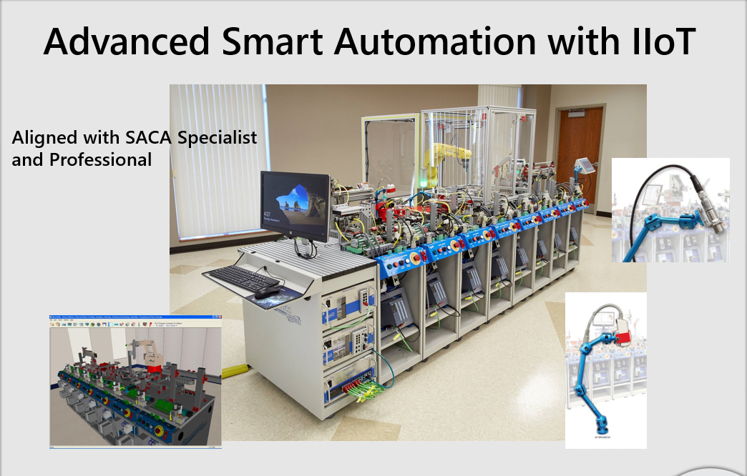

Slide 10
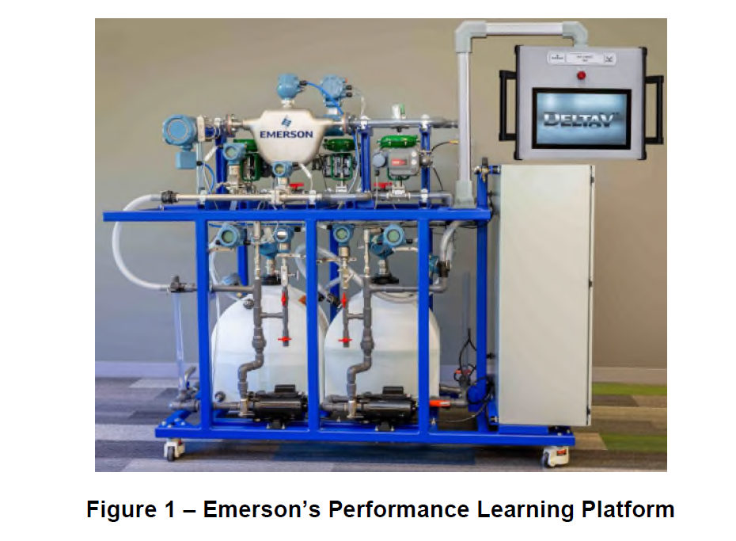

Slide 11
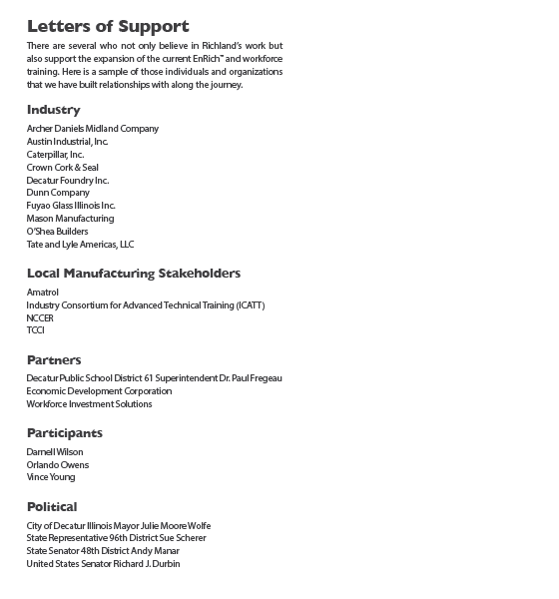

Slide 12

Thank you!

