Slide 1

NAME OF DCLI PRESENTATION HEADER

Slide 2


50 YEARS OF CHANGING LIVES
HISTORY OF RICHLAND
In 1972, the doors opened to the Community College of Decatur in a converted bank building in downtown Decatur.
The College underwent a name change to Richland Community College in 1975 – named after the “rich land” of central Illinois.

Slide 3
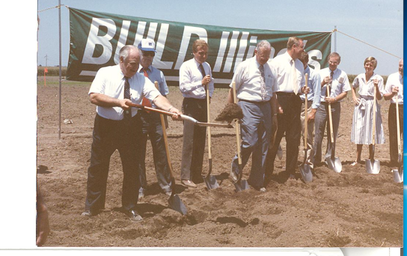
50 YEARS OF CHANGING LIVES
In 1979, the college moved to a rented warehouse, known as Park 101.
In March of 1984, a $5.8 million bond referendum was approved by voters for an $18.5 million permanent campus at our current site.
In July 1986, a groundbreaking was held at our current location of One College Park.

Slide 4
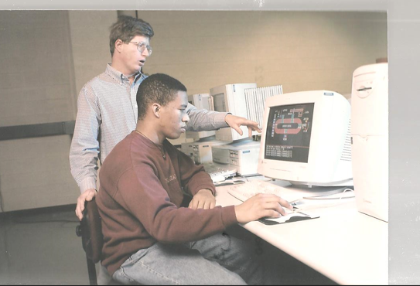
50 YEARS OF CHANGING LIVES
Over the last 50 years, Richland had undergone a name change, moved through three locations, completed several additions, expansions and capital projects, engaged in rewarding partnerships, started new programs, and changed thousands of lives.

Slide 5
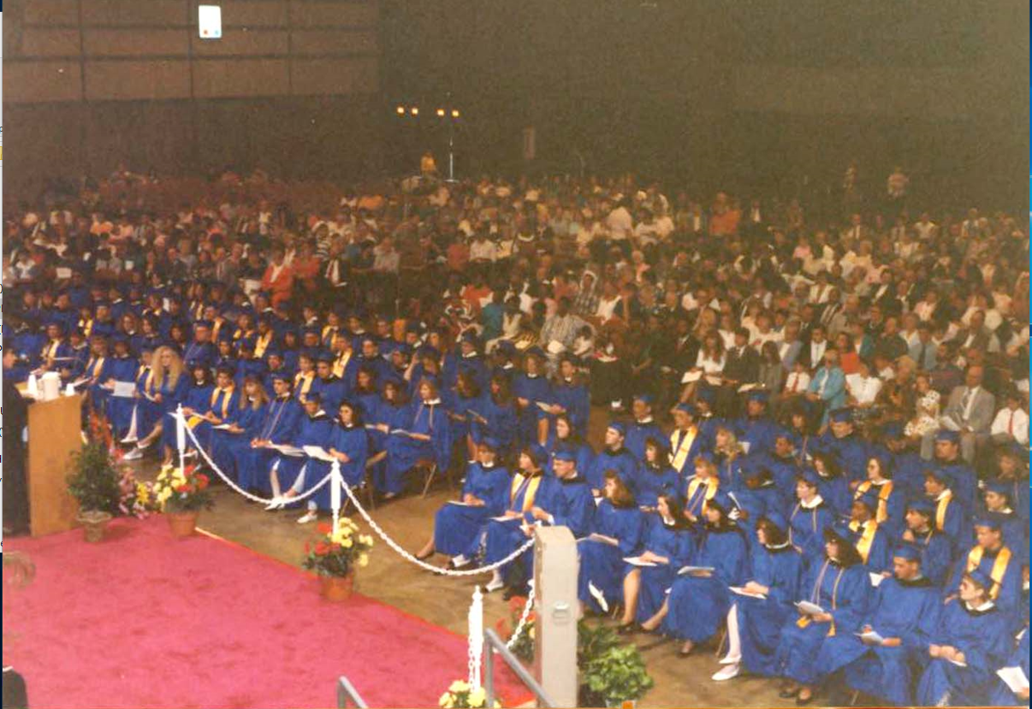
50 YEARS OF CHANGING LIVES
Over the next few months, you will be reminded of (or perhaps learn for the first time) the impact that Richland has made on the communities that we serve.
You are an important part of how far we have come, but also where we are going.
Let’s celebrate 50 YEARS!

Slide 6


50th Anniversary events
FALL 2022
50 Ways of Wellness Challenge: September 8 – October 28, 2022
Welcome Back Picnic: Saturday, September 17, 2022, 3 - 6PM
Founders Day Gala: Saturday, October 22, 2022, 6PM in the Shilling Salons
Student & Community Open House: Tuesday, November 15, 2022, Time TBD

Slide 7
50th Anniversary events
SPRING 2023
Richland Gives Back Day: February 2 - 3, 2023
50 Ways of Wellness Challenge: February 16 – April 7, 2023
State of the College: Wednesday, April 12, 2023, 12PM in the Shilling Salons
50th Commencement Ceremony: Friday, May 19, 2023, 7PM, Decatur Civic Center

Slide 8
50th Anniversary activities
50 STORIES Weekly on social media, and the website, hear the stories of the influential people who have been a part of Richland’s success.
FLASHBACK FRIDAY
Each Friday, on social media, we will share a flashback that allows us to reminisce the past and see how far we have come.
MOTIVATIONAL MONDAY Each Monday, we will share why each of you choose to be a Richland Employee. Check TEAMS for your weekly Monday Motivation!

Slide 9

50 YEARS OF CHANGING LIVES
Why I Choose Richland…
Community
Student
Opportunity
Family
Success
Support
Great
Caring
Innovation
Life

Slide 10


50th Branding Guidelines
LOGO USAGE Use of the 50th Anniversary logos are encouraged. There are 4 logos versions – horizontal & vertical in both color & black/white. Please ensure that they are not distorted when adding to a document.

Slide 11



50th Branding Guidelines
PPT Template Below is a preview of the PPT template. Use of this template is highly encouraged over the course of the academic year, especially for community presentations and Board of Trustee spotlights.

Slide 12
50th Branding Guidelines
Email Signature Each employee will be expected to utilize a standardized signature for the 50th Anniversary. Below is a sample of the signature, with the option to add customized text for each area.
Julie Melton, MNA, CFRE
Assistance Vice President, Institutional Advancement P: 217.875.7200 ext. 6209 | E: jmelton@richland.edu
We are celebrating 50 Years of Changing Lives at Richland. Visit www.richland.edu/give to make your difference.

Slide 13
50 YEARS OF CHANGING LIVES
HOW YOU CAN GET INVOLVED
Share stories & posts on social media
Attend and participate in the events & activities (and encourage your staff to do as well!)
Show off your new swag
Attend Convocation in January (did I say more swag ?)
Use the 50th logo as appropriate
Use the provided PPT for presentations
Change your signature with the provided instructions
Not sure how to participate? Ask for clarification or help

Slide 14
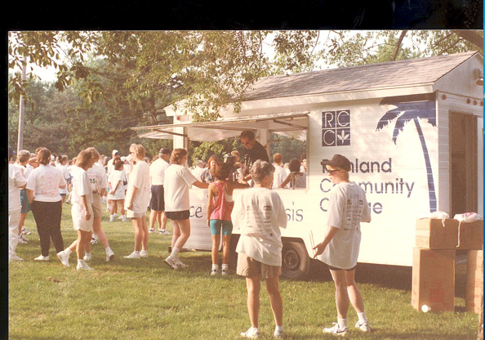
50 YEARS OF CHANGING LIVES
Over the next academic year, watch for special events, news stories, and photo features that showcase the past, the present, and the future of Richland Community College
www.richland.edu/50years

Slide 15

INSTITUTIONAL ADVANCEMENT
What is Institutional Advancement?
Institutional Advancement (embracing alumni relations, fundraising, marketing and grants) refers to a total program to foster understanding and support for Richland Community College.

Slide 16

OUR TEAM
Julie Melton – AVP, Institutional Advancement
Debbie Ellison - Executive Assistant, Institutional Advancement
Loren McGinnis – Annual Giving & Alumni Engagement Coordinator
Tara Mata – Advancement Services & Scholarship Coordinator
Samantha Bright – Marketing Coordinator
Emma Roark – Content Writer & Communications Coordinator
Adam Lovell – Grant Coordinator

Slide 17
MISSION OF THE FOUNDATION
The mission of Richland Community College Foundation
is to support and advance the development activities
that provide enhancements to Richland Community College and its students.

Slide 18
FOUNDATION FY22 RESULTS
In FY22, we achieved a 5% increase in fundraising revenue, exceeding our annual goal by 12%.
We received significant gifts from the John Ullrich Foundation, ADM Cares and the Decatur Memorial Hospital Foundation.
We awarded over $1.3M in support to the college, including over $1M scholarships & emergency relief grants awarded to Richland students.

Slide 19
FOUNDATION PRIORITIES
Goal 1: Foster student success and completion.
Goal 2: Enhance & cultivate partnerships in business, education, government, and our communities to meet current needs of students and emerging trends of the region.
Goal 3: Create a sound financial system that maintains long-term operational funding, promotes operational sustainability, and utilizes an effective organizational structure and maintains resources.

Slide 20
FOUNDATION BOARD
Nicole Bateman, Chair
Stephen Clevenger, Vice Chair
Jim Schroeder, Past Chair
Matt Whitehead, Treasurer
Julie Brilley, Secretary
Joseph Brown
Jeff Dase
Nikki Garry
Jason Herman
Tamar Kutz
Matt Naber
James Rhodes
Trent Thompson
Stacey Young
Dawn Yuhas
Myung Kim, Honorary Director

Slide 21
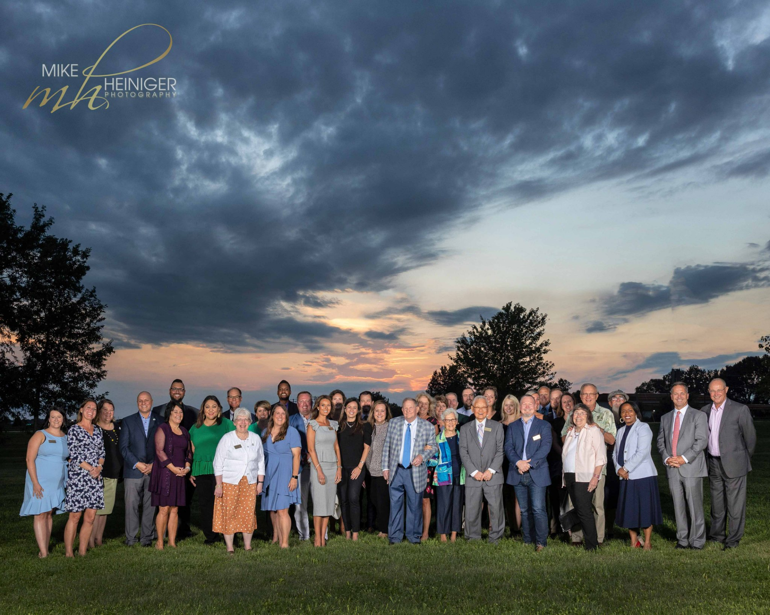

Slide 22
MARKETING PRIORITIES
Goal 1: Review and implement the Strategic Marketing Plan.
Goal 2: Build a data management warehouse for content and digital assets.
Goal 3: Meet with departments/programs across campus to create individualized marketing plans.
Goal 4: Create a multi-level system to support marketing needs across campus.

Slide 23
GRANT PRIORITIES
Goal 1: Create an inventory of current (and recent) grants to identify funding priorities, populations served and unique aspects of the grant.
Goal 2: Develop a process for grant requests & reports to ensure all consistent communication.
Goal 3: Identify grant opportunities based on gaps in current funding or future growth.

Slide 24
GRANT PRIORITIES
Goal 1: Create an inventory of current (and recent) grants to identify funding priorities, populations served and unique aspects of the grant.
Goal 2: Develop a process for grant requests & reports to ensure all consistent communication.
Goal 3: Identify grant opportunities based on gaps in current funding or future growth.

Slide 25
QUESTIONS?
Thank you for all you do to support the Richland Community College Foundation and Institutional Advancement at Richland.

