Slide 1
Facilities Monitoring Report
September 2022

Slide 2
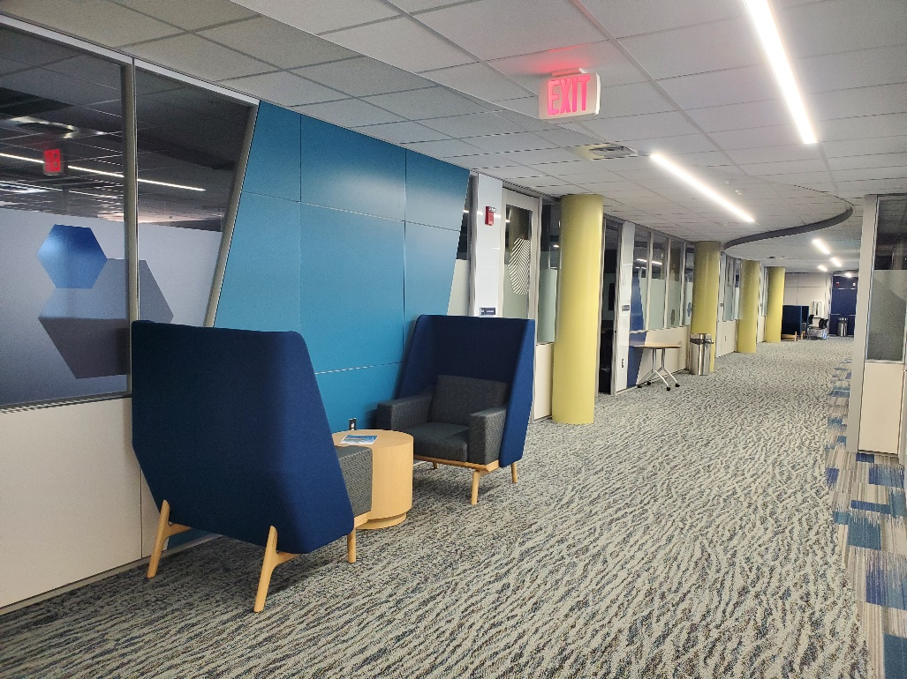
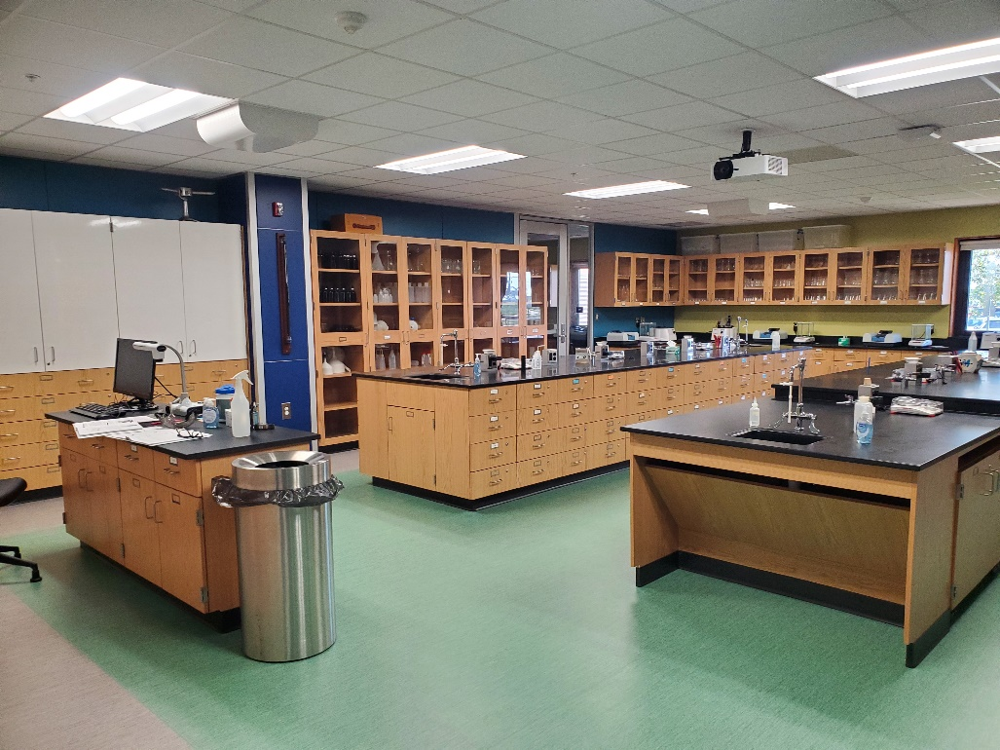
Completed: Master Plan Phase I
Scope: Involved renovating approximately 46,000 square feet of the first floor south and second floor west wings. This included refreshing furnishings and technology.

Slide 3
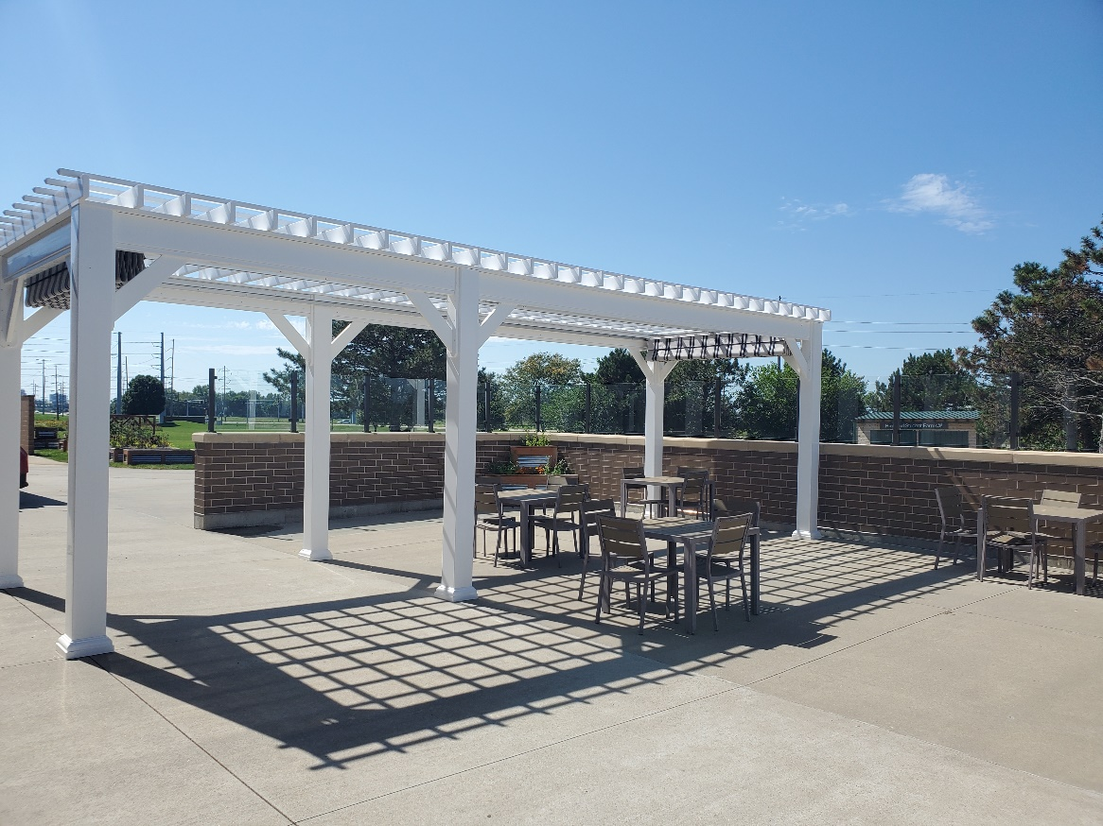
Ongoing: Bistro 537 Patio Improvements
  Scope:
  Installation of glass wind-break walls on top of the existing brick wall& shade structures over the seating area (completed)
  Installation of additional furniture in the seating area (ongoing)

Slide 4
Ongoing: Roof Repairs and Repainting
(State-Funded Deferred Maintenance Project)
Scope:
  Replace aging sections of the Scherer Industrial Tech & south wing flat roofing
  Re-paint metal roofing above the north wing, south wing, and Maintenance Building

Slide 5
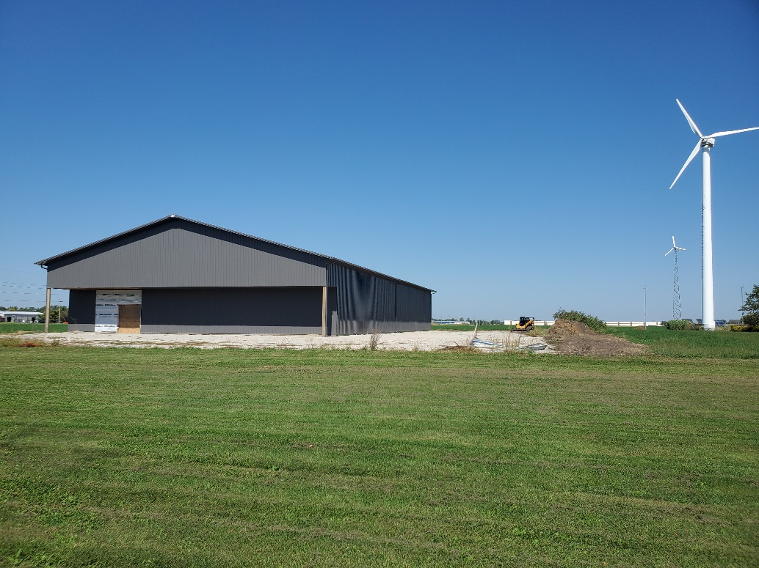
Ongoing: Agriculture Program Building
Scope:
  Construct furnished classrooms, offices, lab space, and study space within the 144’x80’ exterior shell purchased from FBI Buildings
  Construct a greenhouse & head house

Slide 6
Ongoing: Shilling Community Education Center & Bistro Upgrades
(State-Funded Deferred Maintenance Project)
Scope:
  Replace theatre seating & flooring
  Paint / patch theatre interior finishes
  Upgrade Bistro 537 lighting to include dimming capability
  Upgrade architectural lighting in the theatre
  Replace Shilling lobby lighting & adjacent corridor lighting
Work is scheduled to begin in December 2022

Slide 7
Ongoing: Master Plan Phase II
Scope: Includes renovations within the first floor west wing & “center core” of the main building, with a maximum footprint of roughly 51,900 sq. ft.
Currently working with BLDD to ensure that the mix of classrooms, offices, and support spaces align with the college’s current & expected future needs.

Slide 8
Upcoming: 2023 P.A.T.H. Grant Remodel
Scope:
  Refresh the interior of the S151 healthcare training lab, including the installation of a DRTT wall system
(Pipeline for the Advancement of The Healthcare Workforce)

Slide 9
Projects for Future Consideration
Larger projects that address deferred maintenance, protection/health/safety systems, and wayfinding.
The scope for these projects range from upgrading the fire alarm system at the main campus to replacing sinks & sealing joints in the parking lots.

Slide 10
Questions?

