Slide 1

Monitoring Report:
Information Technology
April 2022

Slide 2

Support Structure

Slide 3
Continue to provide technology to students & employees to support remote & hybrid instruction
Outfit classrooms with technology for hybrid & socially-distanced instruction
Install new technology in the South & West wing remodeling areas when construction is complete
Post-COVID, work with other departments to restart work on relevant priorities
  Alternative work technologies
  COVID-19 vaccination tracking system
  Jenzabar CX 10.1
  Cloud-based replication for disaster recovery
  Food Services point-of-sale system
Completion to Goal in the Past 12 Months

Slide 4
Staffing concerns
Supply chain disruptions
Cyberattacks
Compliance
  Gramm-Leach-Bliley (GLBA) – Safeguards Rule
  Cyber Liability insurance
ERP software
Looking Forward: Challenges

Slide 5
Richland Thrive - Degree Planner module [Strategic Plan Goal 2C]
FEITH software upgrade [Strategic Plan Goal 4J]
MCLETC facilities expansion [Strategic Plan Goal 3C, 4E]
Legacy network infrastructure replacement at all sites [Strategic Plan Goal 4H]
ERP system analysis “listening” campaign [Strategic Plan Goal 4J]
Comprehensive cybersecurity toolkit review
Full review & action as needed to ensure GLBA & insurance policy compliance
Disaster recovery tabletop exercise
Looking Forward: Additional Goals

Slide 6
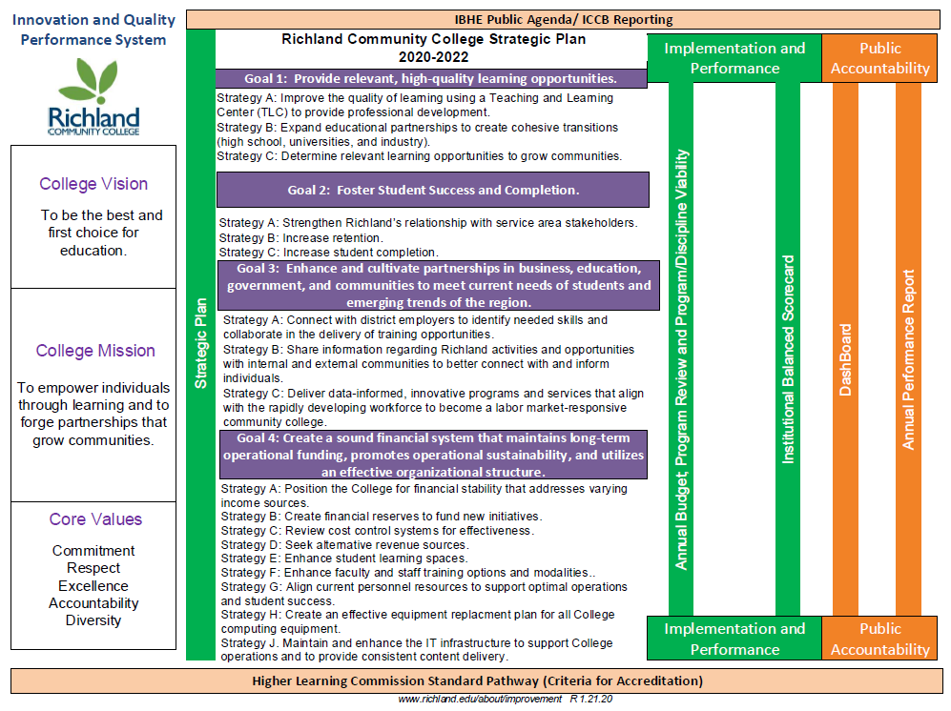

Slide 7

Questions?

