Slide 1
MACON COUNTY LAW ENFORCEMENT TRAINING CENTER
A partnership between the Illinois Law Enforcement Training & Standards Board
and Richland Community College

Slide 2
Basic Law Enforcement Academies Completed in 2021

Slide 3
Basic Corrections Academies Completed
CC21-09 Sunday, February 7 - Friday, March 12 2021
CC21-10 Sunday, April 25 - Friday, May 28 2021
CC21-11 Sunday, October 17 - Tuesday, November 23 2021

Slide 4
Basic Law Enforcement Academies
Scheduled This Calendar Year, 2022
RC22-15 Sunday, January 09 2022 – Friday, April 15 2022
RC22-16 Sunday, April 24 2022 – Friday, July 29 2022
RC22-17 Sunday, May 22 2022 – Friday, August 26 2022
RC22-18 Sunday, August 14 2022 – Friday, November 18 2022

Slide 5
Basic Corrections Academies
Scheduled this Calendar Year, 2022
CC22-12 Sunday, January 23 2022 – Friday, February 25, 2022
CC22-13 Sunday, April 10, 2022 – Friday, May 13, 2022
CC22-14 Sunday, September 11 2022 – Friday, October 14, 2022
Partnership with the Sangamon County Sheriff’s Office

Slide 7
Other Training
last Calendar Year, 2021
IROCC: 90 (approximate)
Range: 10 days
Canine: 2 days
Tactical Village: 30 days
Fire Tower: 26 days
Dive Pond: 5 days

Slide 8
2021 Outside Agency Training
United States Probation and Courts Firearms Range Training
100 Club of Illinois- First Responder Wellness Training
State-Wide Active Shooter Training- Train the Trainer
Illinois Department of Revenue –Agent Scenario Based Training
Illinois Coroner’s Training Board Training
Illinois Department of Corrections Virtra Simulator Training
Local Fire and Police Agency In-Service Training
Alcohol Tobacco and Firearms (ATF) In-Service Training

Slide 9
New Projects/Proposals/ Accomplishments
IDOC Agreement to Provide Services from Richland to the IDOC Academy is completed
Macon County Fire and Rescue Training Facility
(Local/Regional/Statewide Training is being conducted)
Safe T-Act Curriculum has been Implemented
25 Additional Beds have been added to Residential Hall for a total of 135 beds
MCLETC had a substantial Net Profit for the Year

Slide 10
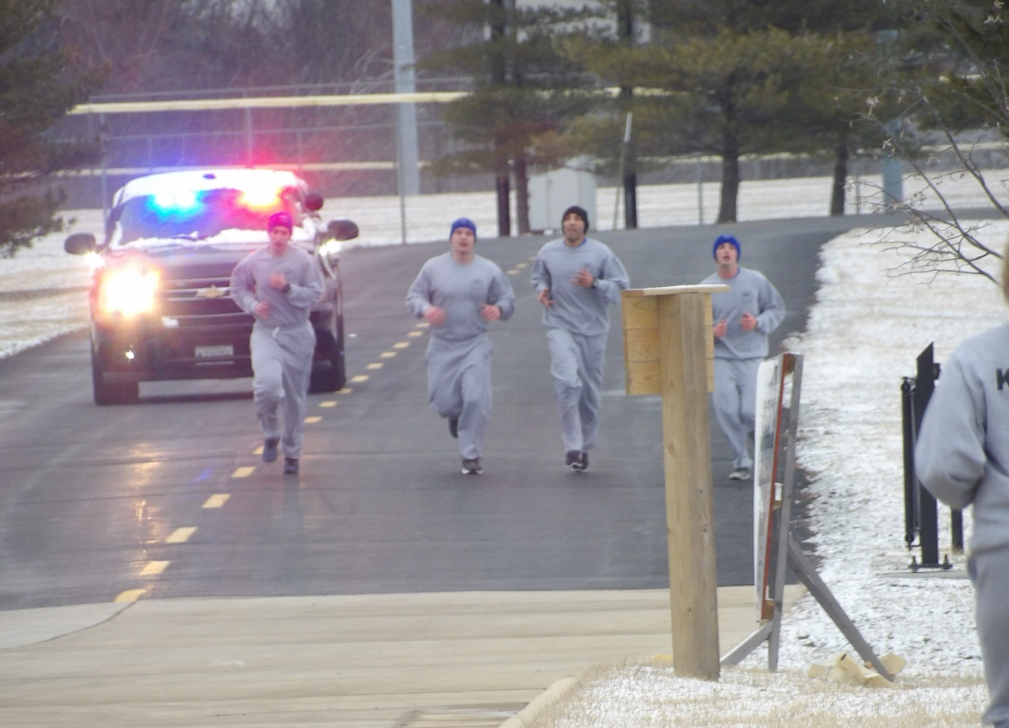
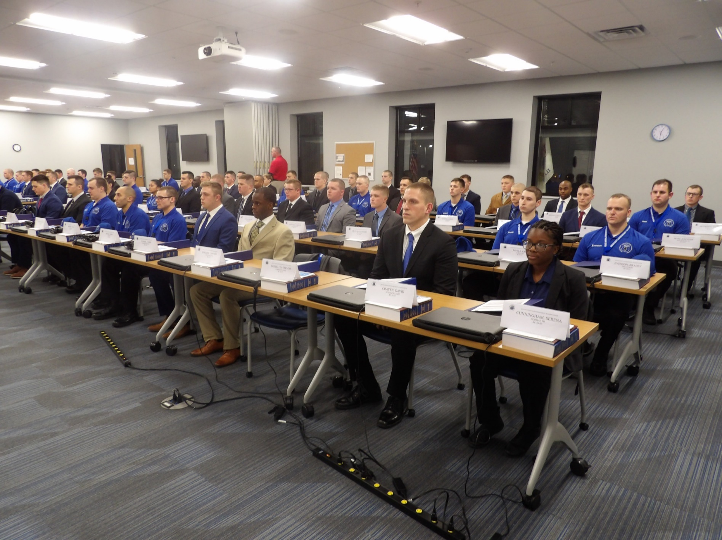
Pre-COVID-19 Academy Class Photos

Slide 11
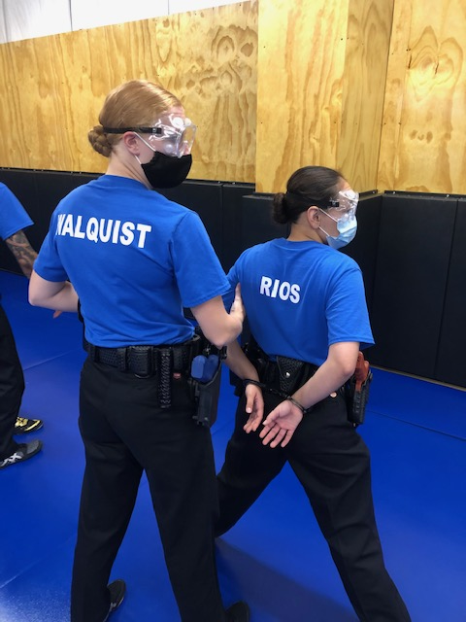
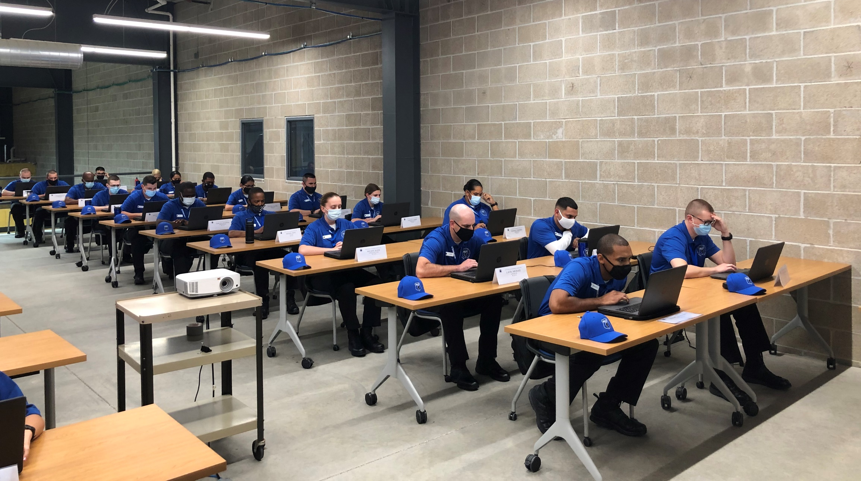
COVID-19 Academy Class Photos

Slide 12
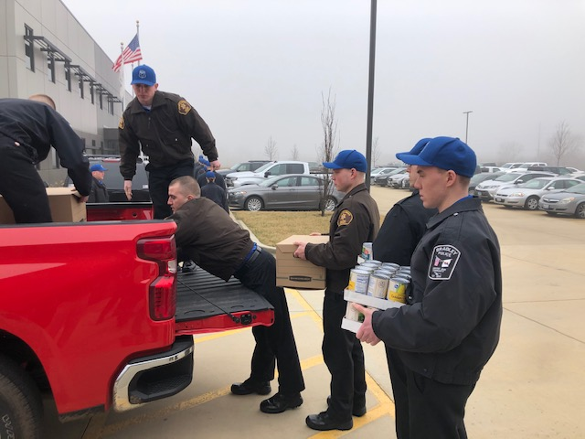
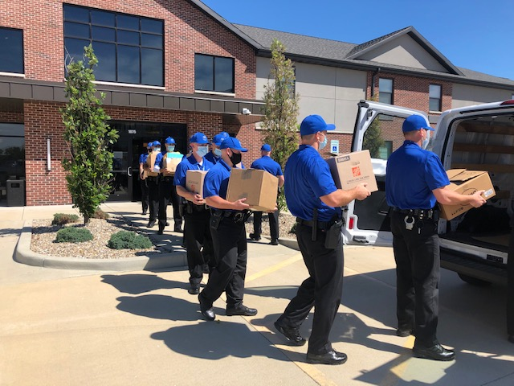
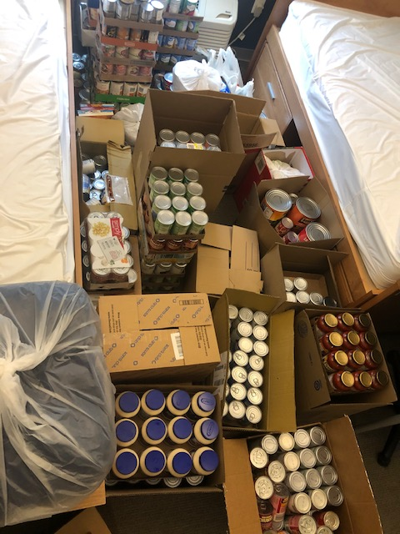
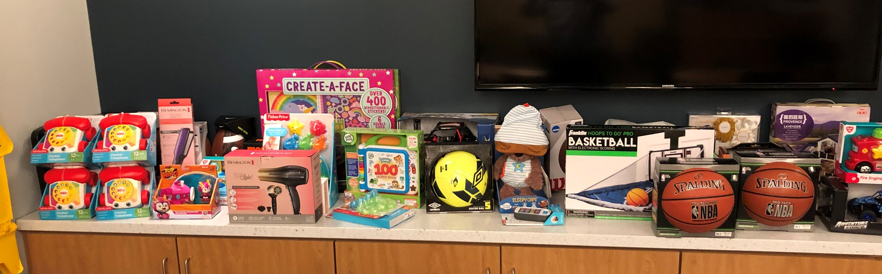
CY2021 Community Projects

Slide 13
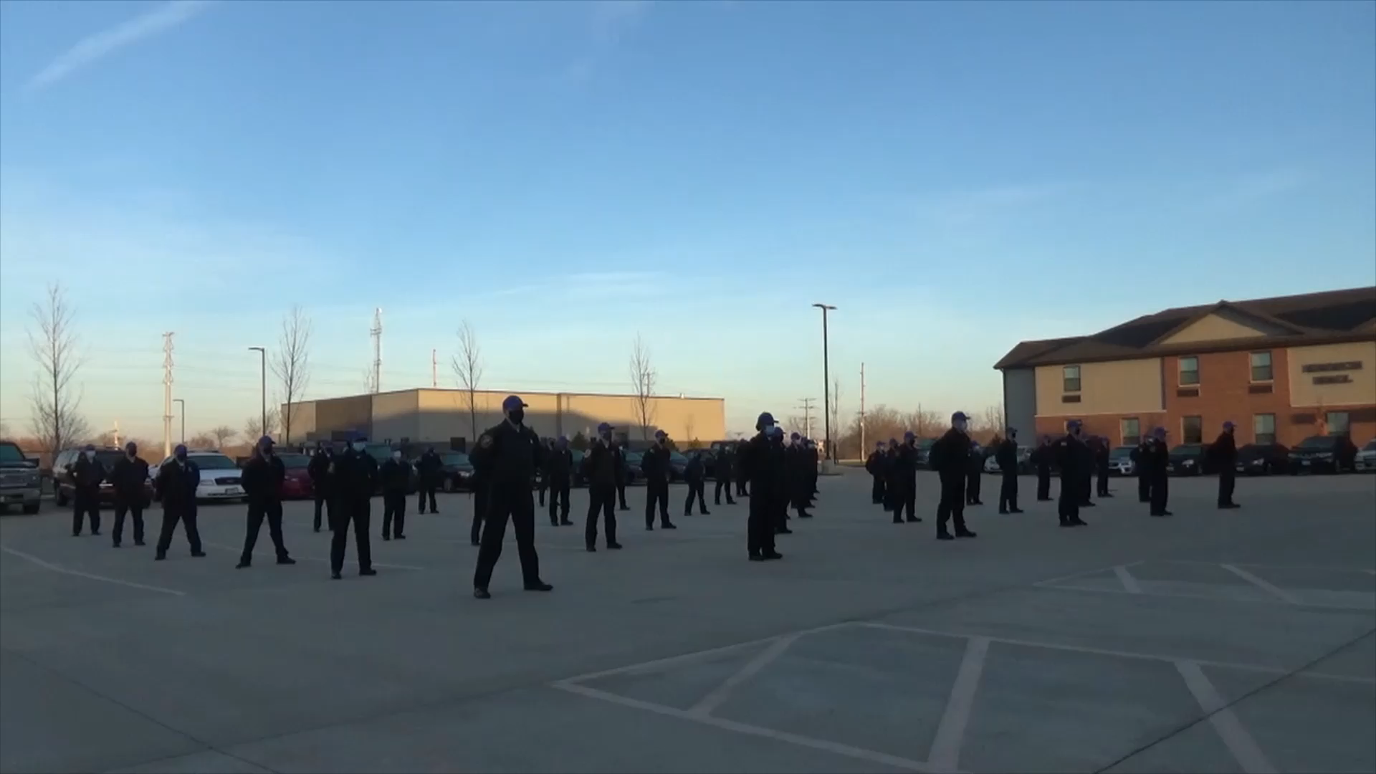

Slide 14
Thomas Schneider
Acting Commander
Macon County Law Enforcement
Training Center
1095 Rotary Way
Decatur, IL 62521
217-875-7211, ext. 1604
217-855-4738 mobile
tschneider@richland.edu

