Slide 1

Student Monitoring Report 2022

Slide 2

Indisputably, the biggest challenge facing most community colleges, will be continuing to navigate through the uncharted territory that we are currently facing with the COVID-19 pandemic and it’s aftermath.

Slide 3
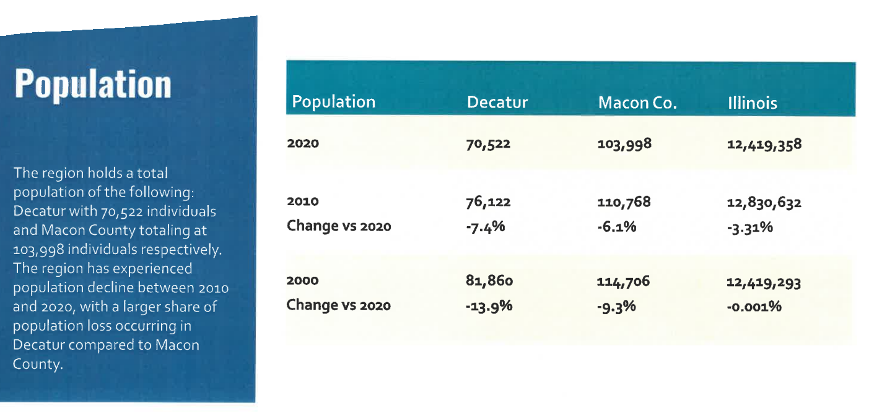

Slide 4
Enrollment Trends
Nationally for CC Enrollments were not doing great to begin with before the pandemic
Illinois remains the third fastest shrinking state, a trend that has been happening for over a decade now (Decatur) is still in the top five as one of the fastest shrinking cities in the country
Only about half of Americans (49%) believe the economic benefits of a college degree outweigh tuition costs
Data suggests this year that more students are really questioning the value of going to college, not just whether this is a good time to go

Slide 5

Target Population
Traditional Students
Nontraditional Students
Transfer Students
Dual Credit and Dual Enrollment
Veterans
Community Members
Non-credit seekers
Notes:
Traditional Students: Reach out to targeted high school juniors and seniors who are looking for an Associate’s degree, transfer opportunities, certificate or occupational programs.
Transfer: Target students who are interested in higher education savings for the first two years and who are interested in transfer opportunities.
Feeder high schools: Our enrollment coach we be focusing on forming relationships with DPS and the other 14 area high schools and guidance counselors.
Dual Credit and Dual Enrollment: Through our dual enrollment program, we would like to target rising juniors and also our senior populations to take college credit courses.
Veterans Affairs: Reach out to Veterans Affairs centers and military high schools to promote Associate’s degree, transfer opportunities, certificate and occupational programs
Community Members: work with clients in the community through community based agencies, government offices and agencies, and local businesses.

Slide 6
How we are Engaging our Students
Text them All Messages
Online Chat Conversations
In Person and Online Coaching Appointments
Social Media
Community Members
Dedicated Registration Events (July 30th & Aug 6th)
Notes:
Traditional Students: Reach out to targeted high school juniors and seniors who are looking for an Associate’s degree, transfer opportunities, certificate or occupational programs.
Transfer: Target students who are interested in higher education savings for the first two years and who are interested in transfer opportunities.
Feeder high schools: Our enrollment coach we be focusing on forming relationships with DPS and the other 14 area high schools and guidance counselors.
Dual Credit and Dual Enrollment: Through our dual enrollment program, we would like to target rising juniors and also our senior populations to take college credit courses.
Veterans Affairs: Reach out to Veterans Affairs centers and military high schools to promote Associate’s degree, transfer opportunities, certificate and occupational programs
Community Members: work with clients in the community through community based agencies, government offices and agencies, and local businesses.

Slide 7
First Time Student Enrollment Initiatives
High School Outreach: Reaching out to all Decatur/County area public, private and alternative high schools.
Counselor Engagement: Forging new and building upon existing relationships with appropriate college counselors and/or other key stakeholders.
Non-Traditional Outreach: Reaching out to local community based organizations, faith based organizations, and other key community bases.
Notes:
Traditional Students: Reach out to targeted high school juniors and seniors who are looking for an Associate’s degree, transfer opportunities, certificate or occupational programs.
Transfer: Target students who are interested in higher education savings for the first two years and who are interested in transfer opportunities.
Feeder high schools: Our enrollment coach we be focusing on forming relationships with DPS and the other 14 area high schools and guidance counselors.
Dual Credit and Dual Enrollment: Through our dual enrollment program, we would like to target rising juniors and also our senior populations to take college credit courses.
Veterans Affairs: Reach out to Veterans Affairs centers and military high schools to promote Associate’s degree, transfer opportunities, certificate and occupational programs
Community Members: work with clients in the community through community based agencies, government offices and agencies, and local businesses.

Slide 8

RCC Typical Student
Female in her early 20s, Caucasian, from Macon County. Who is taking part-time classes (some online, some on campus) and receives some financial aid who is pursuing a two year-degree

Slide 9
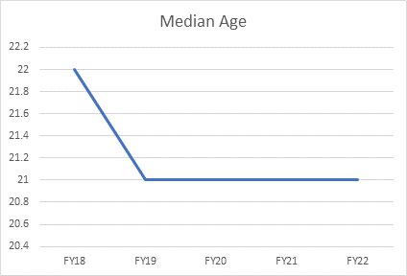

Slide 10
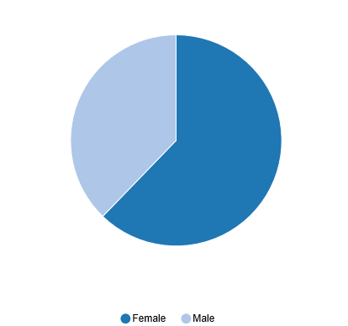
Current Student Demographics
FA22
30% male
70% female
Notes:
SP20
995 Males (38%)
1639 Female (62%)
Chart found in Argos
Path: Student.ICCB.Enrollment-Semester (E1).Dashboard
Charts tab
Select Fiscal Year/Session

Slide 11
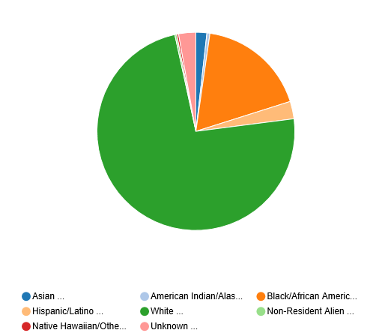
Current Student Demographics
FA22
Notes:
Chart found in Argos
Path: Student.ICCB.Enrollment-Semester (E1).Dashboard
Charts tab
Select Fiscal Year/Session

Slide 12
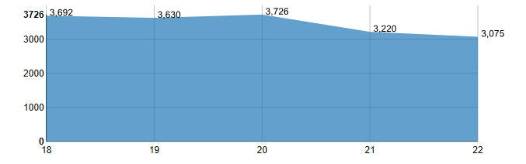

Slide 13
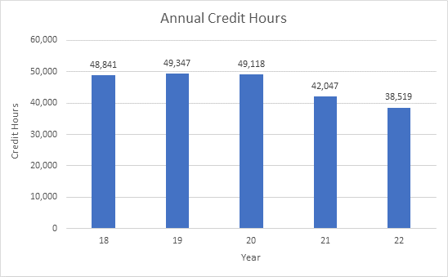

Slide 14
Fall 2022 Current Enrollment Summary
We budgeted/forecasted for -5% Decrease
26 days out for the start of the fall semester
Trending down -5.66%
28% Full Time 72% Part Time
53% or taking online courses
61% away from our goal!

Slide 15
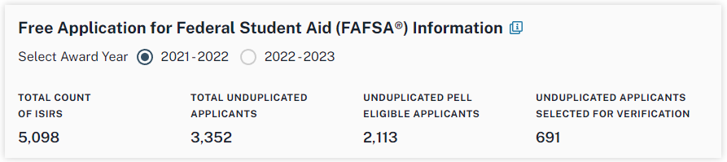
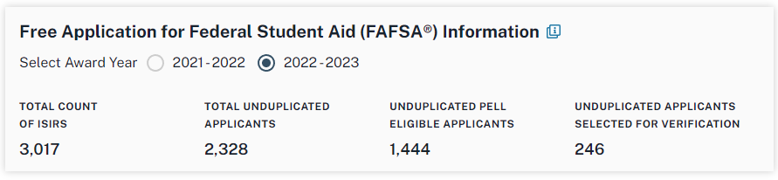
Student Wellness Services

Slide 16

Questions & Answers
Notes:
Traditional Students: Reach out to targeted high school juniors and seniors who are looking for an Associate’s degree, transfer opportunities, certificate or occupational programs.
Transfer: Target students who are interested in higher education savings for the first two years and who are interested in transfer opportunities.
Feeder high schools: Our enrollment coach we be focusing on forming relationships with DPS and the other 14 area high schools and guidance counselors.
Dual Credit and Dual Enrollment: Through our dual enrollment program, we would like to target rising juniors and also our senior populations to take college credit courses.
Veterans Affairs: Reach out to Veterans Affairs centers and military high schools to promote Associate’s degree, transfer opportunities, certificate and occupational programs
Community Members: work with clients in the community through community based agencies, government offices and agencies, and local businesses.

