Slide 1

Student Profile & Enrollment
Impact Report
Dr. Isaac Zuniga
Vice President of Student Success
Richland Community College (Dist. #537)
Notes:
AND, $500,000 appropriation to create a Grow our Own Pathway for education!!
Partners:
DPS 61
All CC District K-12 districts
University of Illinois Springfield
Millikin University

Slide 2
Most Illinois Community Colleges are Experiencing
Slow and low enrollment trends
Institutions are re-evaluating (remote policies, teaching modalities, program offerings)
Having difficulty identifying and retaining Talent Acquisition

Slide 3
More Community College State Trends
The pandemic aftermath continues to take a toll on most community college enrollment across the country (especially for small rural CC)
Rural counties generally have higher proportions of working age populations with some college, but no degree
College enrollment has dropped 34% for African American students in Illinois

Slide 4
Current Student Demographics

Slide 5
Current Student Demographics

Slide 6
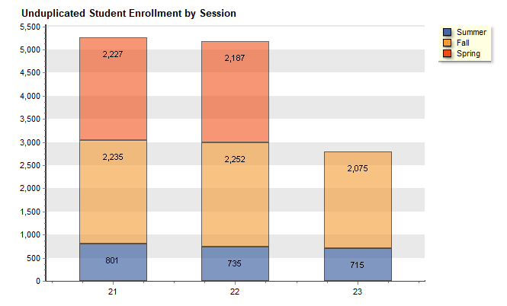
Student Enrollment by Session

Slide 7
Richland Total Headcount
FY 20-21 5,263
FY 21-22 5,174
FY 22-23 2,790

Slide 8
Good News!
Currently 62 days out for the start of the spring 2023 semester
Trending up + 17.83%
Trending up in new and returning students
Current headcount is at 1077 vs 914 same time last year
Current credit hours is at 8,812 vs 7,847 same time last year
Notes:
Very Busy Slide
Potential collaboration with Millikin

Slide 9
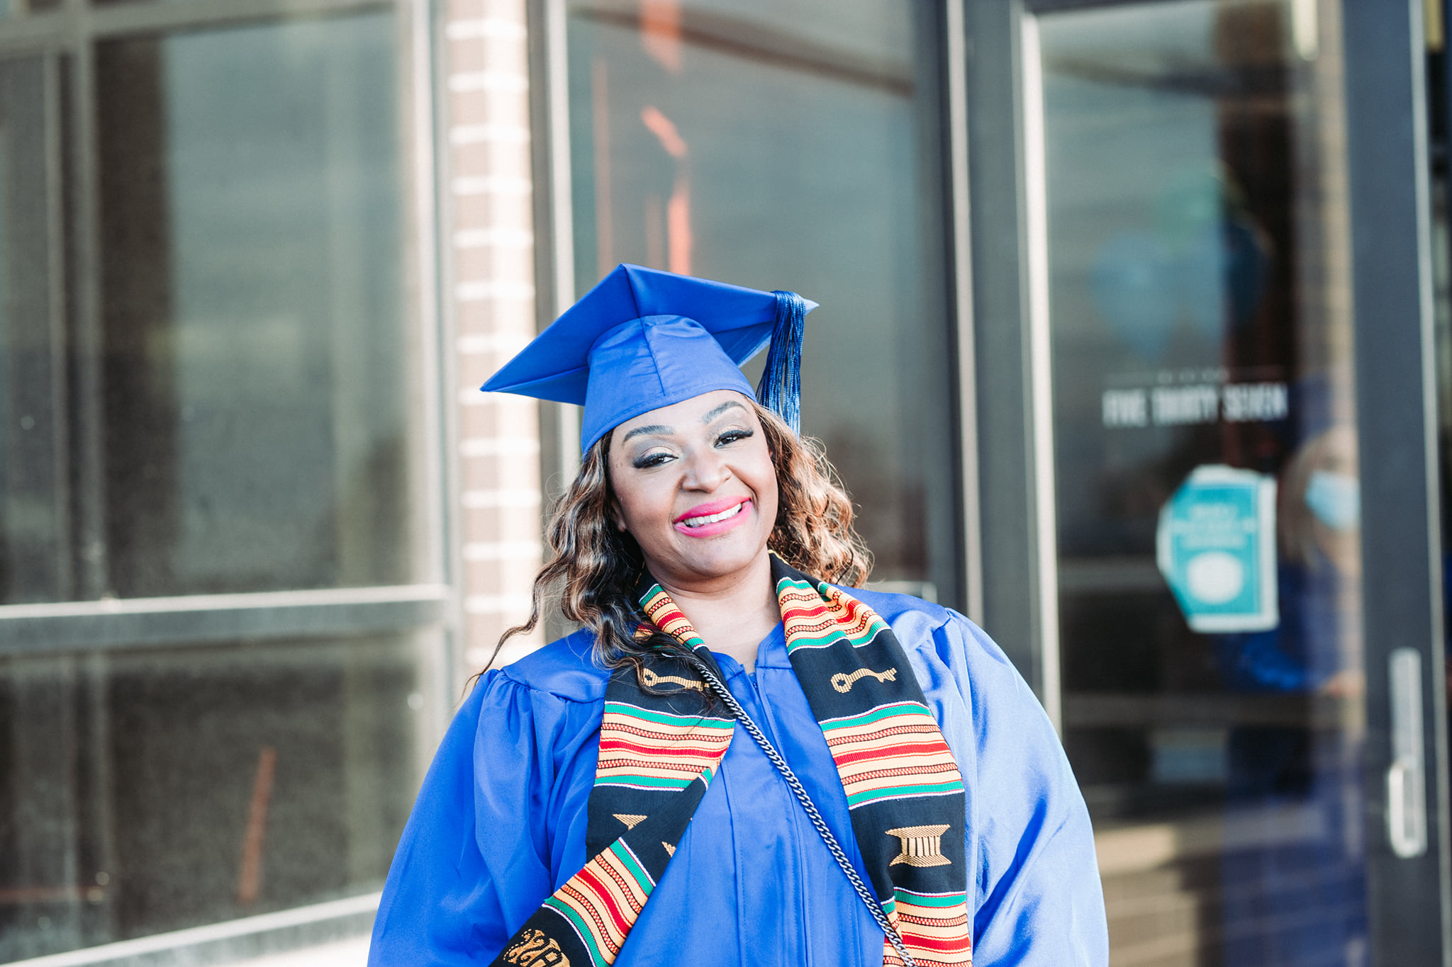

Student Types
Notes:
Percentage of faculty and Staff up by 25% as well but still lagging behind the student population at 15%

Slide 10
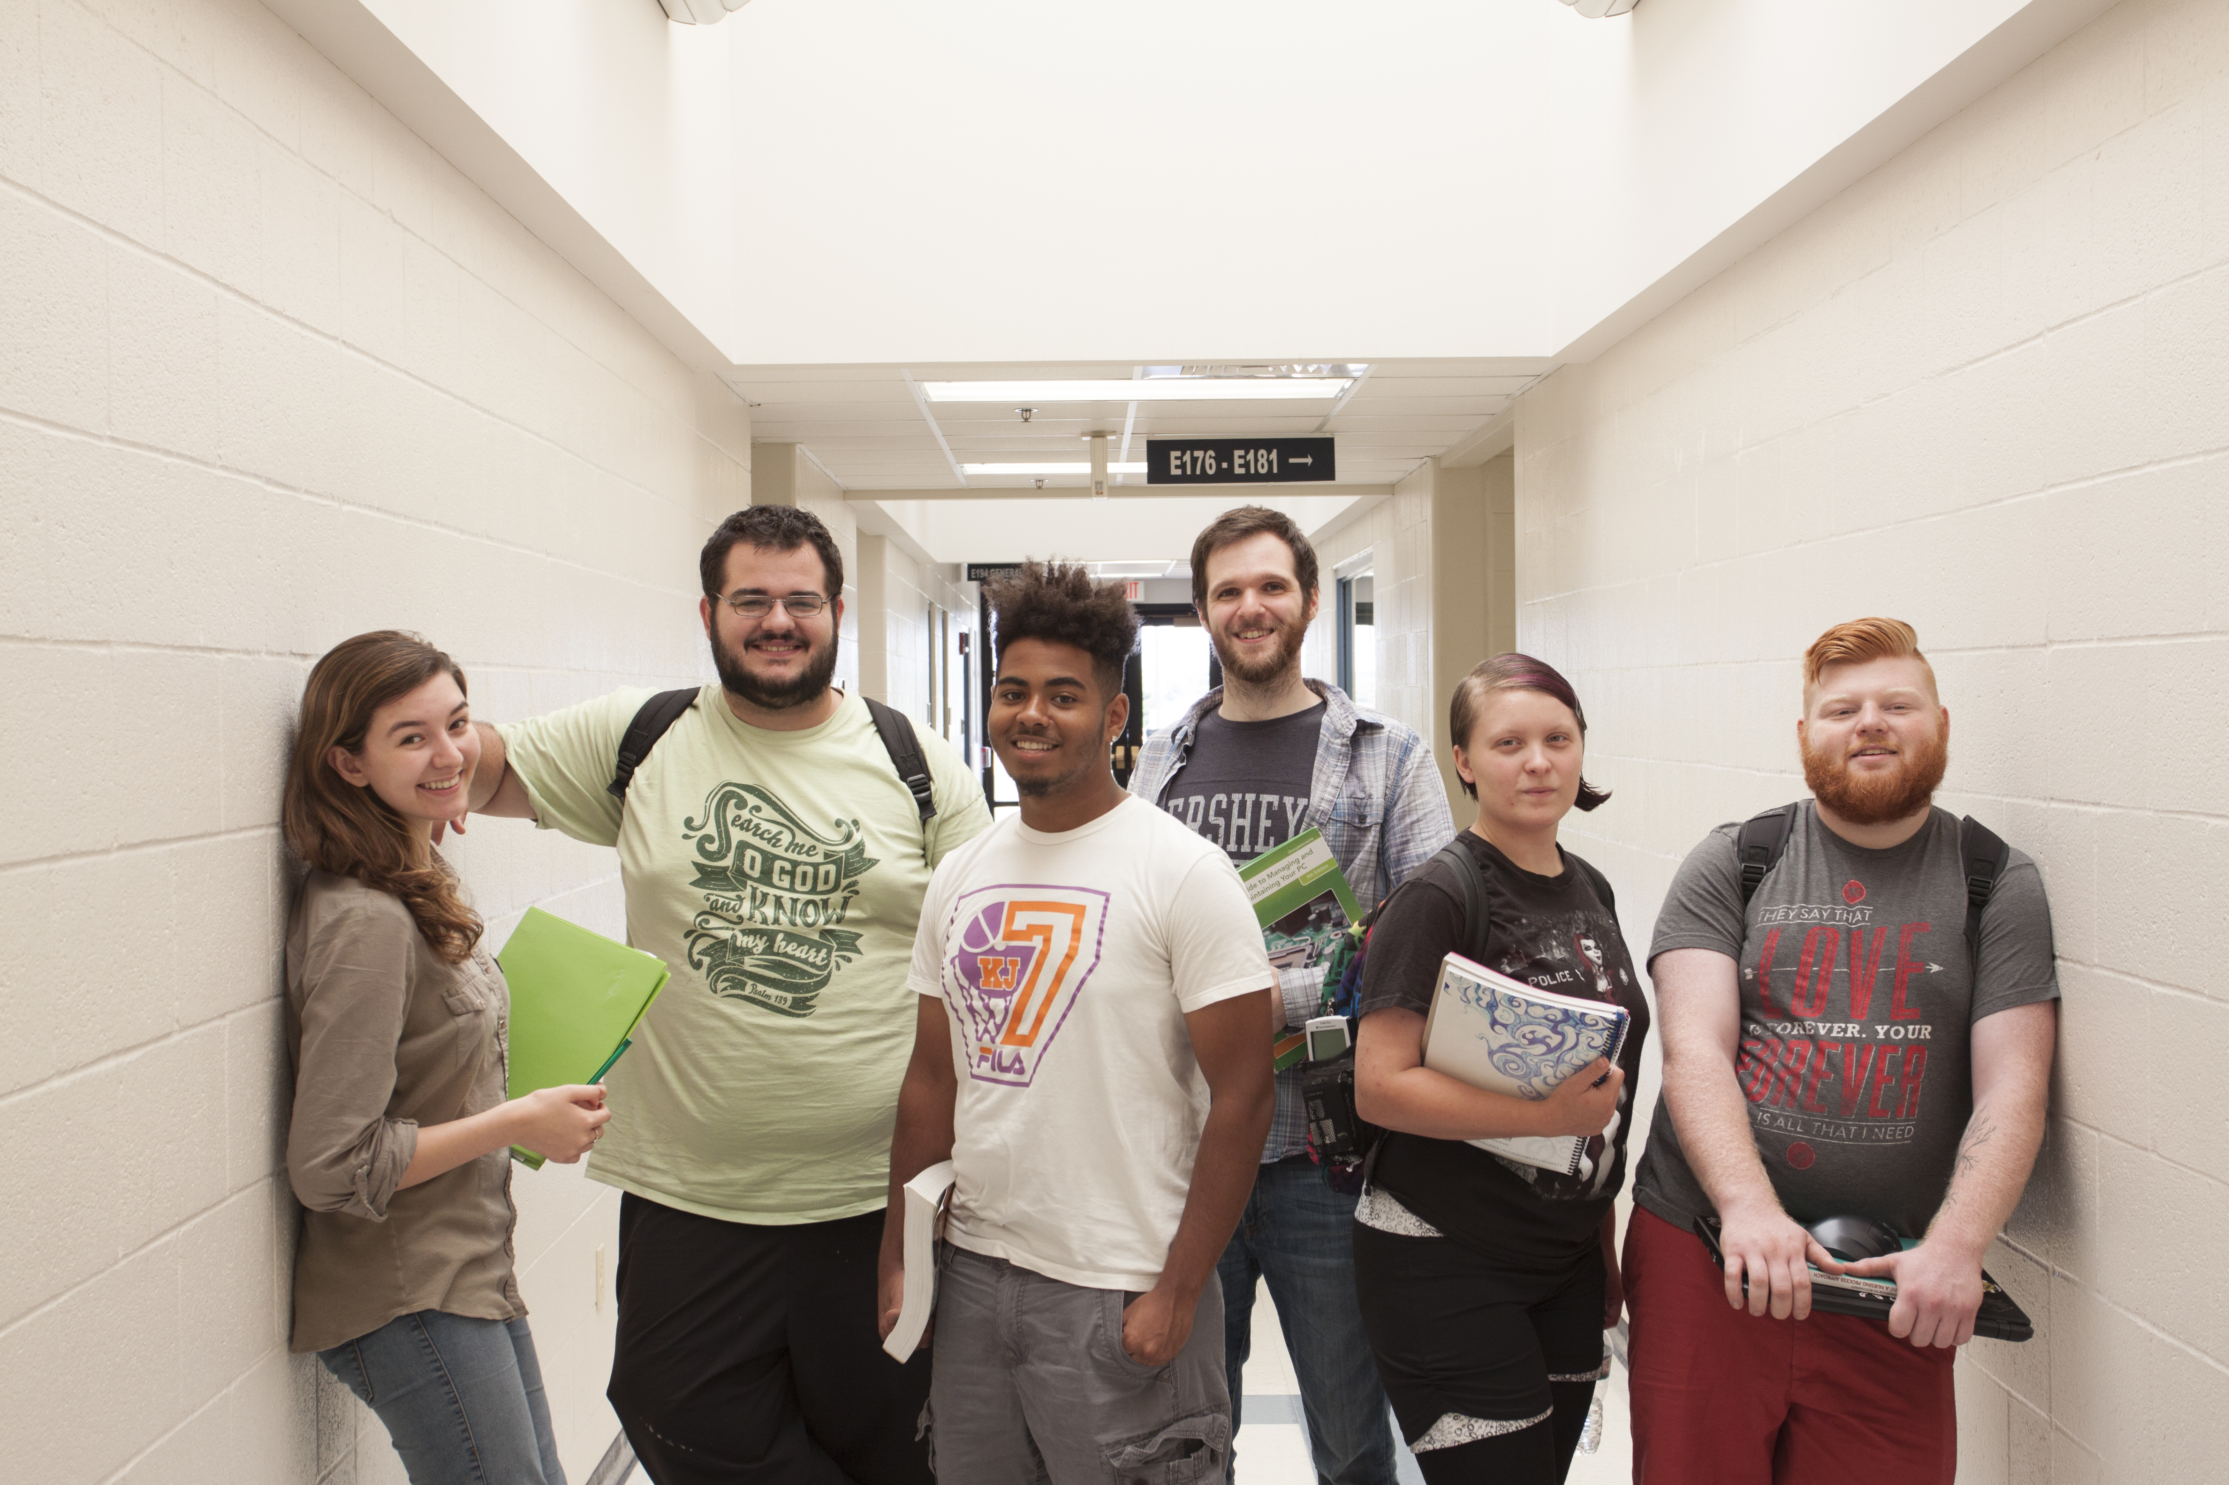
Racial and Ethnic Breakdowns

Slide 11
Richland’s Impact Outside of
Credit Hours & Headcount

Slide 12

Impact
EnRich Programs since 2020 has served slightly move than 1,500 participants
Manufacturing
Construction
CDL
Education
Healthcare
Entrepreneurship

Slide 13
Impact
The Macon County Law Enforcement Training Center (MCLETC ) operated by Richland Community College has served.
Basic Law Enforcement
FY2020-FY2022: 702 Graduates Basic Correction Officer FY2018-FY2022: 378 Graduates

Slide 14
Impact
Our non-credit programs in CPR & Emergency Response, OSHA Safety, Traffic Safety Programs since fall 2019 has served 2,254 students and community members
Our Adult Education since fall 2019 has served 408 students and community members
Our ESL Programs has served 129 students and community members
Project Read Plus program since fall 2019 has served 510 students and community members

Slide 15
Richland Impact Outside of
Credit Hours & Headcount
EnRich Programs 1,500
MCLETC 1,080
Non-credit Programs 2,254
Adult Education 408
ESL Programs 129
Project Read Plus 510

Slide 16
Richland Impact Outside of
Credit Hours & Headcount
5,881

Slide 17
Richland Total Impact
Headcount 13,227
Non-Credit 5,881
Total 19,108

Slide 18
