Slide 1

Community Partnerships
Workforce Development
Monitoring Report
CY ’21

Slide 2

2020 Data
CPR-71 students
OSHA-133 students
Technical Training-66 students
CDL-36 students
Highway Construction-5 completers
Industrial Job Skills-13 completers
Open Enrollment NC- 474 registrations
Facility Rental Headcount- 3,478 people
Traffic Safety-307 individuals
2021 Data
CPR- 245 students
OSHA- 230 students
Technical Training- 92 students
CDL-88 students
Highway Construction-1 completer (didn’t renew grant after June 30)
Industrial Job Skills-8 completers
Open Enrollment NC- 554 registrations
Facility Rental Headcount- 2,726 people
Traffic Safety- 282 individuals
Notes:
Shilling Events
January 2021 – December 2021
TOTAL – 2726
ADM- January thru April came for new hire orientation (large room)
Caterpillar- July thru Oct for new hire orientation (large room)
March – April, 2021
NSEC- was the site for Macon County Health Dept for COVID vaccine
August – December 2021
NSEC – RCC Nursing had for classrooms (Exhibit Hall & classrooms) (construction)
April 2021 – TO DATE
CSI- not rentable- EnRIch Program used for offices

Slide 3



Industrial Job Skills Training
Two previous cohorts for Crossings
3rd cohort started on 1/17/22
Eight have completed with 100% starting jobs in manufacturing

Slide 4
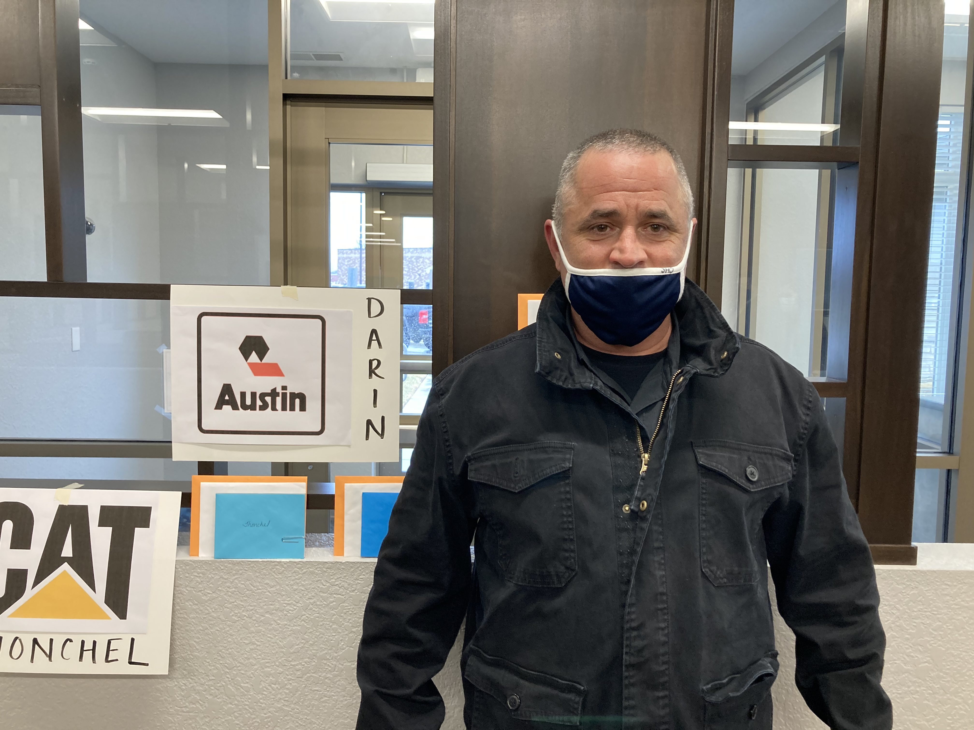
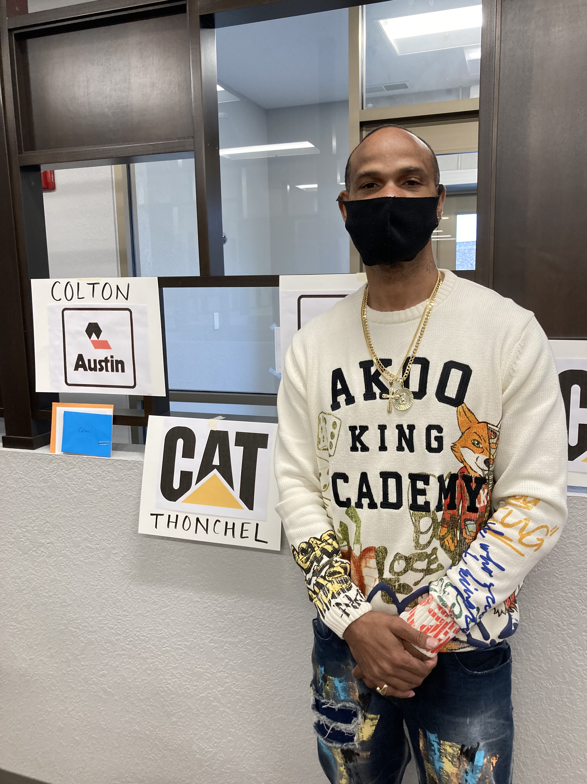
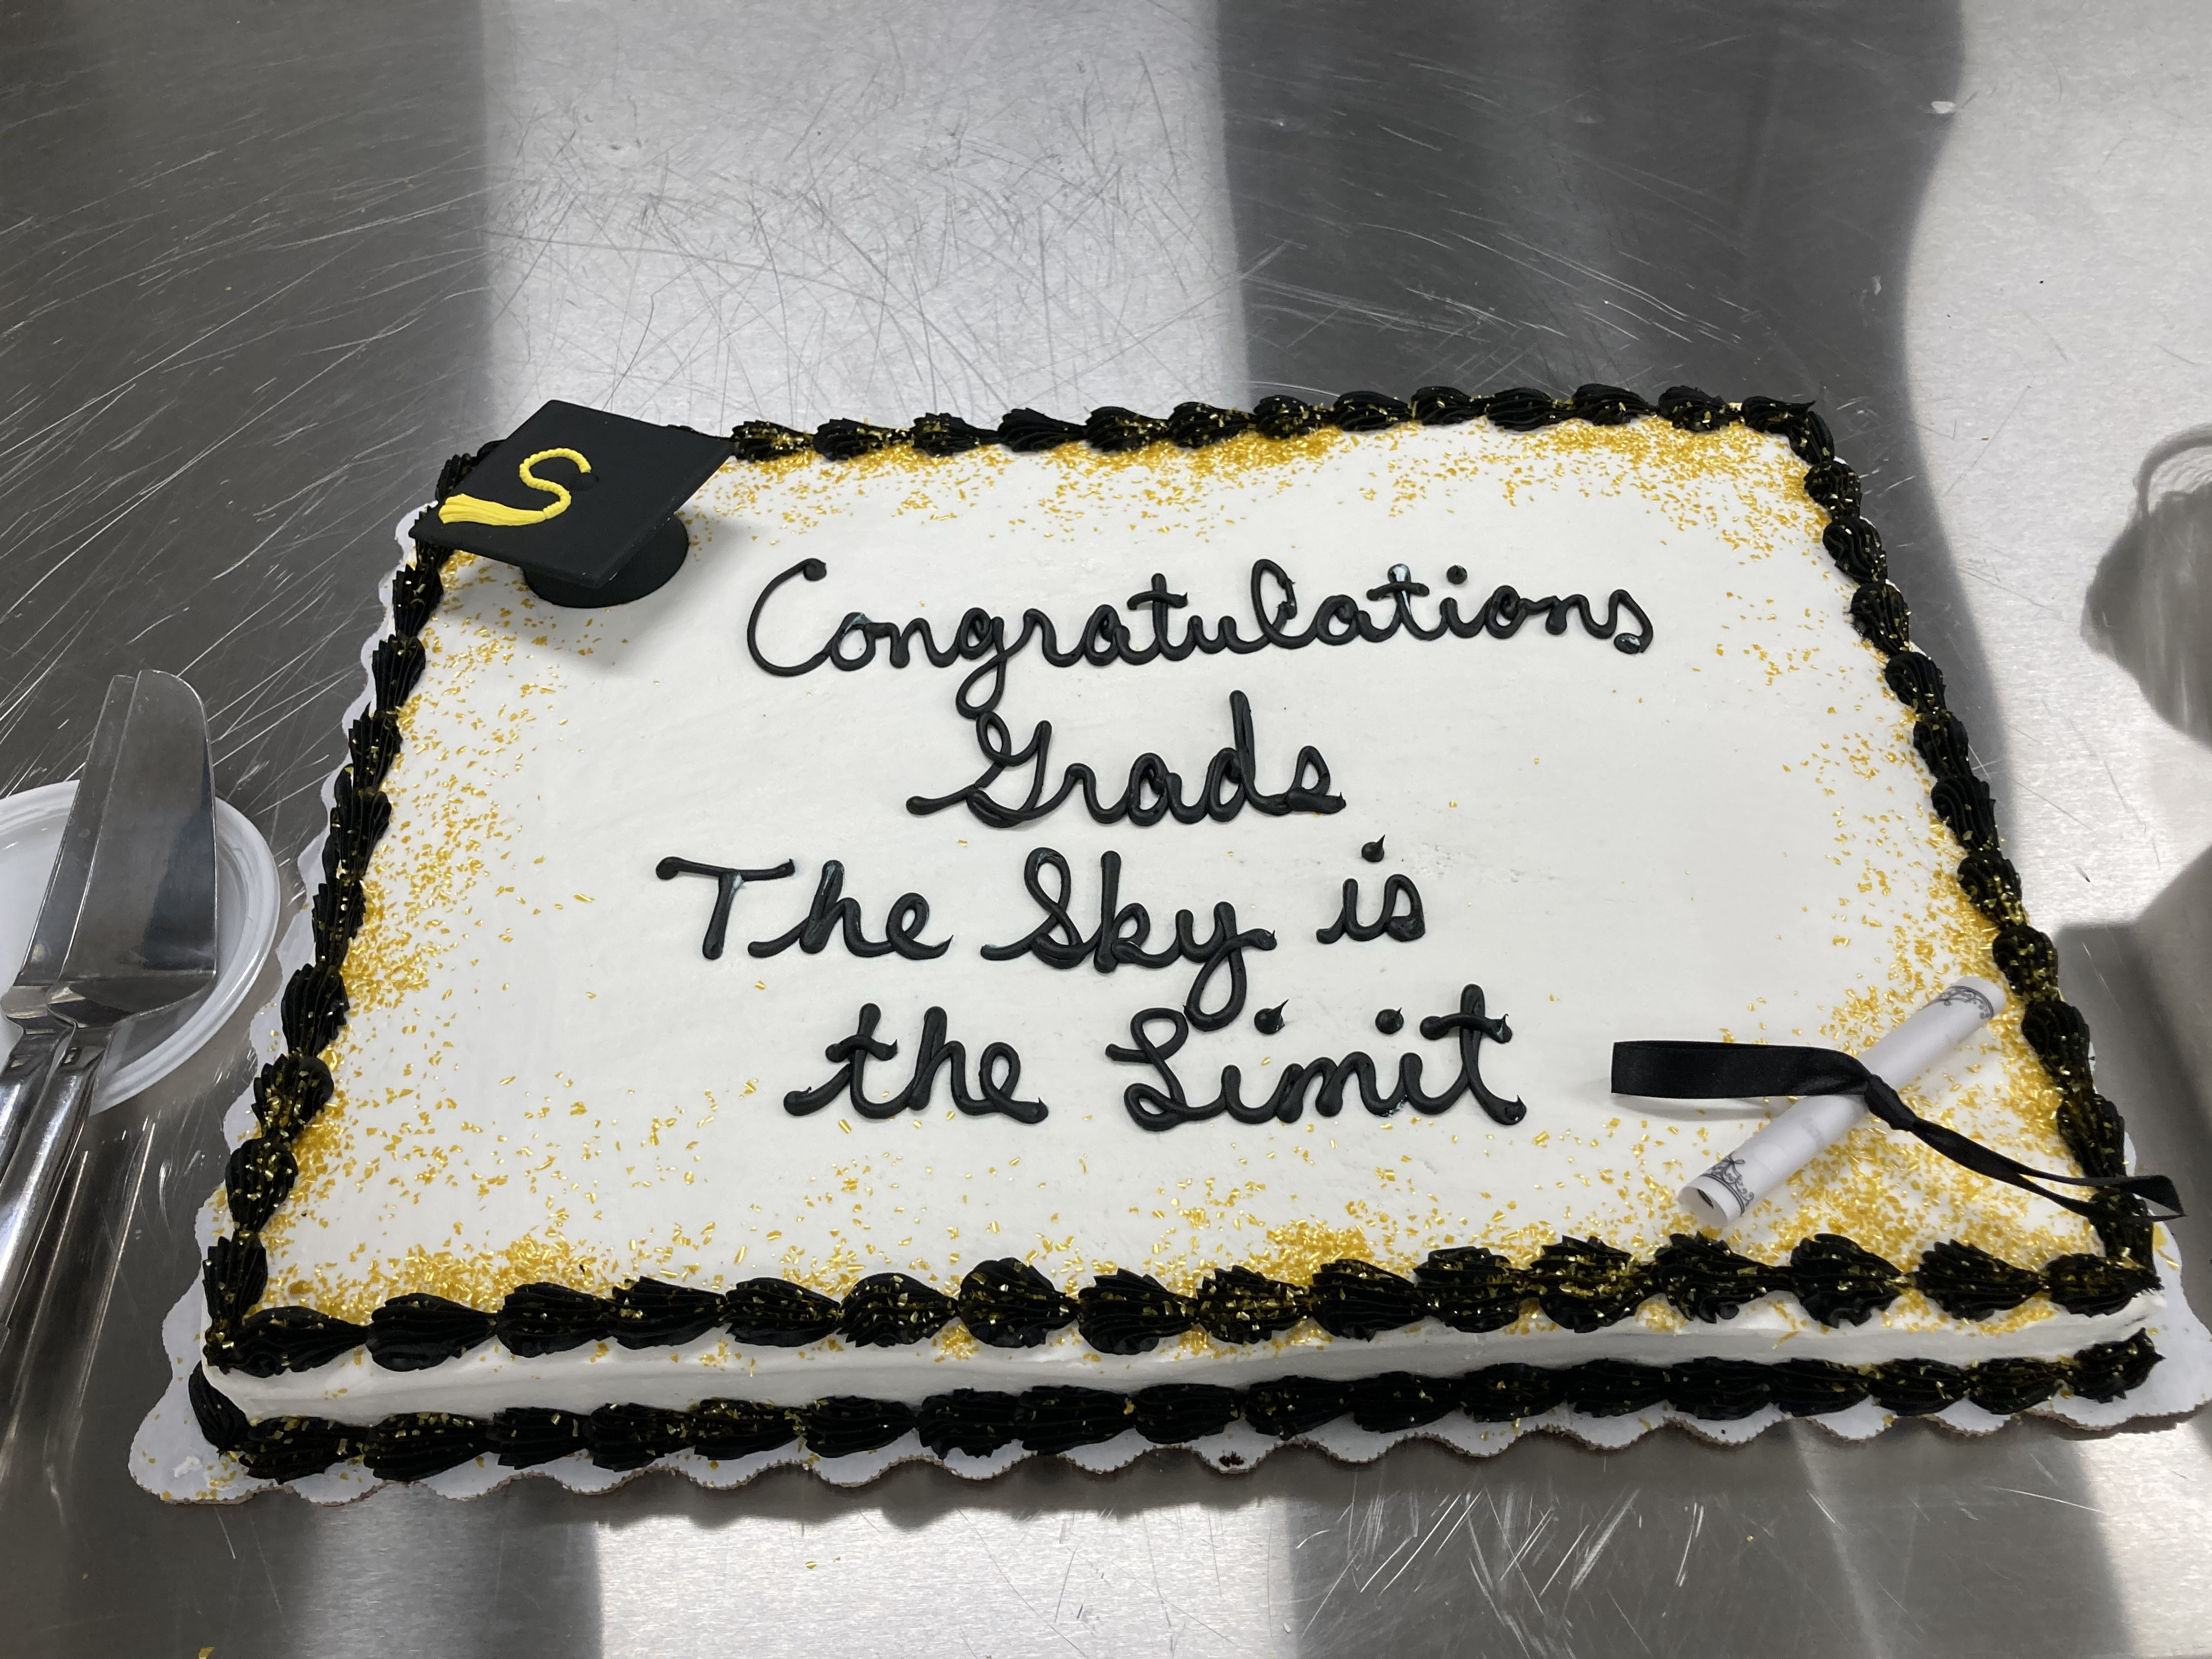
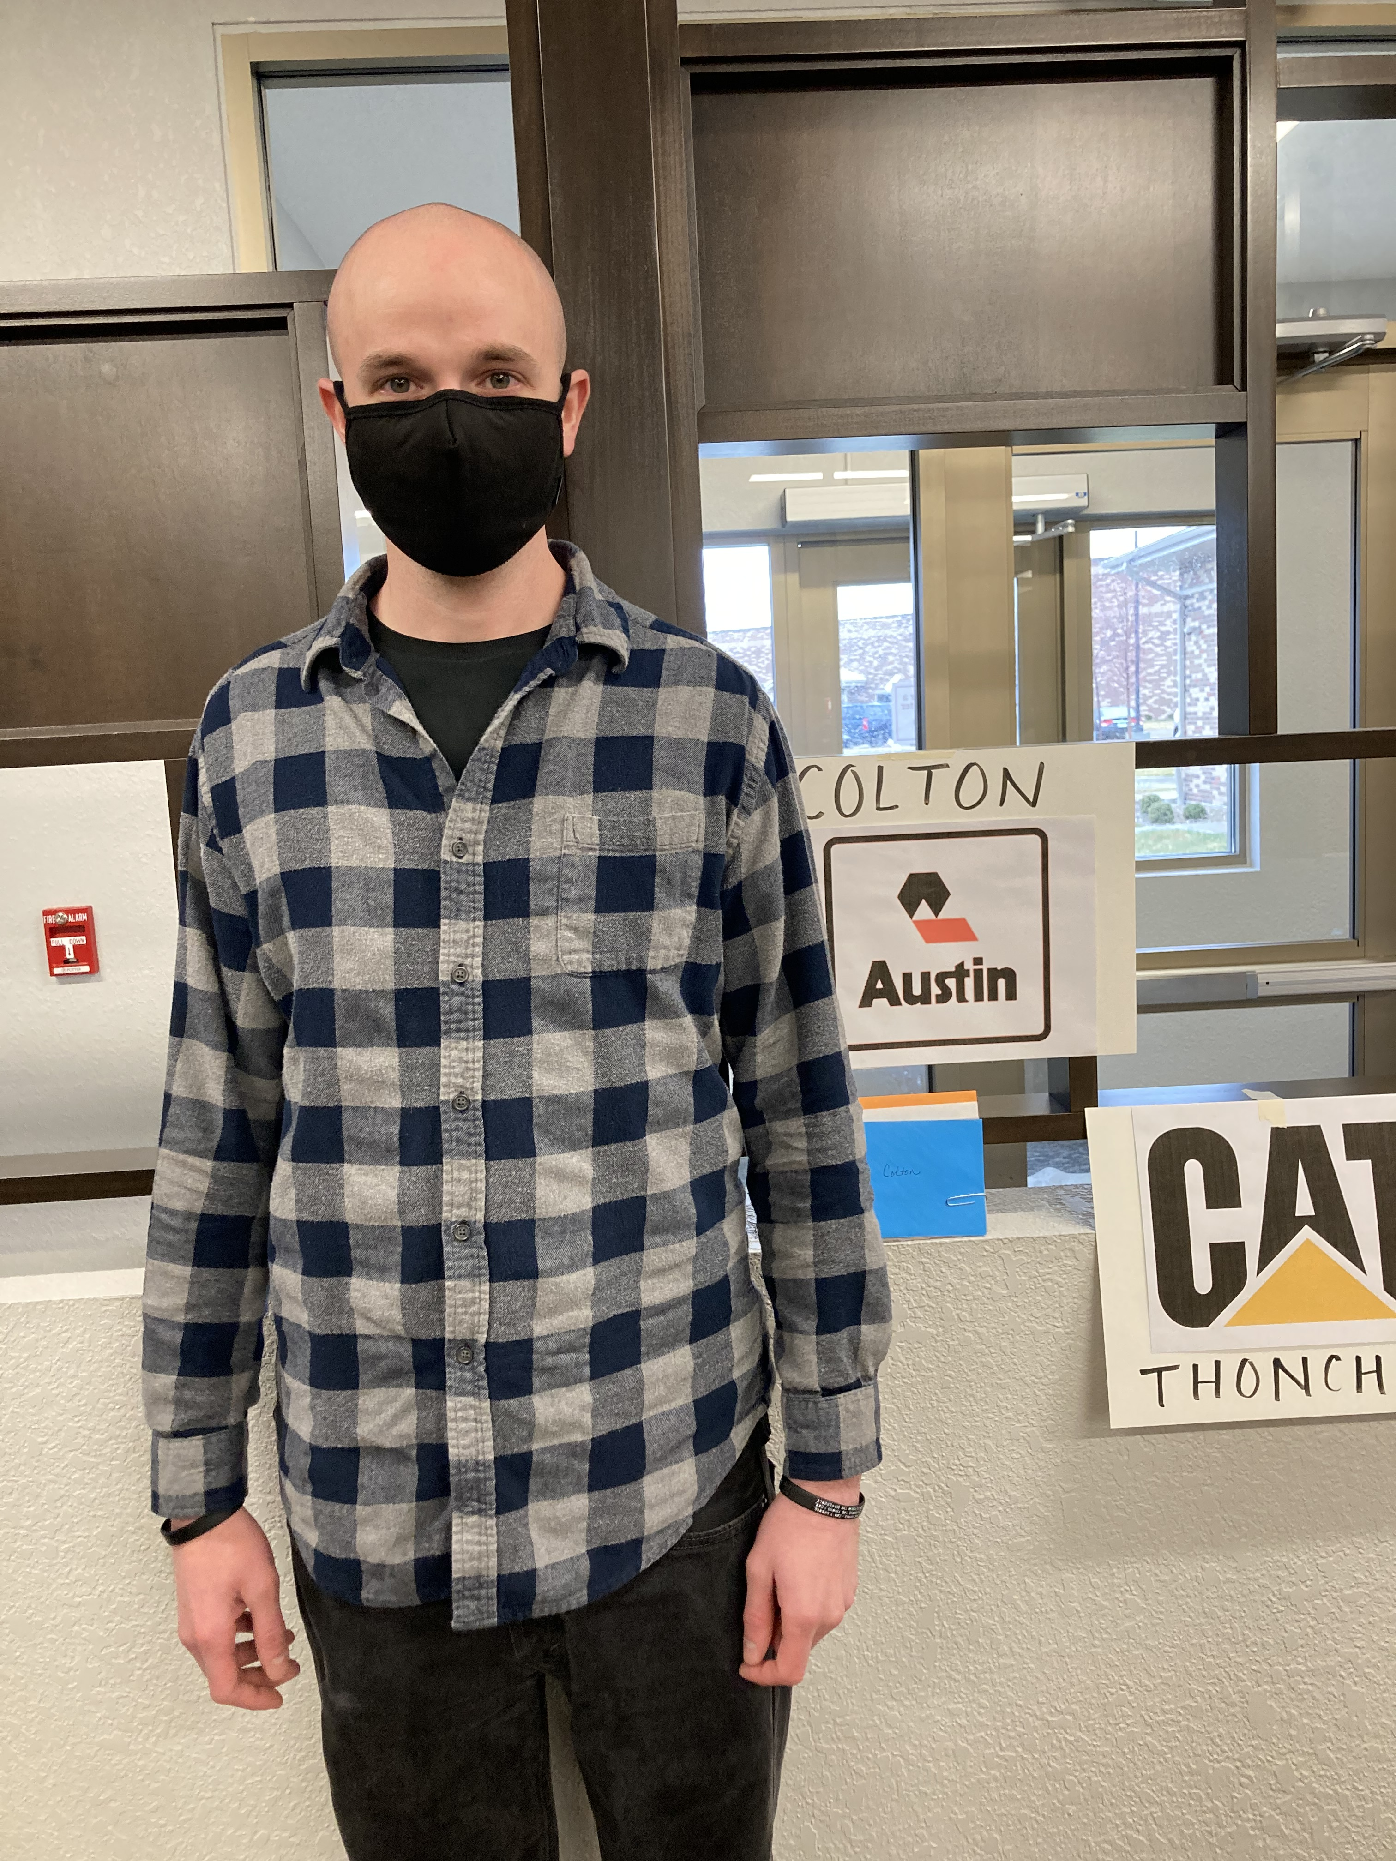
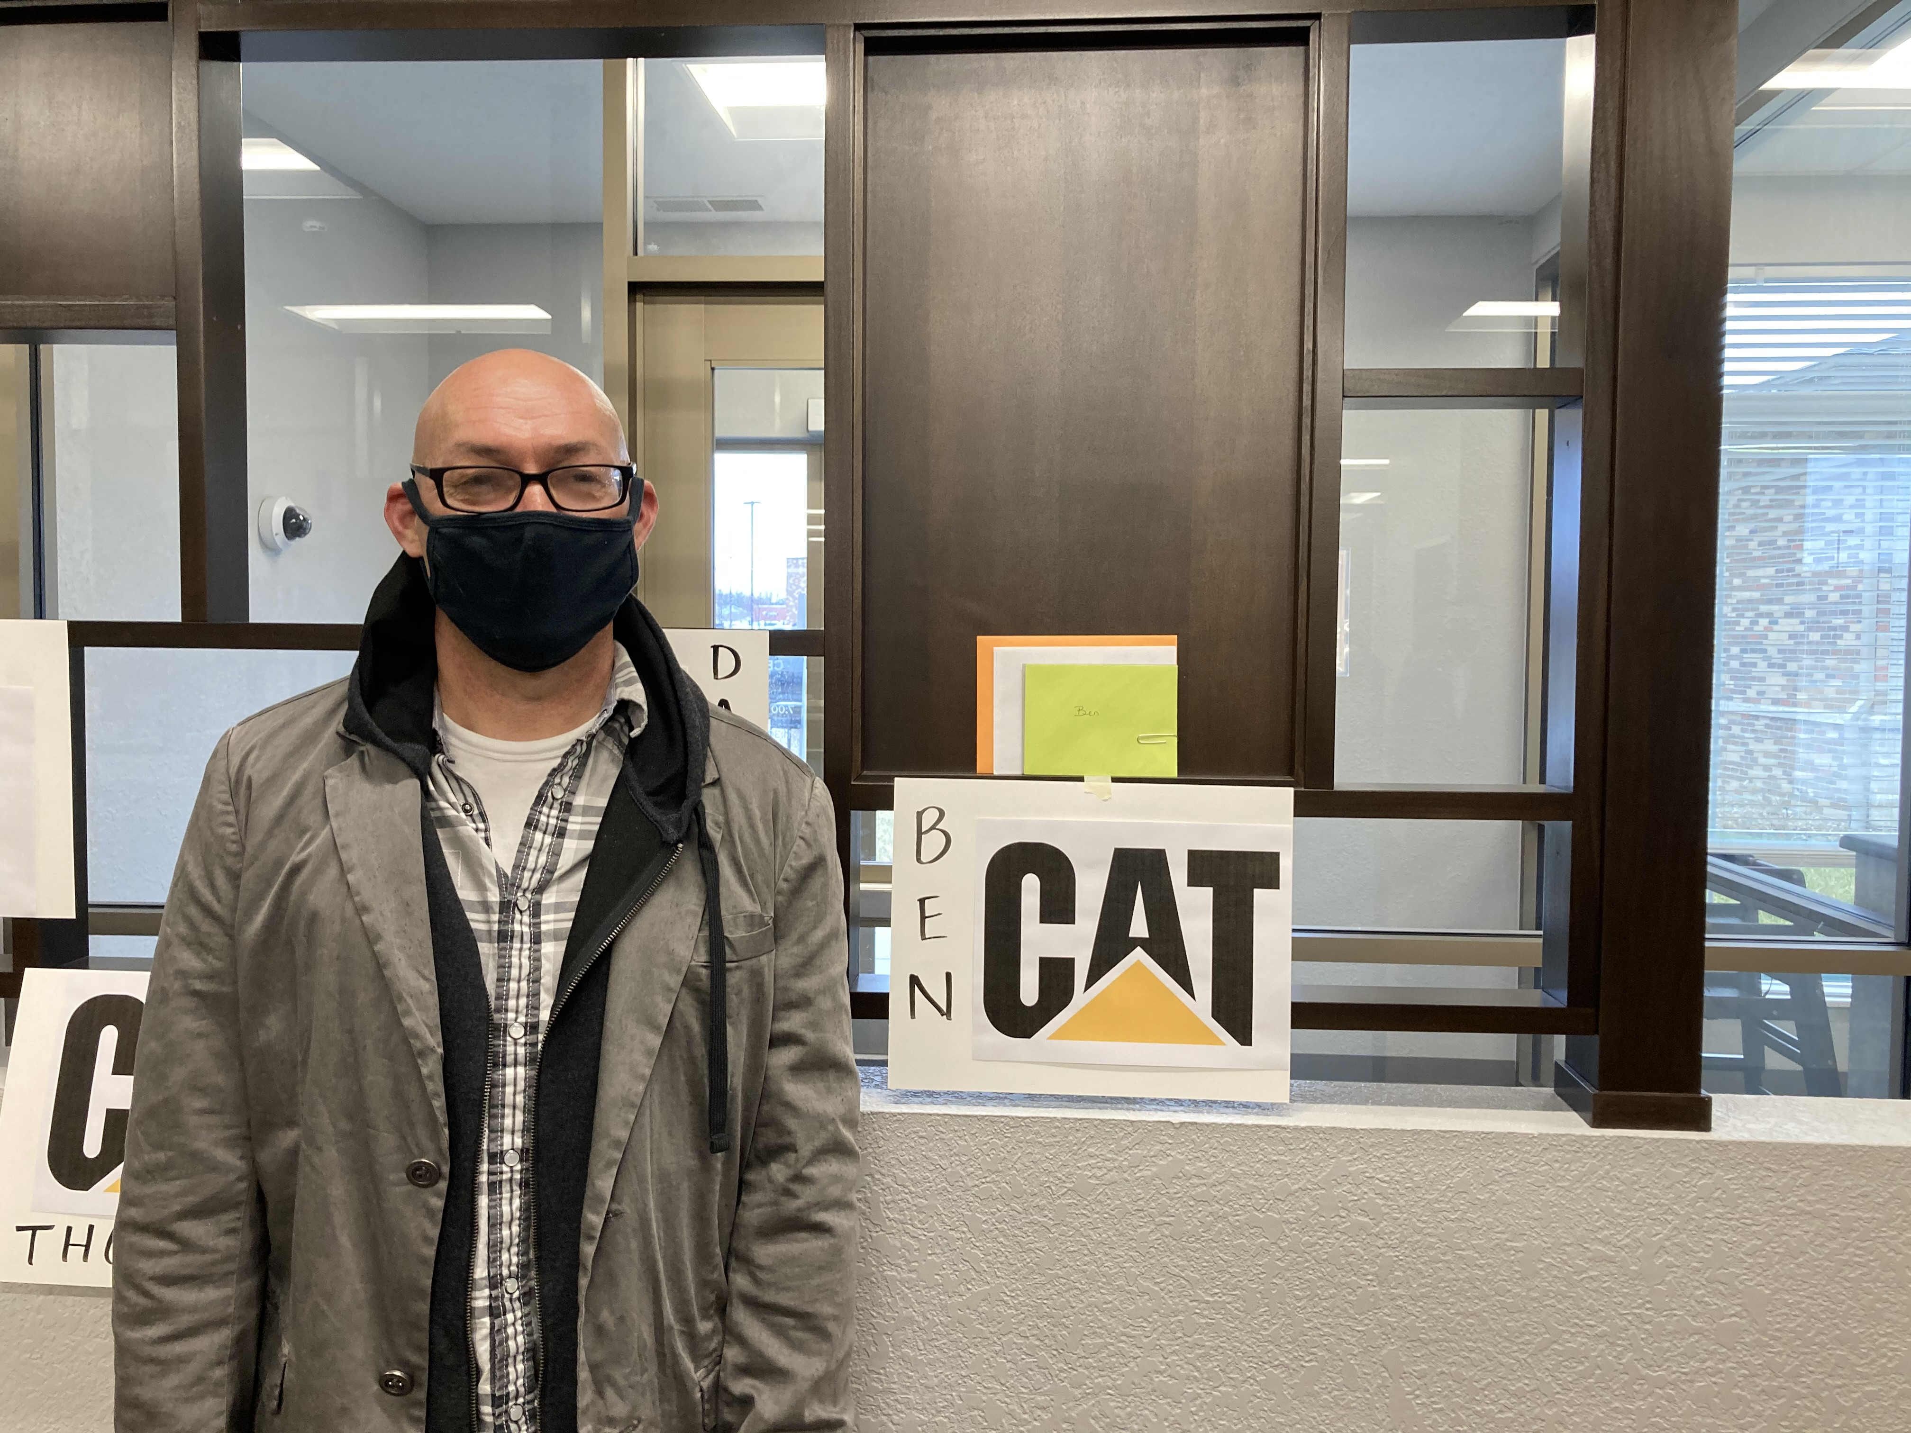

Slide 5

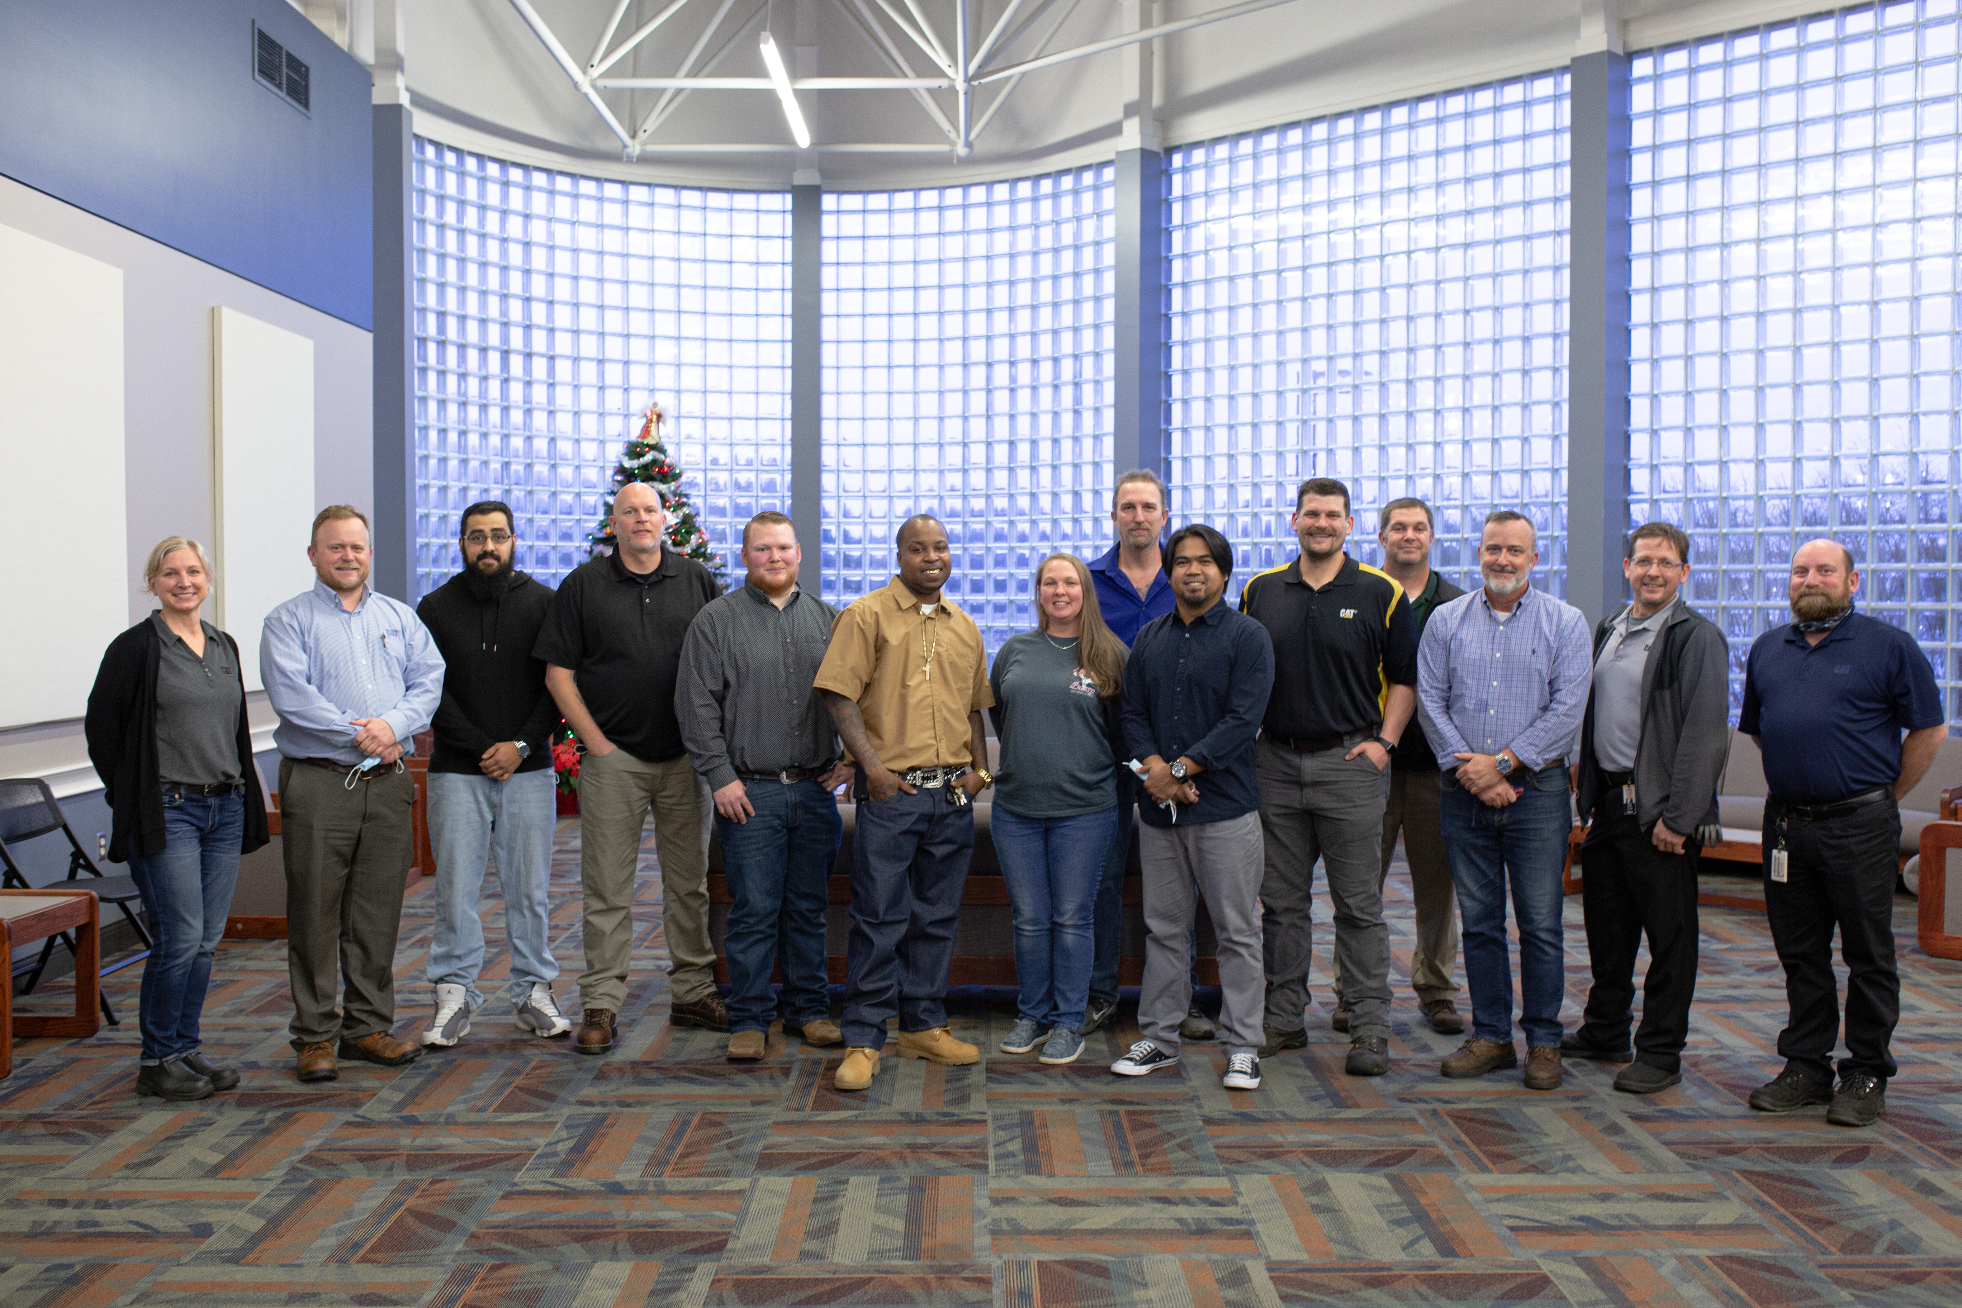

Caterpillar CNC Cohort
  Three year “apprenticeship” for AAS in CNC Technology
  Summer of 2018 completed MATH 091
  August 2, 2018 began college level courses
  Eight completed the training
  Pictured here from grad reception

Slide 6
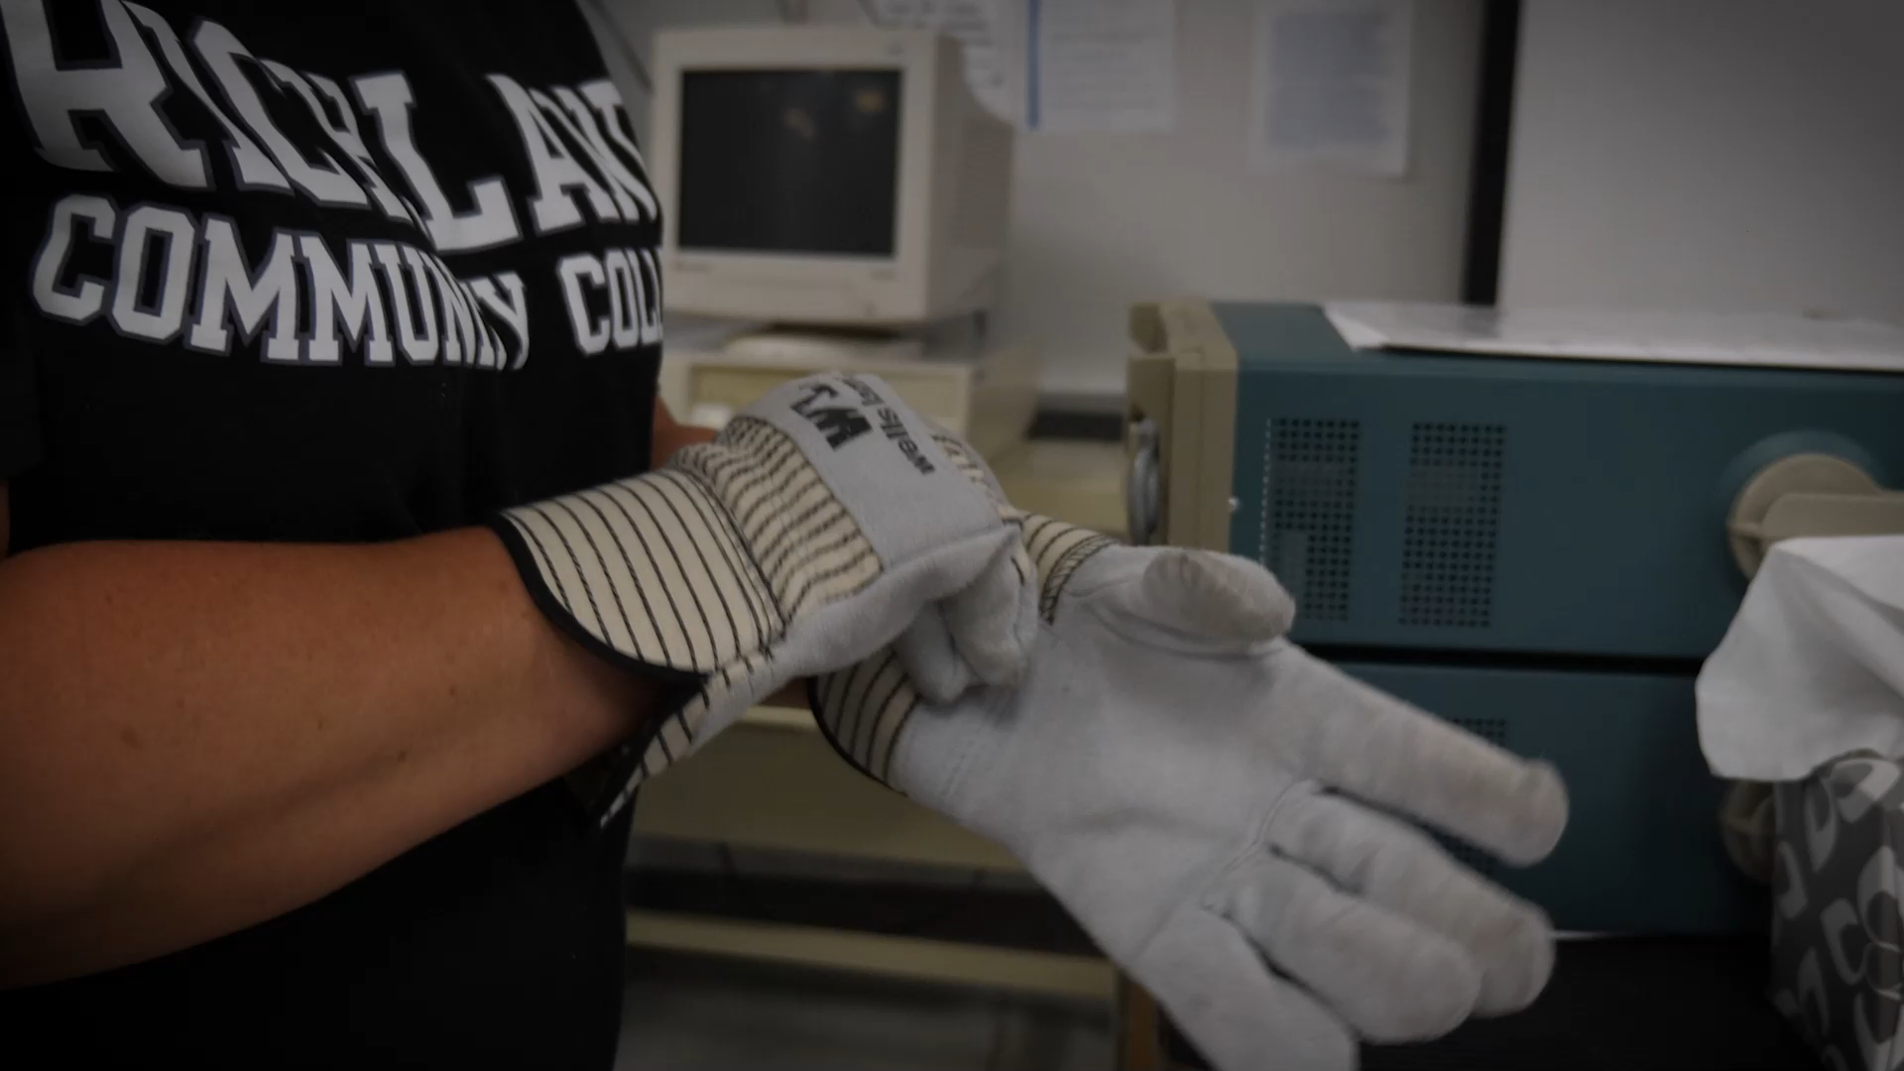

Slide 7


Carbon Capturing and Sequestration
  November 9th, Wolf Carbon Solutions, Inc. partnered with Richland to hold a CCS Community Education Session at NSEC.
  Wolf plans to develop the largest CO2 geologic storage project in the world.
  Richland’s role would include CCS education and public outreach.
  Dr. David Larrick participated in the event
  https://herald-review.com/business/local/adm-announces-effort-to-bury-co2-from-iowa-plants-in-decatur/article_502301ee-78d6-587b-92fc-bfc4a47bff96.html
Notes:
ADM announces effort to bury CO2 from Iowa plants in Decatur
Mateusz Janik
Jan 11, 2022
DECATUR — A more than 300-mile-long pipeline could be used to transport carbon dioxide from two Archer Daniels Midland Co. plants in Iowa to its sequestration site in Decatur, company officials said Tuesday.
ADM announced the plan in a news release about its having signed a letter of intent with Wolf Carbon Solutions, the company that would develop, own and operate the pipeline.
Officials said the 350-mile steel pipeline will be capable of transporting 12 million tons of carbon dioxide and offer dedicated capacity to transport carbon dioxide from ethanol and cogeneration facilities in Clinton and Cedar Rapids, Iowa.
There is also room to serve other third-party customers looking to decarbonize across the Midwest and Ohio River Valley.
"ADM is continuing to lead the way to decarbonize the industries in which we operate,” said Chris Cuddy, president of carbohydrate solutions at ADM. "These efforts are core to our purpose, our culture and our growth, and we look forward to working with Wolf Carbon Solutions to finalize this agreement and further decarbonize our operations and our industry.”
The carbon will be stored in an underground sequestration site — which is a process of injecting captured carbon dioxide into deep subsurface rock formations for long-term storage — in Decatur where ADM has already been burying emissions for more than a decade.
The site has stored around 3.5 million metric tons of carbon dioxide to date and is already making way for more decarbonization with ADM's announcement last year of a zero-emissions power plant adjacent to the company’s Decatur corn complex as well as its achievement of the wheat milling industry’s first carbon-neutral footprint.
ADM has an extensive presence in Decatur which serves as the company's North American headquarters.

Slide 8

ADM Process Technician Program

Slide 9
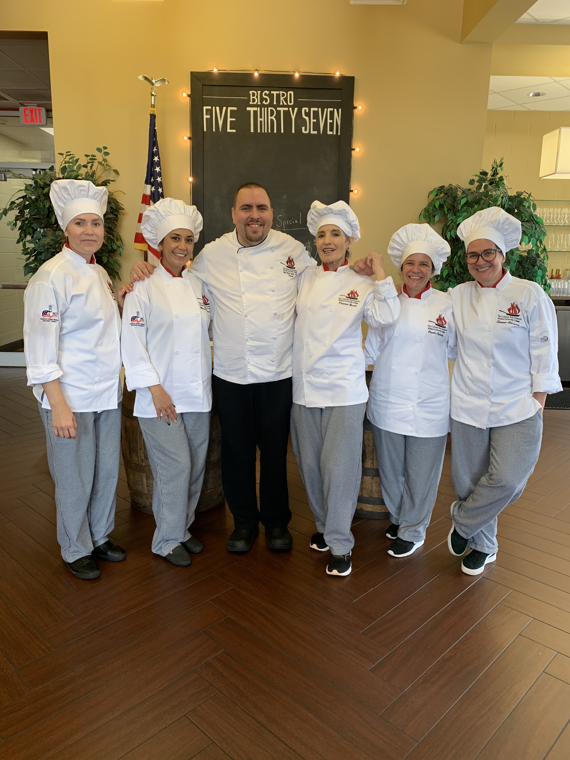
Culinary and Agriculture Partnerships
Farmer’s Market and Bistro Collaboration.
Decatur Leadership Institute utilizes The Culinary Arts Institute for their kick off meeting by having a team building cooking competition in our kitchens.
Adult Education Hospitality Bridge for ESL students over summer ‘21.
RCC Ag staff work closely with ag programs and FFA chapters in the district to host and judge events.

Slide 10

Thank you!

