Slide 1


Slide 2


Slide 3
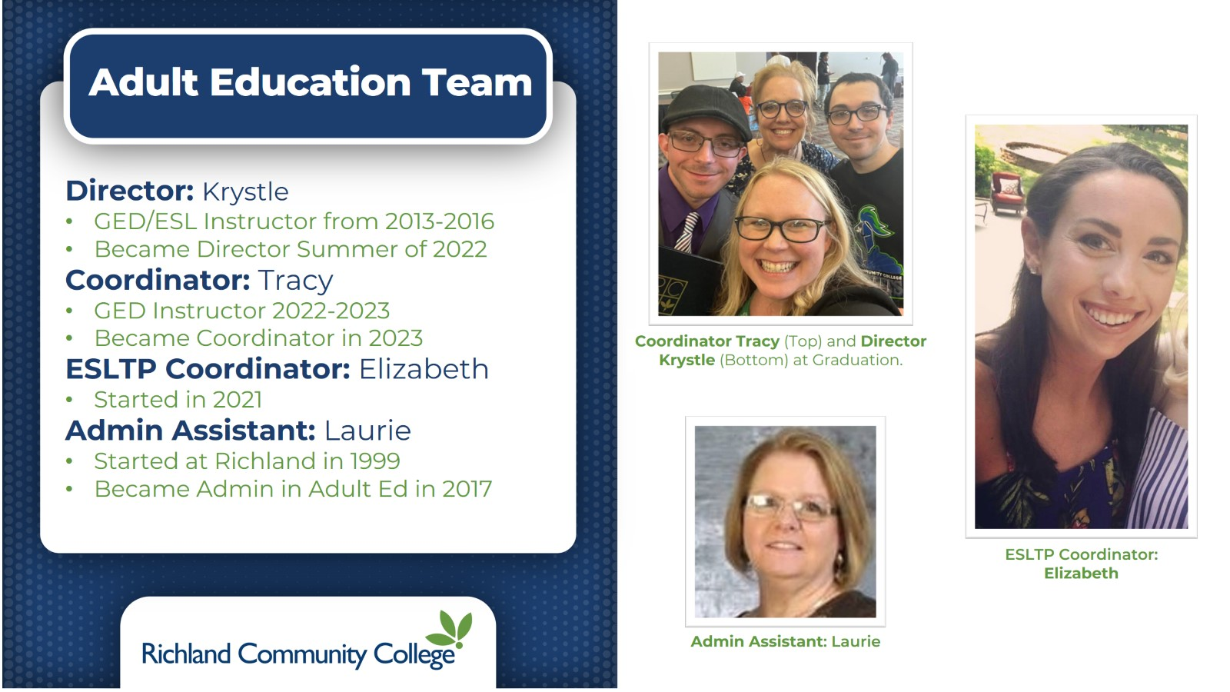

Slide 4
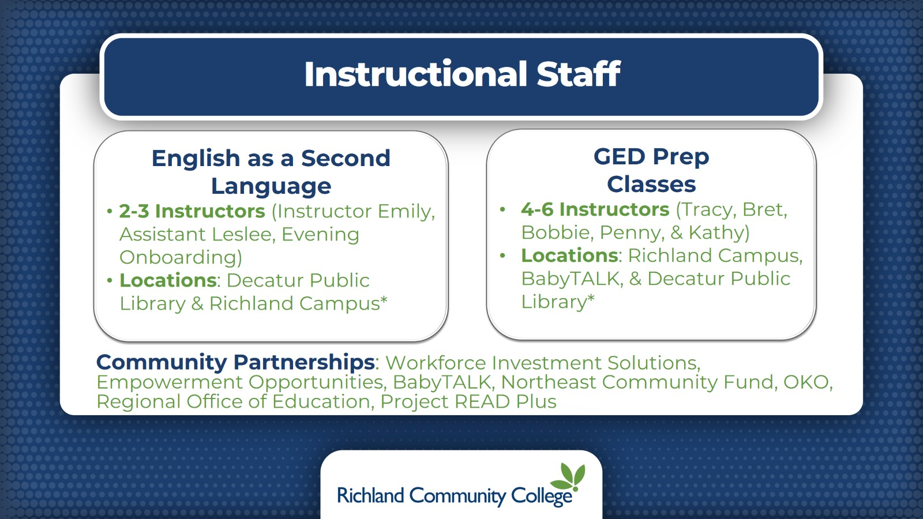
Instructional Staff

Slide 5
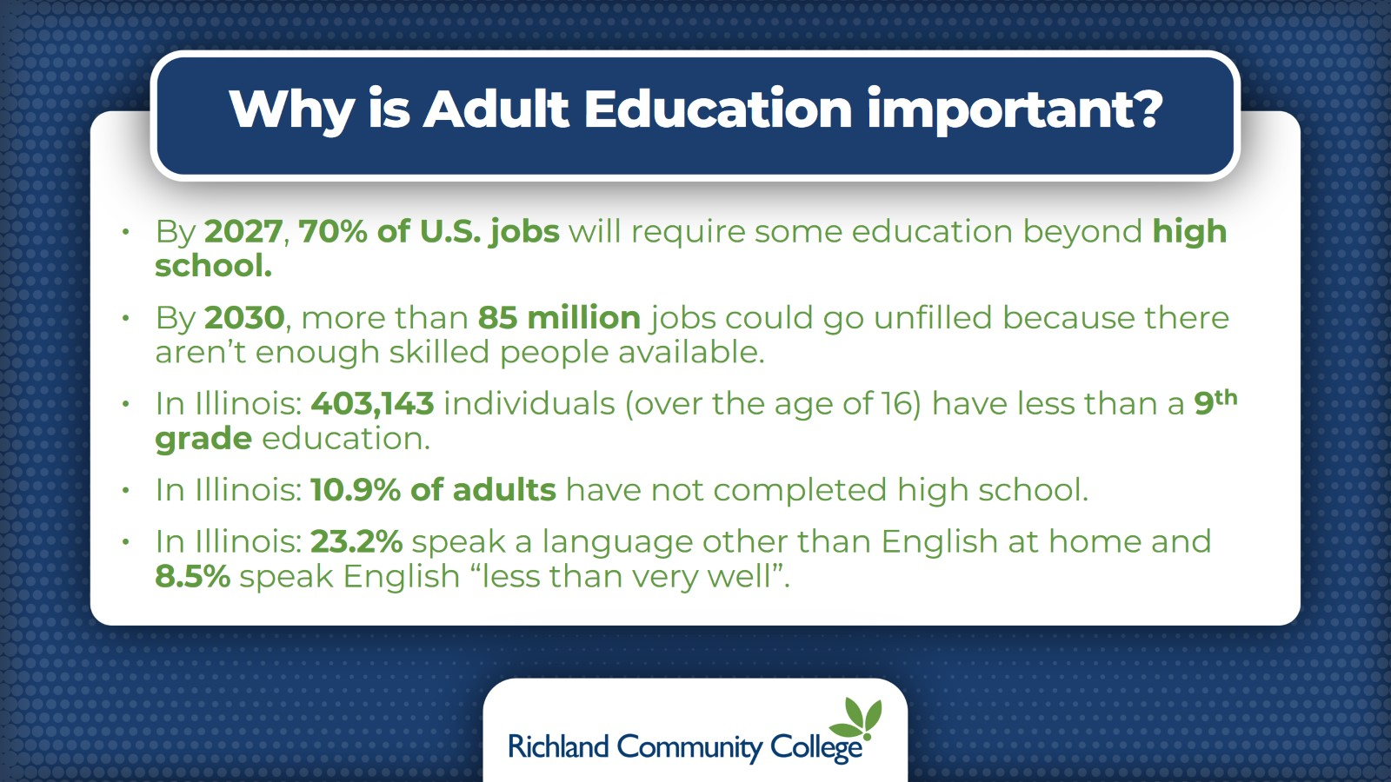
Why is Adult Education important?

Slide 6
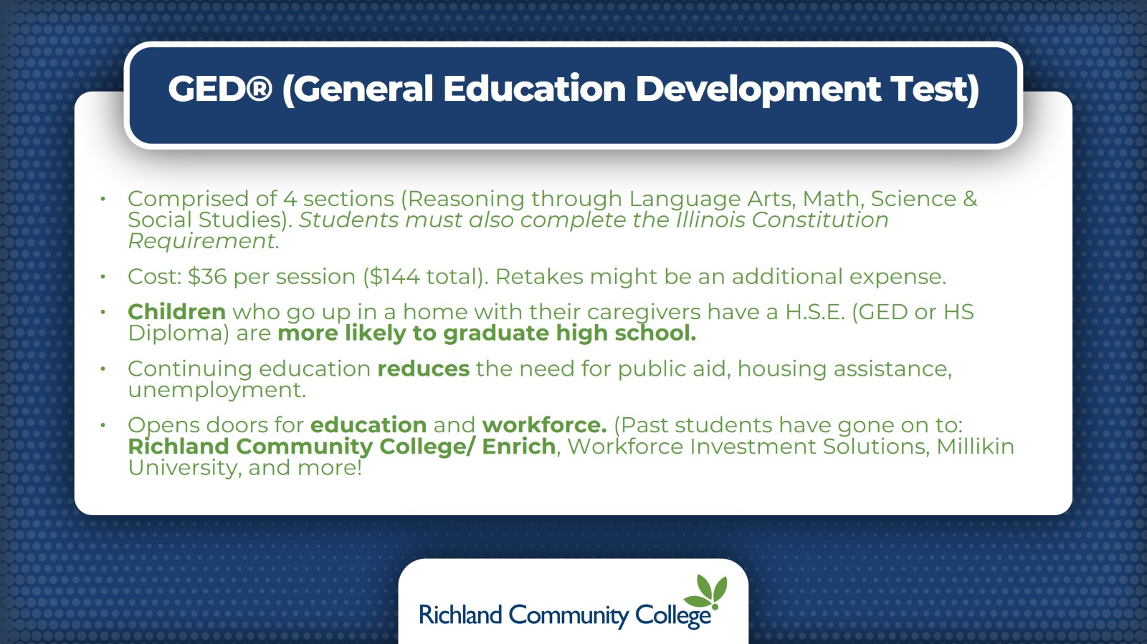
GED® (General Education Development Test)

Slide 7
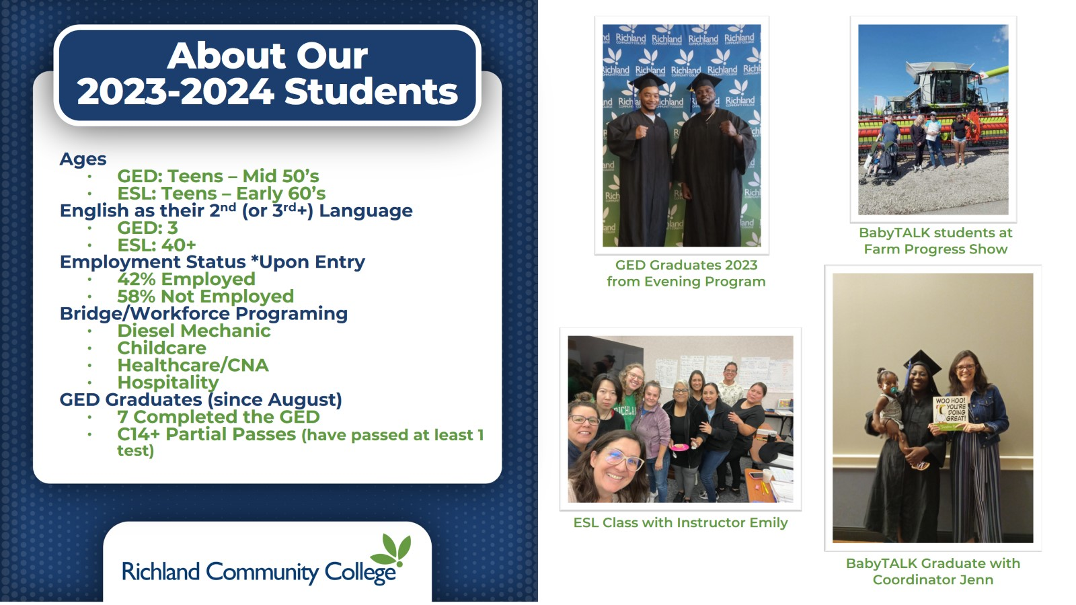

Slide 8


Slide 9


Slide 10
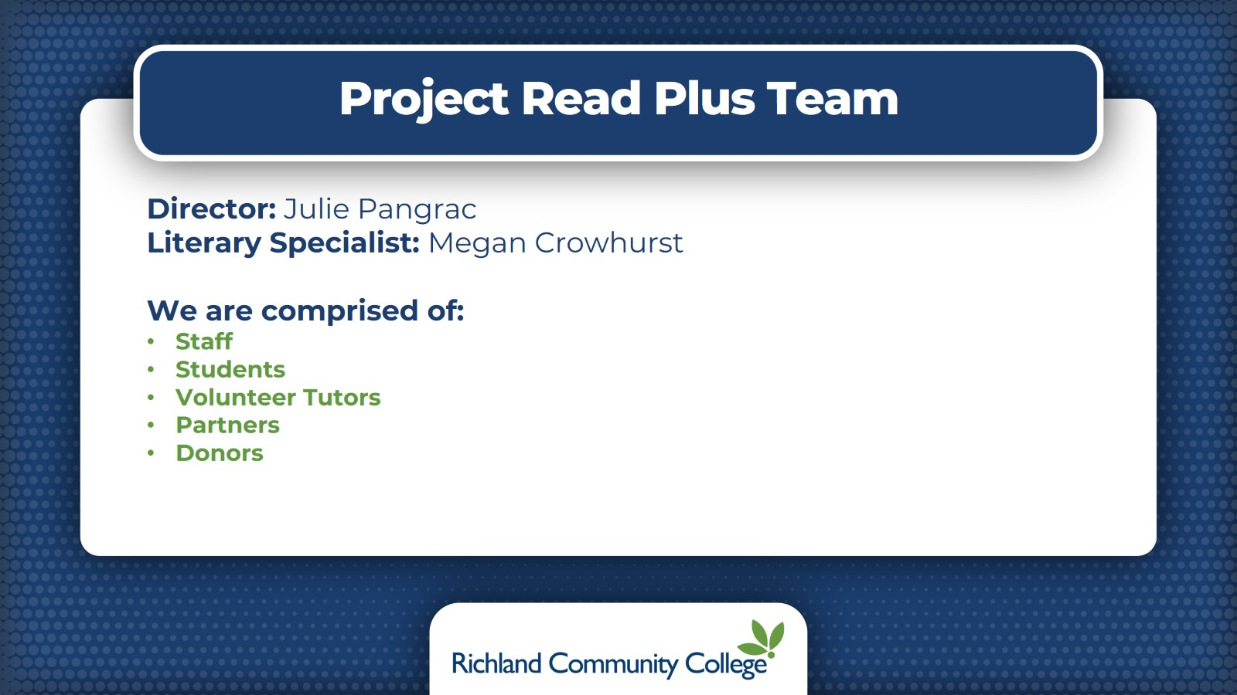
Project Read Plus Team

Slide 11
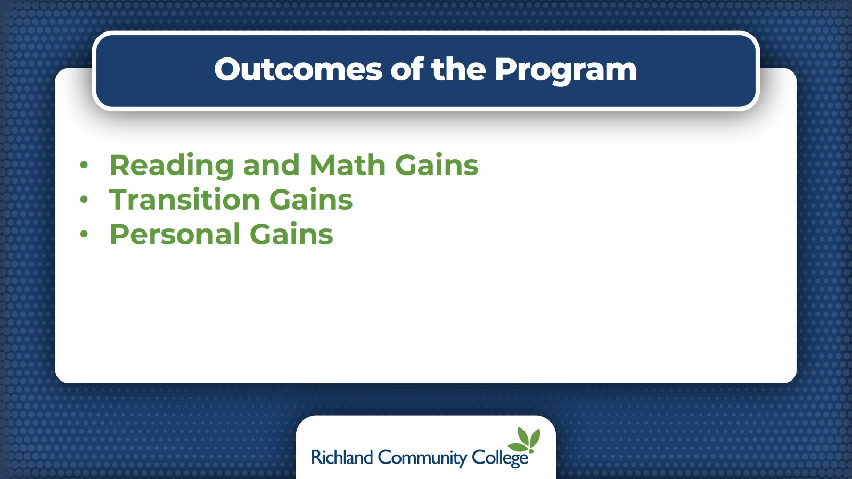
Outcomes of the Program

Slide 12
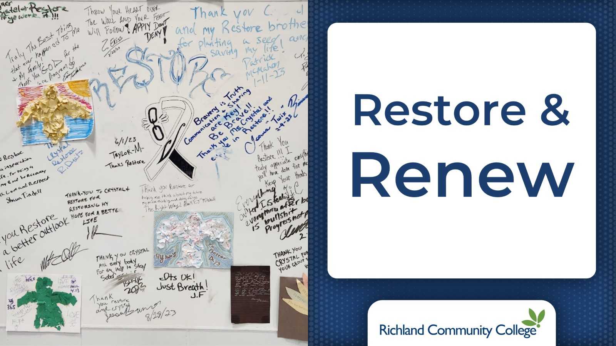

Slide 13


Slide 14
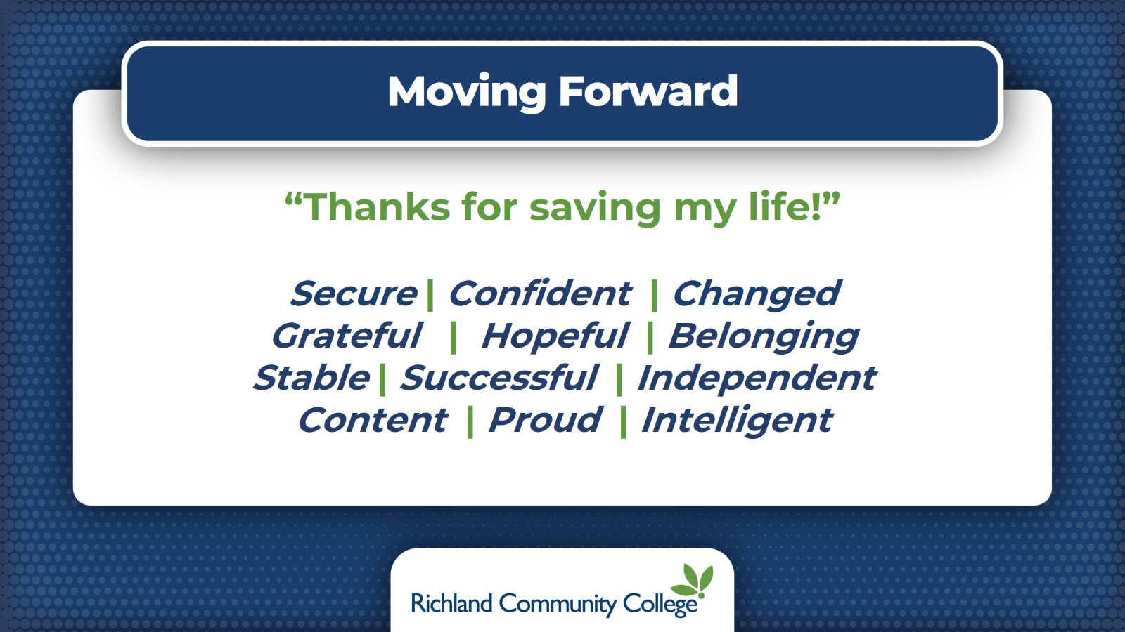
Moving Forward

Slide 15


Slide 16
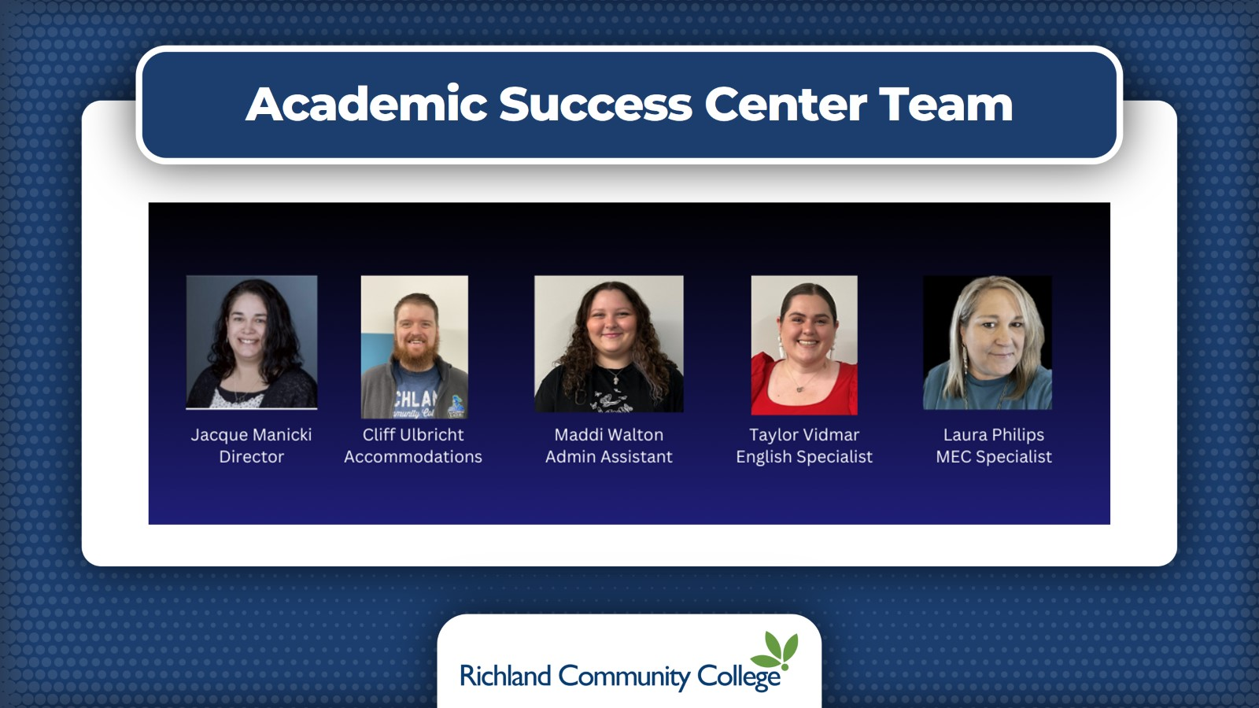
Academic Success Center Team

Slide 17
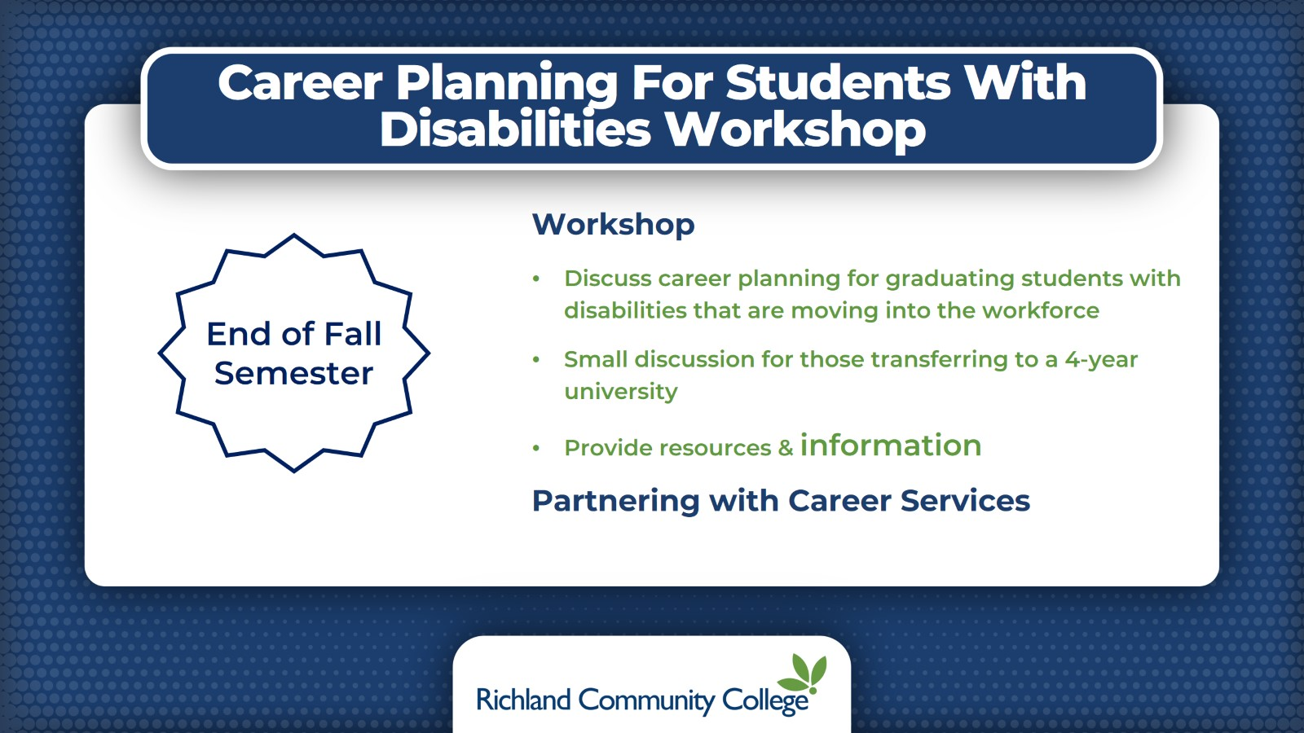
Career Planning For Students With Disabilities Workshop

Slide 18
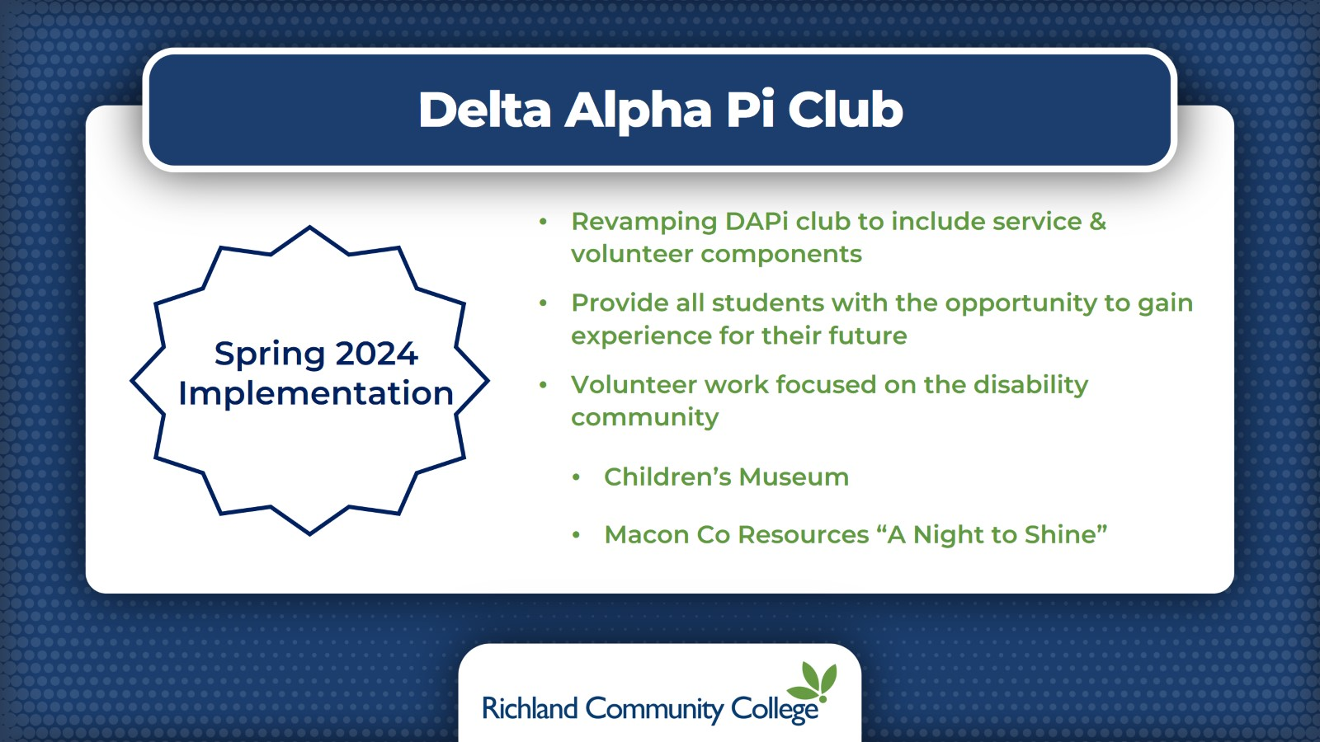
Delta Alpha Pi Club

Slide 19
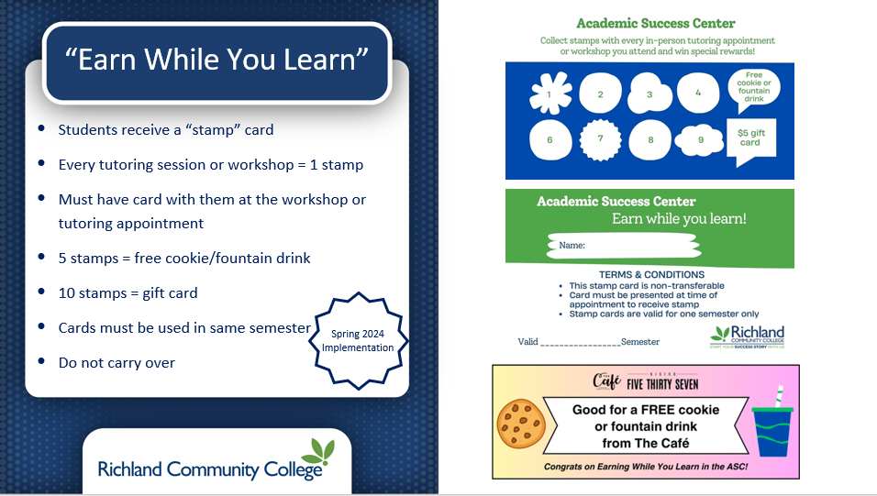

Slide 20
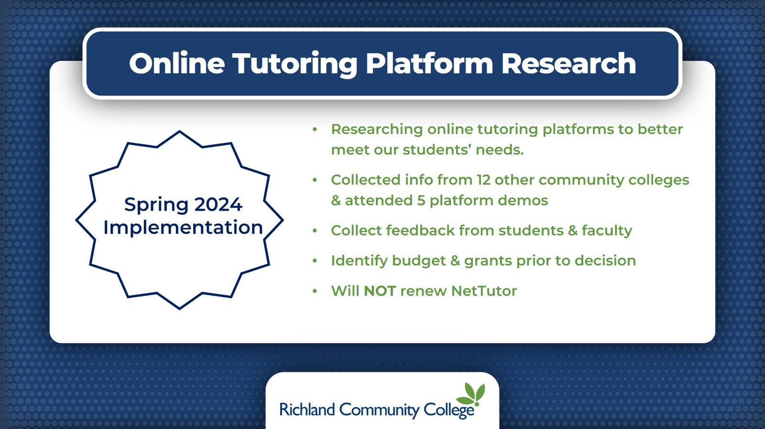
Online Tutoring Platform Research

Slide 21
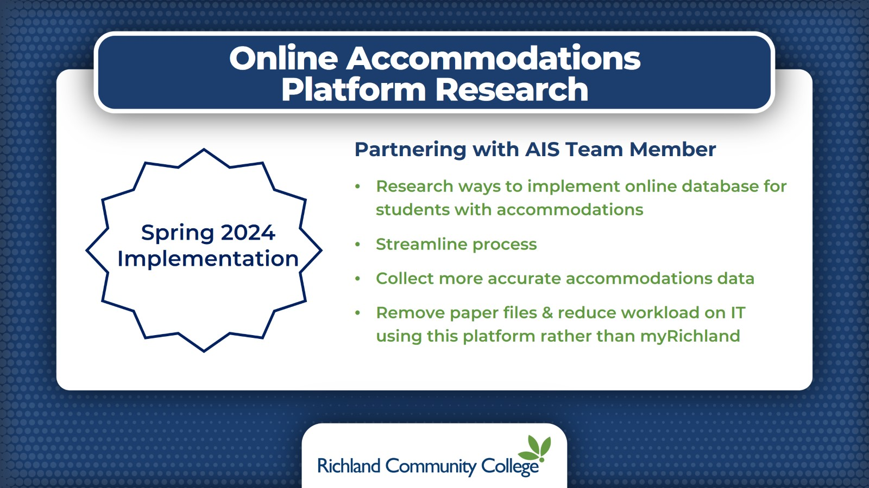
Online Accommodations Platform Research

Slide 22
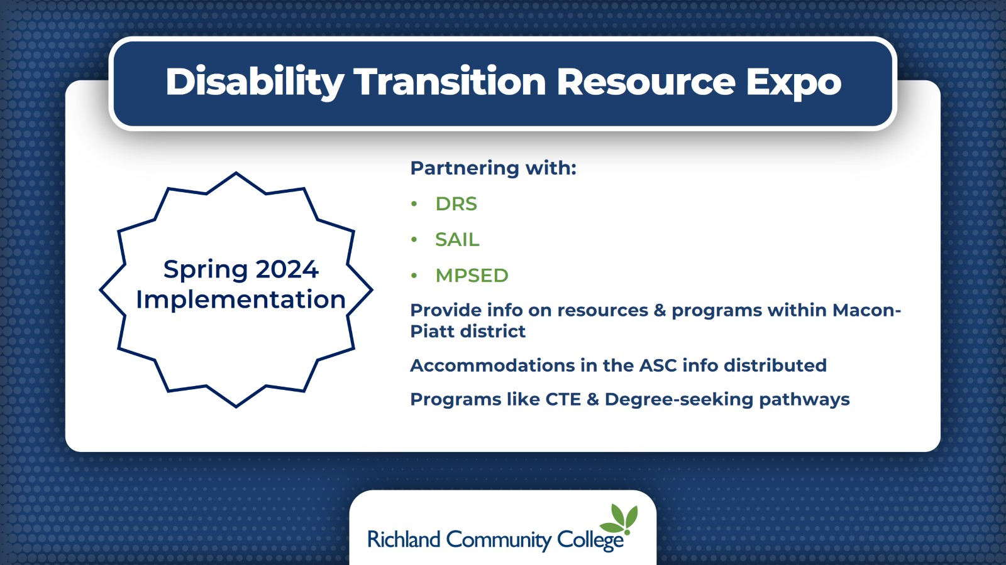
Disability Transition Resource Expo

Slide 23


Slide 24


Slide 25
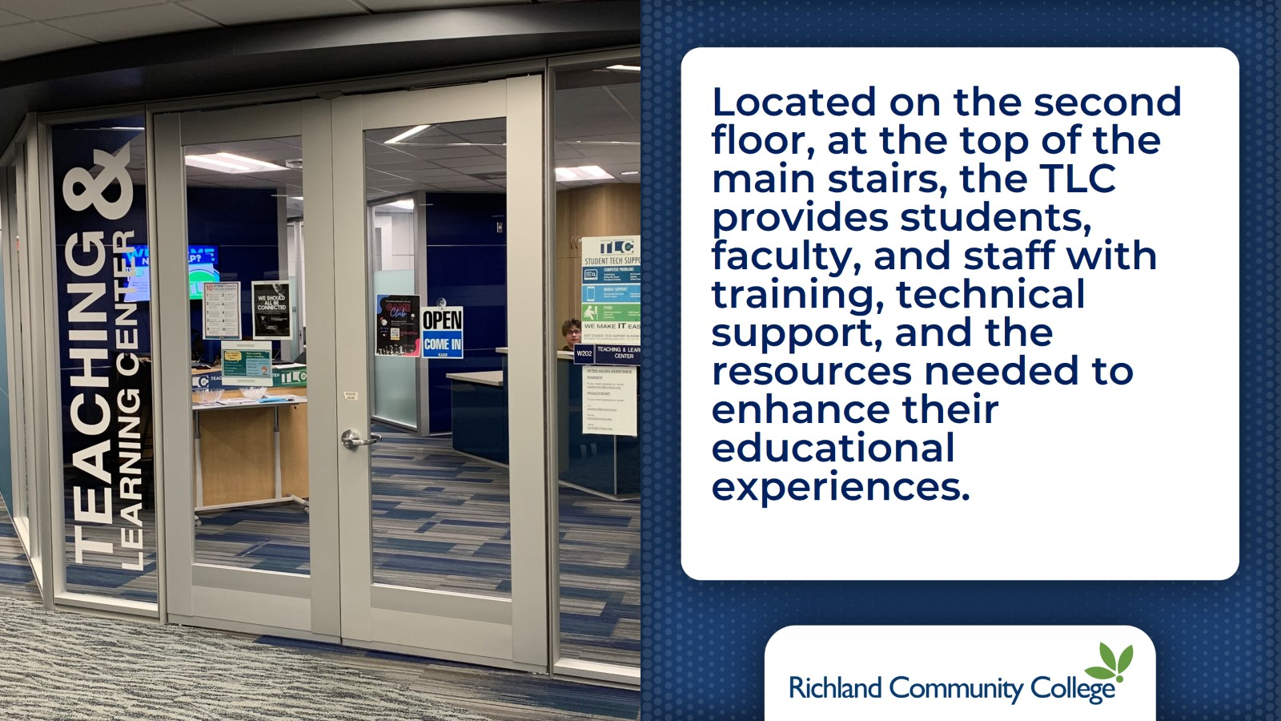

Slide 26
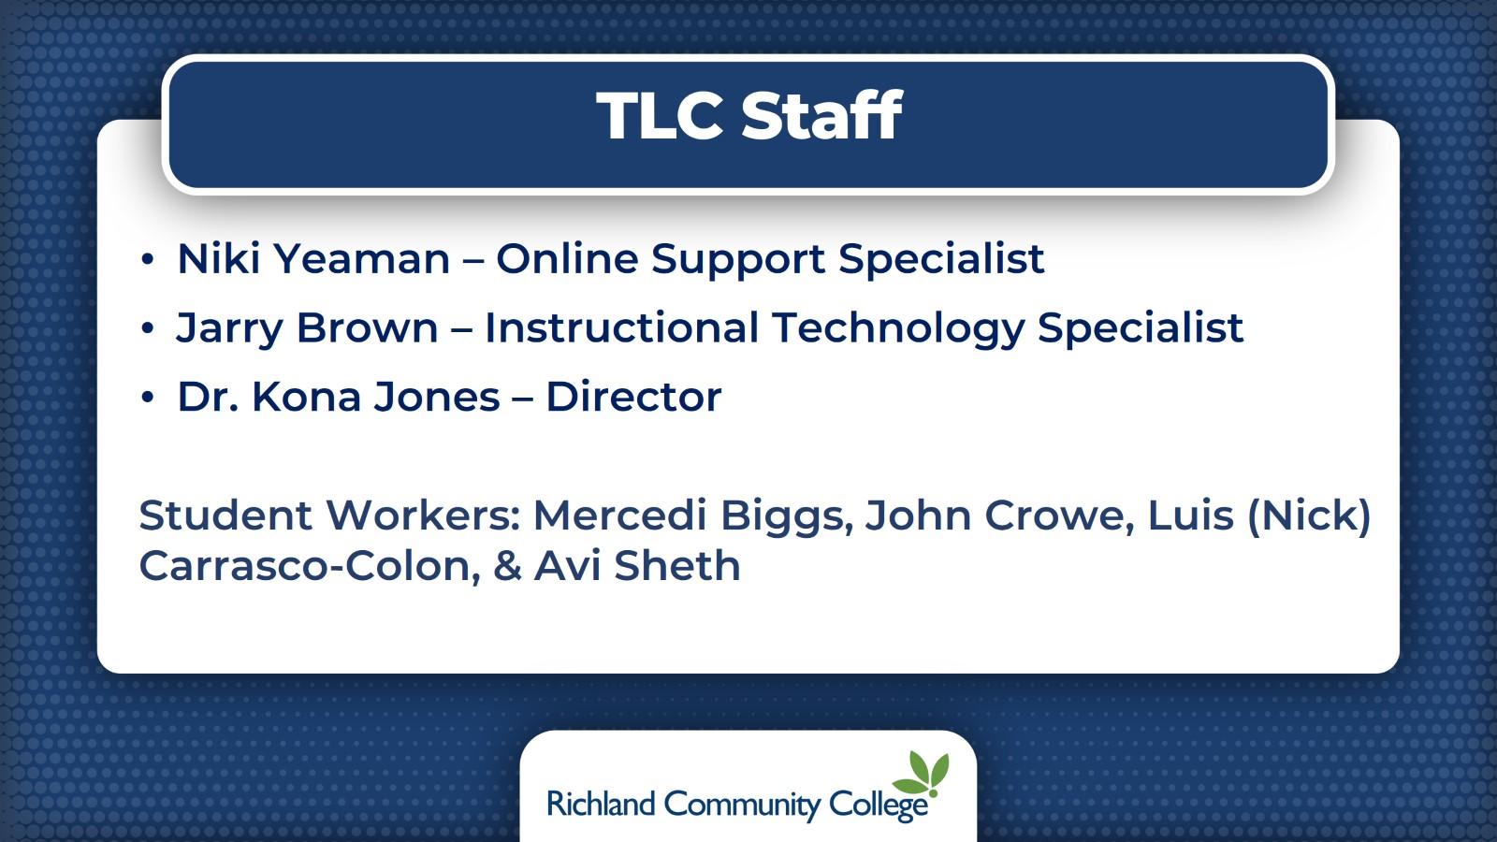
TLC Staff

Slide 27
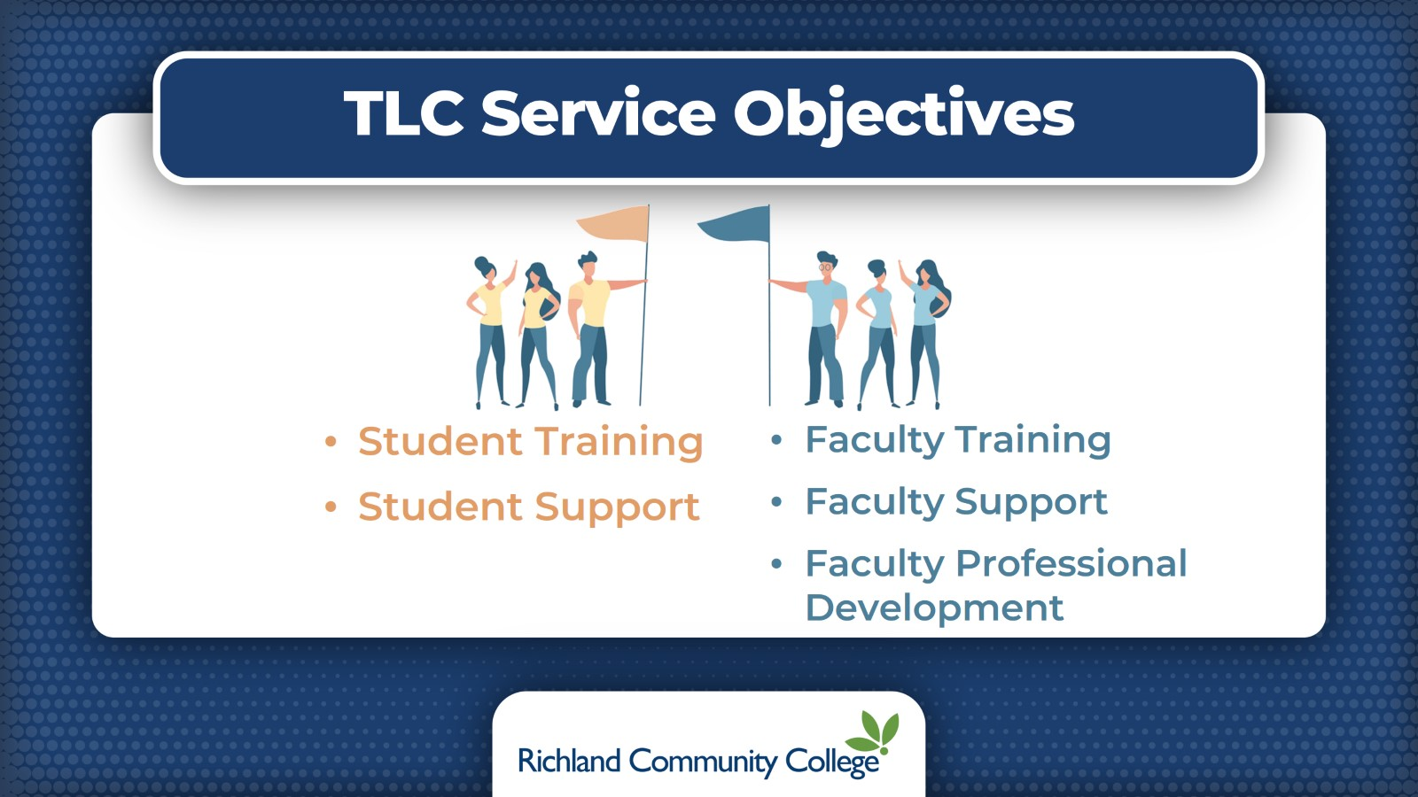
TLC Service Objectives

Slide 28


Slide 29
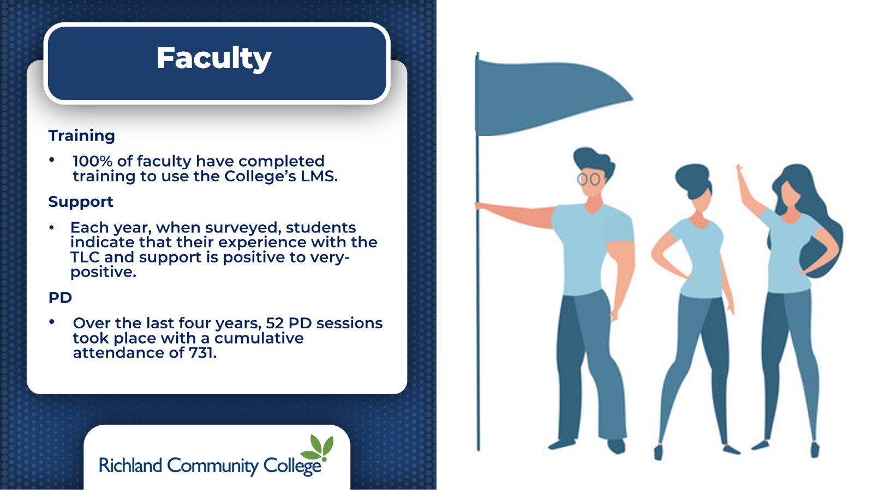

Slide 30
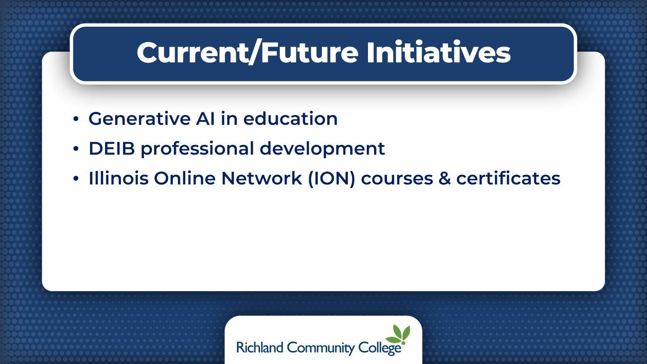
Current/Future Initiatives

Slide 31
