Slide 1

Notes:
Tiffany-Slides: 1-9; 15-20
Kristie-Slides: 10-14; 21-25

Slide 2

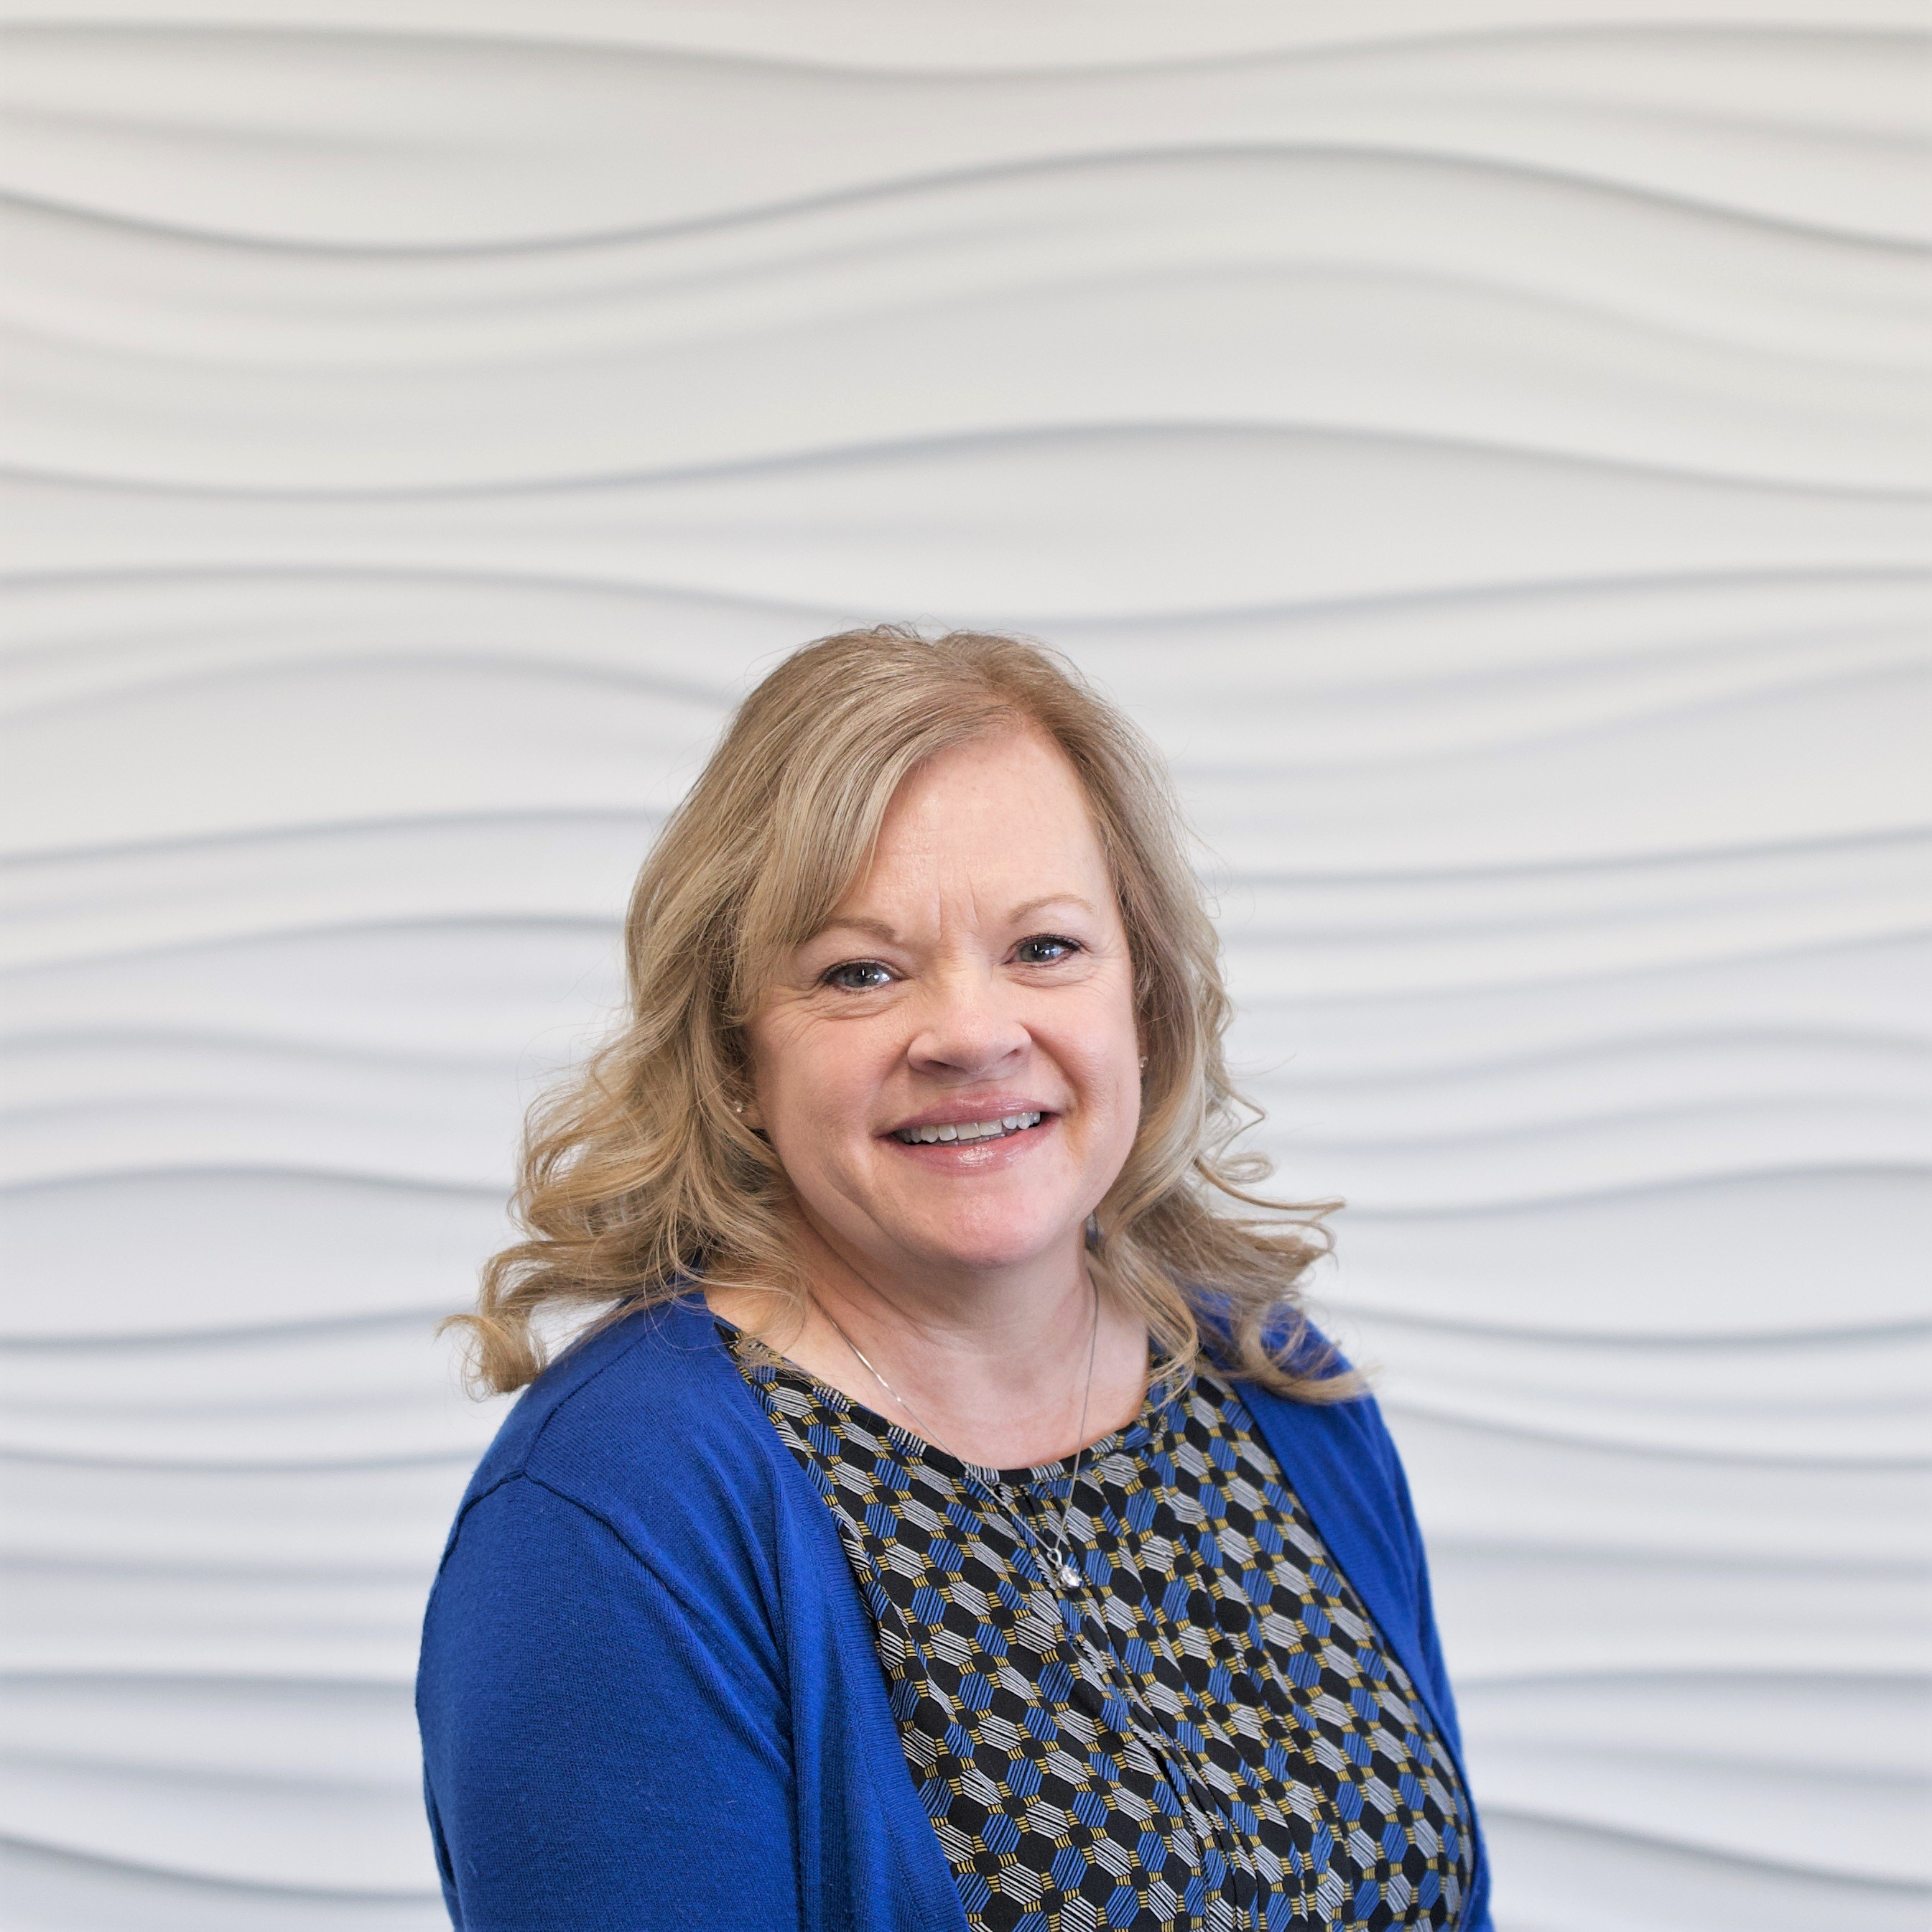
Kim Dial, HR Assistant
First point of contact for the department
File management, updates HR shared drive
Employment verifications
HR department communications
Pulling reports and data entry
Assist with onboarding, new hire orientation, I-9 documents, new hire information and much more!
Back up for Senior HR Generalist

Slide 3
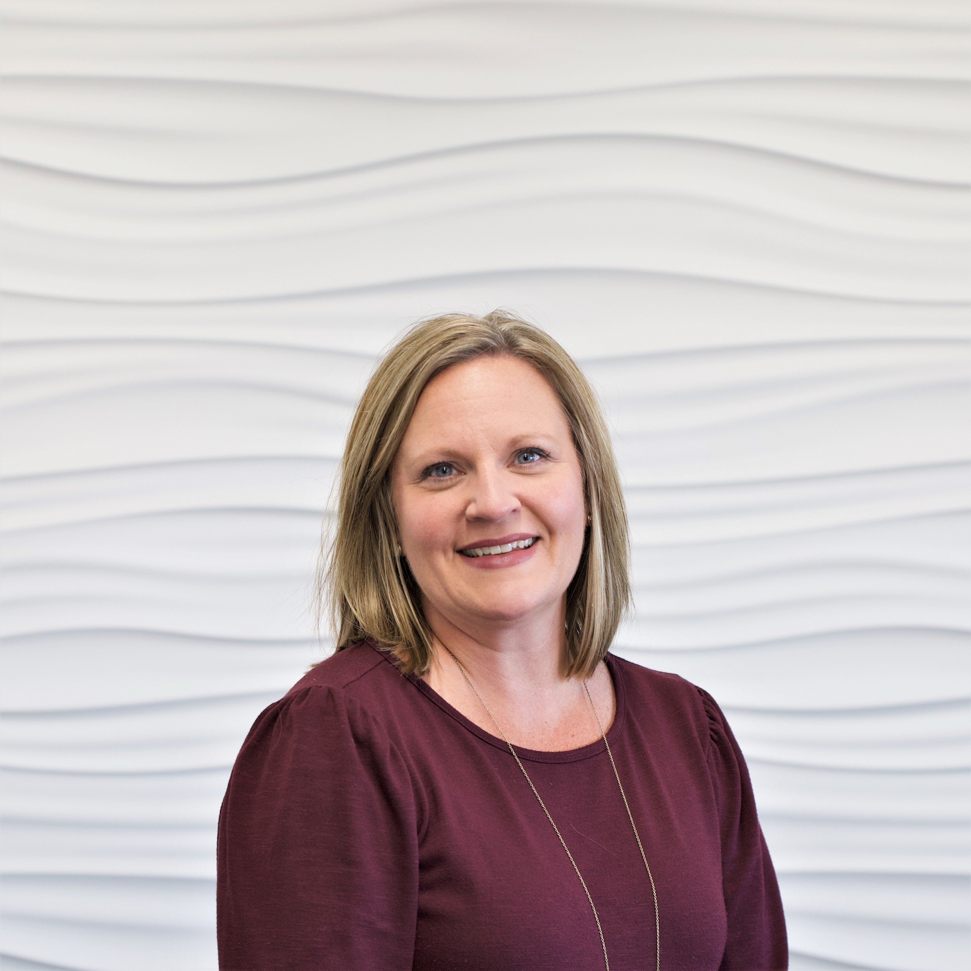
Amy Snow, Senior HR Generalist
Recruitment
New Hire Orientation/Onboarding/New Hire Pal
Training (Employee and Supervisor Training)
Employee Engagement
Back up to Assistant Director, HR

Slide 4
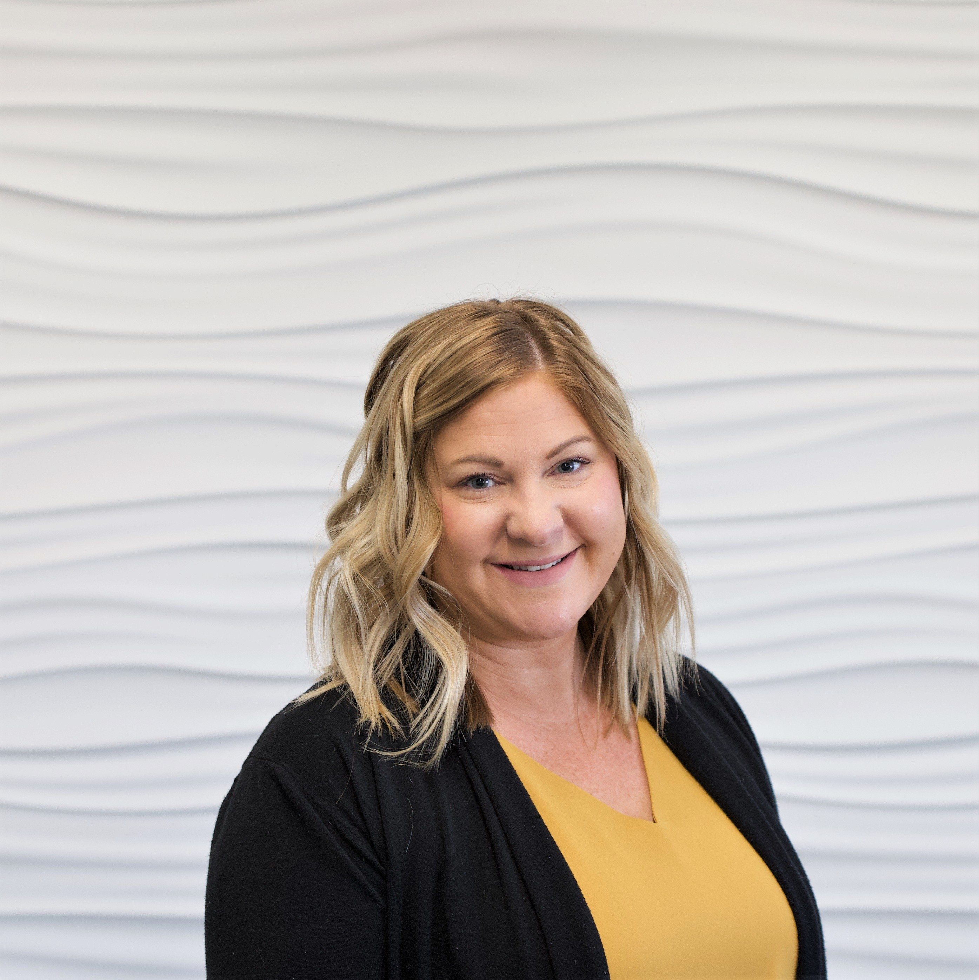
Kristie Dawson, Assistant Director HR
Benefits & Open Enrollment
Leave of Absences (FMLA, Work Comp)
Assist with compensation decisions
Assist with recruitment, onboarding and training efforts
Employee Performance Appraisals
Assist with investigations and employee relations
Fill in for HR Director in absence

Slide 5
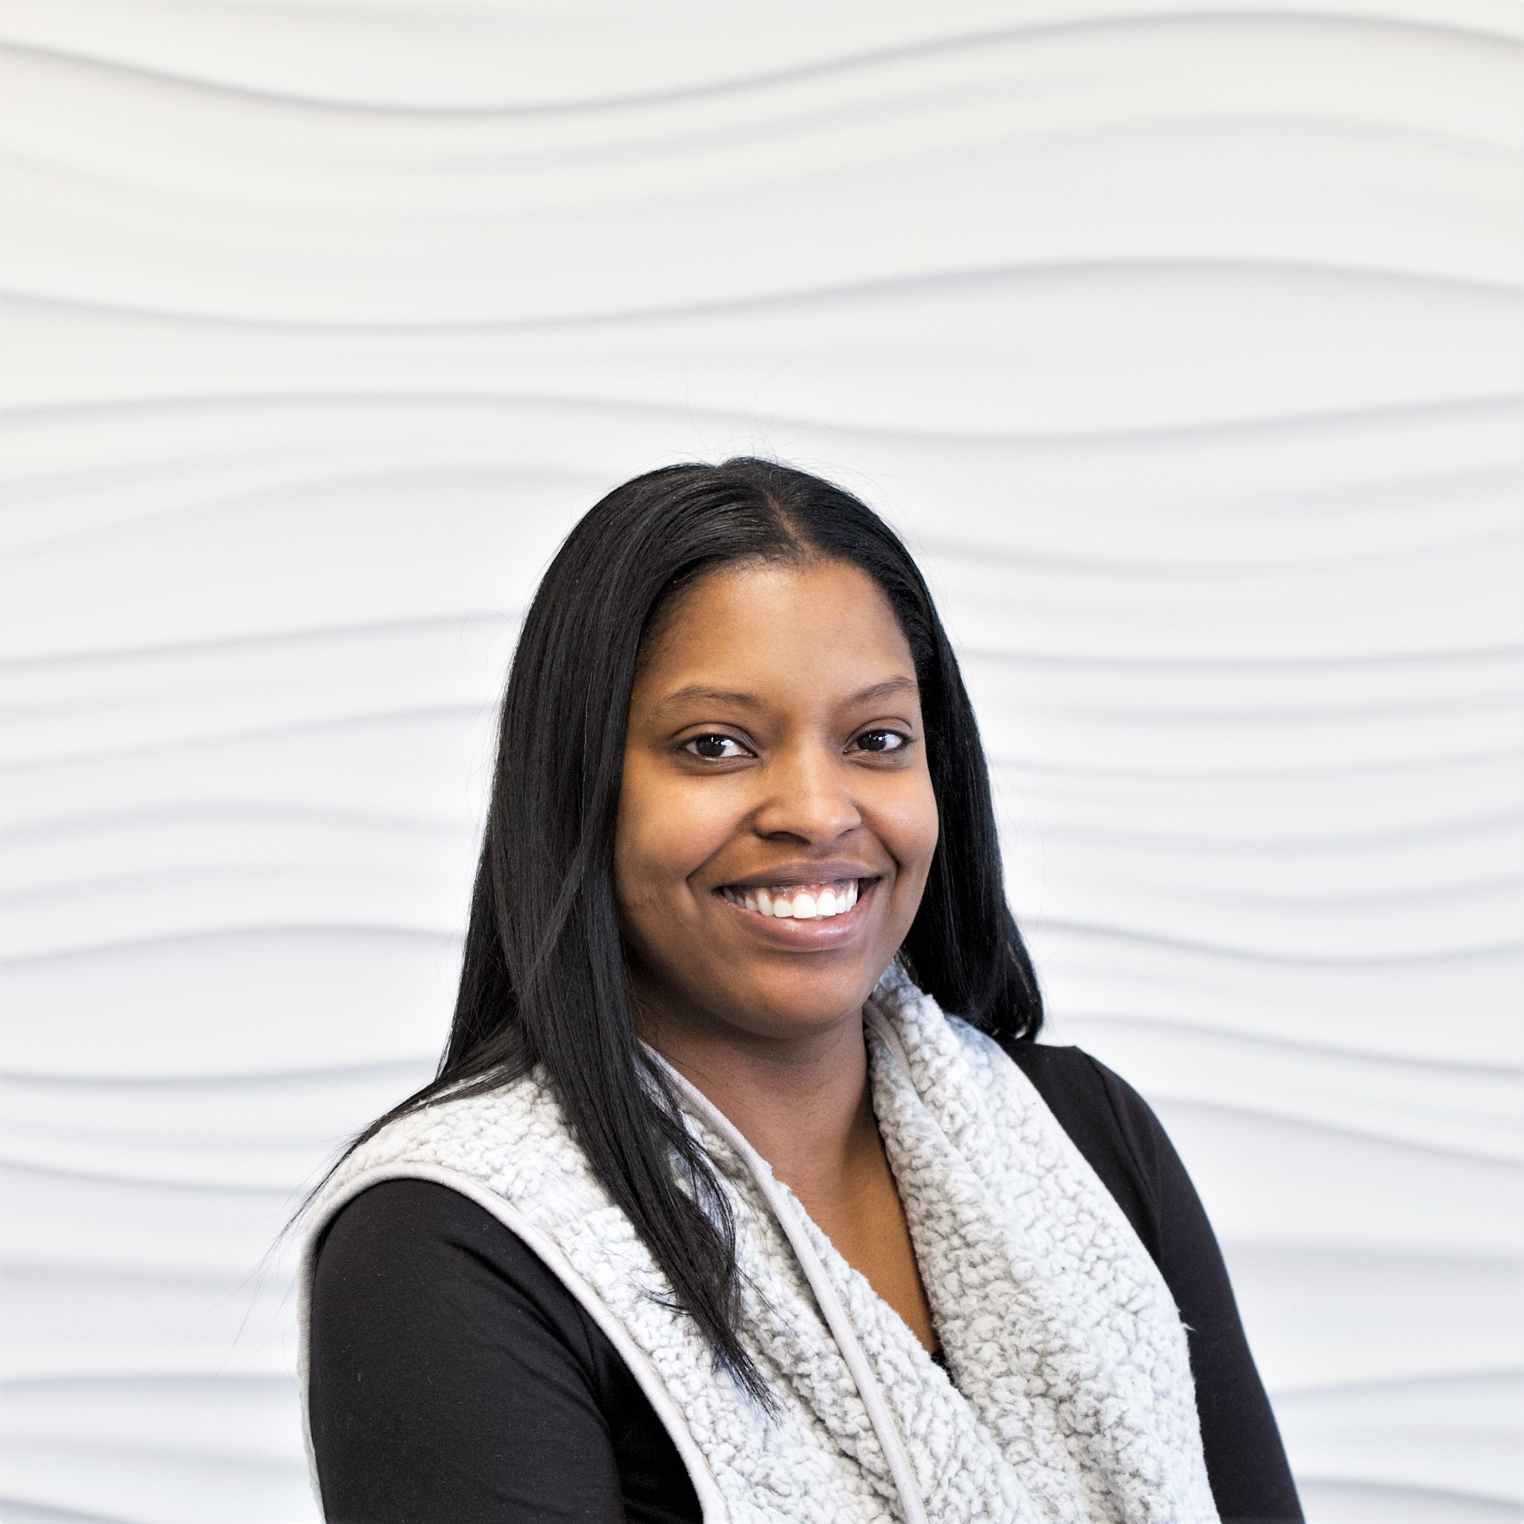
Tiffany Nichols, Executive Director HR
Supervises all HR staff
Oversee the department ensuring compliance in HR
Assist with labor relations
Provides counsel to employees with complaints and follow up with investigations

Slide 6

Positions Filled-2022
Approximately 78 Staff Positions Filled in 2022
  21 internal promotions/changes in positions
5 Faculty Positions Filled in 2022
  1 internal promotion/change in position
Notes:
78 includes temporary positions, food services, MCLETC custodian
Faculty internal move adjunct to FT tenure track faculty: Jennifer Boilliger

Slide 7

Retirements-2022
17 total retirements
Staff: 9 retirements
Faculty: 8 retirements
Notes:
Staff retirements include Tom S. and Denise Crews/Faculty include Kent Mears

Slide 8
Current Open Staff Positions
Accommodation Specialist
Truck Driver Training Specialist
Labor & Trades Transition Liaison
Program Director, ECE
Maintenance Supervisor
Continuous Recruitment (Pool) Postings
Notes:
Between faculty and staff positions, there are 39 positions posted total with the majority being for adjunct/pool postings:
19 current open positions-10 are continuous postings: Non-Credit, CDL, MCLETC, Adult Ed Instructors, Food Service Workers, Fitness Center Worker, Tutors, etc.

Slide 9
Current Faculty Open Positions
Tenure-Track Automotive Technology Instructor
Tenure-Track Electrical Systems Engineering Technology Instructor
Tenure-Track English Instructor
Continuous Recruitment (Pool/Adjunct) Postings
Notes:
20 current open positions-17 are adjunct/continuous postings: baking and pastry, psychology, welding, HVAC astronomy, etc.

Slide 10
Staffing Levels
Notes:
FT staff/faculty has increase of 6.3% from Fall 2021. PT staff/faculty increase 7.8% from Fall 2021.

Slide 11
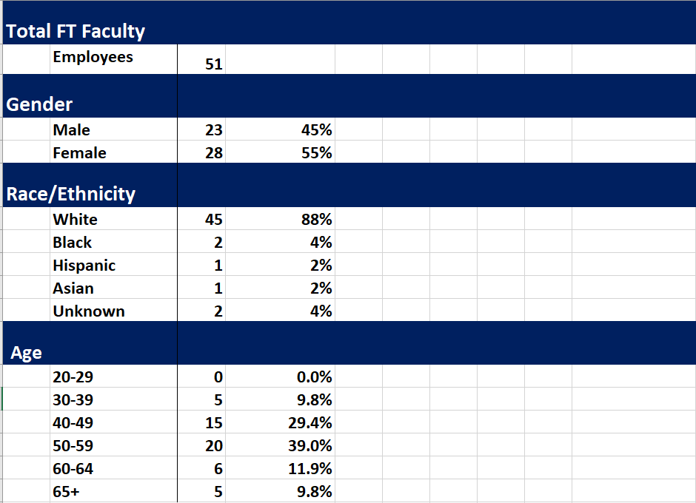
Notes:
FT Faculty

Slide 12
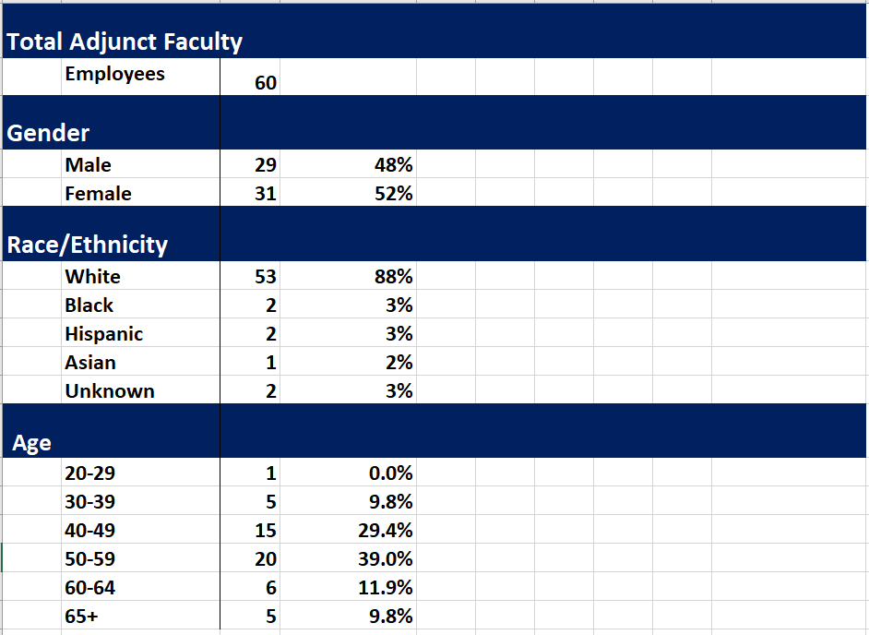
Notes:
Adjunct Faculty Demographics

Slide 13
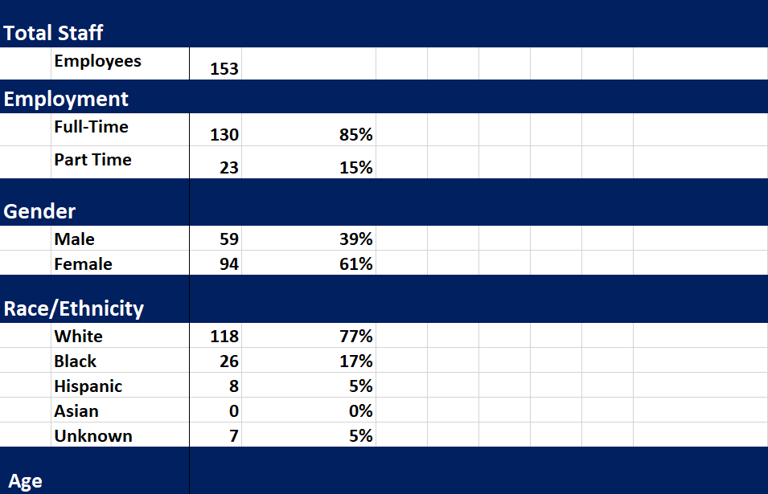
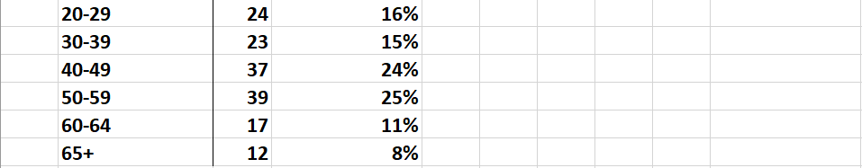
Notes:
Staff Demographics

Slide 14

Insurance Utilization

Slide 15
HR Highlights 2022
New HR Department Location
Restarting Supervisor Training Sessions
Belonging: New Pal
Creating Internal Growth Opportunities

Slide 16
CHALLENGES AND OPPORTUNITIES AHEAD
Increase Recruitment Footprint
Update Performance Review Tool (Moving towards Merit-based by 2026)
More efficient way of tracking retention & turnover
HR Training Manual with cross-training opportunities
Considering new EAP with Memorial Health
Offering Additional, Specialized Training for employees and Supervisors:
  Franklin Covey (Leadership Training)
  Regularly Scheduled Supervisor Trainings
  Civility Training
Notes:
We are working with our marketing department to assist with branding/recruitment toolkit. There will be an increase in attending job fairs this year as we hope to also have the community consider RCC as not just a community college but also see us as an employer. Updated performance review tool will help gear up towards merit based performance reviews by 2026 (reviewing 2025 performance).

Slide 17
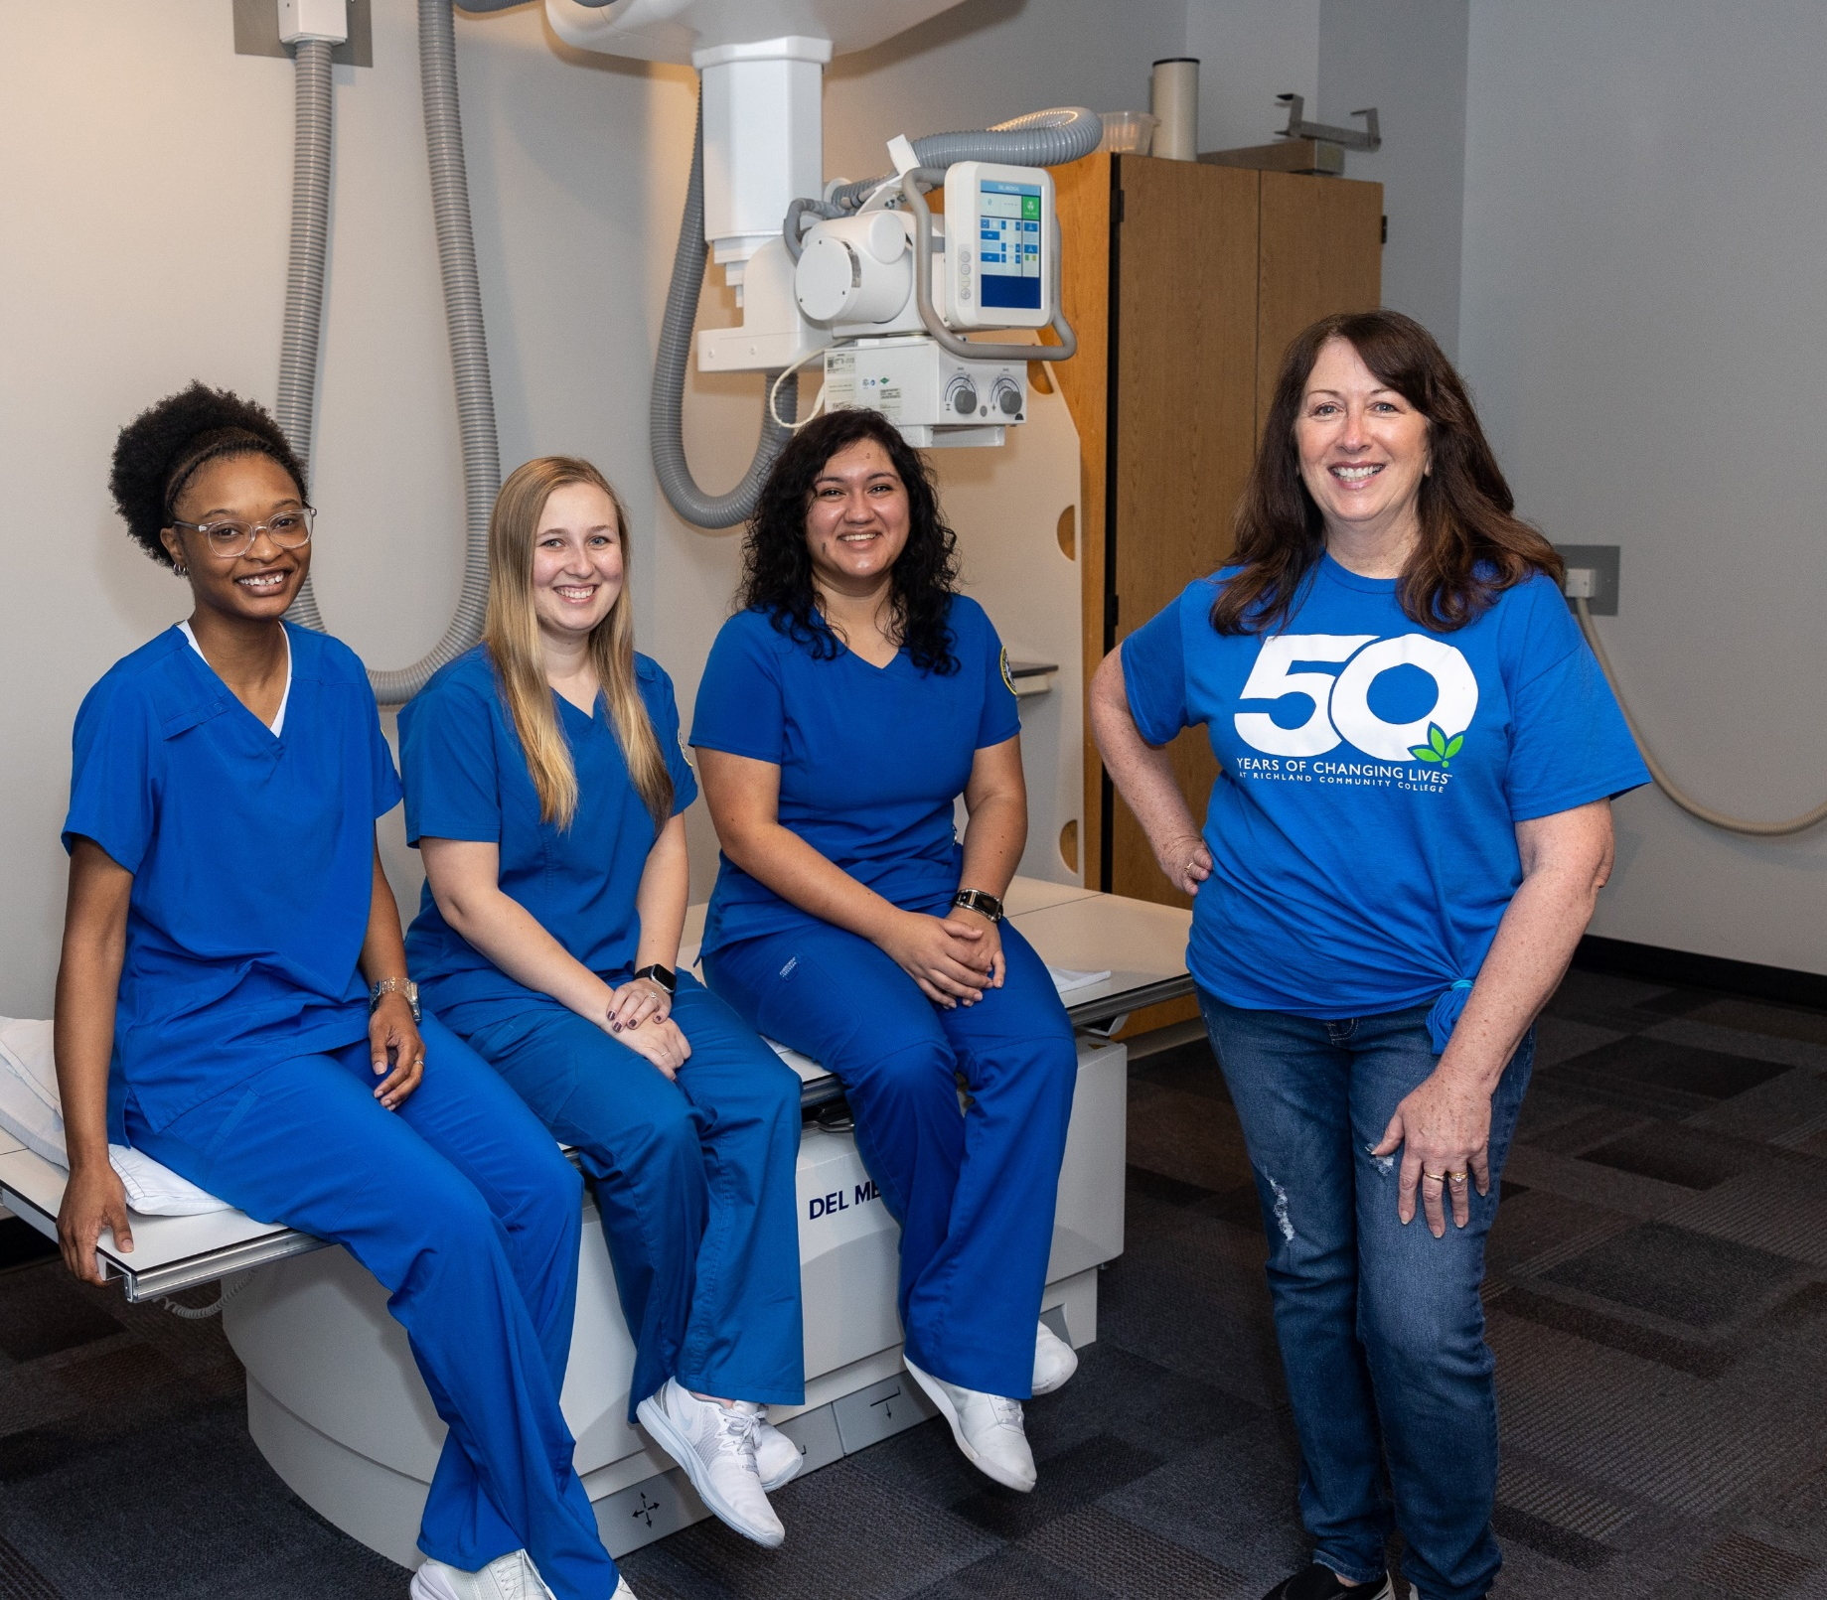
Why I Choose Richland
“I choose Richland as an employee because as a student in Richland's Radiography Program I became aware of the importance of education and having those mentors that help you through your learning experience. I am proud to be an instructor in the Radiography program working alongside those who guided me on my path back to Richland.”
Beth Roach
Radiography Instructor

Slide 18
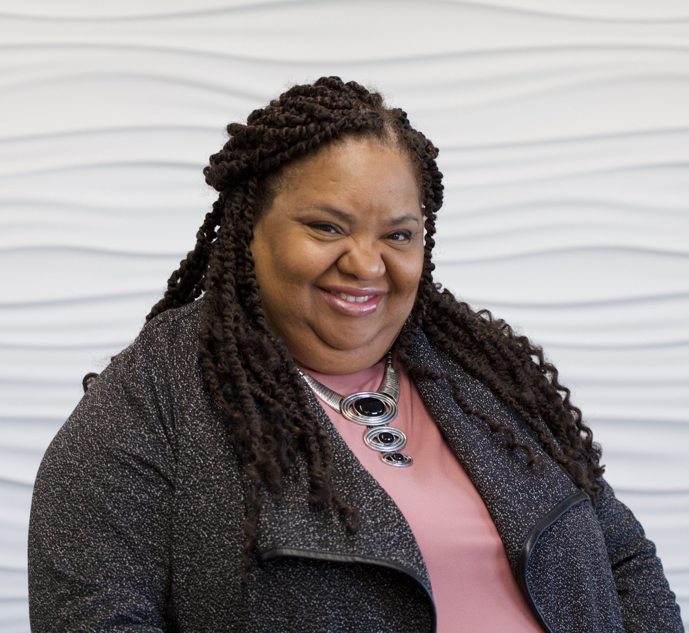
Why I Choose Richland
“I believe in education and second chances, so many people fall through the cracks of life not reaching their potential and feeling hopeless. Richland provides opportunities beyond education that would other wise be loss. As an employee I try my best to encourage and uplift students as they come in for testing that may other wise give up. Why? because I was one of those students.”
Antonia Hawkins

Slide 19
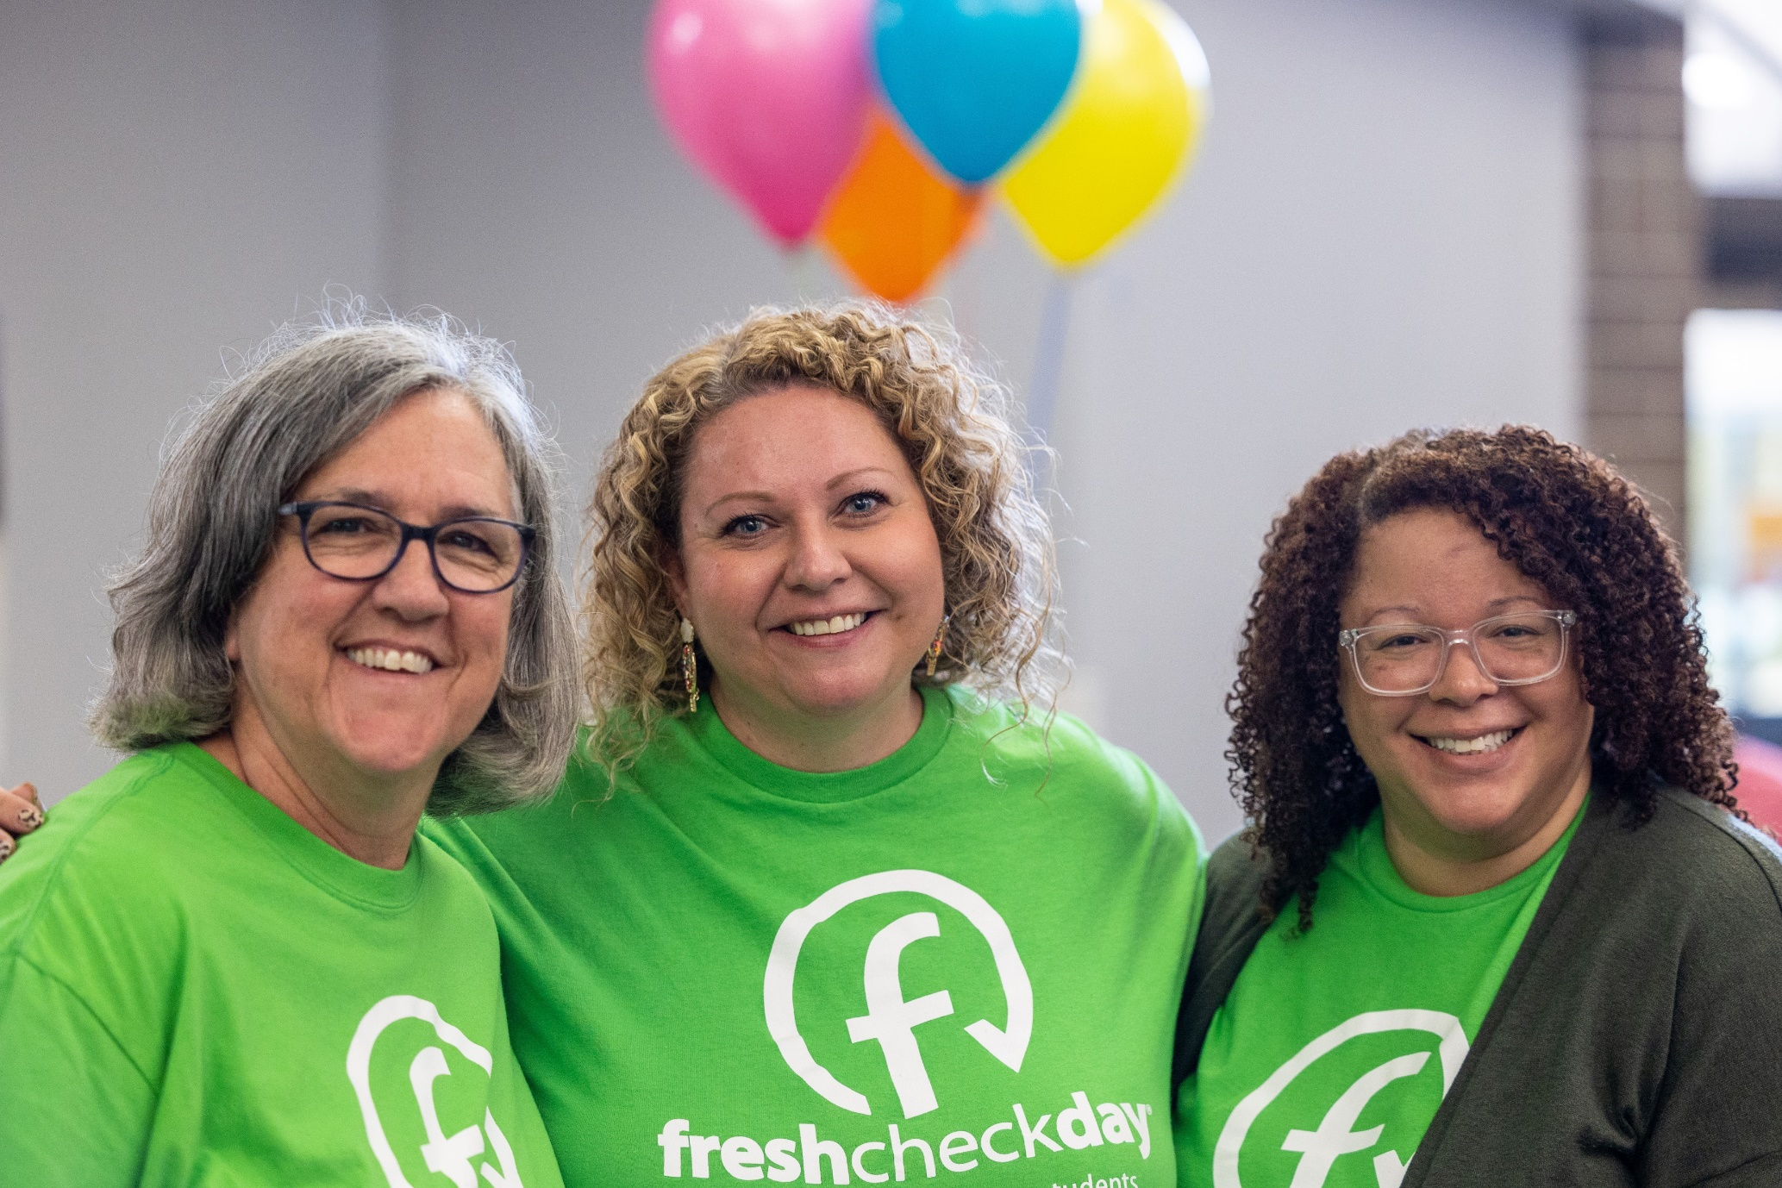
Why I Choose Richland
"I know I've said this before, but I am a PROUD Richland Alum. My time as a student at Richland and the amazing faculty and staff really shaped me and prepared me for my educational journey. As an employee, I am honored that I get to play a part in student's educational journey and help cultivate the same rewarding experience I received so that they can achieve their goals."
Meredith Johnson-Palmer
Dean of Student Success

Slide 20
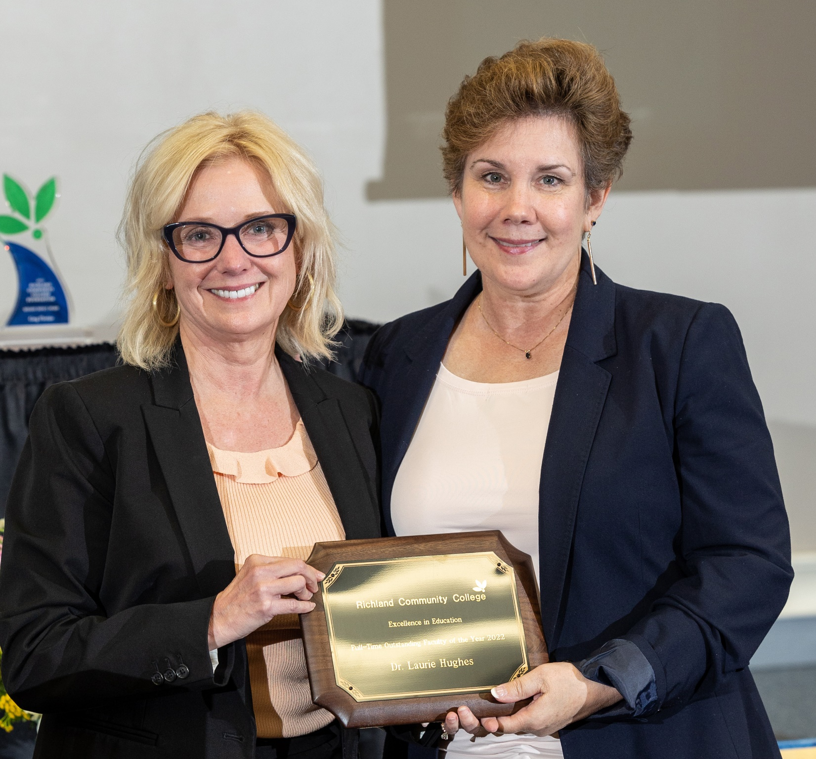
Why I Choose Richland
“Because I get to work with the finest and most committed faculty it’s been my privilege to know. They consistently inspire me to do and be more.”
Laurie Hughes
Professor of English & Humanities

Slide 21
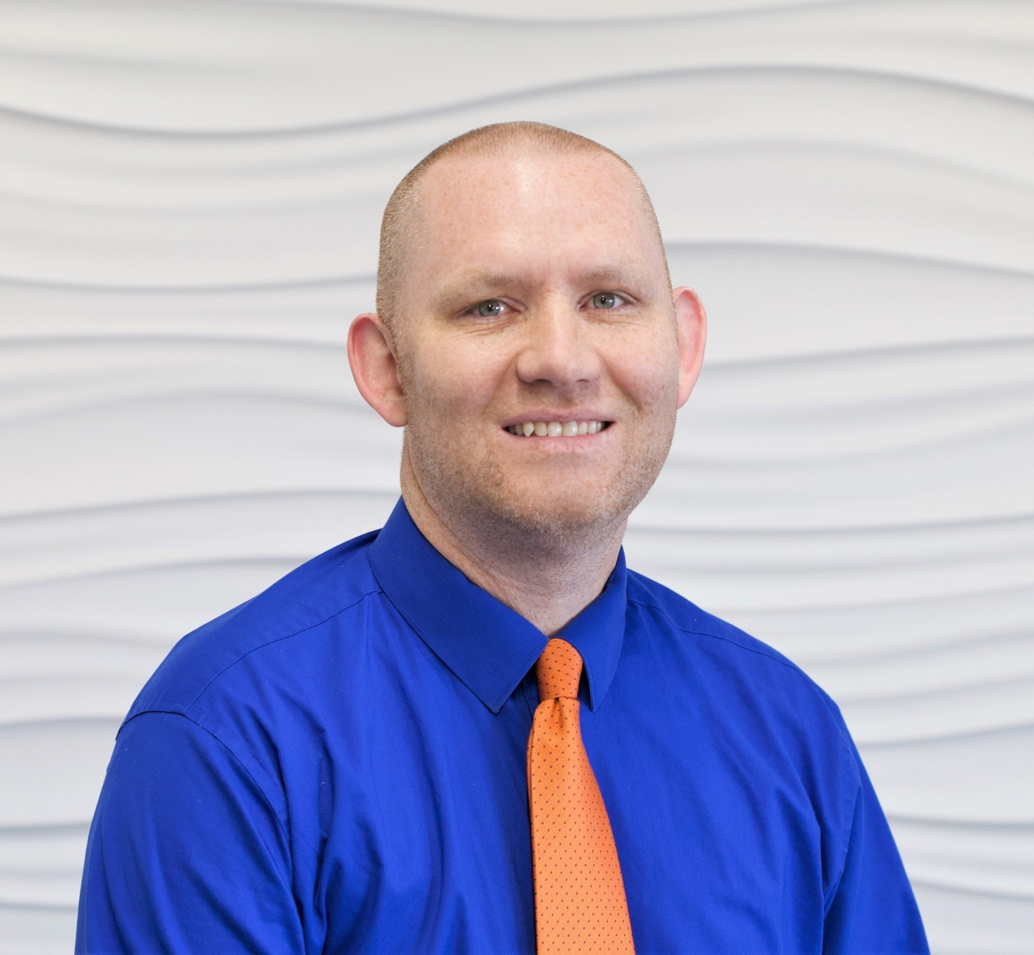
Why I Choose Richland
I choose Richland because Richland chose me. In the past 14 years Richland has provided me the chance to grow my experience and my career, all while helping to provide a good standard of living for my family. It is nice to see how much this place has changed and grown over the years, and I have enjoyed many strong connections with my colleagues.
Andy Hynds
Dean of Math, Science & Business

Slide 22
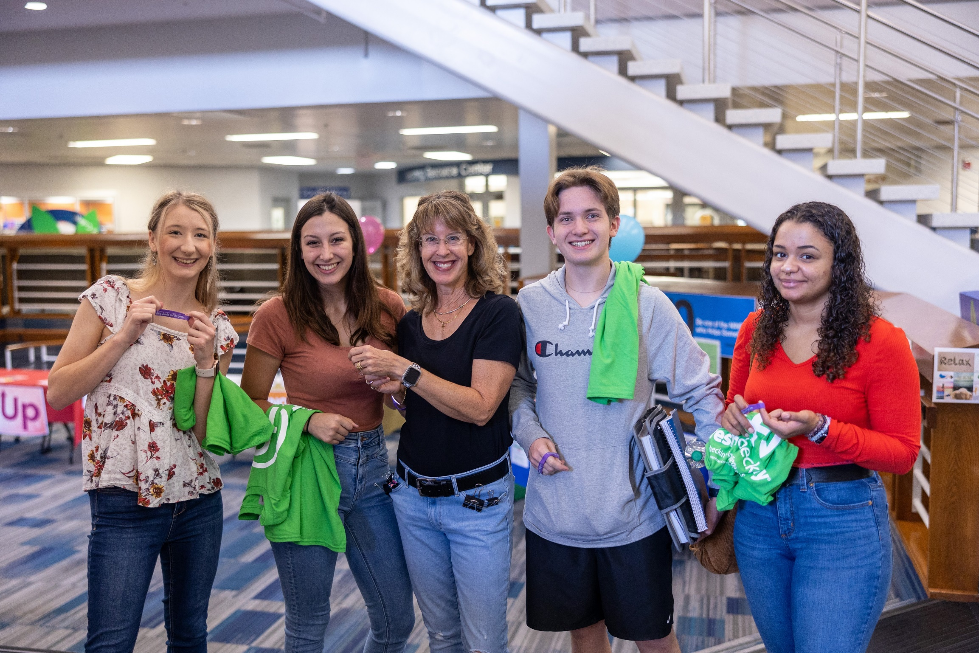
Why I Choose Richland
I graduated from RCC in 1987 and it got me back on track after not doing well in high school. I realized how powerful a community college can be in someone's life and knew that I wanted to teach at RCC myself and impact lives like mine was all those years ago!
Kristie Palmer
Professor of Sociology

Slide 23
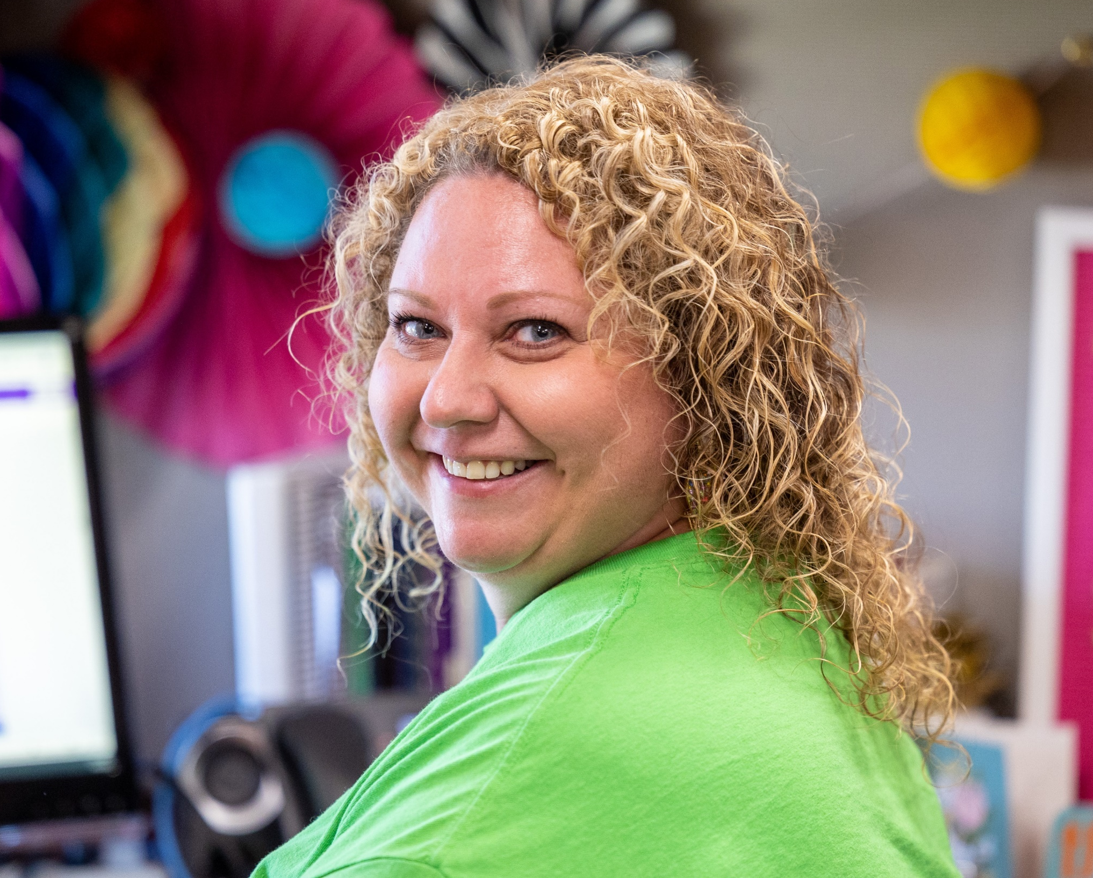
Why I Choose Richland
Richland Community College encompasses the same values and standards I possess for myself. I am passionate about helping people and our community, and so is Richland. Richland consistently makes it their mission to cultivate opportunities for our community to
grow and flourish.
Allison Shuppara
Lead Student Success Coach

Slide 24
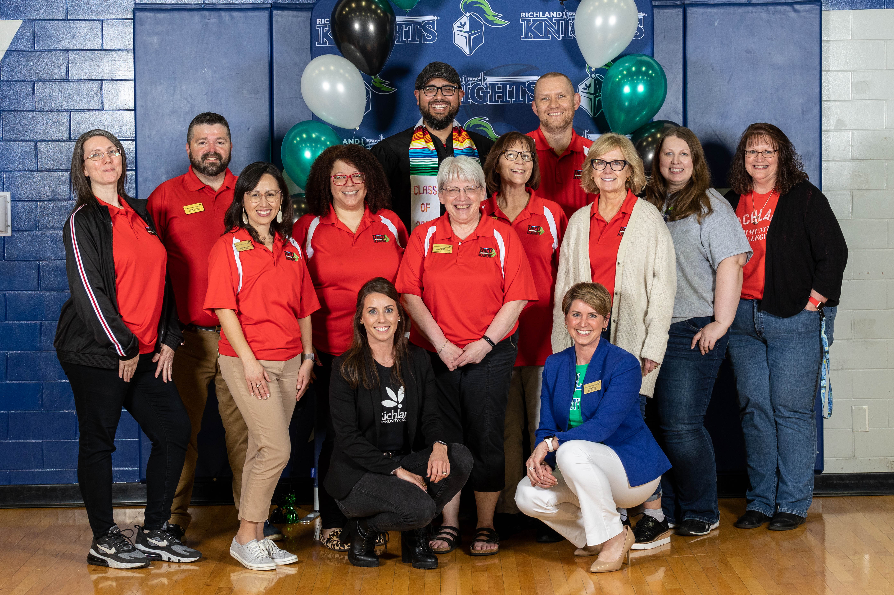
Why I Choose Richland
“Richland has employees who really care about students and are committed to their success.”
Dr. Cris Valdez
President

Slide 25


