Slide 1


Slide 2


Institutional Advancement
What is Institutional Advancement?
Institutional Advancement (embracing alumni relations, fundraising, marketing and grants) refers to a total program to foster understanding and support for Richland Community College.
Our role is to support students, alumni, faculty, and staff through fundraising, communications, and engagement of external constituencies to advance the mission of the College.

Slide 3

Our Team
Julie Melton – AVP, Institutional Advancement/Executive Director, Foundation
Debbie Ellison - Executive Assistant, Institutional Advancement & Foundation
Brian Silotto – Director of Major & Planned Giving
Loren McGinnis – Annual Giving & Alumni Engagement Coordinator
Tara Mata – Advancement Services & Scholarship Coordinator
Samantha Bright – Director of Marketing & Communications
Emma Roark – Content Writer & Communications Coordinator
Wade Ripple – Creative Services Coordinator
Adam Lovell – Grant Coordinator

Slide 4

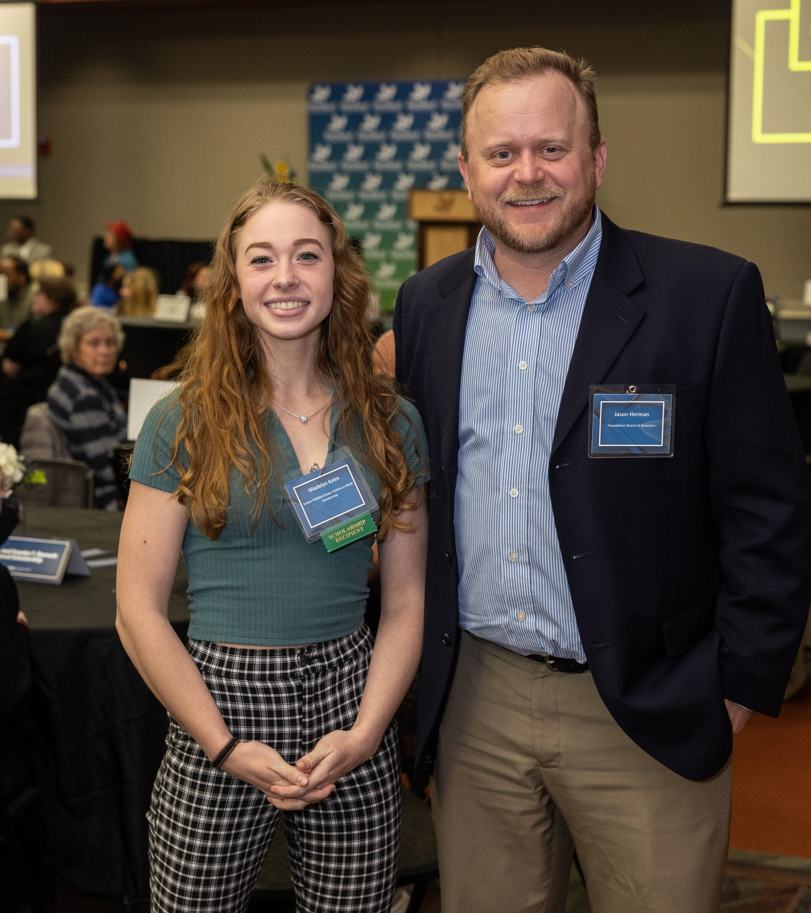
Mission of the Foundation
The mission of Richland Community College Foundation is to support and advance the development activities that provide enhancements to Richland Community College and its students.

Slide 5
Foundation Board of Directors
Stephen Clevenger, Chair
Stacey Young, Vice Chair
Matt Whitehead, Treasurer
Jeff Dase, Secretary
Ryan Dobey
Josh Dubbelde
Jason Herman
Cindy Jackson
Tamar Kutz
Shamika Madison
James Rhodes
Travis Roach
Trent Thompson
Dawn Yuhas
Myung Kim, Honorary Director

Slide 6
FY23 Financials
Total Assets
As of June 30, 2023: $24,404,623
As of June 30, 2022: $19,744,277
Annual Revenue
FY23: $2,377,538
FY22: $1,129,796
Number of Donors
FY23: 415
FY22: 304
Investments
As of June 30, 2023: $19,617,010
As of June 30, 2022: $17,982,584
Board Giving
FY23: 100%
FY22: 94%
Average Gift Size
FY23: $5,729.01
FY22: $3,716.43

Slide 7
Foundation FY23 Results
Exceeded our FY22 fundraising revenue by 110% raising more than $2.37M.
Awarded $1.23M Scholarships, exceeding our FY22 scholarship amount by 32%.
Provided scholarships to over 700 unduplicated students – a 33% increase over last year.
Received significant gifts from the Andreas Family Foundation, the Caterpillar Foundation, and the John Ullrich Foundation.

Slide 8

Student Testimonial

Slide 9
FY24 Annual Fundraising Plan
The Annual Fundraising Plan is outcome based and ties into the Strategic Plan of Richland Community College. It addresses the following revenue components that have the ability to increase revenue and administer funds to provide the greatest impact on Richland and our students.
Annual Giving
Major & Planned Giving
Alumni Engagement
Donor Relations & Stewardship
Scholarship Program
Student Support Programs
Database Health & Enhancement
Board Relationships & Communication

Slide 10
New Initiatives for FY24
Develop an Annual Corporate Sponsorship Brochure
Research & Implement Giving Circles
Implement Free Will – an online Giving Platform
Implement Richland Connect to track & engage Alumni
Implement the Alumni Mentorship Program
Identify funding opportunities for Dual Credit Scholarships
Evaluate barriers of our students to provide the most efficient & timely resources
Implement Financial Edge NXT – a financial database for the Foundation
Develop a stewardship plan and implement automated processes

Slide 11


Slide 12

Alumni Mentorship Program
The Goals & Objectives include:
Foster a sense of belonging for students & Alumni/mentors.
Provide opportunities for students & Alumni to be engaged with the Richland campus.
Provide students with skills & knowledge that can be carried on into their careers.
Help identify career paths for students and support students’ personal growth.
Provide an opportunity for students to learn and practice professional networking skills.
Increase social awareness and responsibility of students through volunteerism.
Help students identify and pursue opportunities for employment related to their programs/degrees

Slide 13

FY23 Marketing Successes
Canvas Website Training
Core College Materials
Campus Photo Shoots
Outreach Kits
Advertising Campaigns
Weekly/Monthly Radio Segments
Social Media Campaigns/Spotlights
50th Anniversary Campaign

Slide 14



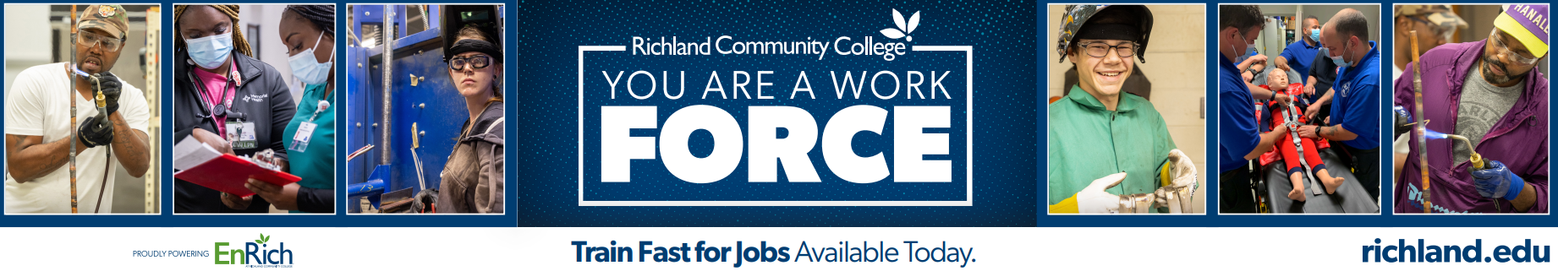

Slide 15

FY24 New Marketing Initiatives
Farm Progress
Website Update
Canva Implementation
Annual Media Buys
Strategic Plan Design
Targeted Email
Marketing
Campus & Employer
Video Shoots

Slide 16
Grant Success & Priorities
FY23 Grant Successes
Hired a Grant Coordinator & Grant Accountant to streamline our application & reporting processes
Over $25M in NEW & continuing grants received in FY23
Anticipate even more in NEW grants in FY24
Increased opportunities for partnerships & collaborations - TCCi, CEJA, iFAB & more!
FY24 Grant Priorities
Create an database of all active grants and applied for grants
Develop & Implement Grant Training Manual to define timelines, roles & procedures
College leadership will continue to identify internal/external opportunities for partnership & collaboration

Slide 17
Questions?

