Slide 1
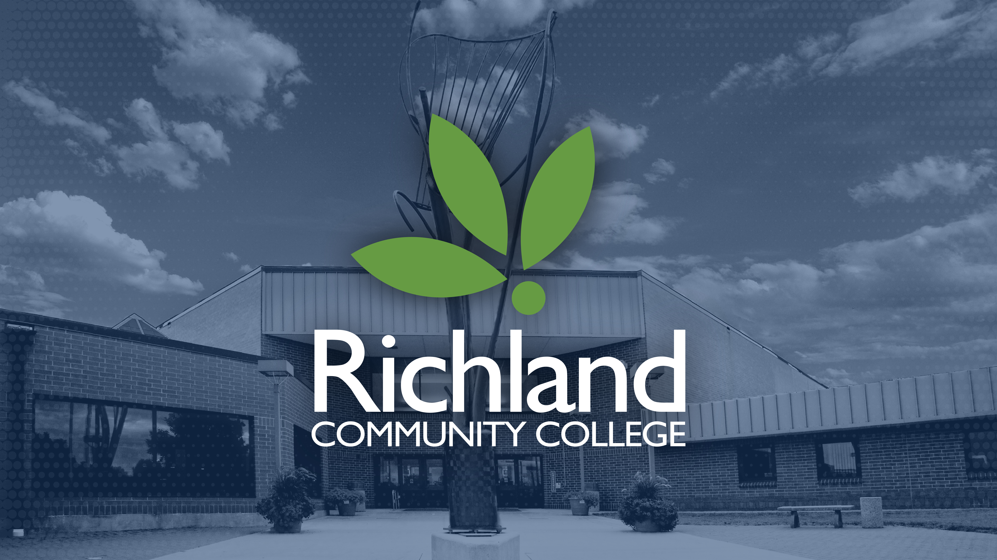

Slide 2

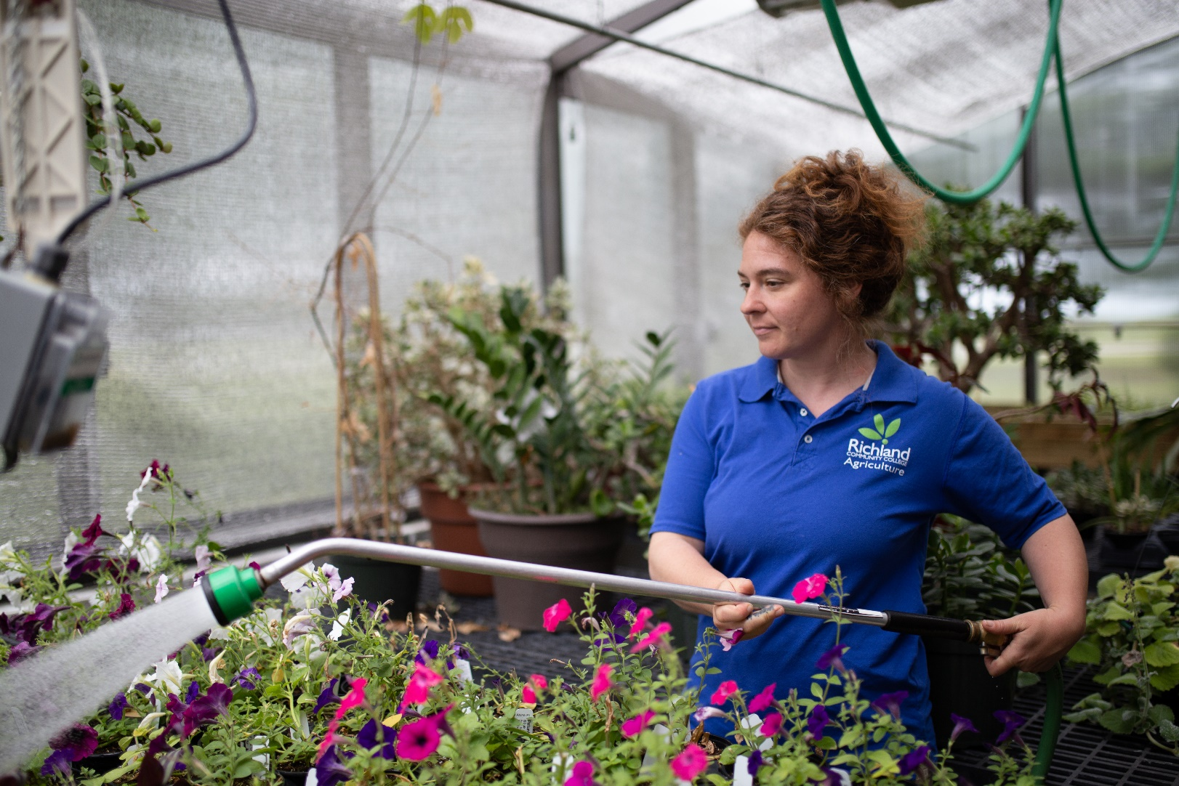
Institutional Effectiveness
Ongoing activities align to support our college mission and values
Strategic Planning
HLC Accreditation
Franklin Covey
HLC Assessment Academy

Slide 3
Strategic Planning
2020-2022 Strategic Plan
2024-2026 Strategic Plan
Co-champions and teams working on the final report
Strategies will be marked as: completed, move to next plan, or remove
Final Report to Board of Trustees in November/December 2023
Use of 4 Goals with newly identified Strategies and Activities
Environmental Scan – trends and data
Focus Groups – internal and external
Draft plan to Board of Trustees in December 2023 with action in January 2024

Slide 4
HLC Accreditation
Open Pathway Assurance Argument and Site Visit
Higher Learning Commission – Accrediting Body
Assurance Argument – Narrative and artifacts submitted to HLC by January 2, 2024
Comprehensive Visit – scheduled February 12-13, 2024

Slide 5
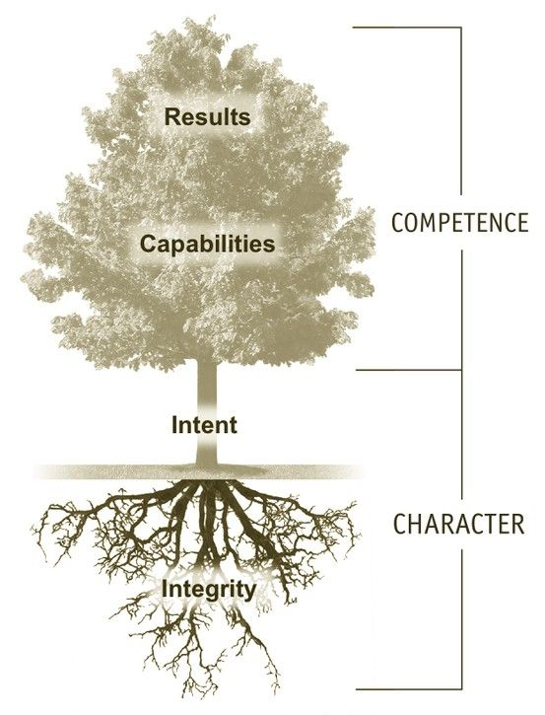
Franklin Covey
The Speed of Trust
In-person, collaborative learning activities
Online Microcourses on topics: building relationships, leading change, unconscious bias, establishing credibility, and more
Improving collaboration between colleagues and students

Slide 6
HLC Assessment Academy
Initial Roundtable- June 2023
Academy Timeline
Student Learning Outcomes
Institutional Learning Outcomes
Sections of the college have their own processes, resulting in “data silos”
4 year commitment (2023-2027)
Milestones by year
- Year 1 – Launch
- Year 2 – Pilot
- Year 3 – Refine & Evaluate
- Year 4 – Sustain & Expand

Slide 7
HLC Assessment Academy
Initial RCC Team
Academy structure
All Deans, Retention Coordinator, Director of Academic Planning, PD of Education
Focus on improving Student Learning Outcomes (SLOs) and Institutional Learning Outcomes (ILOs)
Sections of the college have their own processes, resulting in “data silos”
By standardizing assessment processes, we will be able to use the data in a more meaningful way
HLC Mentor - provides feedback, suggestions and advice on the progress of the team’s Academy work
HLC Scholar and Facilitators – more expert feedback
SparQ – shared learning community with access to hundreds of past projects (past completers and currently enrolled institutions)

Slide 8
Why are we doing all of this?
RCC’s Goal statement for HLC Academy:
Richland Community College’s goal is to revitalize Assessment and “close the loop” of process and communication. At the end of the four-year commitment, Richland Community College will have a robust, comprehensive Assessment Program that will include the following elements:
Integrated
Clearly defined
Public
Standardized
Relevant to stakeholder groups

Slide 9
Why are we doing all of this?
To support our college mission and values
To empower individuals through learning and to forge partnerships that grow communities
QUESTIONS?

Slide 10

