Slide 1
MACON COUNTY LAW ENFORCEMENT
TRAINING CENTER
A partnership between the Illinois Law Enforcement Training & Standards Board
and Richland Community College

Slide 2
Basic Law Enforcement Academies
Scheduled in Calendar Year 2023
RC23-19 -Sunday, January 8 – Friday, April 28, 2023
RC23-20 -Sunday, May 7 – Friday, August 25, 2023
RC23-21 -Tuesday, September 5 – Friday, December 22, 2023

Slide 3
Basic Corrections Academies
Scheduled in Calendar Year 2023
CC23-16 Sunday, January 22 – Friday, February 24, 2023
CC23-17 Sunday, April 2 – Friday, May 5, 2023
CC23-18 Sunday, June 25- Friday, August 18, 2023
CC23-19 Sunday, September 17 – November 10, 2023

Slide 4
Illinois Department of Corrections
Scheduled in Calendar Year 2023
7 CLASSES MINIMUM
100 PER CLASS

Slide 5
2023 Estimated Enrollment
Basic Law Enforcement 210
Basic Correctional Cadets 200
IDOC Correctional Cadets 700

Slide 6
YTD GRADUATES
(2018- Present)
Basic Corrections 517
Basic Law Enforcement 1025

Slide 7
New Projects/Proposals
IDNR
U.S. Marshall’s
Indiana University Police
Additional Outside Training
Improve Marketing Ourselves
Academy Internships

Slide 8
STAFFING (20)
1 Commander
1 Deputy Commander
1 Director of Training
1 Class Coordinator
1 Coordinators of Operations
1 Housekeeping Supervisor
6 Housekeepers
1 Part Time Maintenance
1 IT
6 Culinary Staff ( RCC Culinary Budget)

Slide 9
2023 ESTIMATED REVENUES
BLE TUITION $ 1.25 Million
BCO Tuition $ $740,000
IDOC Contractual $ 1.16 Million
Other Misc. $150,000

Slide 10
2023 Estimated Expenses
Salaries and Benefits $ 1.3 Million
Operational Costs $ 1.85 Million
  Meals Accounts for $1.1 Million
  Ammo for Training $100,000
  Uniforms $100,000

Slide 11
FUTURE EXPENDITURES
Range Reclamation
Range Filters
Building Maintenance

Slide 12
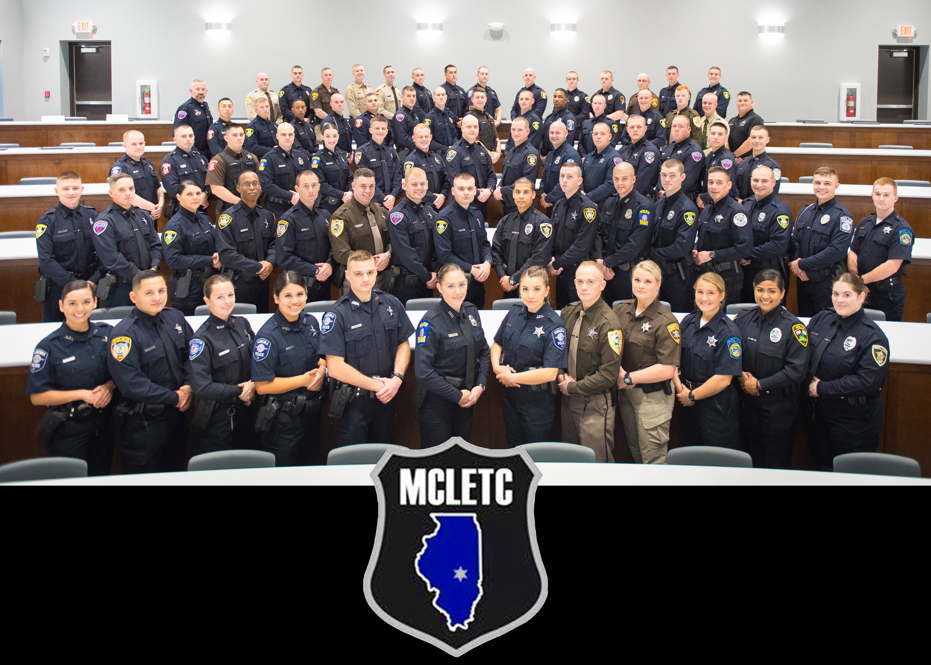
Recruit Class 22-18

Slide 13
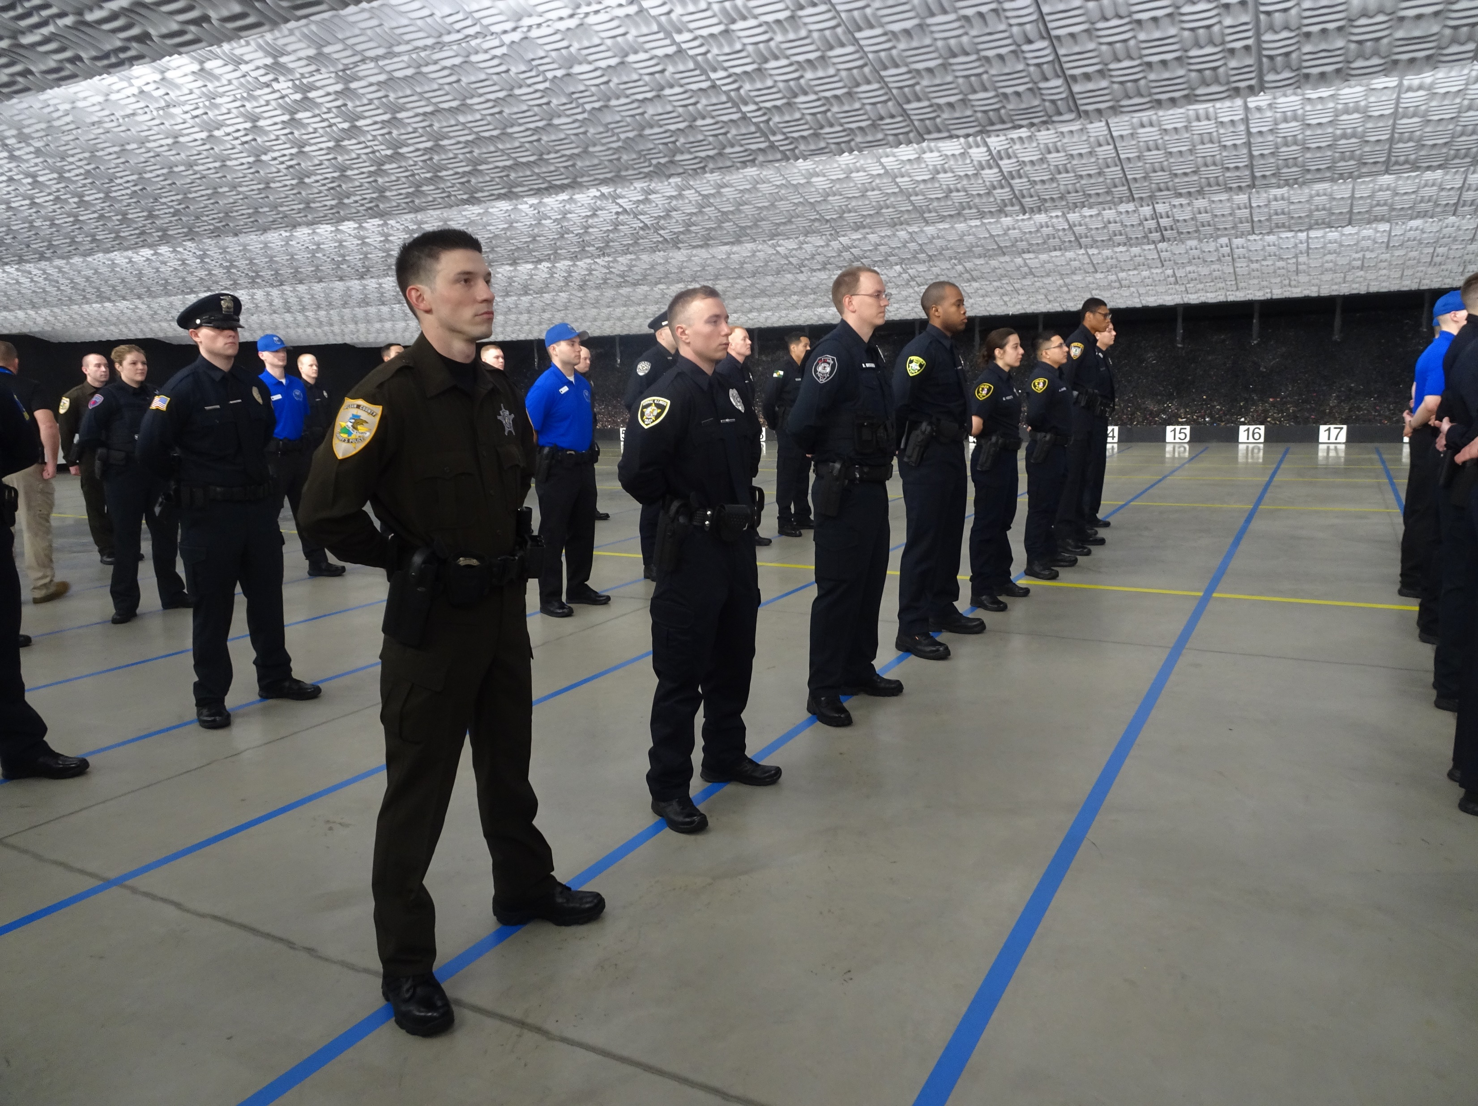

Slide 14
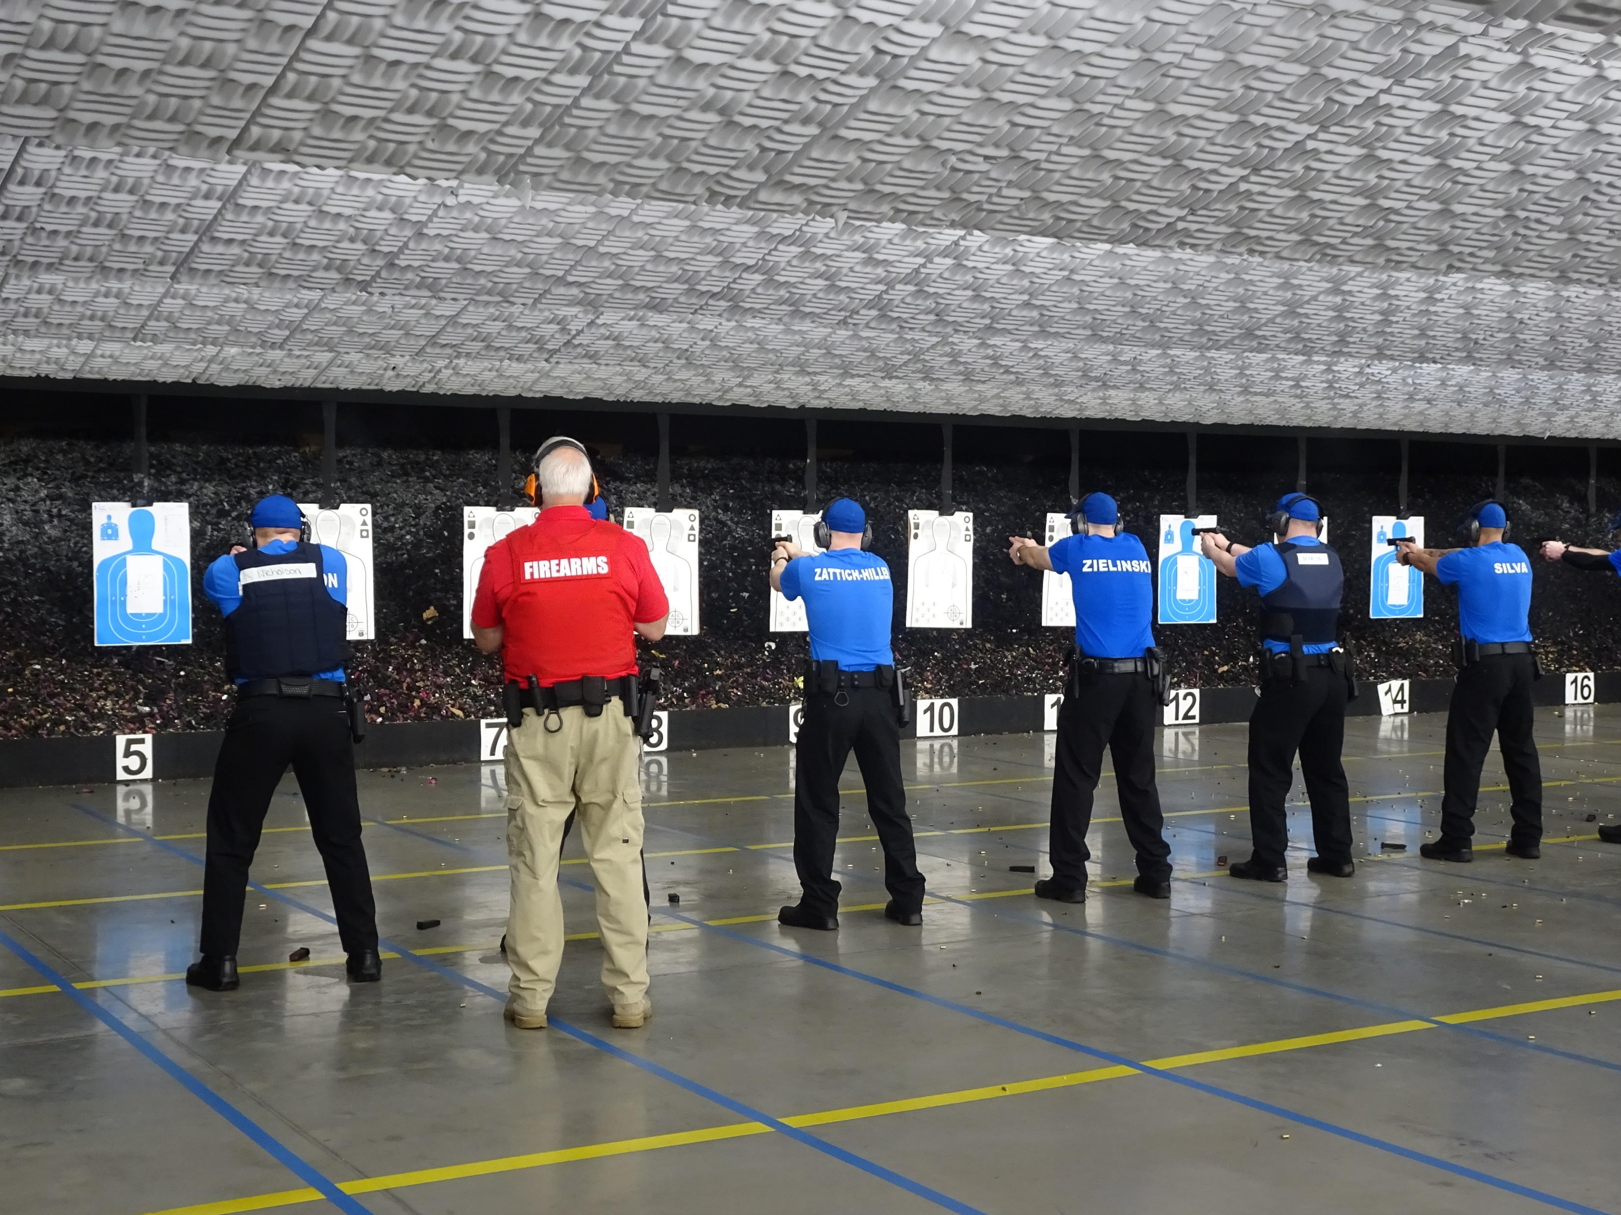

Slide 15
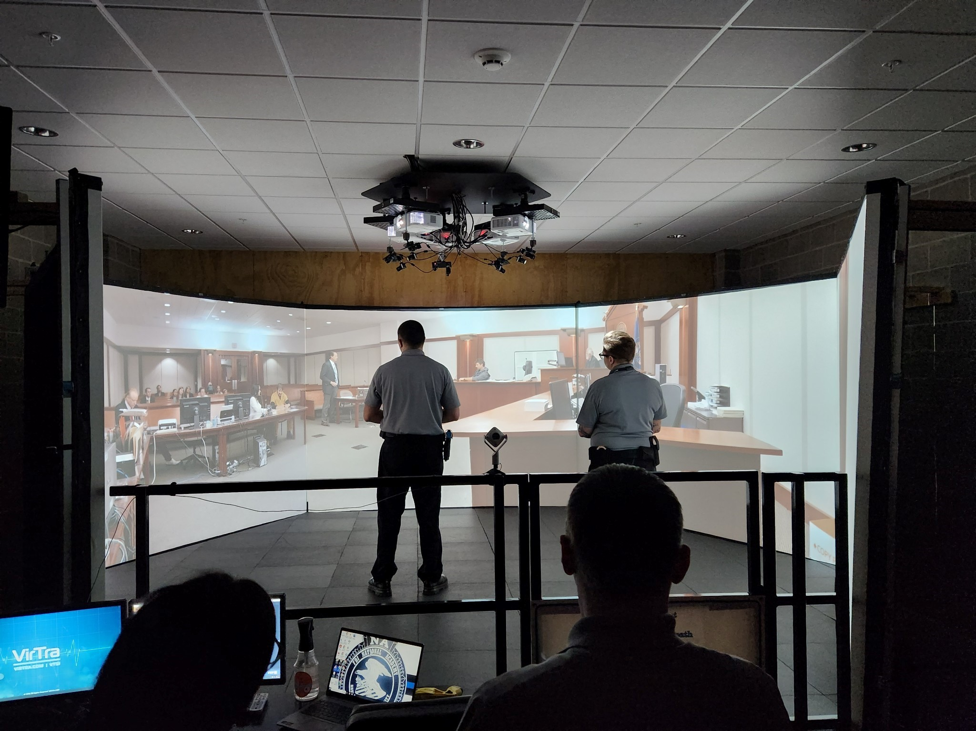

Slide 16
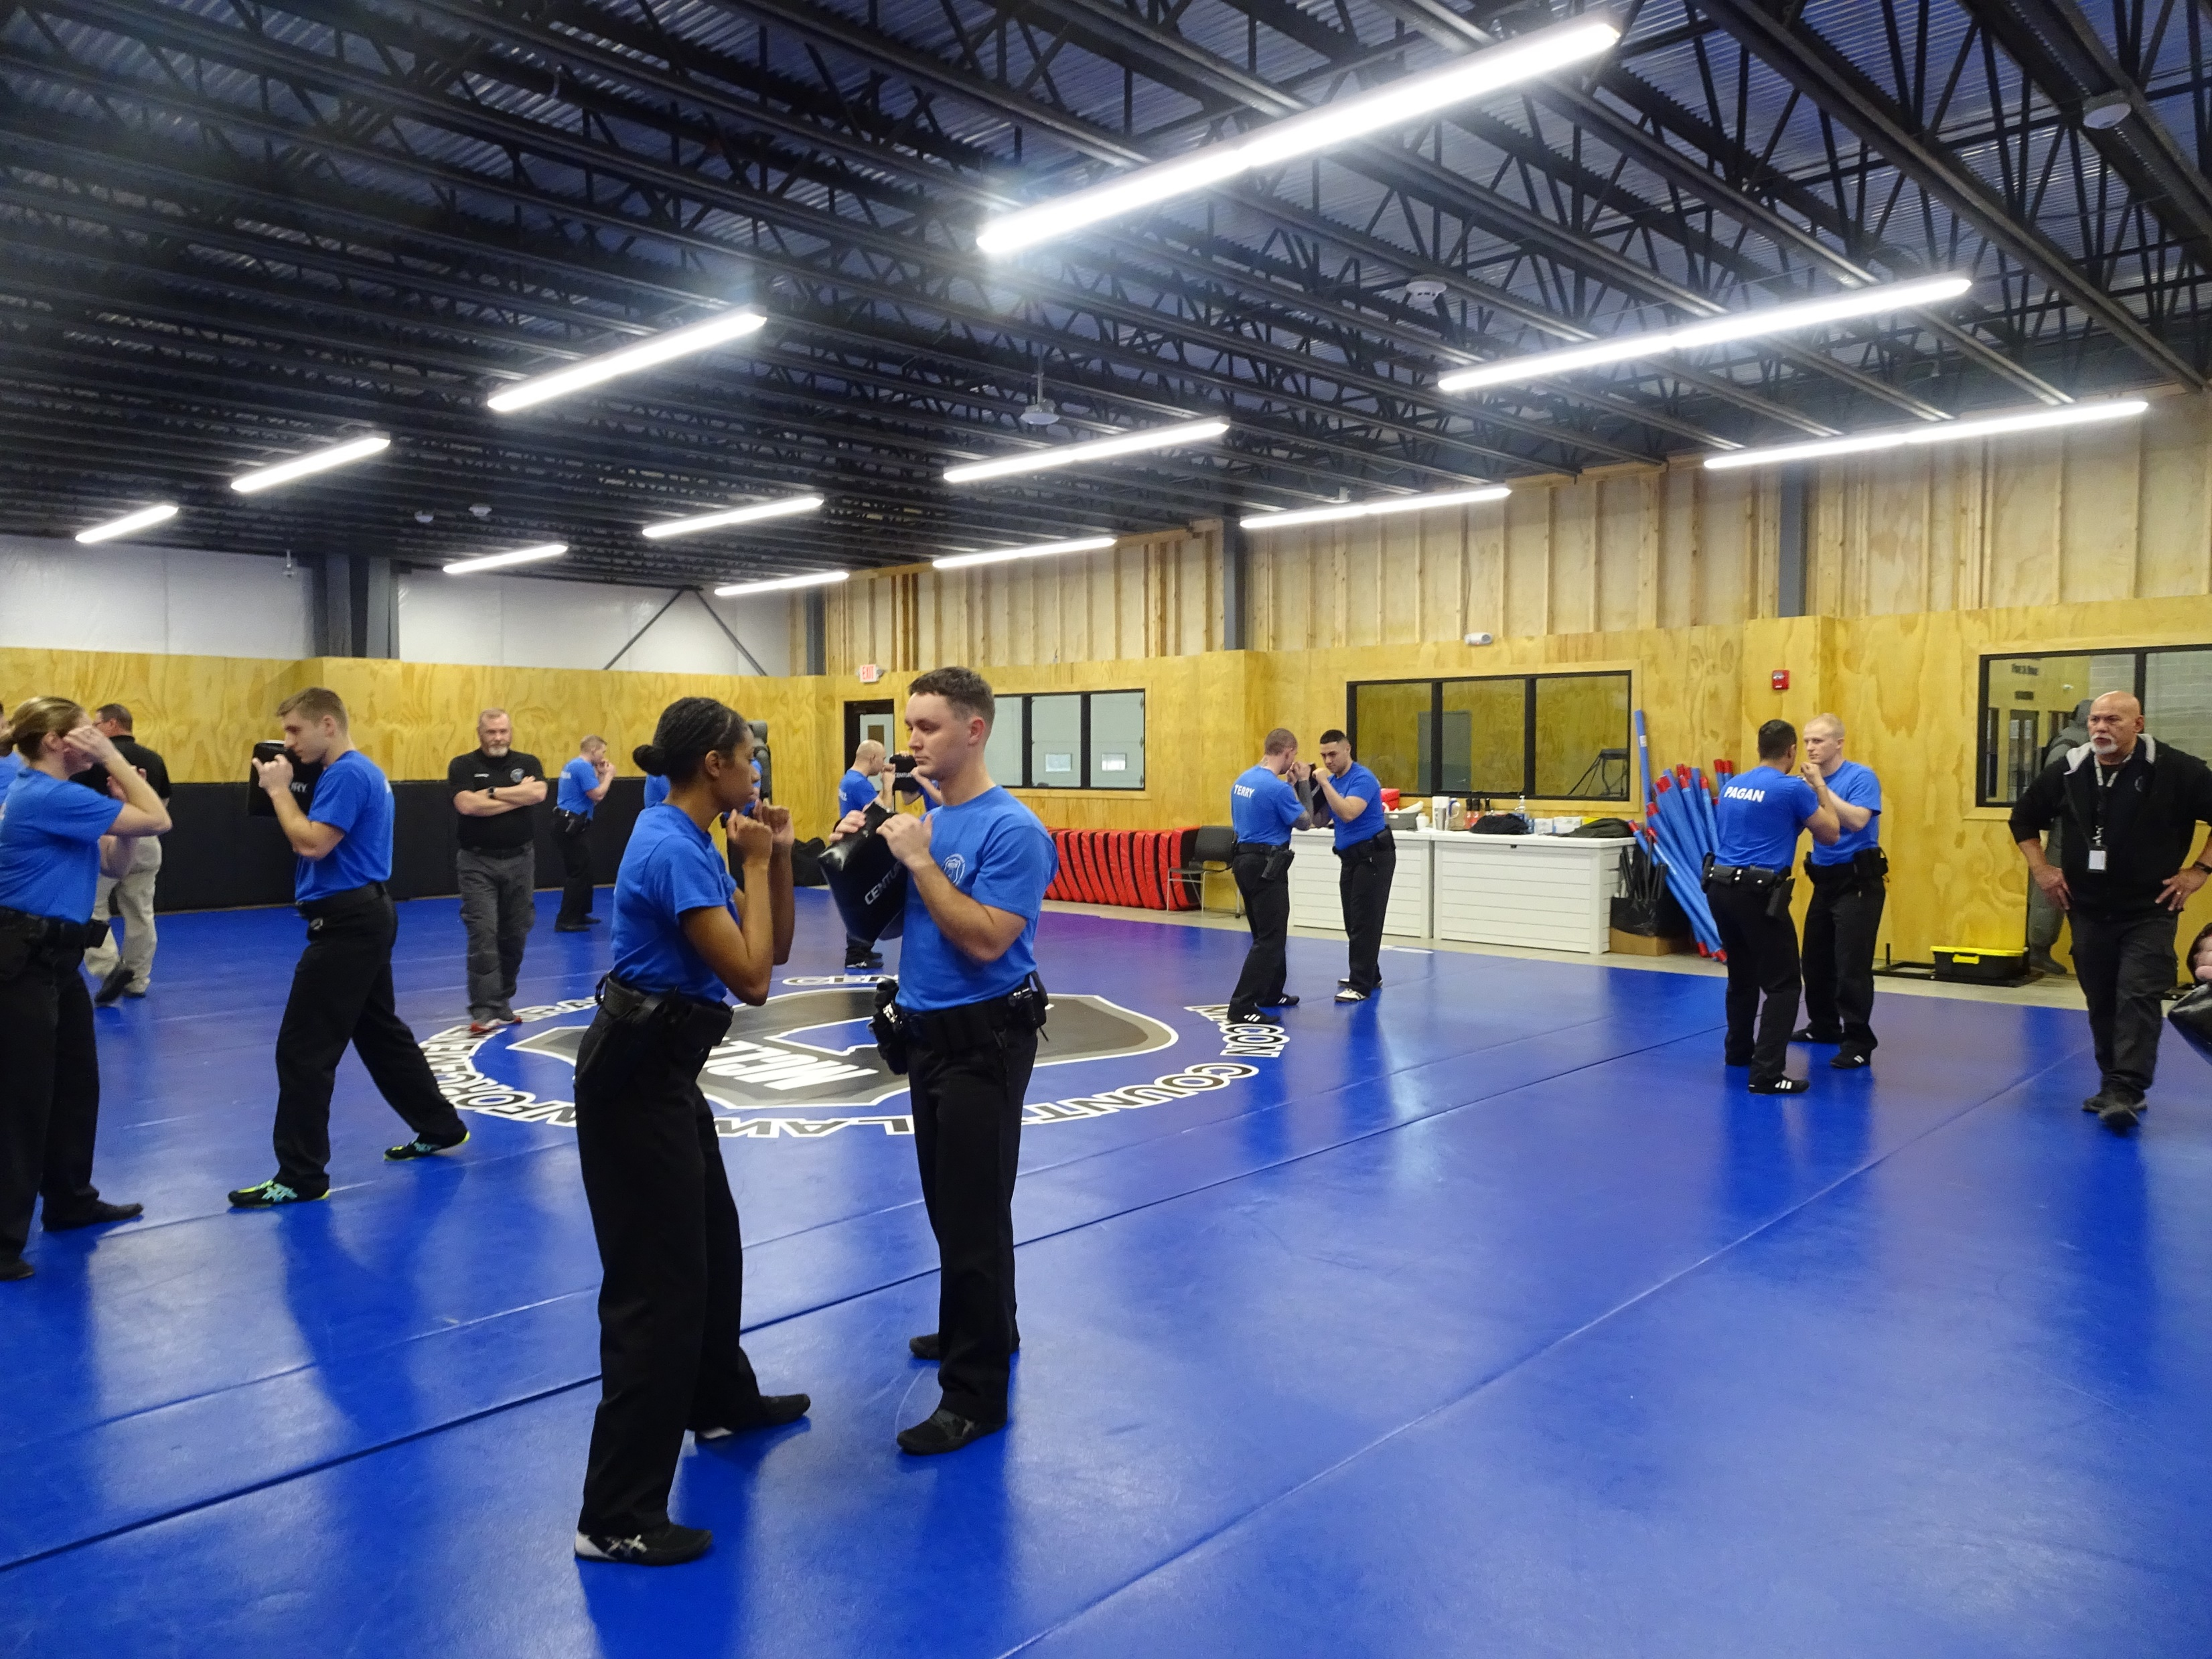

Slide 17
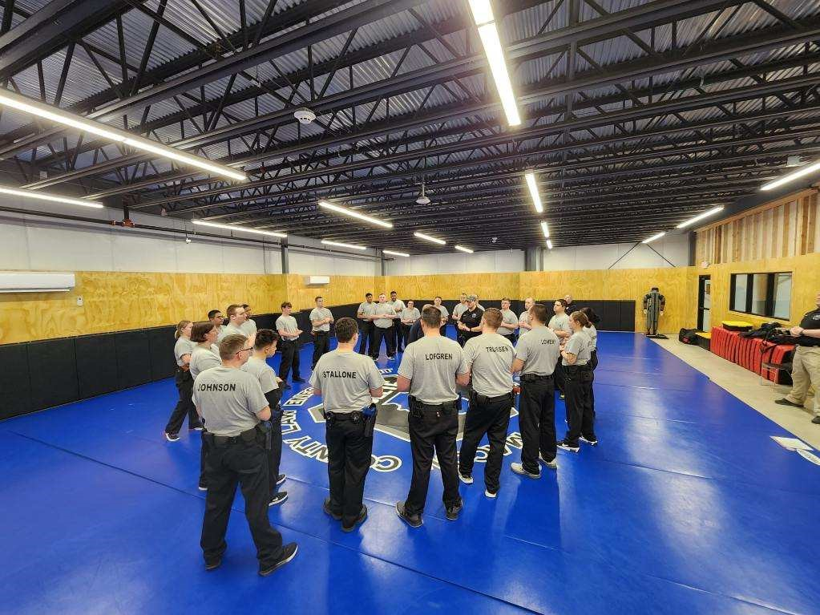

Slide 18
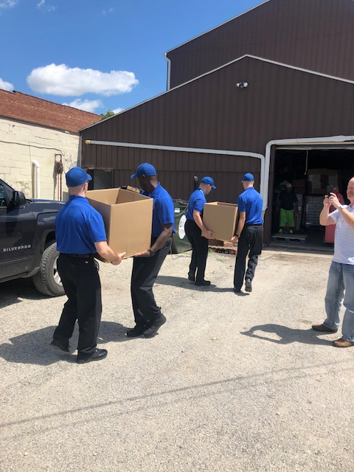
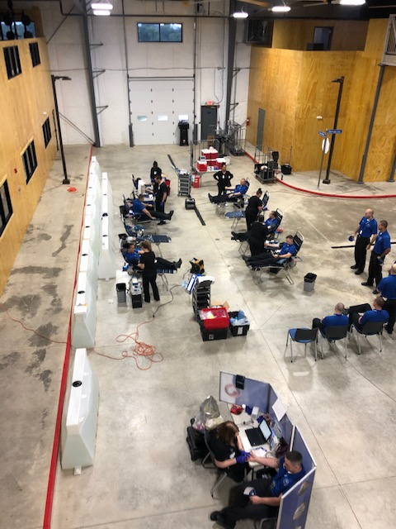
Special Projects

Slide 19
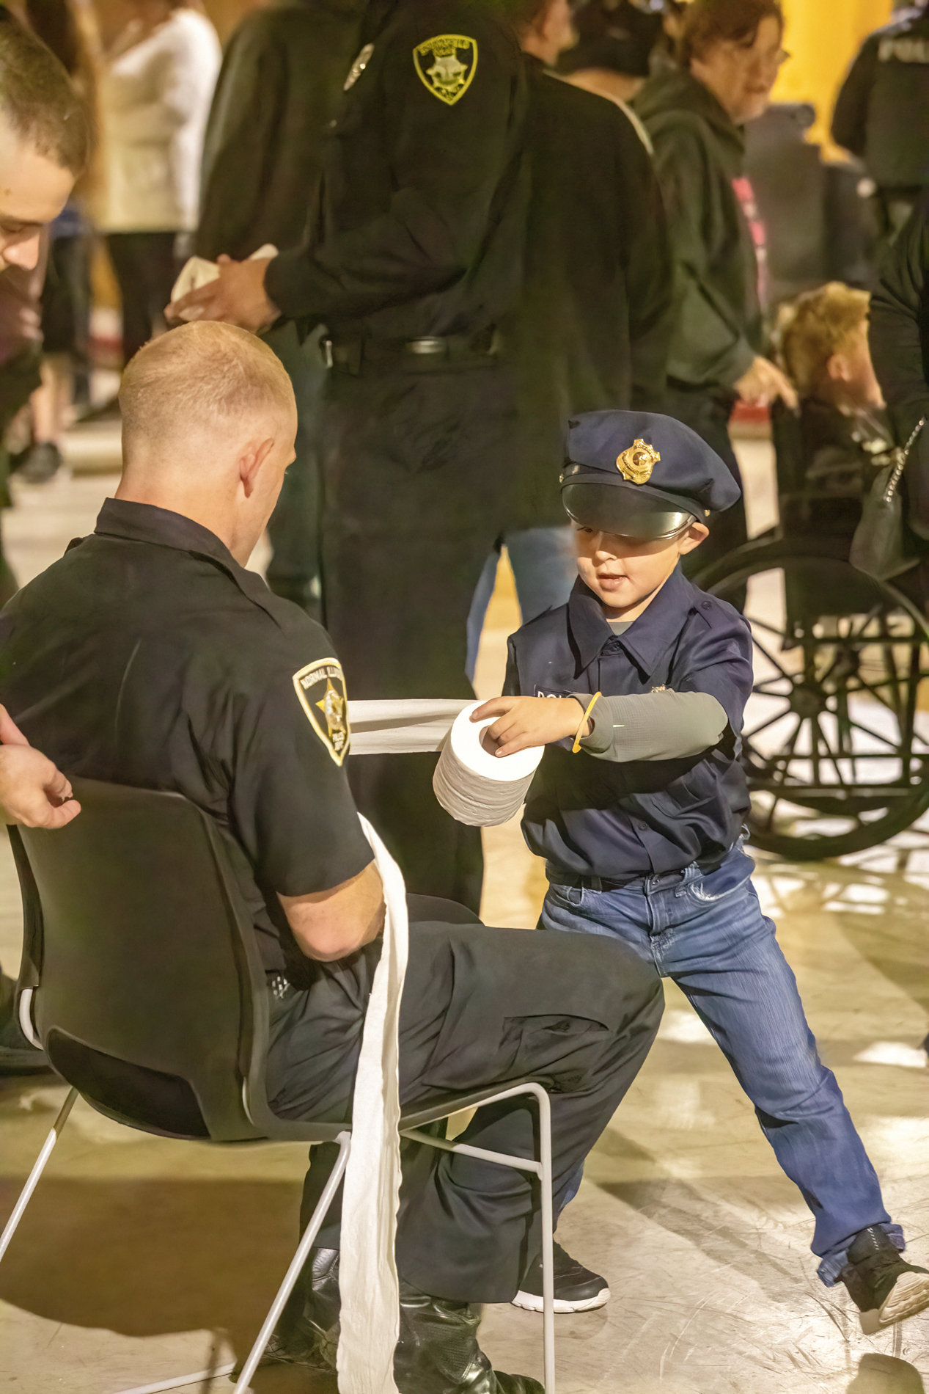
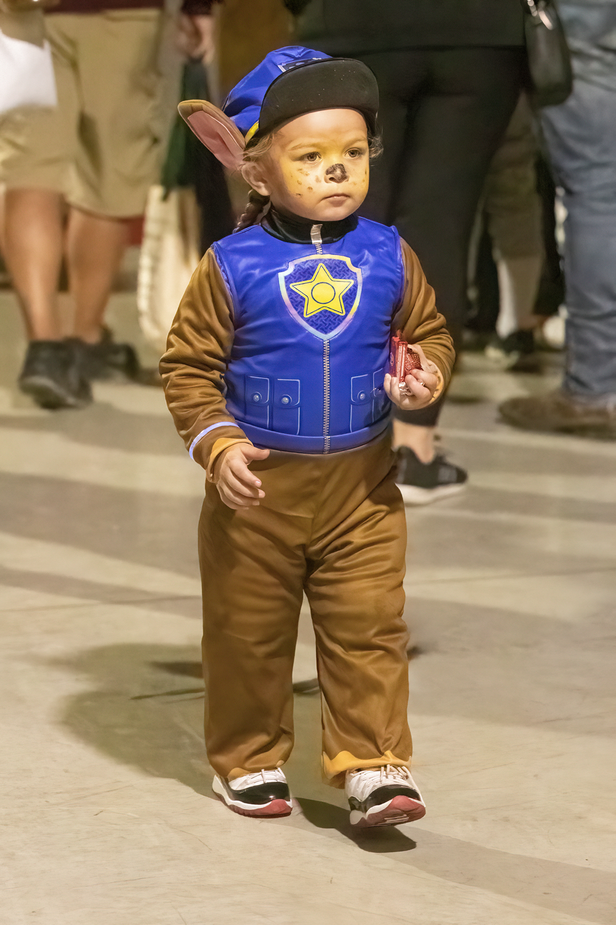
Halloween 2022

Slide 20
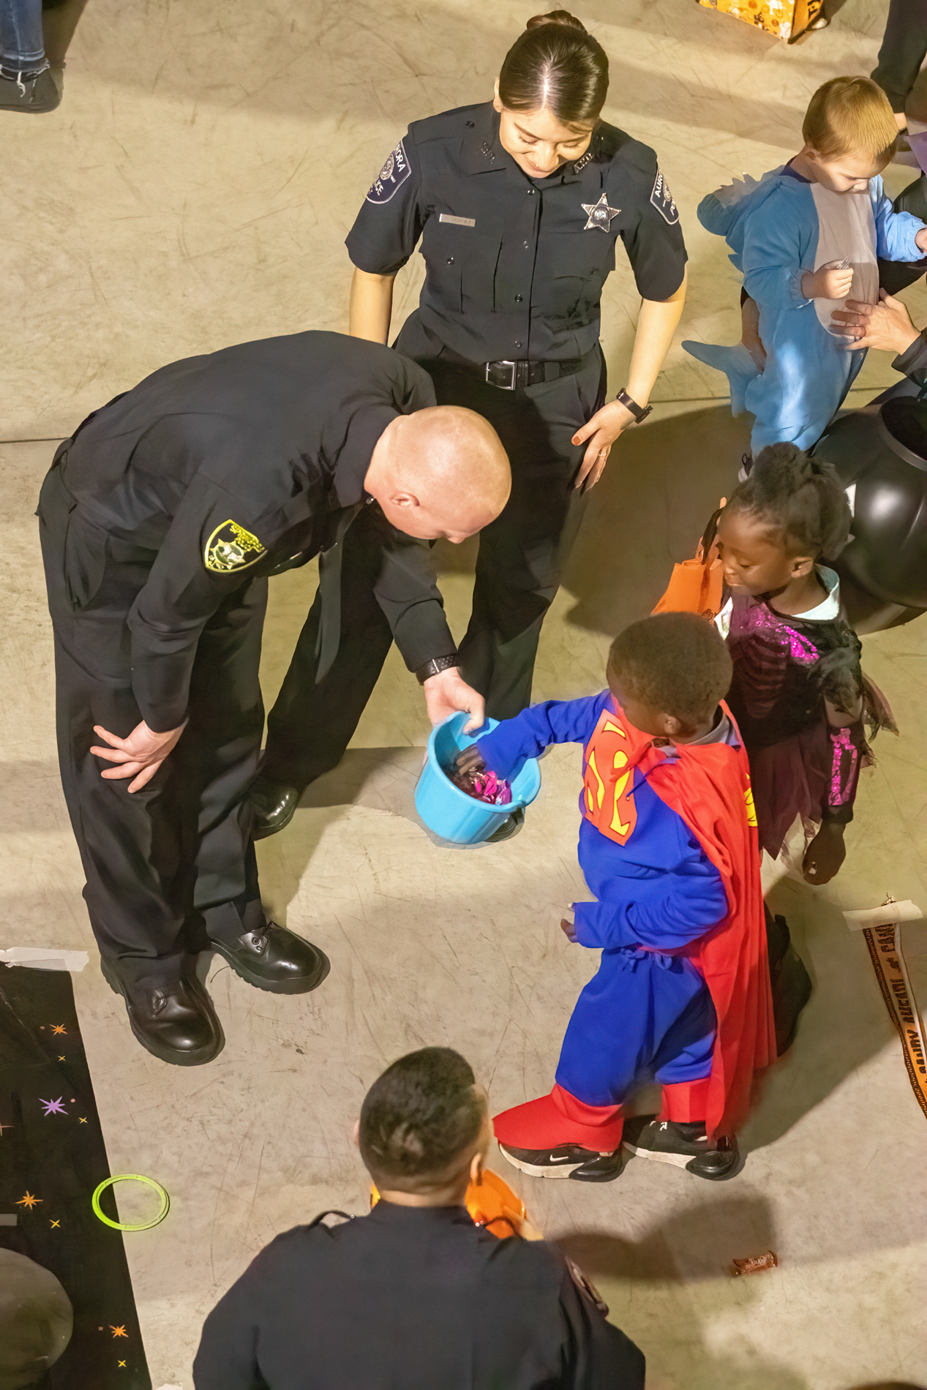

Slide 21
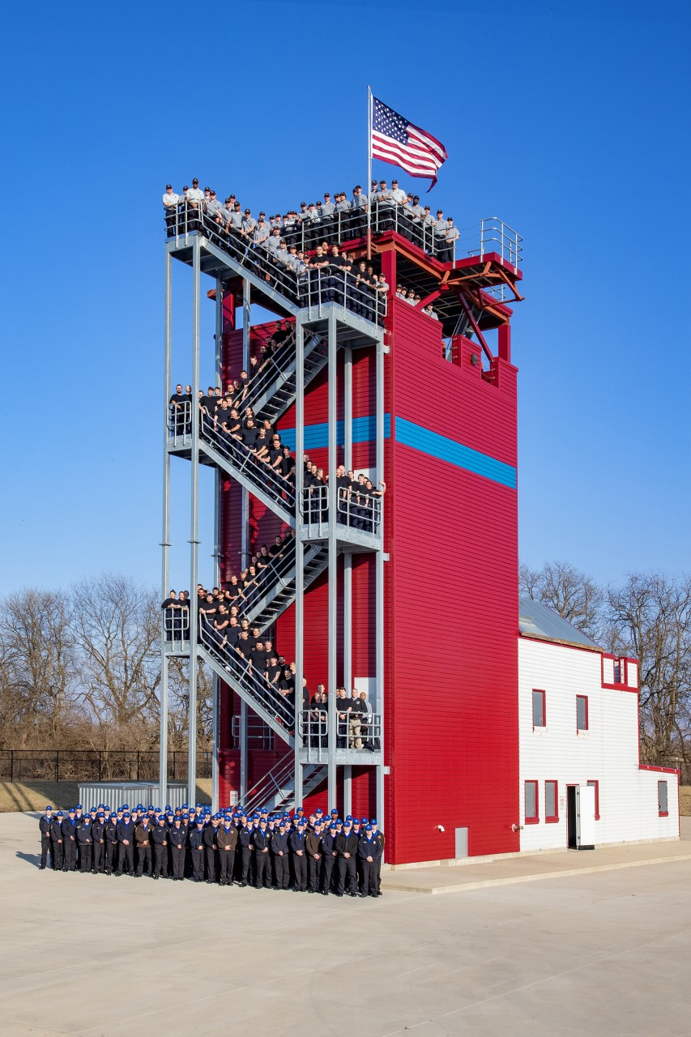
Fire Tower

Slide 22
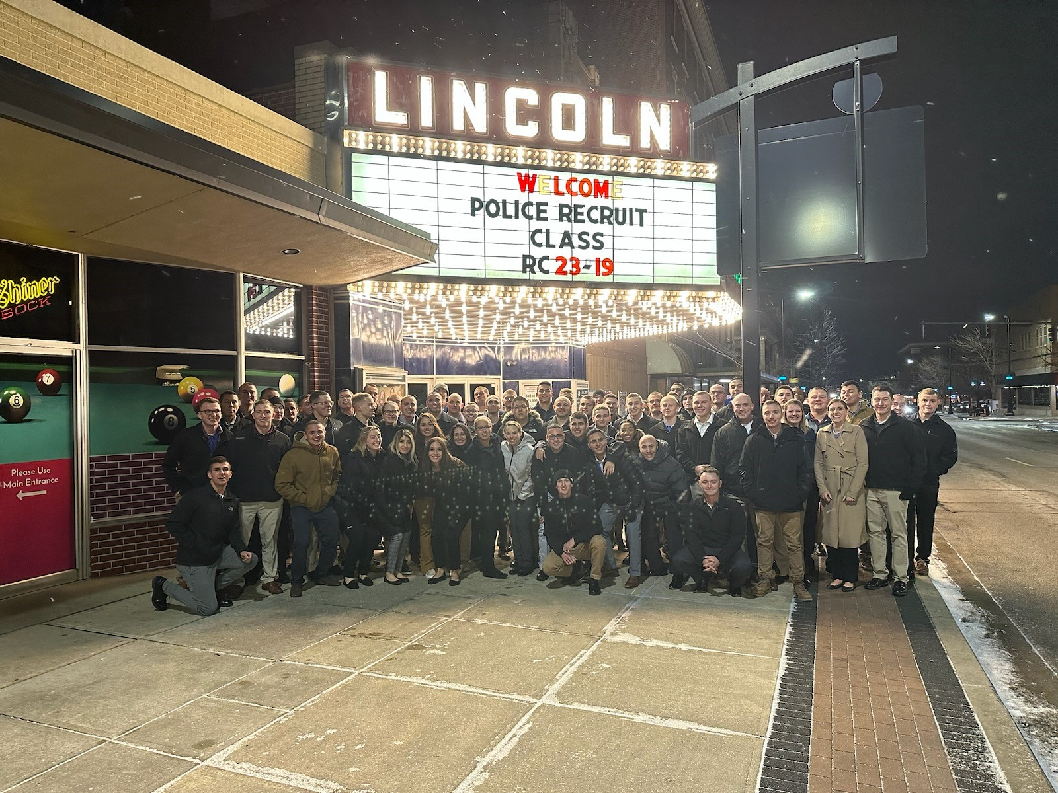
Downtown Decatur

Slide 23
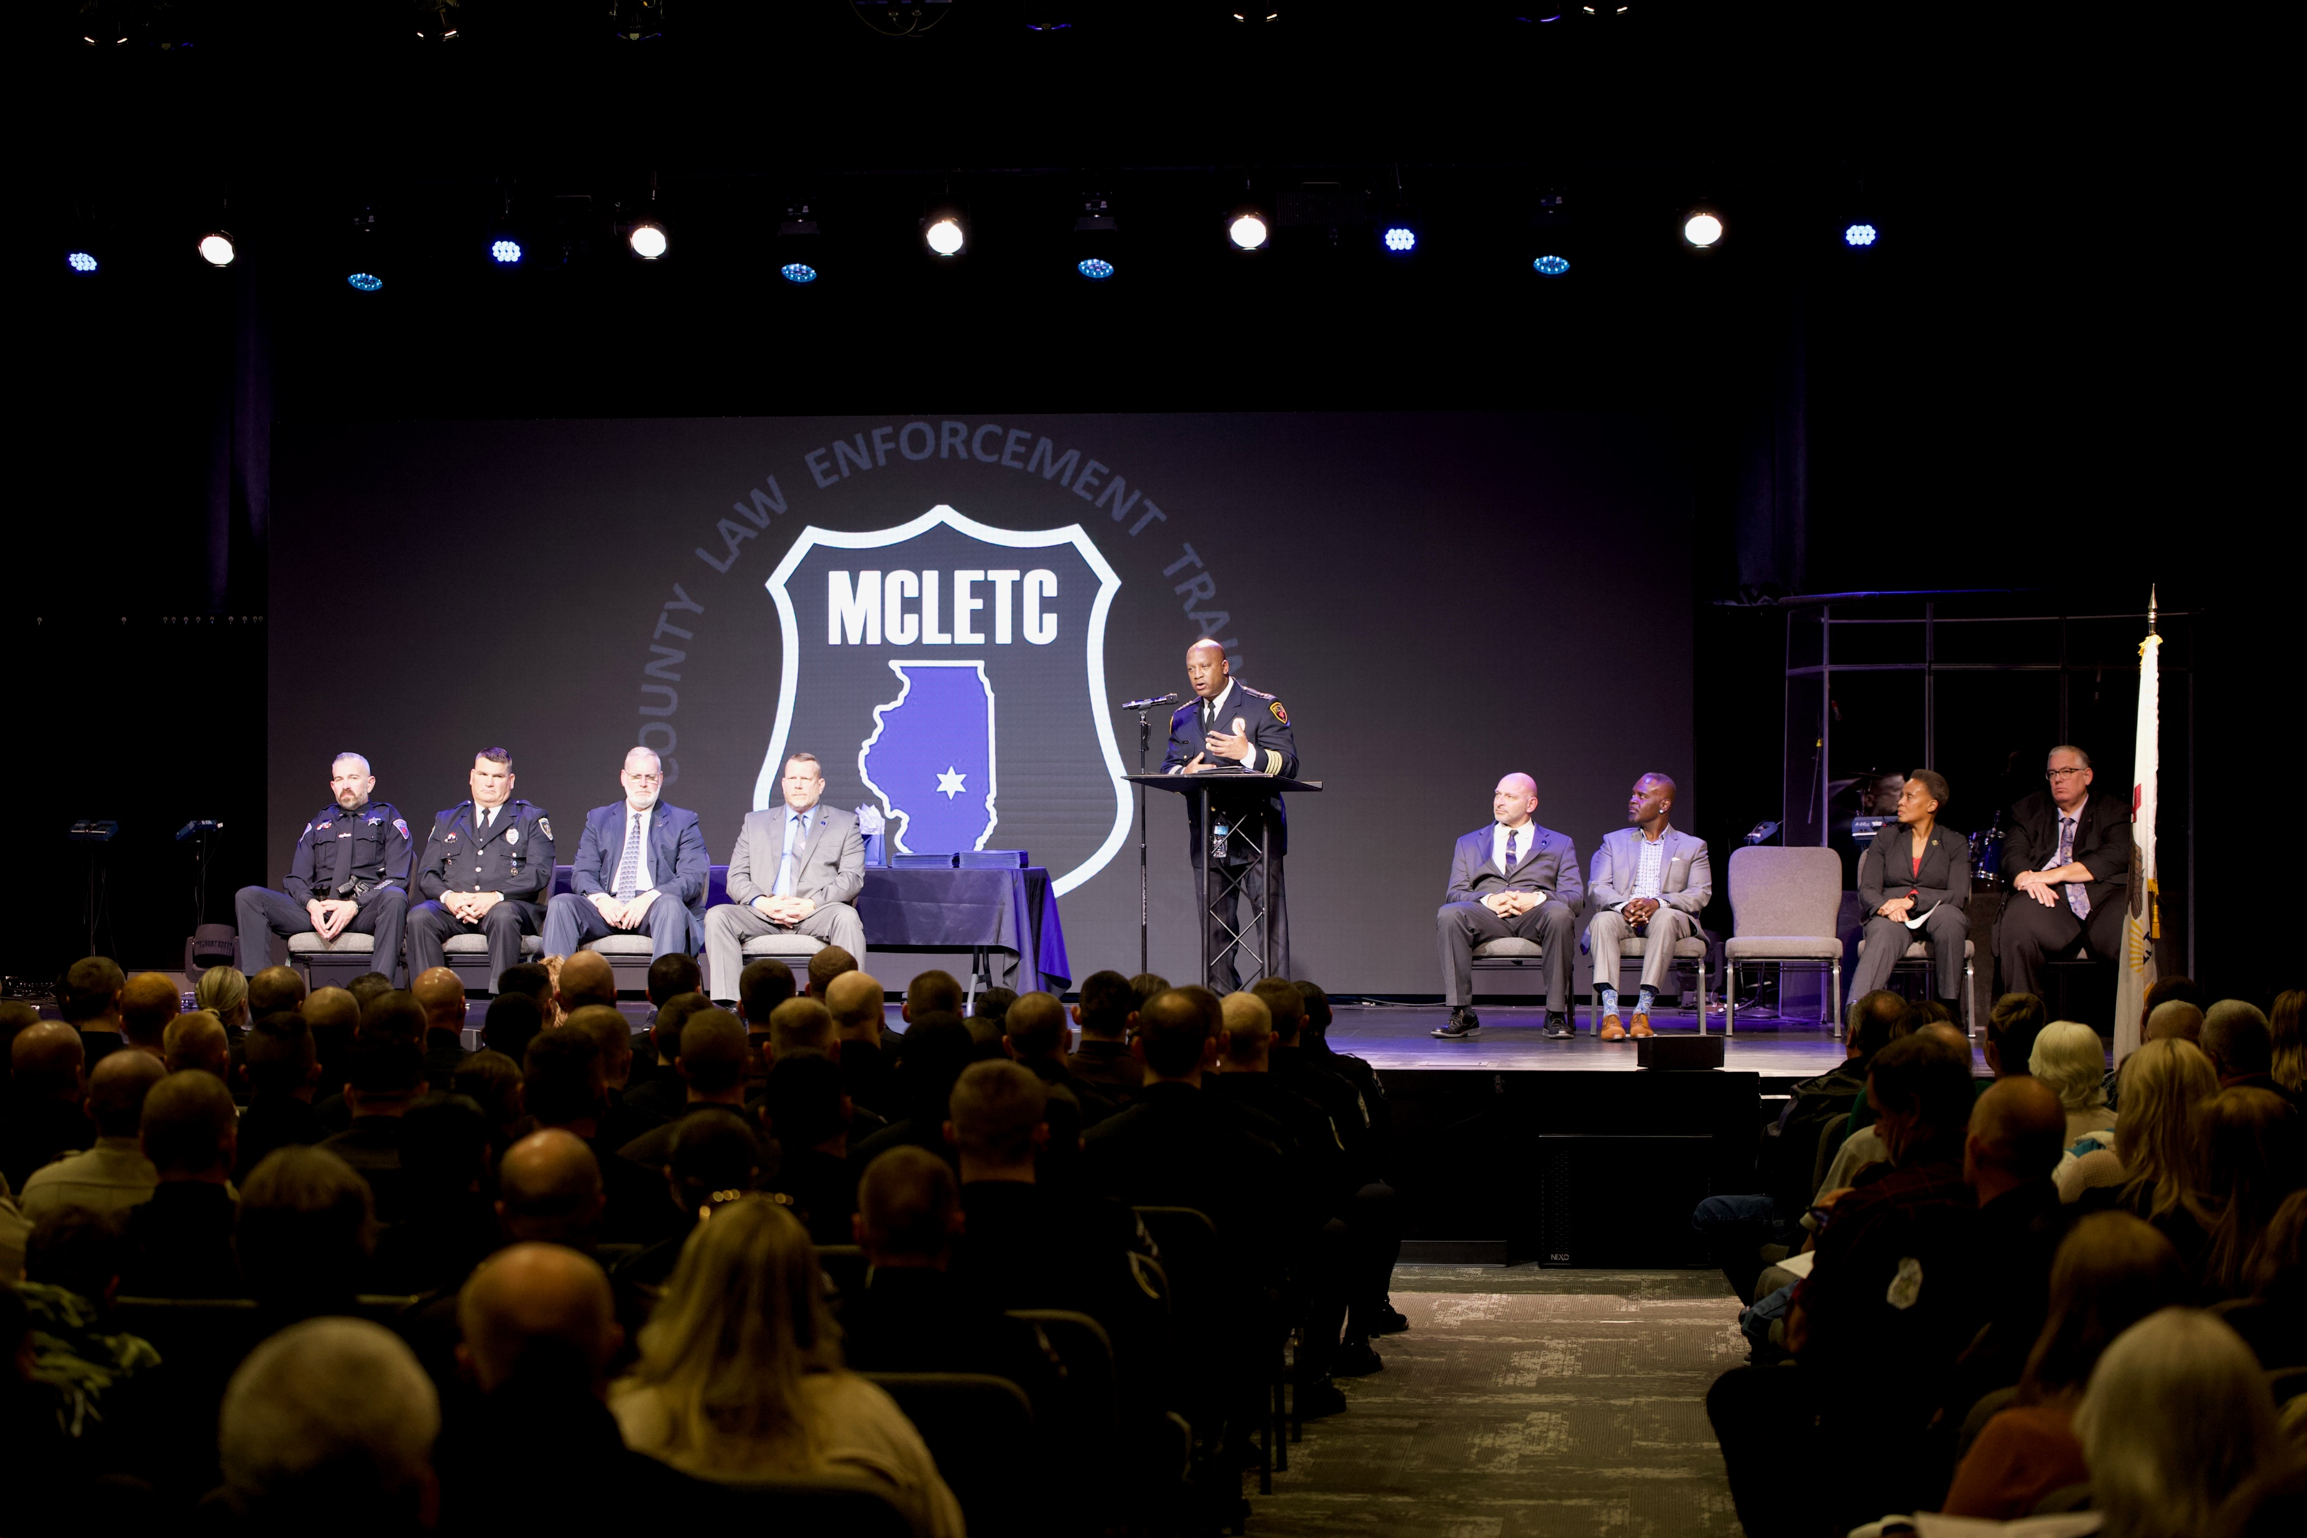
Recruit Class 22-18 Graduation

Slide 24
TOURS
State of Illinois Comptroller Susana Mendoza
State of Illinois Deputy Governor Andy Manar
DPS 61
Mount Zion High School
Golden K Kiwanis
Capital Area Career Center
Numerous Law Enforcement Agencies

Slide 25
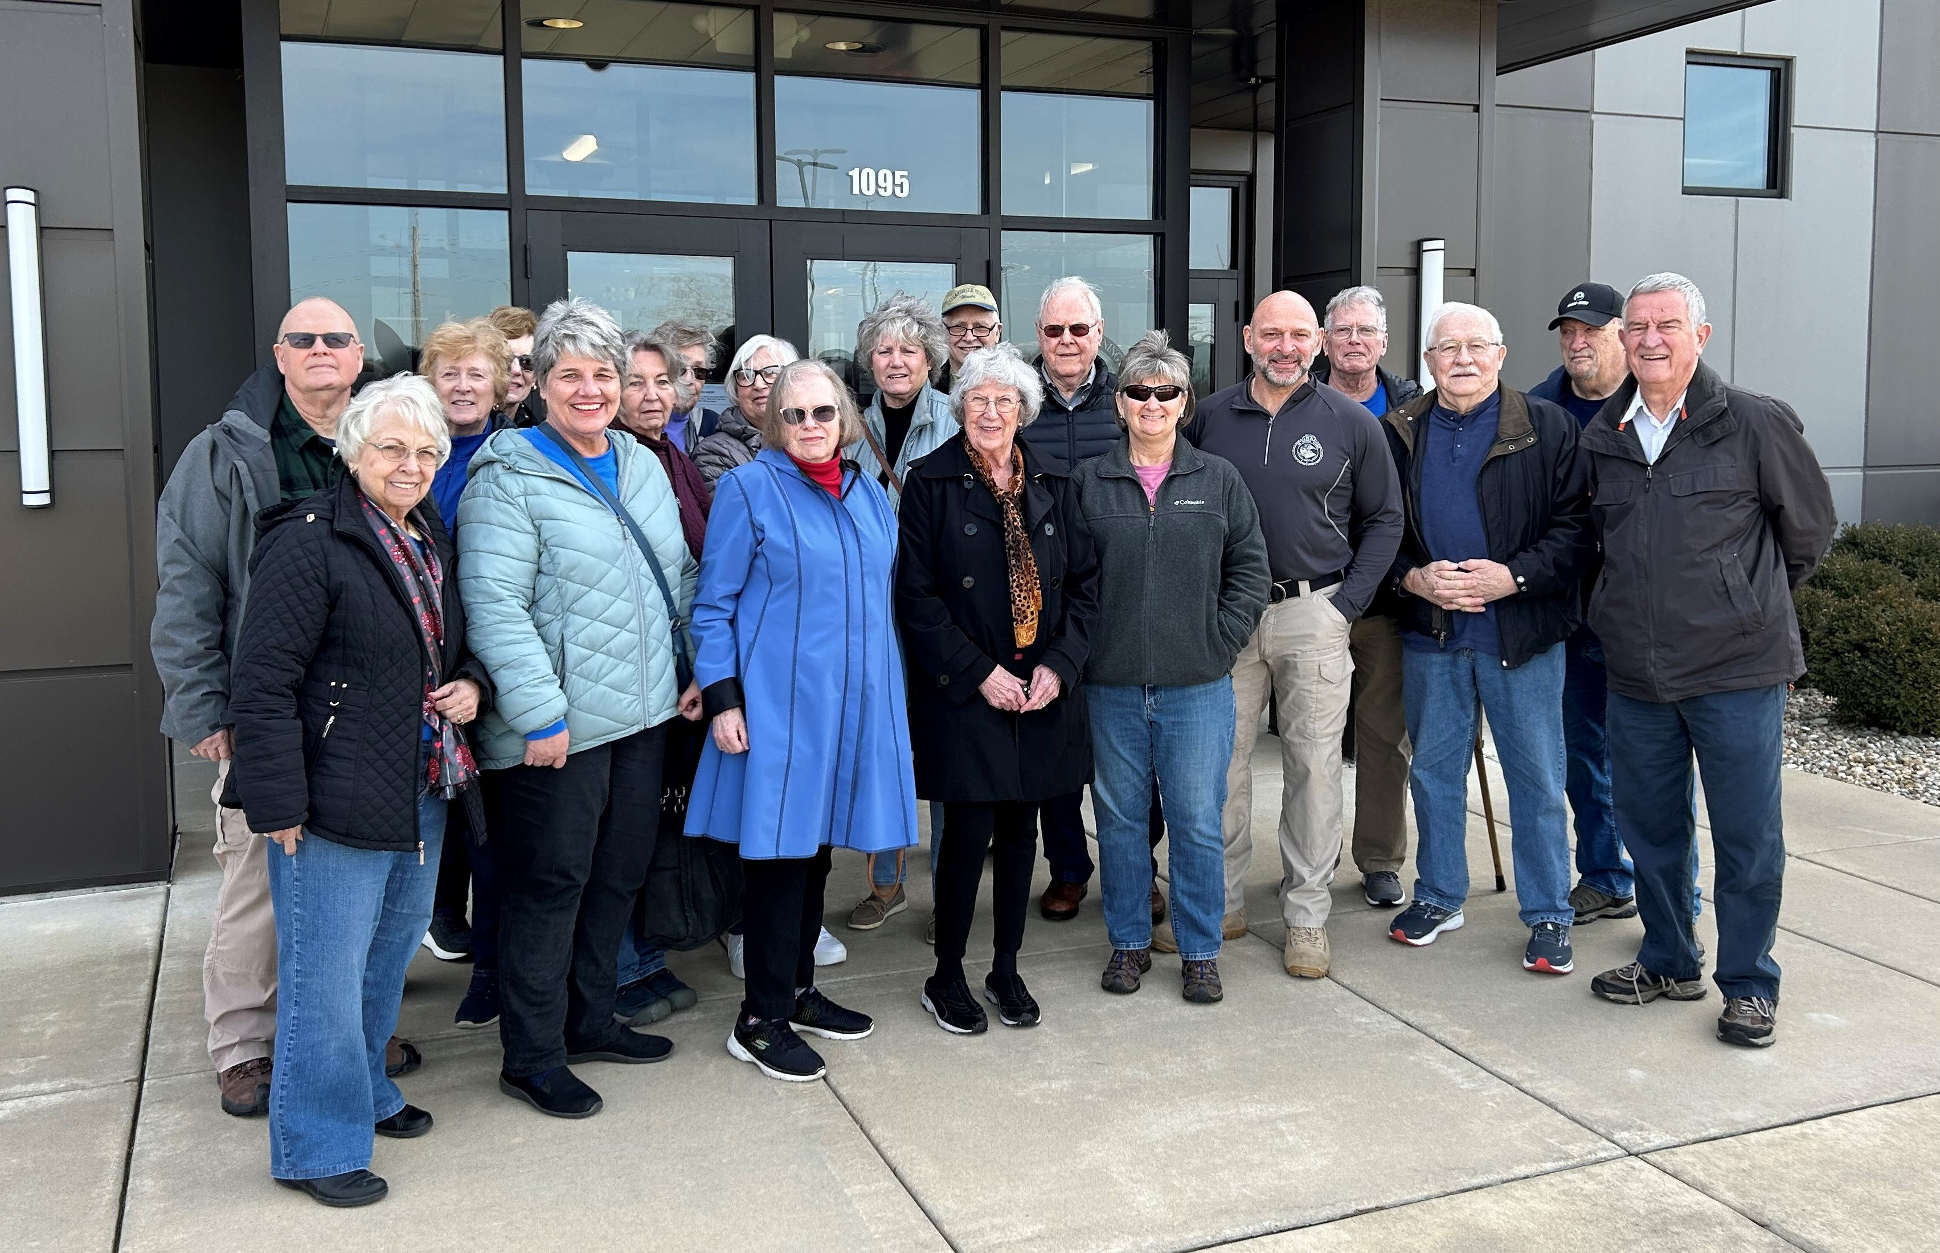
Golden K Kiwanis Tour

Slide 26
Events
Illinois Municipal League Mayor’s Convention
Hosted Macon/Piatt Regional Officer for Cyberbullying Class
Hosted State of Illinois Wardens Retreat
ROMEO Club
United Way Meeting

Slide 27
UPCOMING
UKRANIAN POLICE ACADEMY ADMINISTRATORS AND INSTRUCTORS
HEARTLAND TECHNICAL ACADEMY
CENTRAL ILLINOIS FIRST RESONDERS CAR SHOW- May 20,2023

Slide 28
Jim Getz
Commander
Macon County Law Enforcement
Training Center
1095 Rotary Way
Decatur, IL 62521
217-875-7211, ext. 1603
217-330-4705 mobile
jgetz@richland.edu

