Slide 1

NAME OF DCLI PRESENTATION HEADER

Slide 2

Student Profile & Enrollment
Impact Report
Meredith Johnson-Palmer
Executive Dean, Student Success
Richland Community College (Dist. #537)

Slide 3
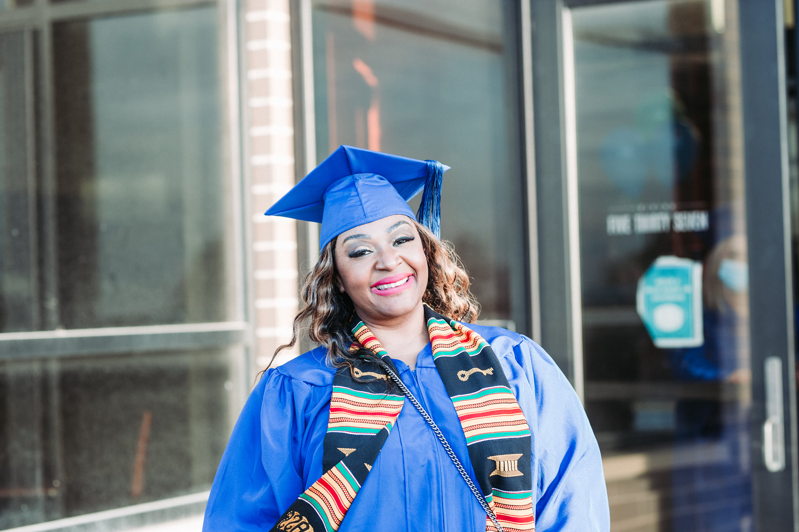

Student Types

Slide 4
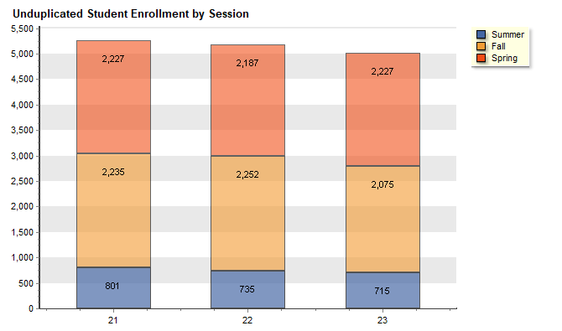
Student Enrollment by Session

Slide 5
Current Student Demographics

Slide 6
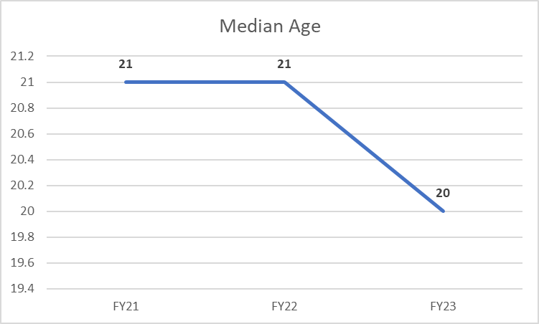
Current Student Demographics

Slide 7

Enrollment Trends
High School Students
25% - 30% of our enrollment are high school students.
Even as headcount has varied, HS enrollment has remain steady.

Slide 8
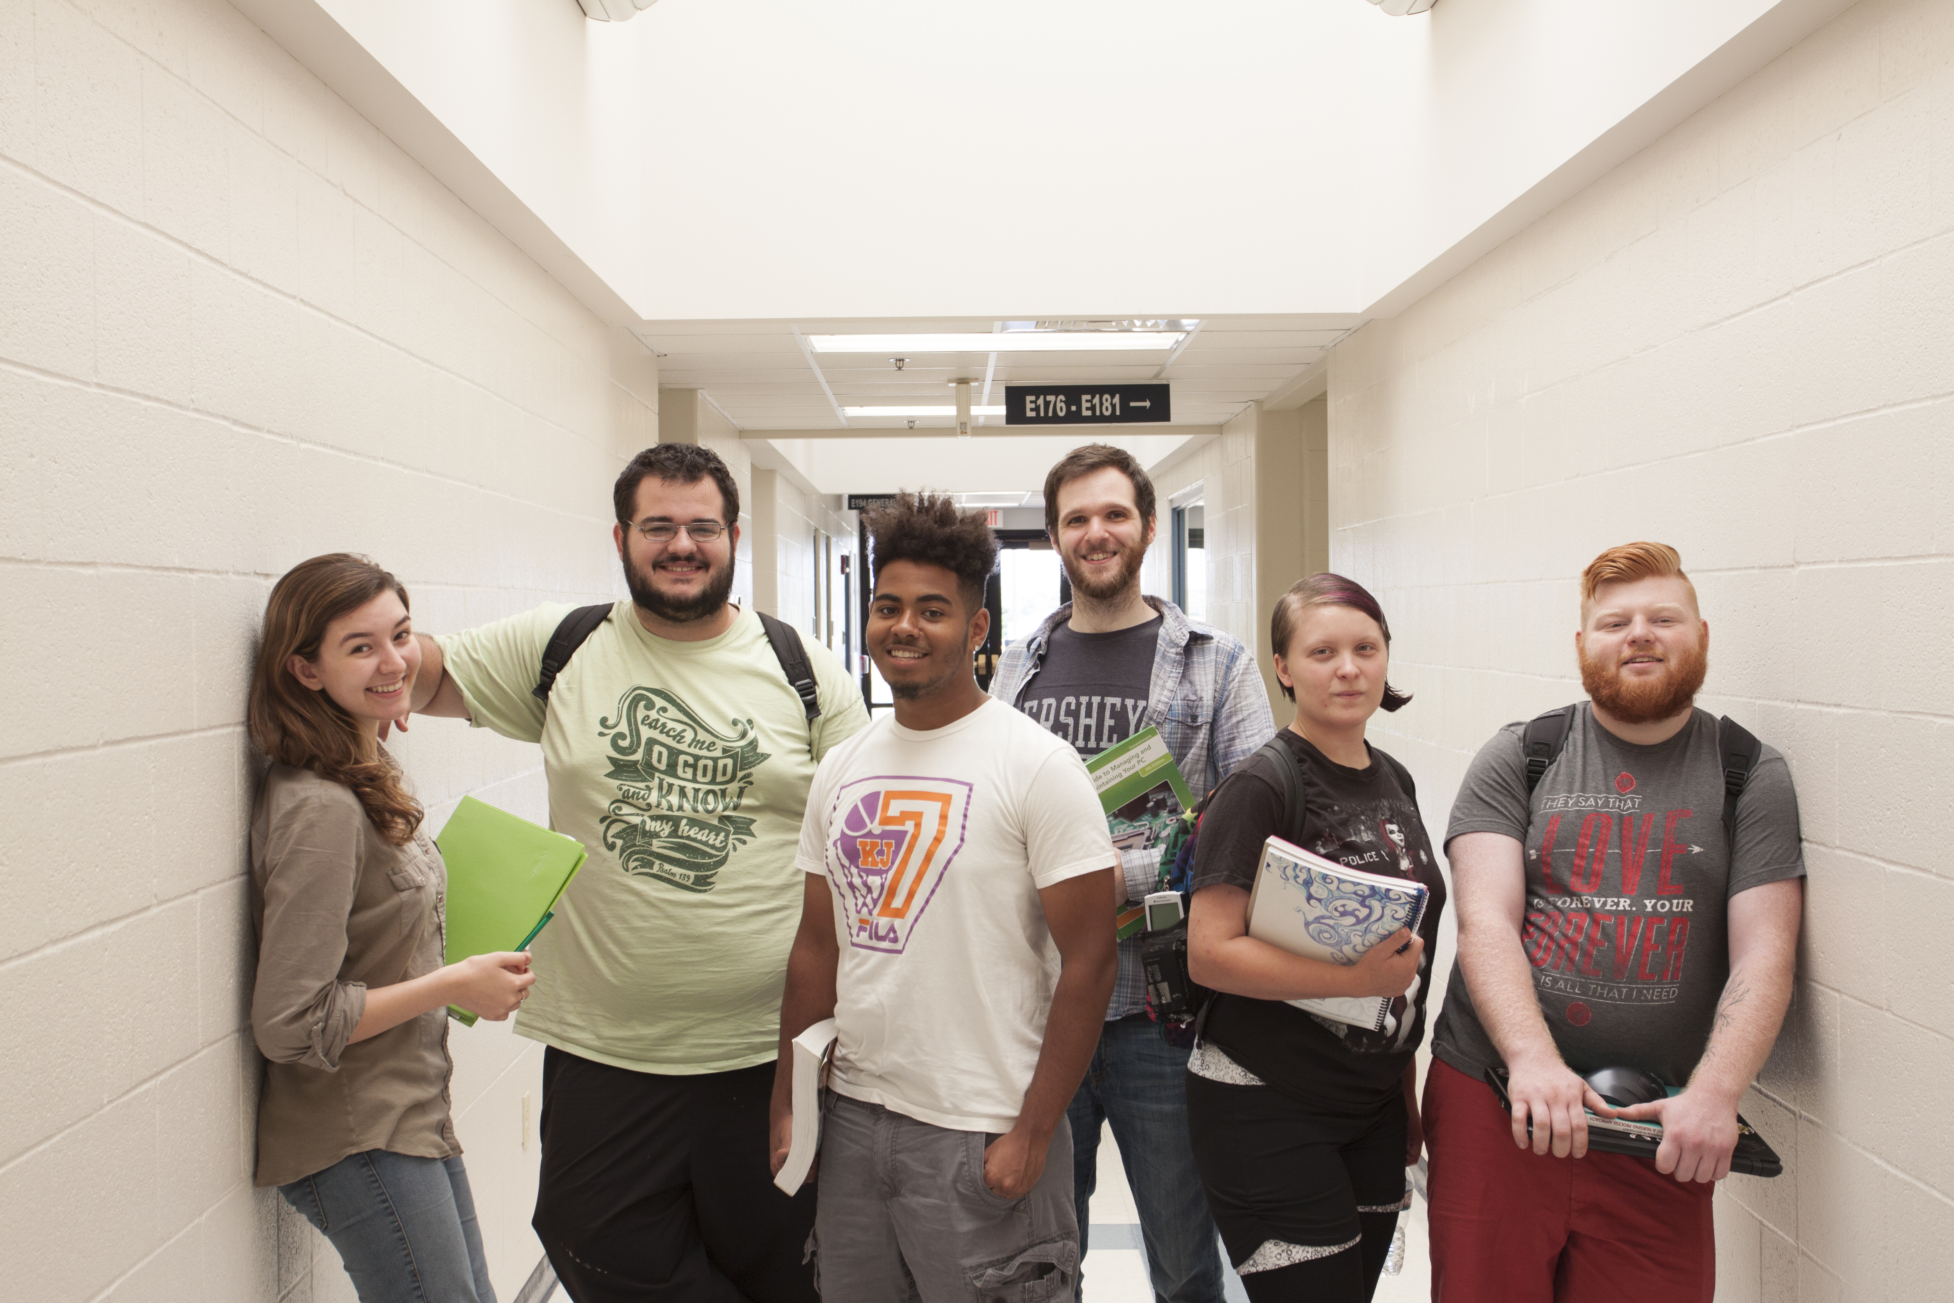
Racial and Ethnic Breakdowns

Slide 9
Enrollment Trends
Virtual Course Enrollment
Count of students who registered for a course with an online component (sections starting with V,D,Y)

Slide 10
Good News!
Currently 47 days out for the start of the summer 2023 semester.
Trending up 15 %.
Trending up in new and returning students.
Current headcount is at 375 vs 323 same time last year.
Current credit hours is at 1947 vs 1727 same time last year.

Slide 11


