Slide 1


College Trends, Priorities, & Enrollment​

Slide 2

Richland Fall Headcount
FALL 2021 2252
FALL 2022 2075
FALL 2023 2214
Notes:
Data available on Enrollment-Semester (E1) dashboard, Chart tab in Argos. Path: Student.ICCB & VFA.Illinois Community College Board (ICCB)

Slide 3
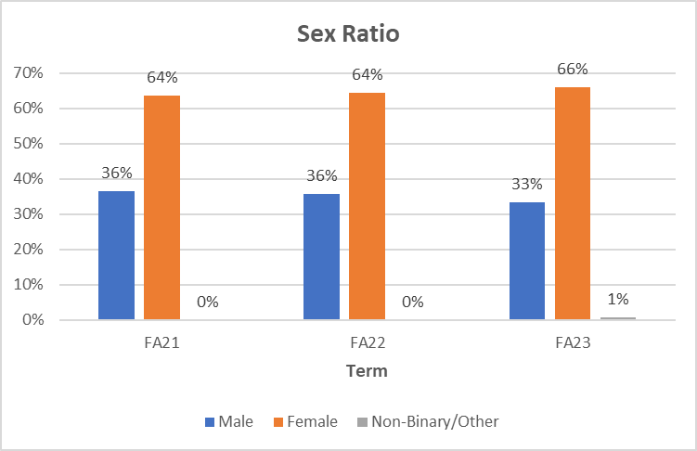
Current Student Demographics
Notes:
Uses E1 headcount data. Other category added FA22, but didn’t really start collecting until that term.
Data available on Enrollment-Semester (E1) dashboard, Chart tab in Argos. Path: Student.ICCB & VFA.Illinois Community College Board (ICCB)

Slide 4
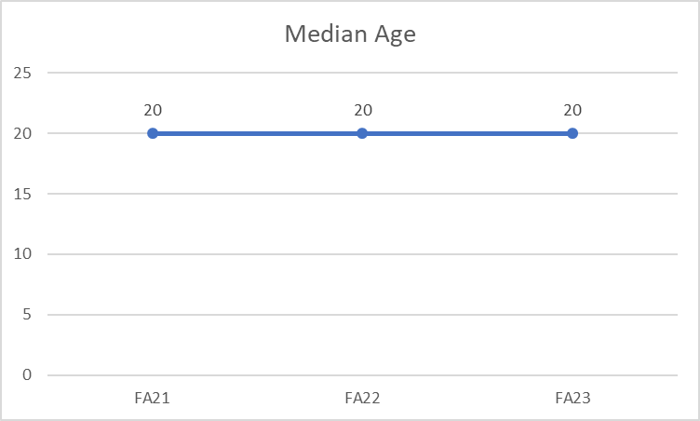
Current Student Demographics
Notes:
Data available on Enrollment-Semester (E1) dashboard, Chart tab in Argos. Path: Student.ICCB & VFA.Illinois Community College Board (ICCB)

Slide 5


Student Types
Notes:
Percentage of faculty and Staff up by 25% as well but still lagging behind the student population at 15%.
Data comment: I’m sure the data exists in Argos somewhere, but I just created a query on E1 data using enr_stat for student type.

Slide 6

Racial and Ethnic Breakdowns
Notes:
Data available on Enrollment-Semester (E1) dashboard, Chart tab in Argos. Path: Student.ICCB & VFA.Illinois Community College Board (ICCB)
Pull into Excel to format chart.

Slide 7

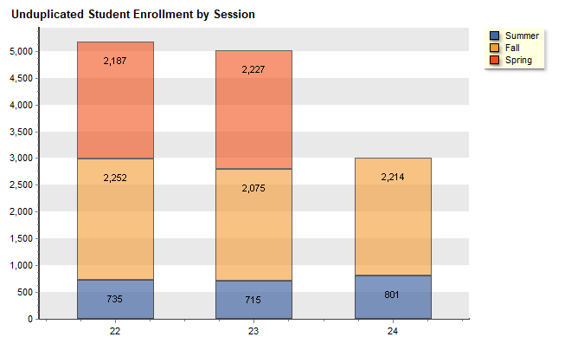
College Enrollment Data
Notes:
Data available on Enrollment-Semester (E1) dashboard, Chart tab in Argos. Path: Student.ICCB & VFA.Illinois Community College Board (ICCB)

Slide 8
Success Coaching
NACADA does not have a suggested ratio since advising duties vary by institution type and the purpose(s) of the advising office. The CAS Standards of Academic Advising state that "Academic advising caseloads must be consistent with the time required for the effective performance of the activity" https://www.nacada.ksu.edu/Resources/Clearinghouse/View-Articles/Using-CAS-Standards-for-self-assessment.aspx Eric White, a NACADA past-president and former NACADA representative to CAS, states that in considering caseloads "an institution must take into account
(1) what kinds of students are to be advised and consequently what are their advising needs (e.g, athletes, honor students, undecideds, seniors in majors, underprepared students);
(2) Who is providing the advising (professional staff with no other responsibilities, faculty with teaching and/or research responsibilities, graduate students); and
(3) what other responsibilities would an advisor have that might determine an appropriate 'case load.'"
You can find the median number of advisees per advisor for a full-time advisor is 296 students (as listed in the NACADA 2011 Survey).
https://nacada.ksu.edu/Resources/Clearinghouse/View-Articles/Advisor-to-Student-Ratio-Caseload-Resources.aspx
What we know:
Students at Richland have unique needs and barriers.
Due to relationship building, our students often turn to their Coach with issues, questions, and support.
Our students do not feel comfortable registering themselves and would rather meet with their Coach to ensure they are on the right path.
Richland implements Richland Thrive progress surveys to address academic needs and potential barriers. These progress surveys occur twice per semester, but an instructor can raise flags at any time.
Richland provides additional outreach beyond flags and kudos to student cohorts. High touch cohort receives monthly additional communication, Moderate receives three per semester, and low receives two per semester.
Notes:
Data available on Enrollment-Semester (E1) dashboard, Chart tab in Argos. Path: Student.ICCB & VFA.Illinois Community College Board (ICCB)

Slide 9
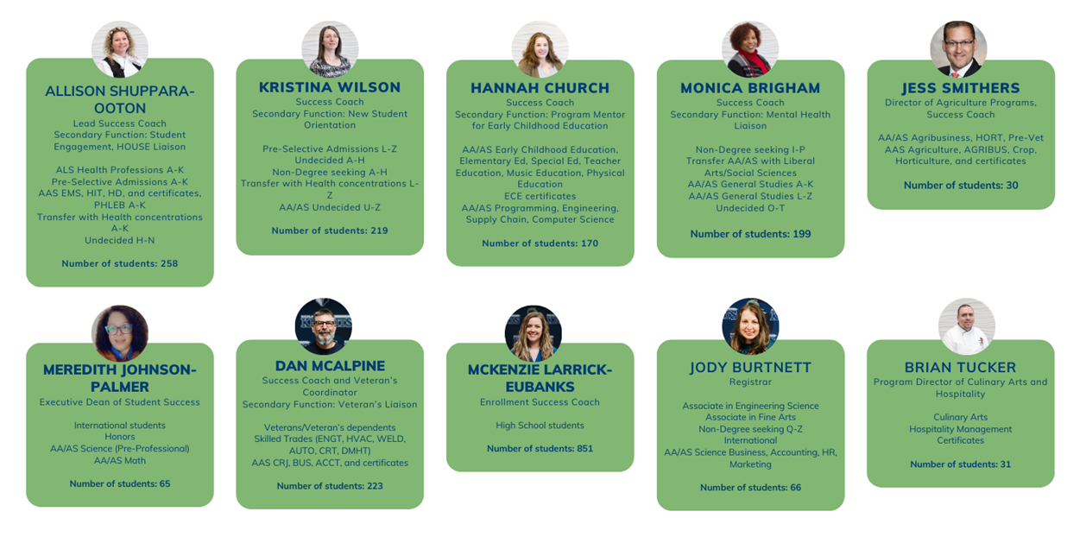
Coaching Assignments
​

