Slide 1


Slide 2



Slide 3

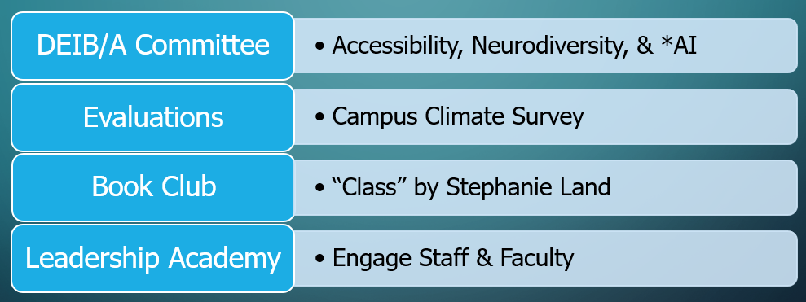
Overview

Slide 4
Moving to Action
Research has unveiled:
Cohesive teams are able to adjust better to campus changes
Engaging others in relationship building (book club, strolling campus, etc.)
Data driven alignment with campus goals (strategic plan):
Highlight areas for celebration
Generate greater buy-in & accountability
Realign resources for areas with the greatest needs
Show areas for improvement (access, retention, completion, starting salary, and stackable credentials)
social upward mobility

Slide 5
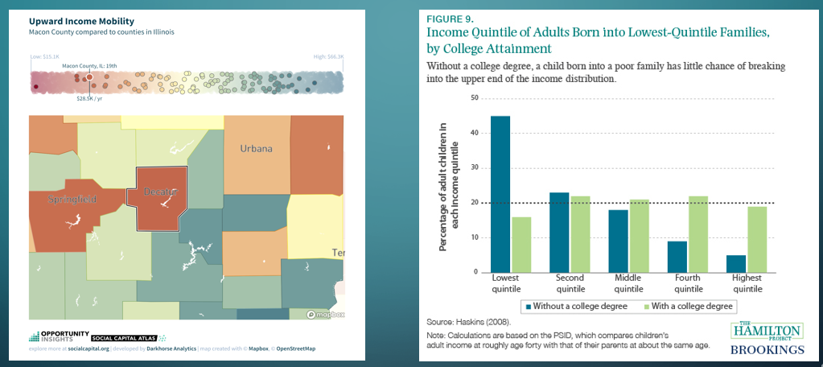

Slide 6
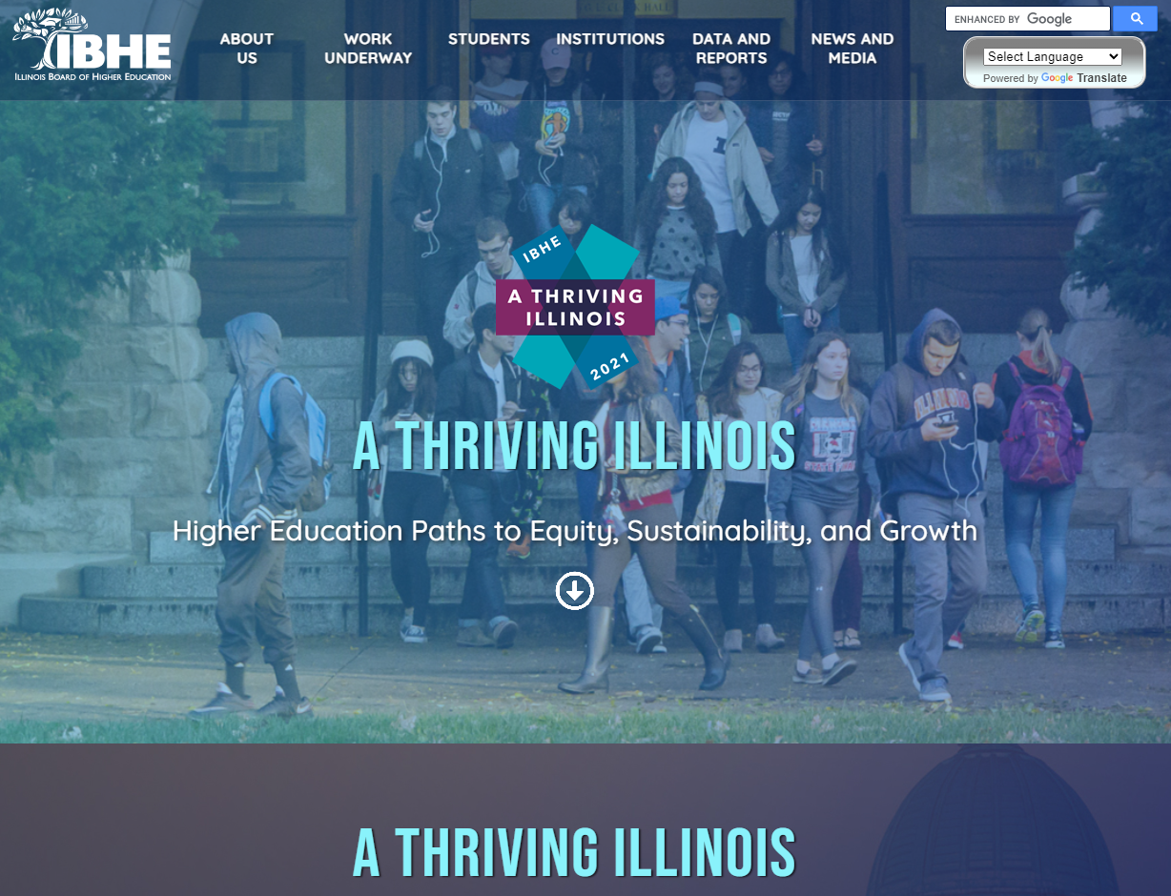

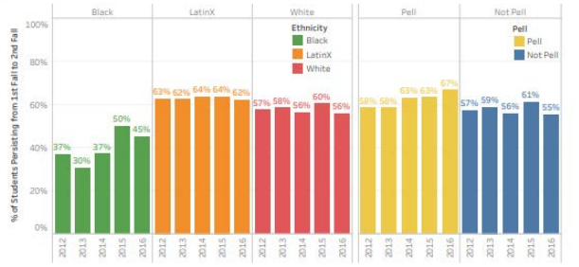
Equity Plan

Slide 7
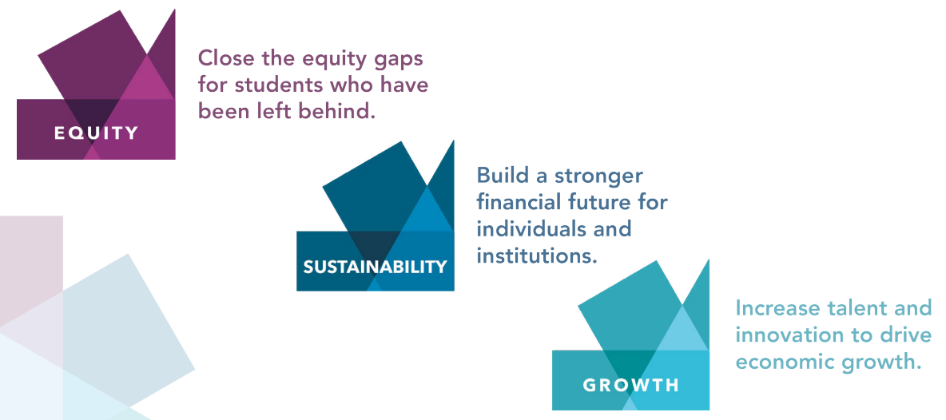

Slide 8
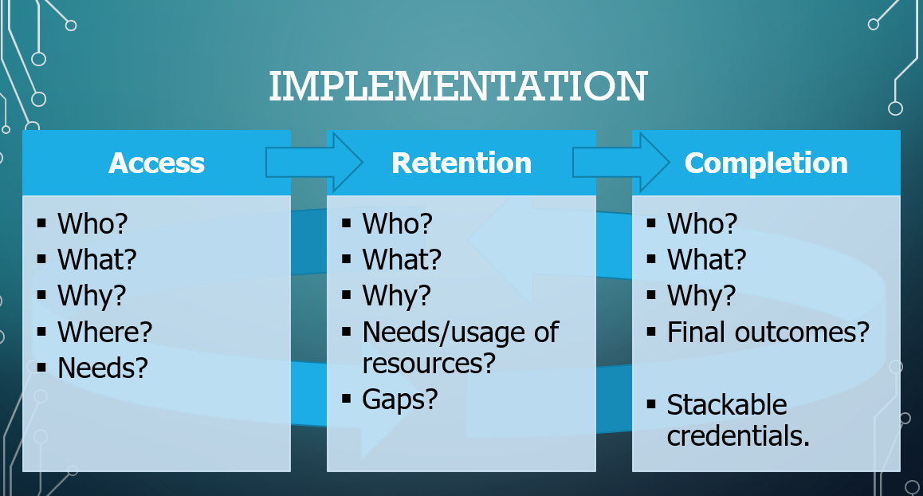

Slide 9
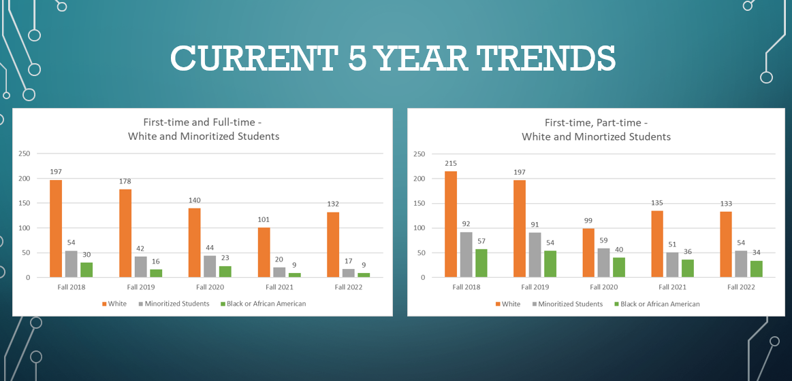
Notes:
ACCESS
Access 2018-2022
FTFT are important measure for national benchmarking provided by IPEDS as relates to retention. However RCC student population is roughly 20% FT, 80% PT (with 33% of those students being high school dual credit students going part-time). So focusing exclusively on full-time students excludes a large portion of students attending RCC.
Note that white and minoritized students are the whole, Black students are a subset of minoritized students.
Minoritized students are increasingly enrolling part-time, largely due to a disproportionate decline in full-time, first-time registration.
Post-2020 recovery in enrollment of White first-time students not seen in minoritized and Black first-time students.
Fall 2022 first semester of EnRich enrollment – but EnRich students are not necessarily first-time students and didn’t necessarily start taking credit courses that semester.

Slide 10
Status by Gender
Notes:
Overall student population tends to be 60 Female : 40 Male . Male students are closer to 50% of the first-time, full-time population – roughly equal numbers enroll as full-time and part-time students. Female students disproportionately enroll as part-time students. Age factor? Outside commitments?
Possible survey question to follow-up with students enrolled part-time.

Slide 11
Associates by Race
Notes:
Completion
Associates Degree
Pretty static in minoritized student population. Decrease in the associate’ degrees awarded to white students in last three years, mirrors decreasing enrollment.

Slide 12
Certificates by Race
Notes:
Cert completion
Increasing certificate completion among Minortized, especially pronounced in Black student certificate completions
EnRich may be pushing some of these increases in certificate completions.

Slide 13
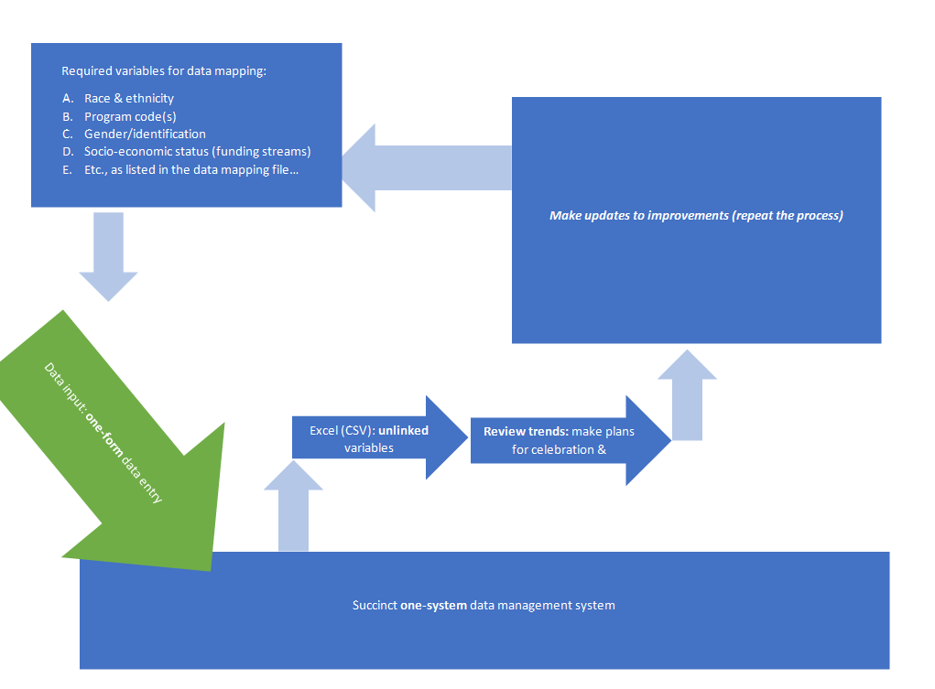
Centralized Data Management

Slide 14
Thank You!

Slide 15

REFERENCES
Council, Y. E. (2018). Council post: 10 proven methods for creating a cohesive company culture. Forbes. https://www.forbes.com/sites/theyec/2018/03/12/10-proven-methods-for-creating-a-cohesive-company-culture/?sh=8beed2169c8a
Fouts, M. (2020). Council post: Cohesive Teams Need Diversity. Forbes. https://www.forbes.com/sites/forbescoachescouncil/2020/09/09/cohesive-teams-need-diversity/?sh=7f9ce48f1fde
Harvard Second Generation Study. harvardstudy. (2015). https://www.adultdevelopmentstudy.org/
Krasnoff, Basha. (2016).
Culturally Responsive Teaching: A Guide to Evidence-Based Practices for Teaching All Students Equitably https://educationnorthwest.org/sites/default/files/resources/culturally-responsive teaching.pdf
Ladson-Billings, G. (1994). The dreamkeepers: Successful teachers of African American children. San Francisco, Calif.: Jossey-Bass Publishers.
Molnau, D. (2023). High-performance teams: Understanding Team Cohesiveness. isixsigma.com. https://www.isixsigma.com/teams/high-performance-teams-understanding-team-cohesiveness/
Watson, C. E., & Colvard, N. B. (2018). Open educational resources (OERs): Another high impact practice? Paper presented at the annual meeting of the Association of American Colleges and Universities, Washington, DC.

