Slide 1
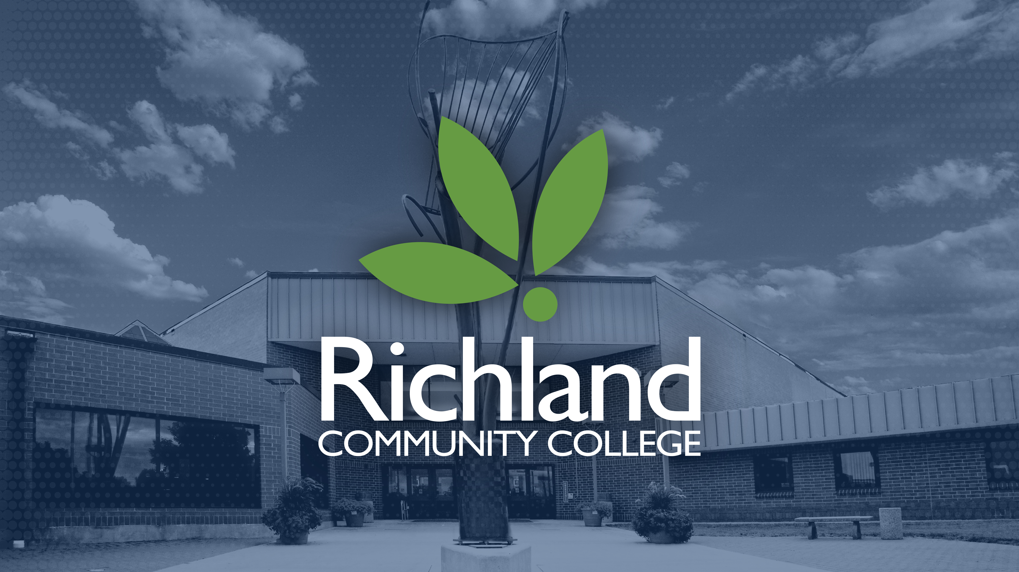

Slide 2

Dual Credit Monitoring Report – May 2024
Andy Hynds, Executive Dean of Academics
Mackenzie Larrick-Eubanks, Enrollment Success Coach

Slide 3
What is Dual Credit
Dual Credit: Coursework allowing students to receive college credit and high school credit simultaneously
Dual Enrollment: College coursework completed by high school students outside of their high school courses

Slide 4
Types of Dual Credit at Richland
Heartland Technical Academy: Career-focused courses offered to 11th and 12th graders in Macon and Piatt Counties, located on Richland’s campus for half-days
Dual credit courses taught at high schools by qualified high school faculty
Transfer Academy: Transfer courses offered to high school students for half-days on Richland’s campus
Prep Academy: A partnership with DPS #61 offering the full Associate of Arts degree within the four years of high school, with 11th and 12th grade on Richland’s campus

Slide 5
Who Are Our Students?
Dual Credit Students in Spring 2024
863 dual credit students enrolled, representing all 14 district high schools
Dual credit students represented 37% of the total Richland population
Largest dual credit populations:
Mt. Zion: 174
MacArthur: 142
Eisenhower: 138

Slide 6
Dual Credit Support
Dual Credit Staff
Mackenzie Larrick-Eubanks, Enrollment Success Coach
Katie Murphy, Dual Credit Coordinator
Meredith Johnson-Palmer, Executive Dean of Student Success
Five Academic Division Deans
Faculty

Slide 7
Dual Credit Support
Student Supports
Success Coaching
Academic Success Center services (Tutoring, Accommodations)
Richland Thrive
Counseling

Slide 8
Recent Initiatives
Dual Credit Advisory Committee
Education Symposium
HLC Site Visit

Slide 9
Dual Credit Successes
2023-2024 Achievements
Four students receiving a high school diploma and Associate’s Degree
Mt. Zion: 1 student in May 2024
Cerro Gordo: 3 students in August 2024
DPS #61: 1st cohort completed on-campus courses in 2023-2024
Fall 2023 overall course success rate (A/B/C) of 88.67%

Slide 10
Upcoming Initiatives
Upcoming in 2024-2025
Ongoing training for new and returning faculty
DPS #61: First graduating class in May 2025
Dual credit scholarships

