Slide 1


CREATED BY RICHLAND COMMUNITY COLLEGE. ALL RIGHTS RESERVED 2021.

Slide 2

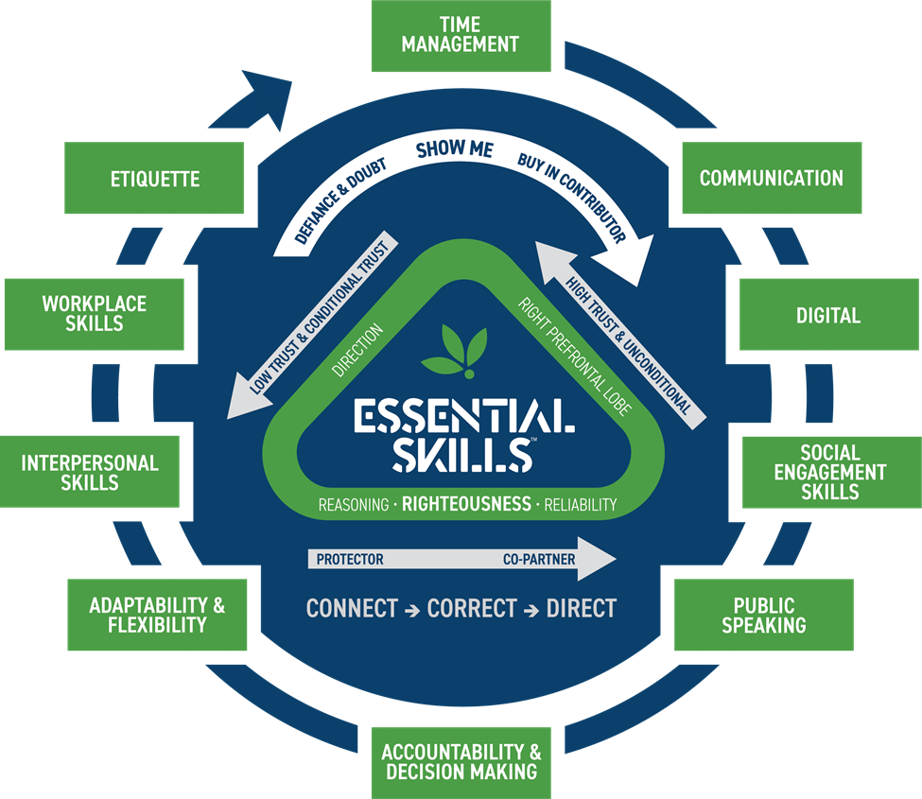

CREATED BY RICHLAND COMMUNITY COLLEGE. ALL RIGHTS RESERVED 2021.

Slide 3
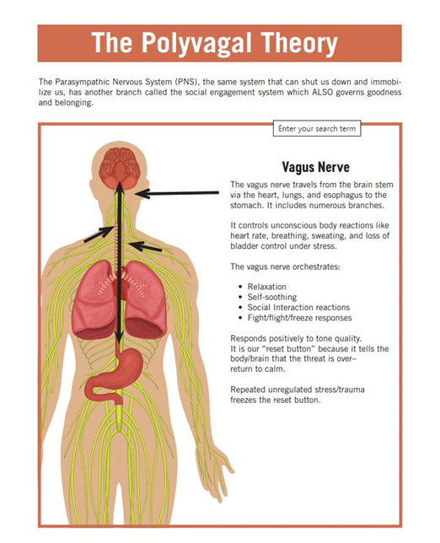
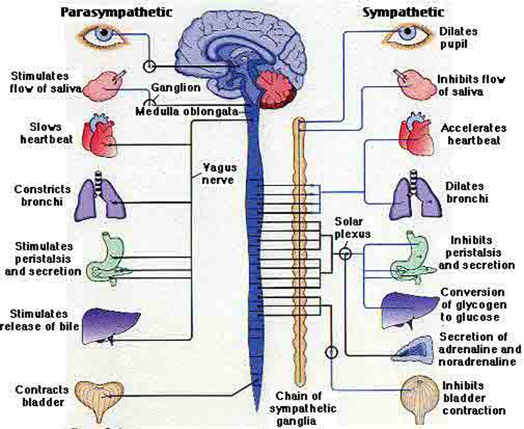
CREATED BY RICHLAND COMMUNITY COLLEGE. ALL RIGHTS RESERVED 2021.

Slide 4
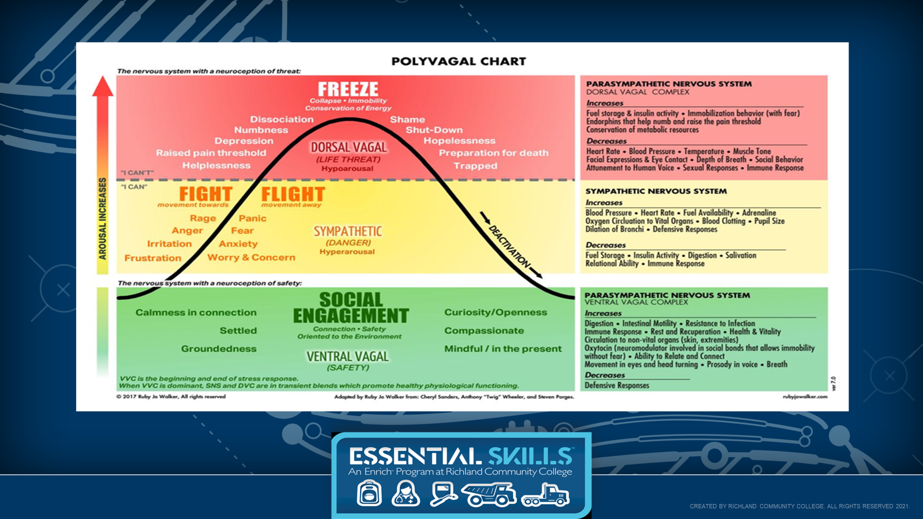

Slide 5
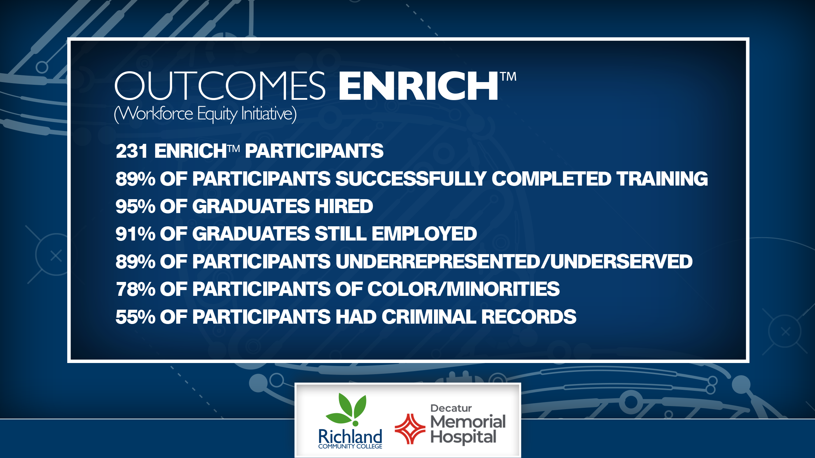
CREATED BY RICHLAND COMMUNITY COLLEGE. ALL RIGHTS RESERVED 2021.

