Slide 1
MACON COUNTY LAW ENFORCEMENT TRAINING CENTER
A partnership between the Illinois Law Enforcement Training & Standards Board
and Richland Community College

Slide 2
Basic Law Enforcement Academies
Scheduled in Calendar Year 2024
RC24-22 - Sunday, January 7- Friday, April 26, 2024 (65 Graduates)
RC24-23 -Sunday, May 5 - Friday, August 23, 2024 (70 Graduates)
RC24-24 - Tuesday, Sept. 3 -Friday, December 20, 2024 (61 In Session)

Slide 3
Basic Corrections Academies
Scheduled in Calendar Year 2024
CC24-20 - Sunday, April 14 – Friday, June 7, 2024 (55 Graduates)
CC24-21 - Sunday, June 16 - Friday, August 9, 2024 (42 Graduates)
CC24-22 - Sunday, August 18 -Friday, October 11, 2024 (36 Graduates)
CC24-23- Sunday, October 20- Friday, Dec. 13, 2024 (30 Registered)

Slide 4
Illinois Department of Corrections
2022/2023 - 611 (Moved in and started classes September 2022)
2023/2024 - 768
2024/2025 - 191 ( Since July 1, 2024)
YTD - 1,570
Rotate new classes campus every 4 to 6 weeks

Slide 5
2024 Estimated Enrollment
Basic Law Enforcement 195
Basic Correctional Cadets 166
IDOC Correctional Cadets 768
1,129

Slide 6
YTD GRADUATES (2018- Present)
Basic Corrections 780
Basic Law Enforcement 1,294
IDOC Correctional Officers 1,570
IDNR 40
3,684

Slide 7
STAFFING (21)
Commander
Deputy Commander
Director of Training
Class Coordinator
Coordinators of Operations
Housekeeping Supervisor
Housekeepers (6)
Maintenance (1, PT)
IT
Culinary Staff (7, Richland Culinary Budget)

Slide 8
2024/25 ESTIMATED REVENUES
BLE TUITION $ 1,600,000
BCO Tuition $ 1,000,000
IDOC Contractual $ 1,260,000
Other Misc. $100,000
$ 3,960,000

Slide 9
2024/25 Estimated Expenses
Salaries and Benefits $ 1,400,000
Operational Costs $ 2,400,000
$ 3,800,000

Slide 10
2024/25 Operational (Major) Costs
Meals $ 1,250,000
Ammo for Training $ 60,000
Uniforms $ 150,000

Slide 11
FUTURE EXPENDITURES
New Lawn Equipment
Training Squad Cars
Building Maintenance

Slide 12
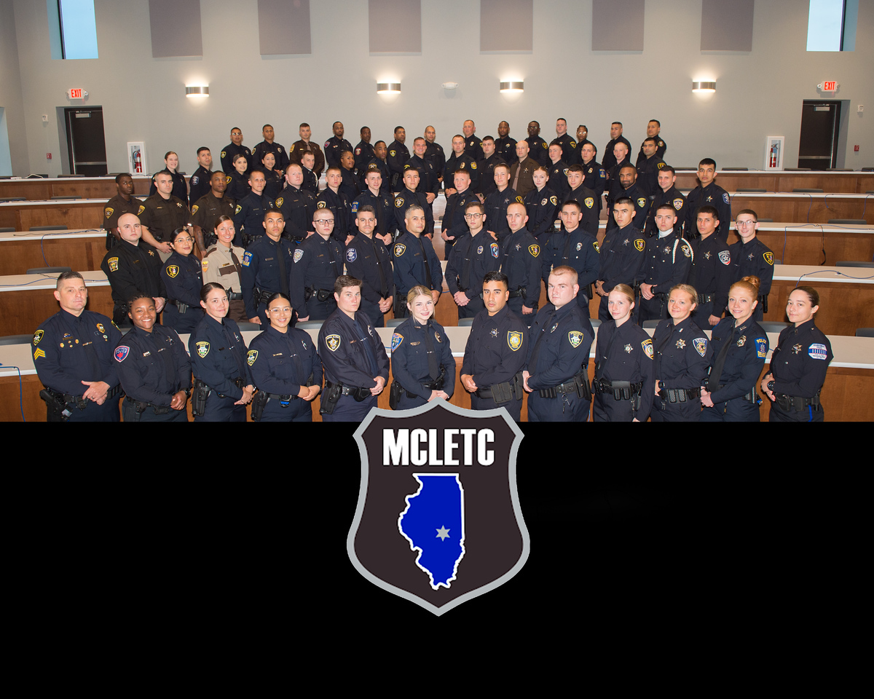
Recruit Class 24-23

Slide 13
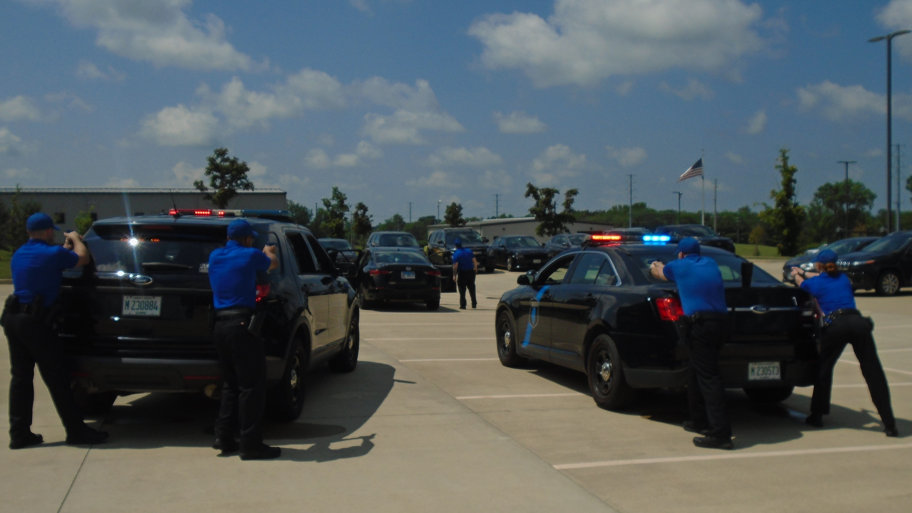

Slide 14
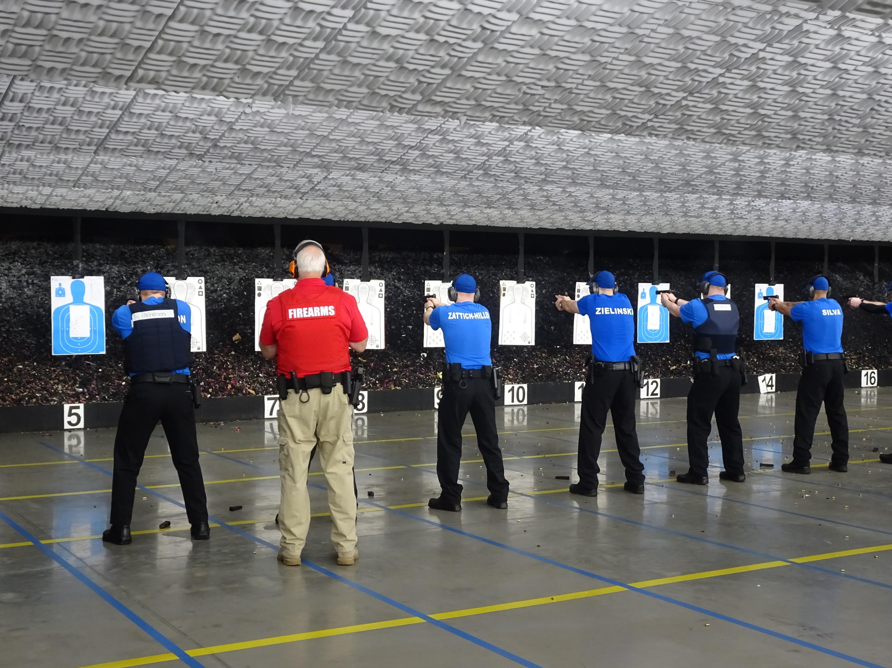

Slide 15
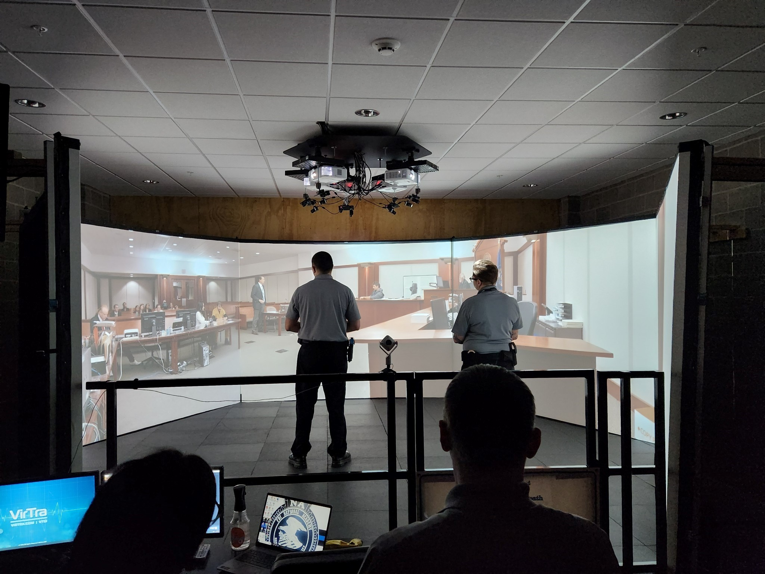

Slide 16
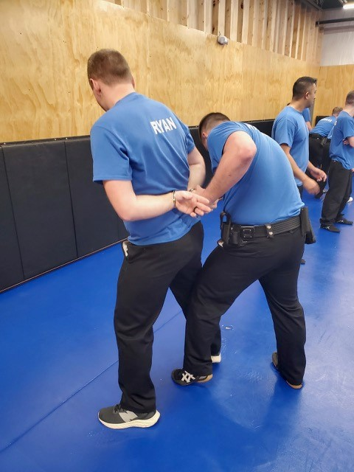

Slide 17
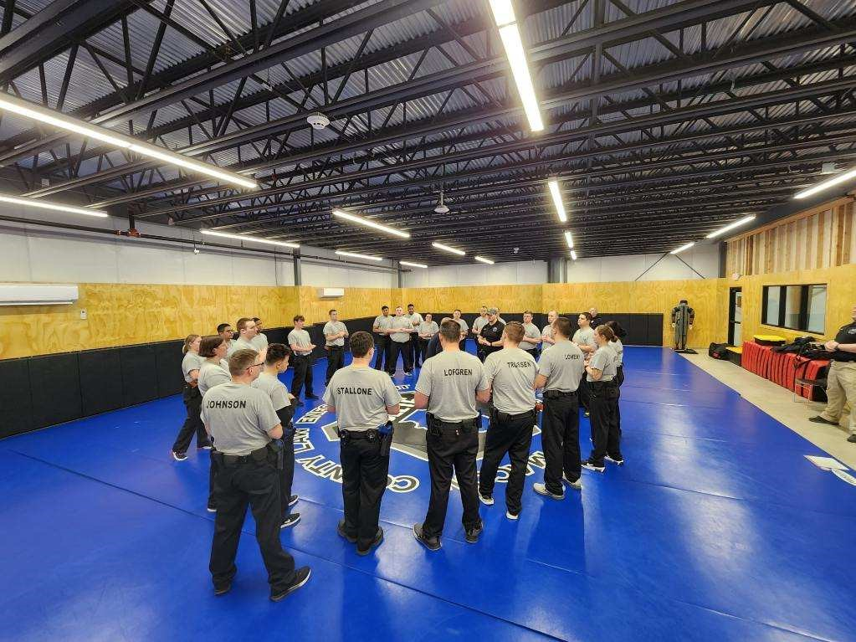

Slide 18
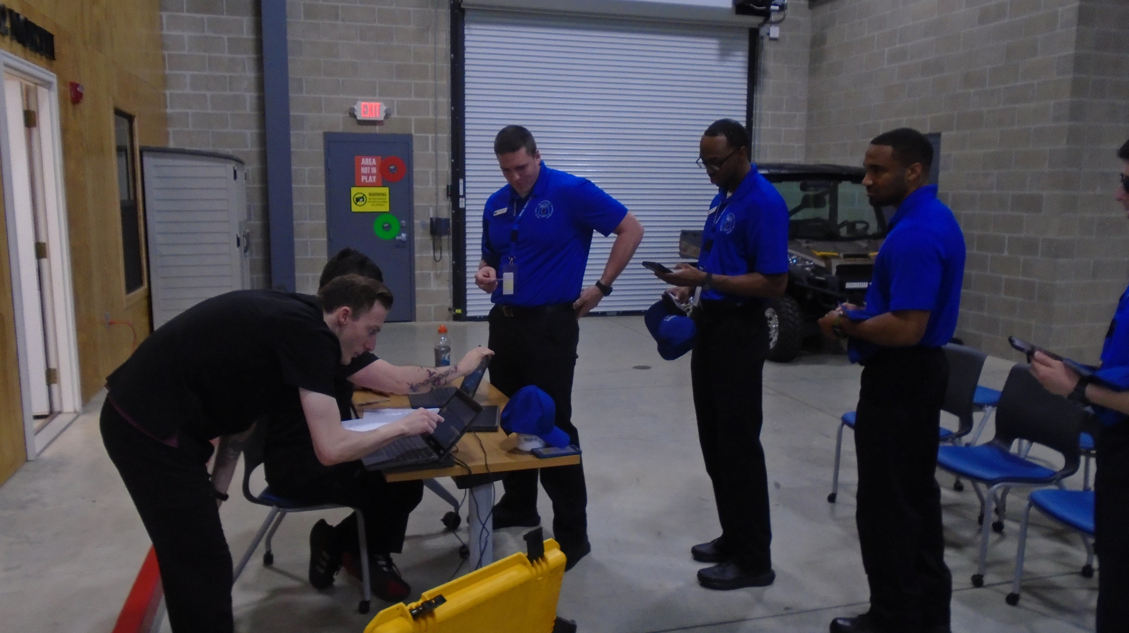
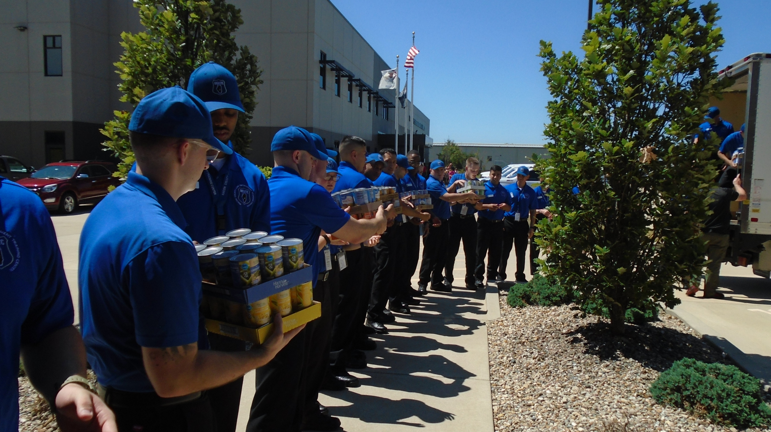
Special Projects

Slide 19
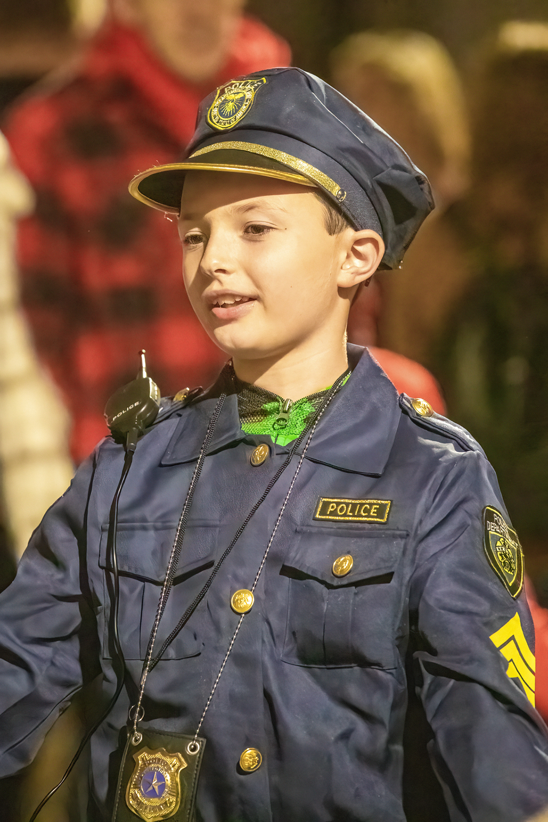
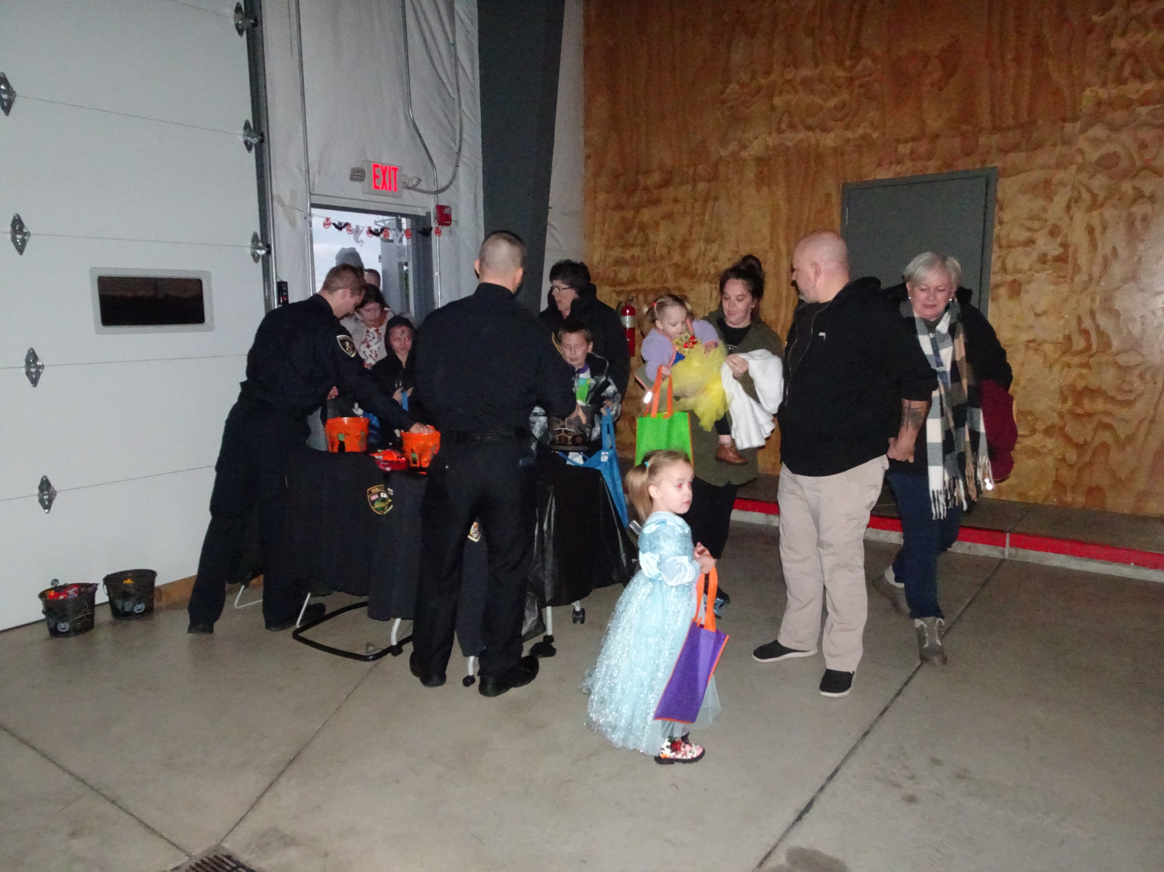
Halloween 2022

Slide 20
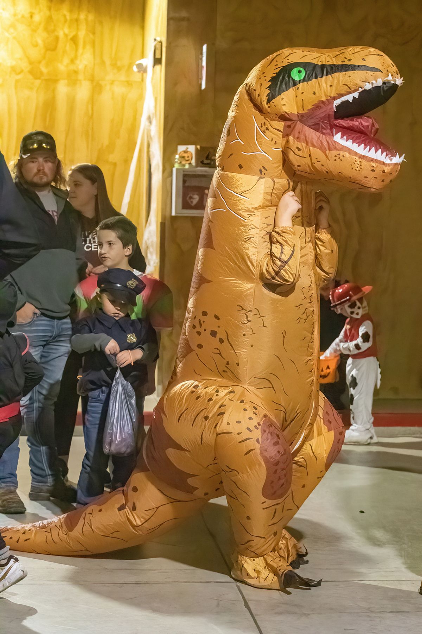

Slide 21
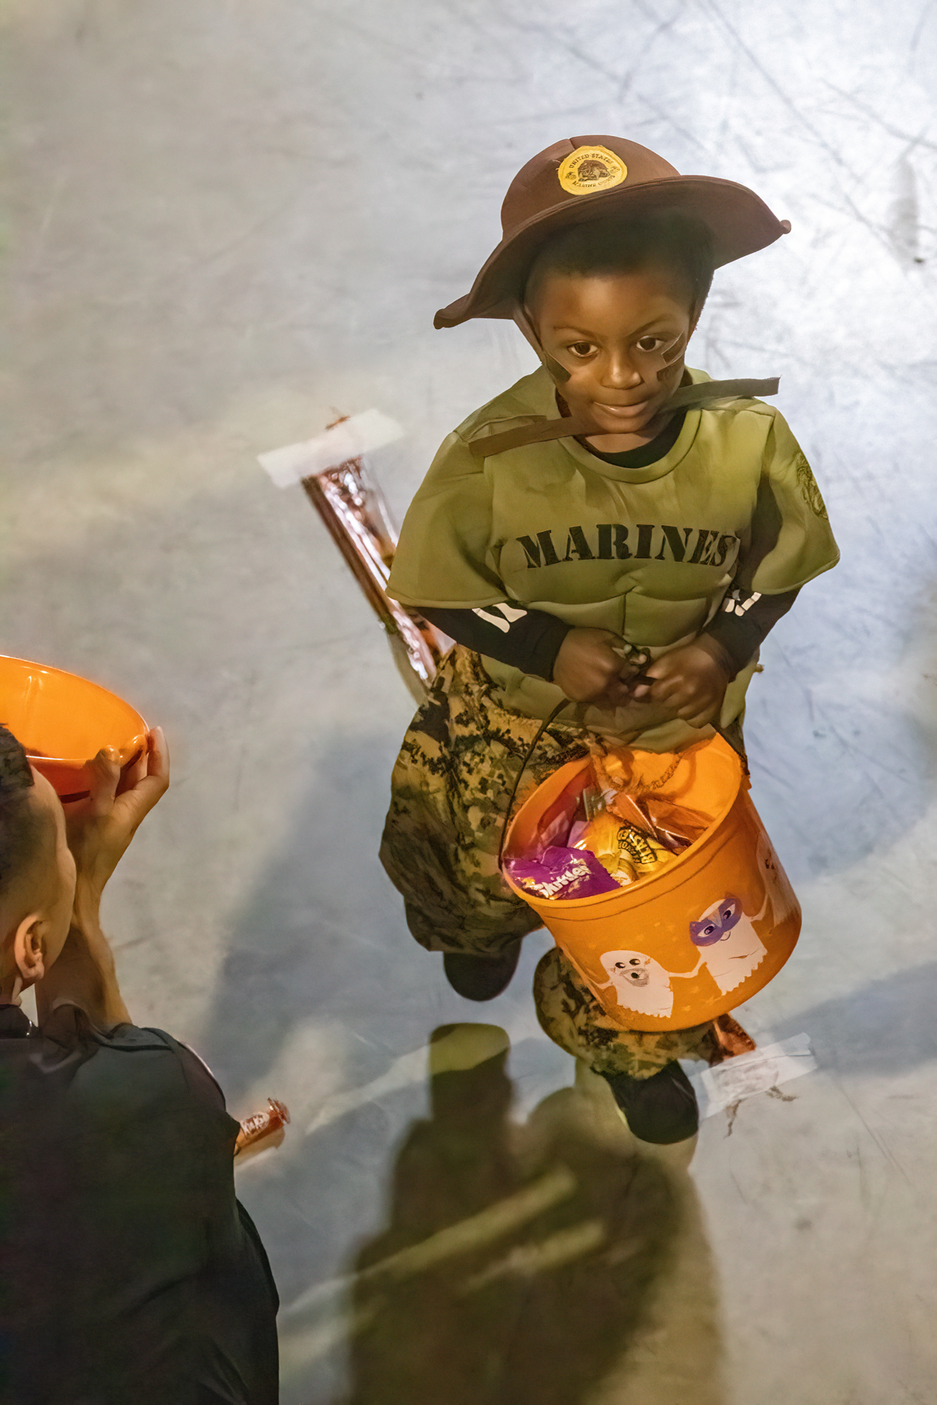

Slide 22
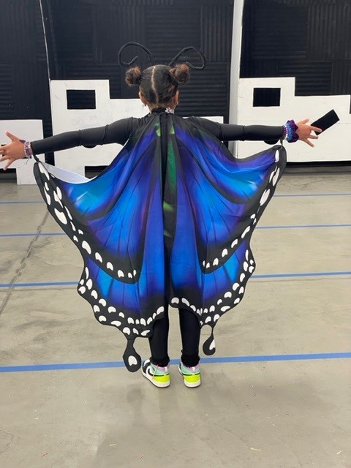

Slide 23
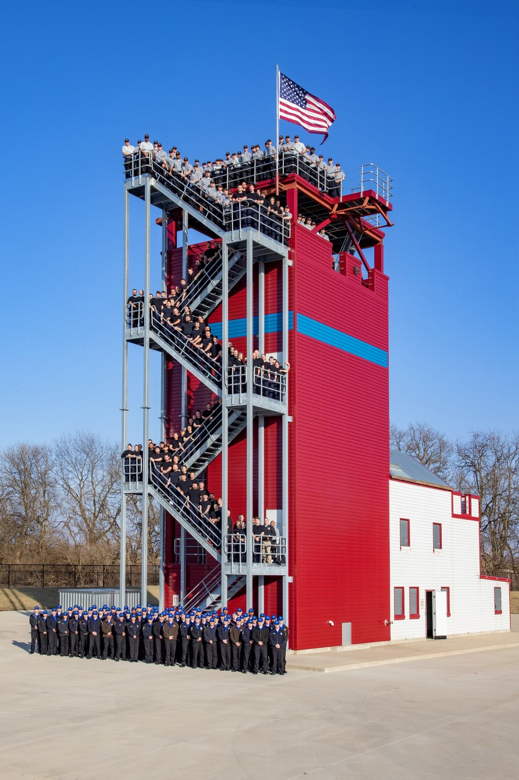
Fire Tower

Slide 24
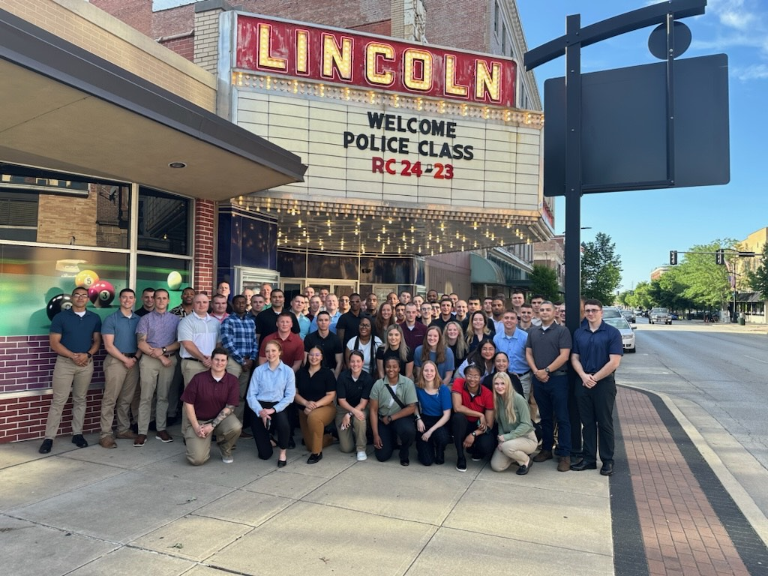
Downtown Decatur

Slide 25
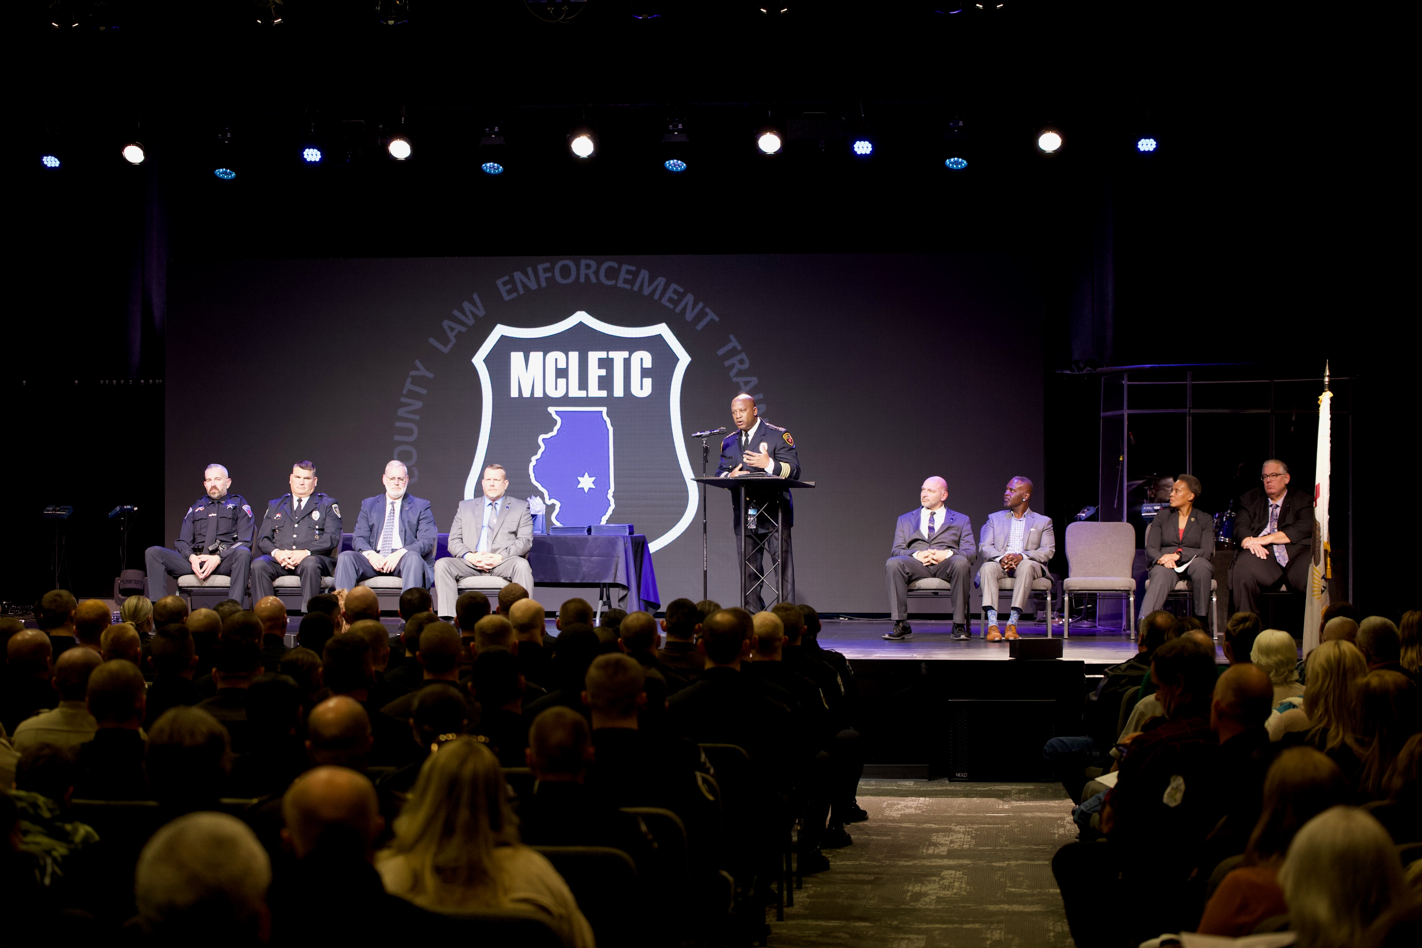
Recruit Class Graduation

Slide 26
TOURS
Senator Sally Turner
DPS 61 High Schools
Mount Zion High School
Golden K Kiwanis
SWIC Board of Trustees and President
Numerous Law Enforcement Agencies
YMCA Youth Group
Several Youth Church Groups

Slide 27
Events
ICCTA Executive Retreat
Hosted State of Illinois Wardens Retreat
ROMEO Club Meeting
Hosted State of Illinois Coroners Training
Hosted Ukrainian K-9 Officers

Slide 28
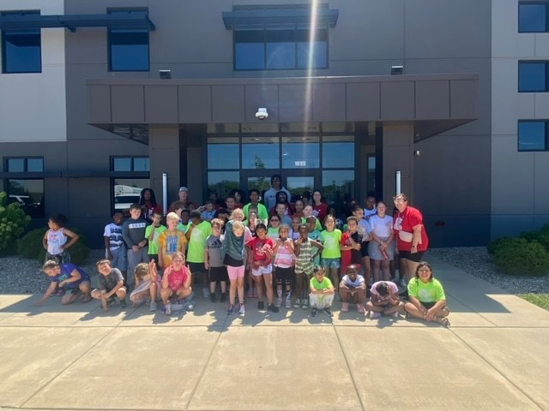
YMCA Summer Visit

Slide 29
Jim Getz
Commander
Macon County Law Enforcement
Training Center
1095 Rotary Way
Decatur, IL 62521
217-875-7211, ext. 1603
217-330-4705 mobile
jgetz@richland.edu

