Slide 1


Slide 2


Academic Profile Monitoring Report​
Notes:
All slides updated 8/15/24 - JH

Slide 3
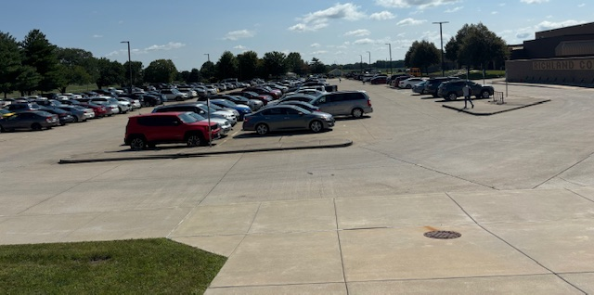
Notes:
All slides updated 8/15/24 - JH

Slide 4
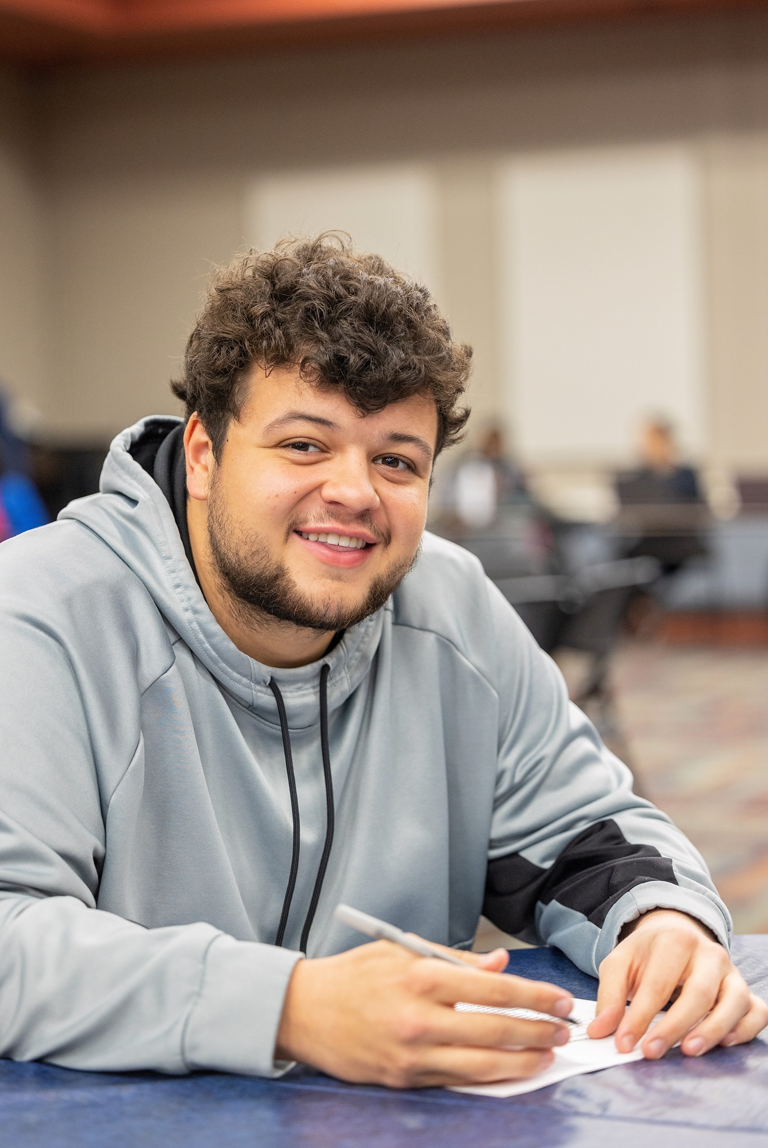

Student Types
Notes:
Updated with SP24 data

Slide 5

Current Student Demographics
Notes:
Updated with full academic year 2324 data
Spring & Fall median age is consistently a year younger than the full academic year median age (21 over the same period). Summer session median age is higher (23-24 years old) likely due to smaller high school population in the summer – some summer-specific programs might also skew older.

Slide 6

Racial and Ethnic Breakdowns
Notes:
SP24 Racial and Ethnic Breakdown

Slide 7
Enrollment Update
4.5% increase in unduplicated headcount compared to last August
6% increase in credit hours
Two successful Saturday drop-in registration events serving 75 students
Focus Shift is now on retention
Census date is August 29th, 2024
Notes:
Updated with full academic year 2324 data

Slide 8
Richland Fall Total Headcount
Fall 22 2,075
Fall 23 2,111
Fall 24 2,206 (+4.5%)
Notes:
Updated with full academic year 2324 data

Slide 9
Academic Division Updates
Notes:
All slides updated 8/15/24 - JH

Slide 10

Convocation Professional Development
8/14 Workshop 1: Campus DEIB Updates and Completing College Presentation Total Attendance: 62 (48 faculty & 14 staff)
8/14 Workshop 2: Grants 101 & Impact of EnRich Total Attendance: 77 (48 faculty & 26 staff)
8/15 Workshop 3: Teaching & Learning Center Total Attendance 58 (44 faculty and 14 staff)
8/15 Workshop 4: Work-Life Balance and Therapeutic Drumming Total Attendance: 64 (45 faculty and 19 staff)

Slide 11
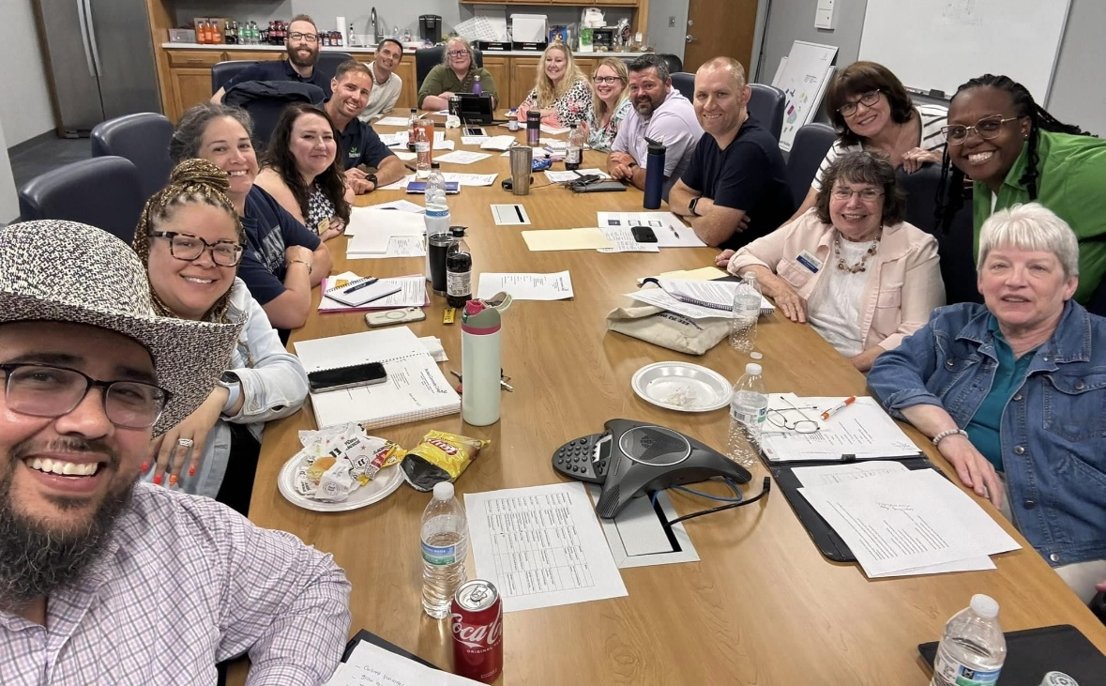
Current Student Demographics
Notes:
Updated with full academic year 2324 data
Spring & Fall median age is consistently a year younger than the full academic year median age (21 over the same period). Summer session median age is higher (23-24 years old) likely due to smaller high school population in the summer – some summer-specific programs might also skew older.

Slide 12
Leadership Team
Executive Administrative Assistant- Connie Hartman
Director, Academic Success Center- Jacque Manicki
Director of Adult Education- Krystle Tempel
Director, Financial Aid and Veterans’ Affairs- Jody Hall
Direct, Fitness Center- Scott Broyles
Director, Institutional and Academic Planning- Teena Zindel-McWilliams
Director of Library Services- Gavena Dahlman
Director, Project Read Plus- Julie Pangrac
Interim Director, Teaching & Learning Center- Jarry Brown

Slide 13
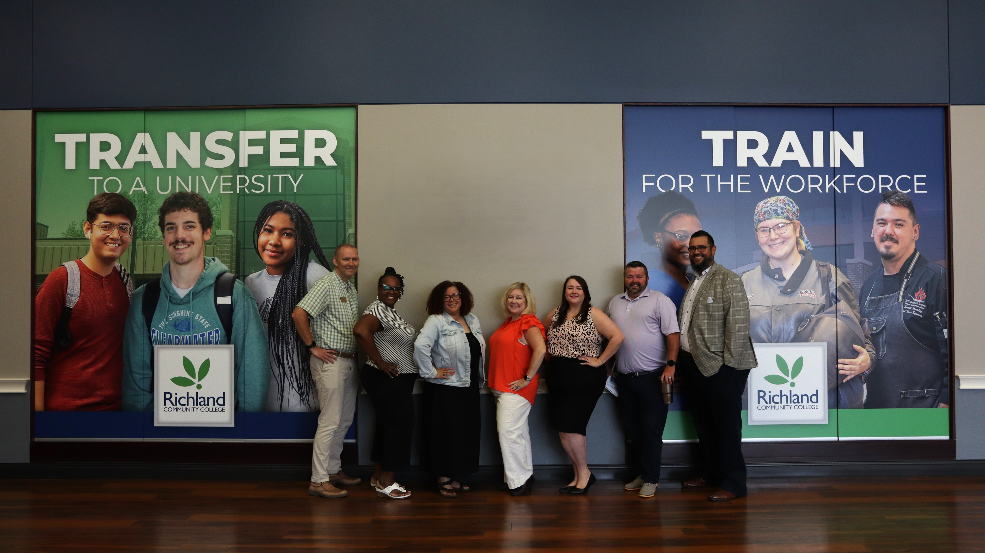
​
Notes:
All slides updated 8/15/24 - JH

Slide 14
LIBERAL ARTS DIVISION
Dean Danielle Patricio
Total Number of Faculty Members: (15) Full-Time Faculty, (24) Adjunct Faculty, 2 Program Directors (16 Area HS Dual Credit Teachers)
Subjects Taught (18): Art, African American Studies, Culinary Arts, Early Childhood Education, Education, English, Foreign Language, Music, Philosophy, Communications, Theatre, History, Hospitality, Humanities, Political Science, Psychology, Student Development, Sociology, Honors
Fall 2024 Semester Sections: (140) Sections (24) Additional Dual Credit Sections Taught by Area HS Dual Credit Teachers

Slide 15
MATH, SCIENCE, AND BUSINESS
Executive Dean: Andy Hynds
Transfer Disciplines (10): Astronomy, Biology, Chemistry, Earth Science, Economics, Engineering, Math, Physics, Physical Education, Sequestration
CTE Programs (9): Accounting, Agribusiness, Business, Crop Production, Criminal Justice, Horticulture, Network Technology, Software Applications Programming
Total Faculty: (15) Full-Time Faculty (21) Adjunct Faculty in Fall 2024 (4 of whom are also Full-Time Richland staff)
Fall Semester Section(s): (105) sections total

Slide 16
Workforce Development
Dean: John Oliver
Total number of Faculty Members: 15 total which includes 6 Full time Faculty members and 9 Adjunct Faculty members (part-time)
Subjects Taught in Workforce Development: Engineering Technology (4 specialties), Welding Technology, HVAC, Automotive Technology, Diesel/Medium Heavy Truck, Collision Repair, Transportation (CDL), Noncredit Trainings.
Fall Semester Section(s): (98) sections during FA24 which includes multiple sections of CDL that run on a 4-6 week basis.

Slide 17
ALLIED HEALTH PROFESSIONS
Dean: Dr. Tasha Jones
Total number of Faculty Members: (16) total which includes (6) Full time Faculty members and (10) Adjunct Faculty members
Subjects Taught in Allied Health: Emergency Medical Technician, Health Information Technology, Health Documentation, Radiography, Surgical Technology, Medical Terminology, CPR, Nutrition
Fall Semester Section(s): (50) sections total which includes (12) clinical sections

Slide 18
Nursing
Dean: Michelle Luhrsen
Total number of Faculty Members: (16) total which includes (6) Full time Faculty and (6) Adjunct Faculty members
Subjects Taught in Allied Health: Associate Degree Nursing, Practical Nursing, Bridge PN to ADN, Nurse Assistant/Aide, Phlebotomy/Forensic Phlebotomy, Medical Assisting
Fall Semester Section(s): (23) sections total which includes (48) clinical sections

