Slide 1


Slide 2

NATIONAL TRENDS
Mental Health on College Campuses
Uptick since the Pandemic
Rates of anxiety, depression and suicidal ideation increased
More than 60% of college students met the criteria for at least one mental health problem
Healthy Minds Survey 50% Increase since 2013
Institutions have invested money and resources into improving student wellness

Slide 3
WHAT ARE COACHES/FACULTY SEEING?
Housing/Food/Financial Insecurity
Time Management
Anxiety/Mental Health
Personal/Family Commitments
Limited Access to Resources
Growth Mindset
Motivation
Resiliency
Lack of Self-Advocacy
Poor Study Habits

Slide 4
RICHLAND RESOURCES
META
Top Article Searches
Free Counseling Sessions, What To Expect in Counseling & Finding the Right Counselor
Privacy & Confidentiality
Are Your Relationships Strong
Path to Calm
203 Students
264 Sessions
1,605 Chat Sessions
242 Articles Read

Slide 5
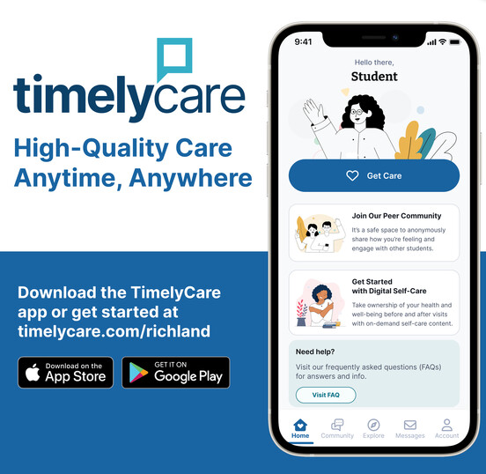
RICHLAND RESOURCES
TimelyCare
TalkNow
Scheduled Counseling
Health Coaching
Self-Care Content
Basic Needs Support
Peer Community

Slide 6
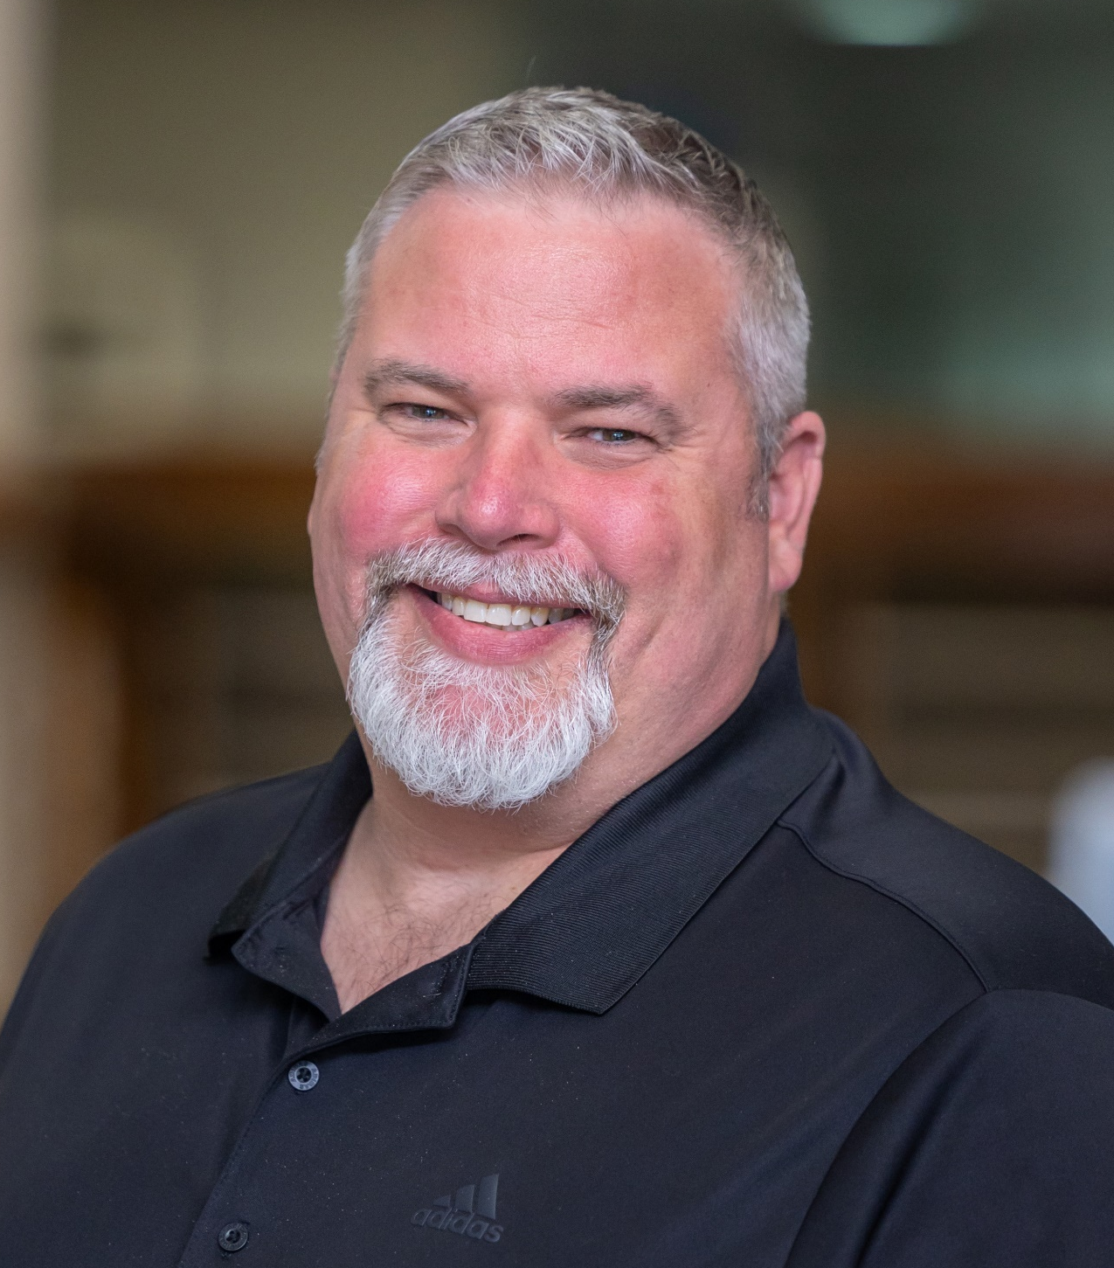
RICHLAND RESOURCES
Memorial Health Partnership - Joe Drew, MA, LPC
Appointments: In-person & Telehealth
Drum Circles/Group Sessions
Provides Diagnosis of Mental Health
Crisis Intervention
Can Address: Suicidal Ideology, Anxiety, Depression, Trauma, Interpersonal Skills, and More

Slide 7

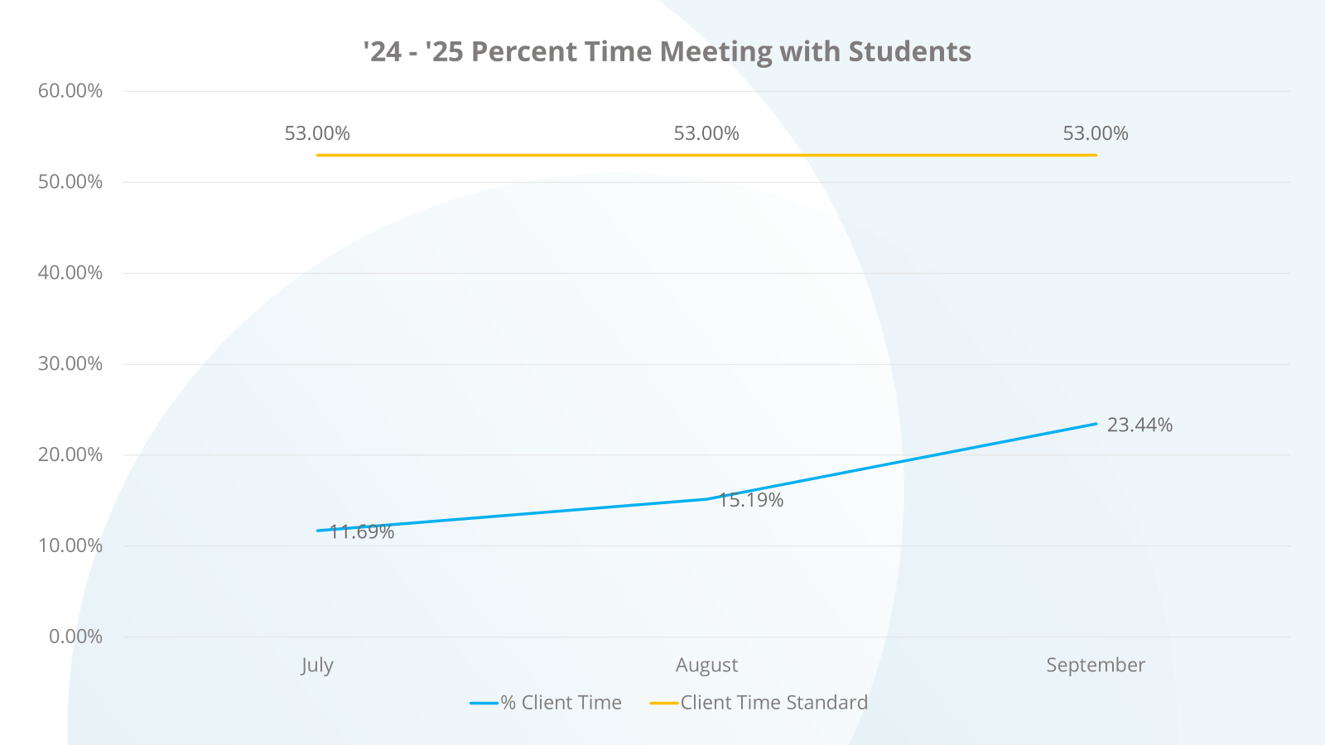
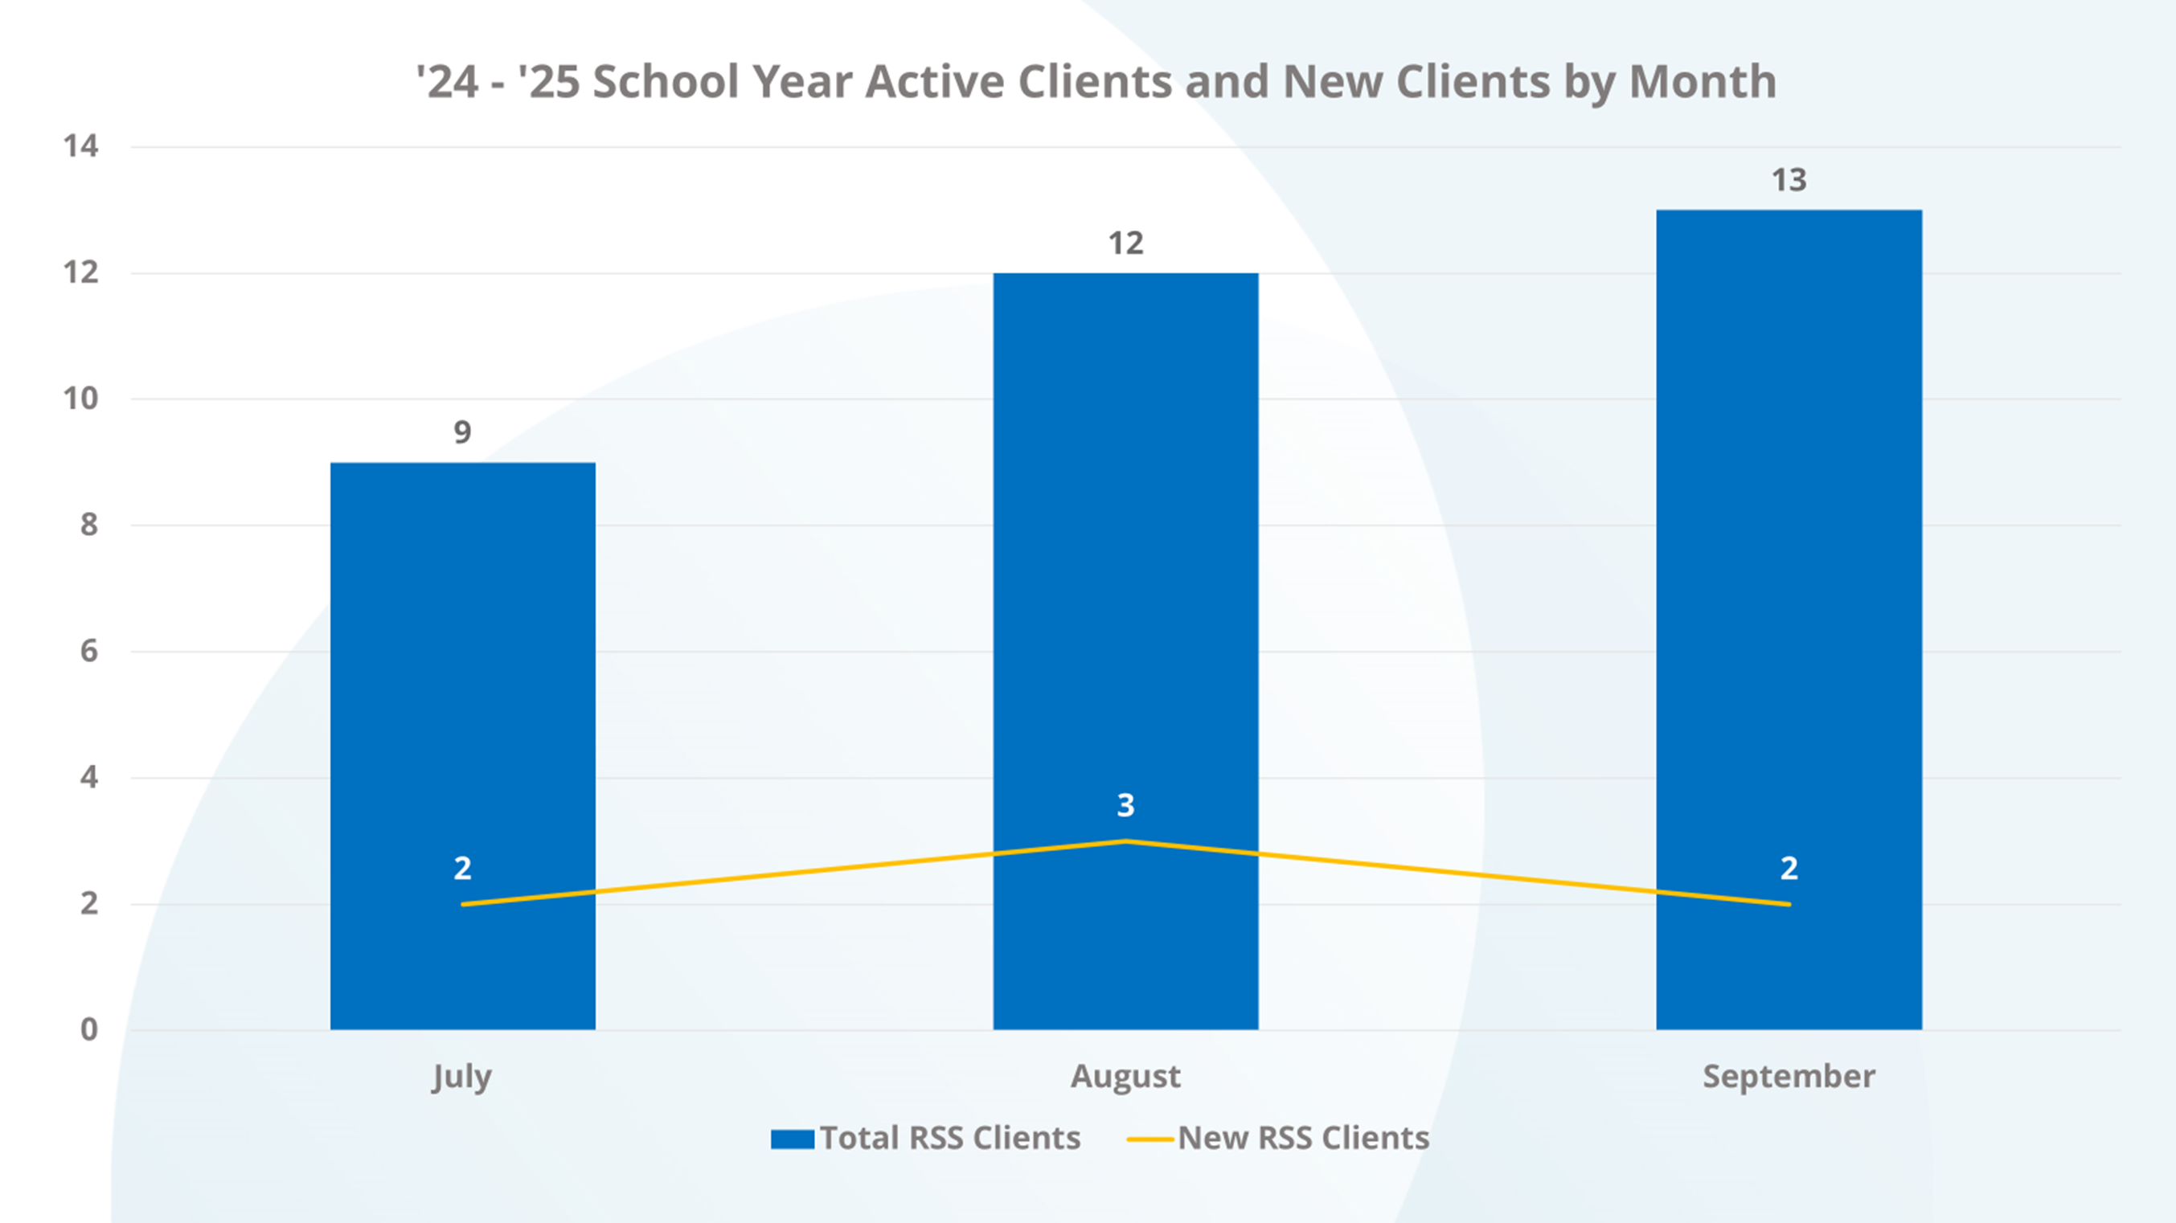

Slide 8

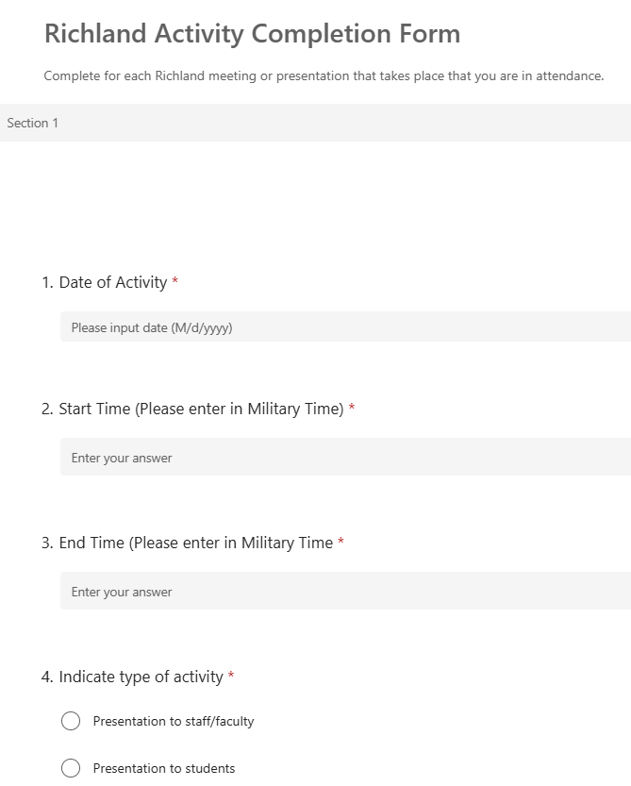
FOCUS ON GENERAL EMOTION STATE
Joe will be completing the form after providing generalized emotional health service
Data can be extracted to demonstrate additional value provided

Slide 9

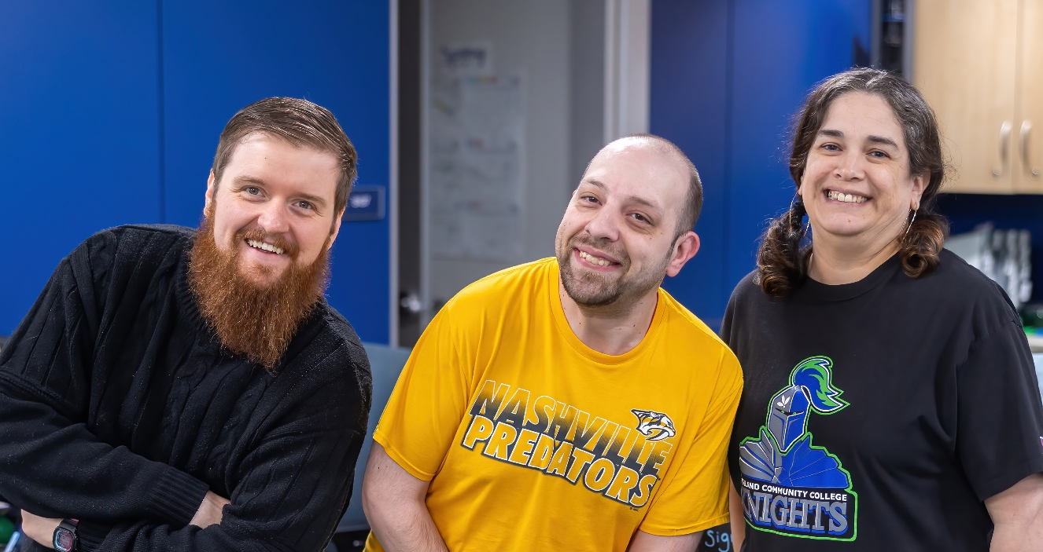
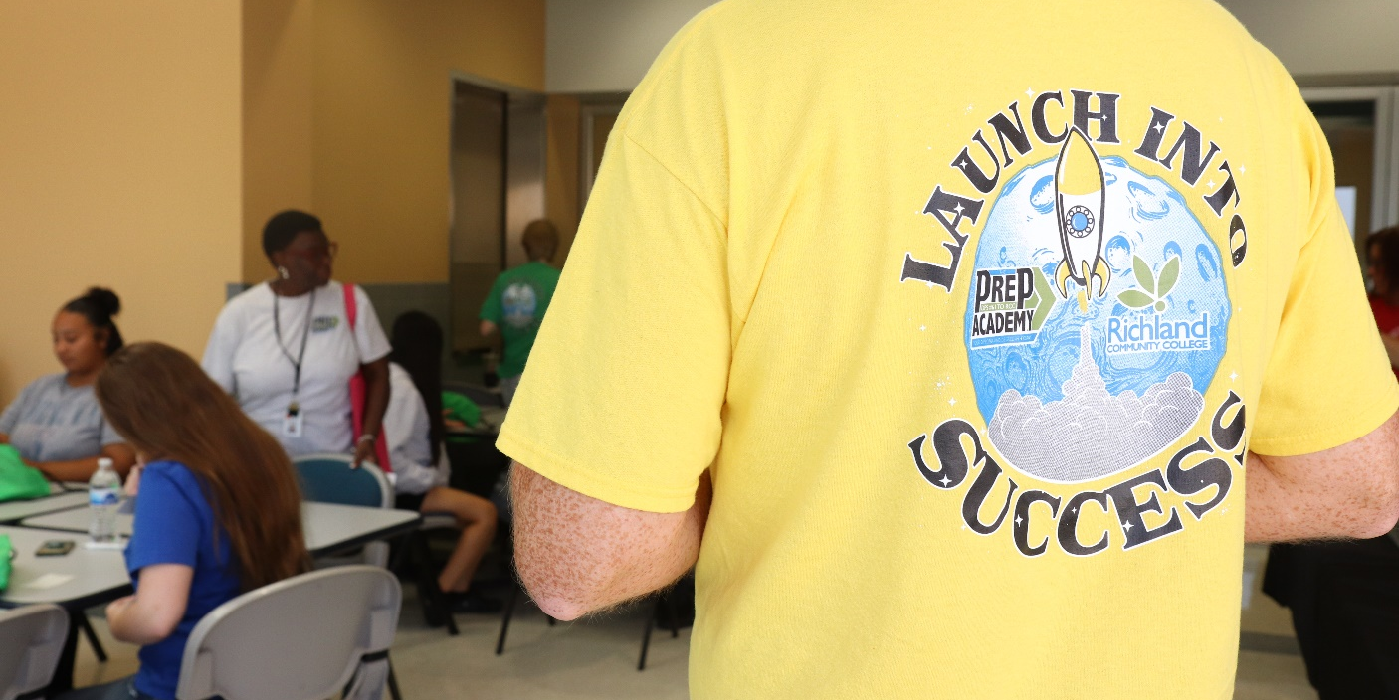

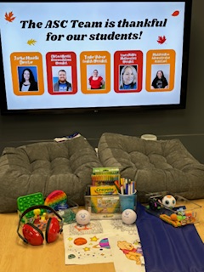
ACADEMIC SUCCESS
CENTER
Accommodations
Tutoring
Passport Courses
Prep Academy Launch
Sensory Support Tools
“What’s Poppin’ in the ASC”
Disability Expo
“I would like to say I am very thankful for the second chance and I am very appreciative for a school and people that think about their students the way RCC does!”
“I'd just like to say that my experience at Richland thus far has been outstanding, and I'm very grateful… I feel as though there will always be someone there to assist with anything I need and I can't overstate how reassuring that is. Sincerely, thank you.”

Slide 10
ADDITIONAL SUPPORTS & RESOURCES
Fitness Classes Weekly
Health Challenges
Fresh Check Day
Student Emergency Fund (Foundation)
School Supply Closet
Career Closet
The Pantry
Free Coffee & Snacks (SSC & ASC)
Mental Health Series Grant Application

Slide 11

References
Abrams, Z (2022). Student mental health is in crisis. Campuses are rethinking their approach. American Psychological Association. https://www.apa.org/monitor/2022/10/mental-health-campus-care
Flannery, M (2023). The Mental Health Crisis on College Campuses. National Education Association. https://www.nea.org/nea-today/all-news-articles/mental-health-crisis-college-campuses
Mowreader, A. (2024). Survey: Getting a Grip on the Student Mental Health Crisis. Inside Higher Ed. https://www.insidehighered.com/news/student-success/health-wellness/2024/08/19/experts-weigh-college-student-mental-health-crisis#:~:text=Recent%20data%20from%20Inside%20Higher,mental%20health%20as%20%E2%80%9Cpoor.%E2%80%9D
META. (n.d.). META Teletherapy. META https://www.meta.app/
TimelyCare (n.d). A Connected System of Care. TimelyCare https://timelycare.com/what-we-do/
.

Slide 12
Thank You!

