Slide 1


Slide 2

December 2024 Monitoring Report
Technology & Operations Teams
Facilities & Grounds
Campus Police
Information Technology (IT) Department

Slide 3
Monitoring Report: Facilities
Purpose: Maintain and enhance the college’s facilities and grounds to support of the institution’s mission & vision
2024-2026 Strategic Plan Goals:
Facilities Master Plan progression
Reduced energy consumption

Slide 4
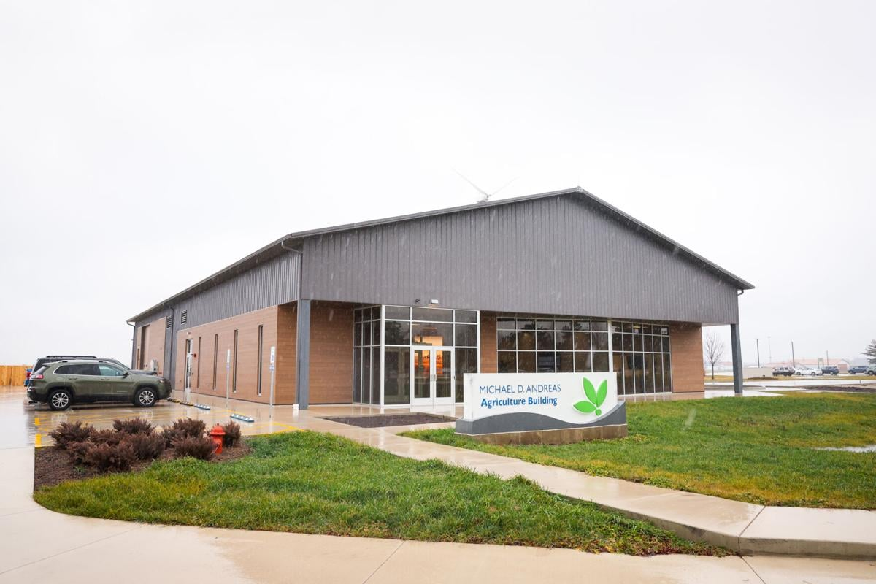

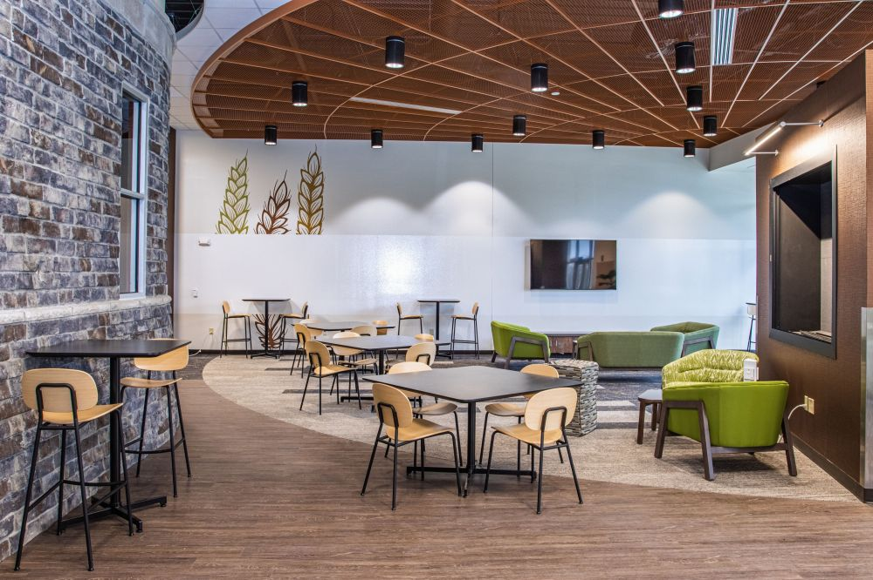
Monitoring Report: Facilities
Master Plan Progression: Andreas Agriculture Building
$4 million investment supporting academic operations
Greenhouse & headhouse work have largely been completed; currently completing final post-construction enhancements

Slide 5
Monitoring Report: Facilities
Project Currently In Progress
Master Plan Phase II: First Floor, West Wing & Center
Grant Operations Wing: offices & learning spaces
Parking lot & sidewalk concrete repair (co-funded by ICCB)
Elevator car repair (summer 2025)
Clock and annunciator system upgrades
Parking lot call box upgrades
Smart lighting upgrades
Pneumatic control system replacement
CSI exterior wall repair
Atrium skylight & roof repair
Stair tower ceiling replacement & window repair
Exterior door & frame replacement
Wayfinding improvements & digital signage
Building automation system (BAS) tuning

Slide 6

Clery Act Reporting | On Campus
 | 2021 | 2022 | 2023
Murder/non-negligent Manslaughter | 0 | 0 | 0
Negligent Manslaughter | 0 | 0 | 0
Sex Offenses (Forcible) | 0 | 0 | 0
Sex Offenses (Non-Forcible) | 0 | 0 | 0
Robbery | 0 | 0 | 0
Aggravated Assault | 0 | 0 | 0
Burglary | 0 | 0 | 0
Motor Vehicle Theft | 0 | 0 | 0
Arson | 0 | 0 | 0
Hate Crimes | 0 | 0 | 0
Domestic Violence | 1 | 0 | 1
Stalking | 0 | 0 | 0
Dating Violence | 0 | 0 | 0
Illegal Weapons Possession | 0 | 0 | 0
Drug Law Violations | 0 | 0 | 1
Liquor Law Violations | 0 | 0 | 0
Illegal Weapons Possession | 0 | 0 | 0
Drug Law Violations | 0 | 0 | 0
Liquor Law Violations | 0 | 0 | 0
Monitoring Report: Campus Police
Mission: To create an environment where people can safely learn, work and visit
Provides campus crime prevention, emergency response, and related services 24/7/365
Sworn Officers: 3 (2 F/T, 1 P/T)
Contract Officers: 5 (4 F/T, 1 P/T)

Slide 7
Monitoring Report: Campus Police
Behavioral Evaluation Threat Assessment (BETA) Team
Provides consultation, makes recommendations for action, and coordinates campus resources in response to reports of disruptive or concerning behavior displayed by students, staff, or faculty.
Results in actionable decisions intended to ensure a safe learning environment

Slide 8
Monitoring Report: Information Technology (IT)
Purpose: Provide a secure technological environment for activities which align with the institution’s mission& vision.
2024-2026 Strategic Plan Goals:
Student Information System (SIS) software upgrade
Cybersecurity enhancements

Slide 9
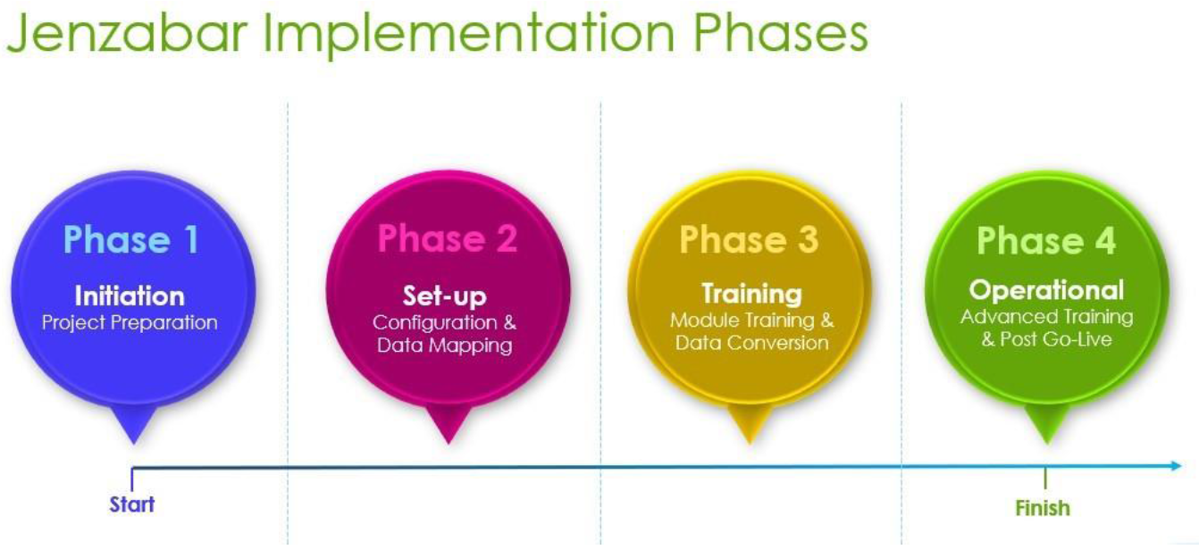
Monitoring Report: IT
Jenzabar Student Information System Conversion: Status

Slide 10
Monitoring Report: IT
Jenzabar Student Information System Conversion: Timeline
January 2024 – December 2024:
Planning discussions & data mapping
Identify “big picture” software/process changes, develop initial change plans
January 2025 – December 2025:
Complete any lingering planning work
Begin user training & data conversion testing
January 2026 – February 2026:
Wrap up user training & conversion testing
March 2026:
Go-Live: 7-day system blackout to complete the final conversion)

Slide 11
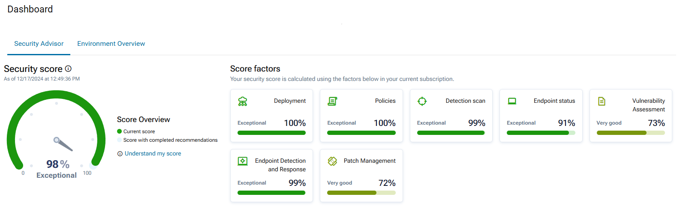
Monitoring Report: IT
Cybersecurity: Malwarebytes EDR (Endpoint Detection & Response)

Slide 12
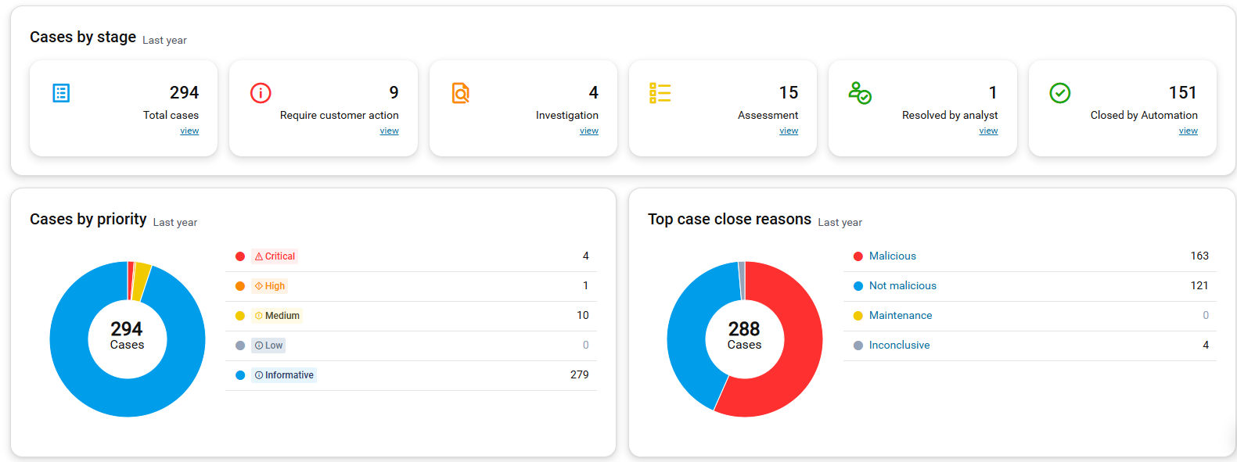
Monitoring Report: IT
Cybersecurity: Malwarebytes EDR – Past 12 Months

Slide 13
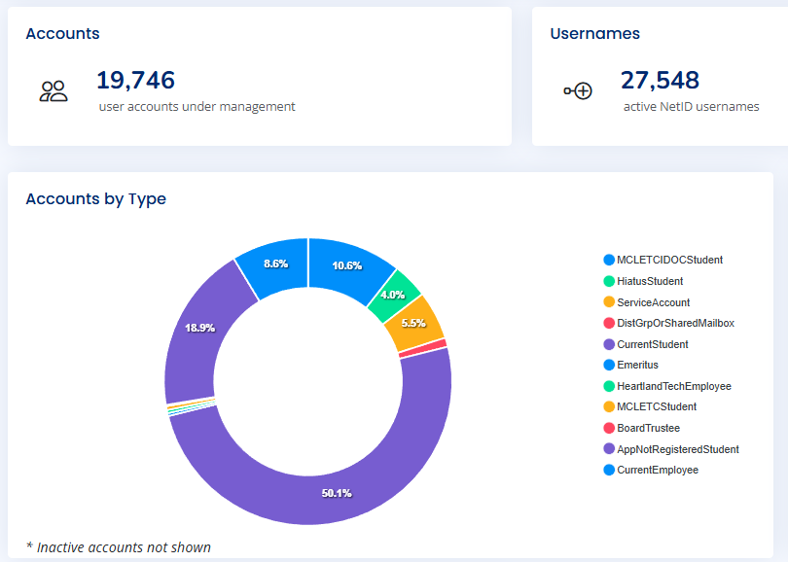
Monitoring Report: IT
Cybersecurity Incident: Restoration
Physical servers: 28 (138TB)
Virtual servers: 103
Workstations: 1,453
Deployed applications: 118
Deployed patches: 691

Slide 14

Questions ?

