Slide 1


Slide 2

Board Ends Alignment
Because of Richland, students will acquire the knowledge and skills needed to succeed in and contribute to a diverse and global community and to exercise their rights and responsibilities as citizens
Because of Richland, students who graduate with applied (A.A.S.) degrees will be prepared to be skilled, successful employees in the workplace
Because of Richland, students will have opportunities to successfully pursue training and education at and beyond the community college

Slide 3
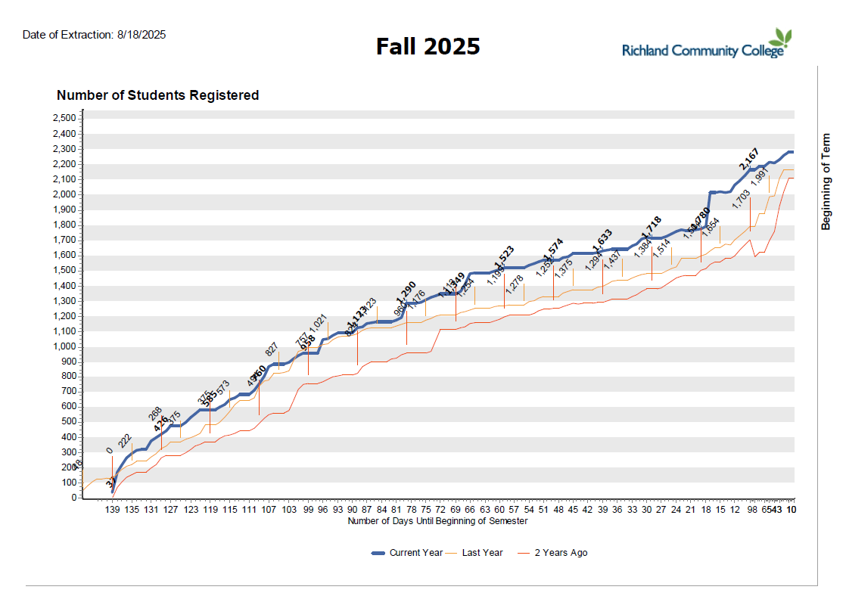
Students Registered
.

Slide 4
Enrollment Growth
Cost & Affordability
Accessibility & Proximity
Sense of Belonging & Community
Dual Credit / Early College Expansion
Workforce Programs Tied to Local Industry
Partnerships with Employers

Slide 5


Program Approvals and Transfer Standards
All Richland Associate Degrees and Certificates programs are approved by the ICCB, the IBHE, and the HLC
All transfer degrees have IAI-designated courses or courses that individual universities have approved for transfer
Richland Community College ensures that students enrolled in college-level courses meet the necessary academic requirements through a structured placement and eligibility review process.

Slide 6
Cross-Disciplinary Outcomes (CDO)
Richland Community College continues to have four cross-disciplinary outcomes (CDO) for degree seeking programs.
Written Communication: Degree-Seeking students will communicate effectively in writing.
Oral Communication: Degree-Seeking students will be able to orally communicate effectively.
Information Literacy: Degree-Seeking students will access, evaluate, and appropriately use information in various research and applied contexts.
Critical and Creative Thinking and Problem Solving: Degree-Seeking students will think critically and creatively

Slide 7

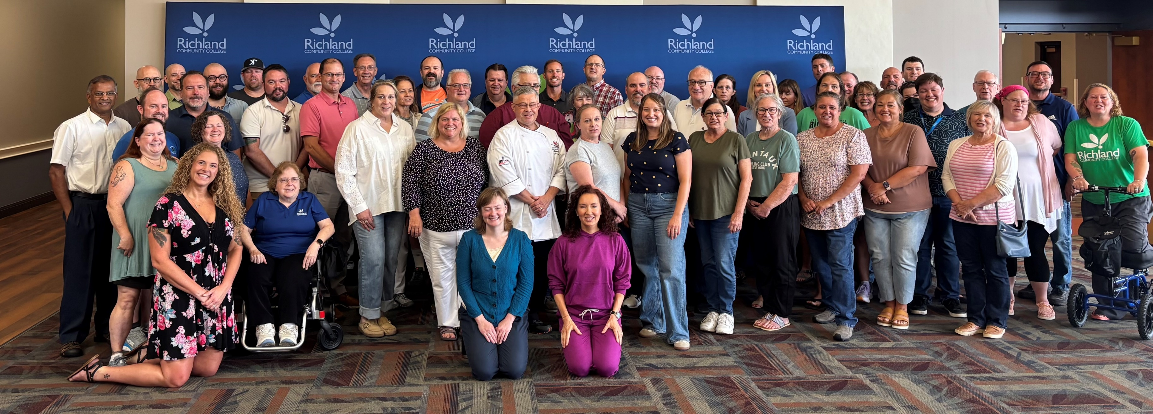
Full Time Faculty

Slide 8
New Faculty Hires
Dr. Maria Alberto Tenure-Track English Faculty
Dr. Matthew Bowman Tenure-Track English Faculty
Dr. Teresa Tarbuck, Tenure-Track Chemistry Faculty
Michael Mornado, Tenure-Track Math Faculty
Ashley Collingwood, Associate Degree Nursing Tenure-Track Clinical Faculty
Elizabeth Weber Practical Nursing Faculty
Angela Ritchie-Surgical Technology.
Jameson Neff Tenure-Track Math Faculty
Anna Shapland, Interim Director of Teaching and Learning Center

Slide 9

ILLINOIS FEDERATION OF TEACHERS OFFICERS
FirstName | LastName | Role
Brooke | Oliver | President
Faith | Brenner | Vice President
Schuy | Weishaar | Secretary
Travis | White | Treasurer

Slide 10



Division Updates
Allied Health Professions
Liberal Arts
Math & Sciences
Applied Science & Technology

Slide 11
Allied Health Professions
Dean: Dr. Tasha Jones
Nursing Education Programs: Associate Degree Nursing, Practical Nursing, Bridge PN to ADN, Nurse Assistant/Aide, Phlebotomy/Forensic Phlebotomy, Medical Assisting
Total Faculty: 16 Full-time faculty, 15 Adjunct Faculty
Total Staff: 2 Administrative Assistants 2 Lab coordinators

Slide 12

Allied Health Professions
We will host two accrediting bodies on campus for site visits in September:
Joint Review Committee on Education in Radiologic Technology (JRCERT) for the Radiography program Site visit dates: Sept 18-19
Accreditation Commission for Education in Nursing (ACEN) for the ADN program Site visit dates: Sept 23-25

Slide 13
Liberal Arts
Dean: Danielle Patricio
Disciplines: African-American Studies, Art, Communication, Early Childhood Education, English, Foreign Language, History, Music, Philosophy, Political Science, Student Development, Theatre
Total Faculty: 10 Full-Time Faculty, 16 Adjunct Faculty
Other Staff: Administrative Assistant, Education Program Director

Slide 14

Prep Academy
District 61 graduated its first cohort of Prep Academy students in May 25 students earned their Associate’s degree while earning their high school diploma in 2025.
Nearly all of them are transferring to a university this month to continue their education.

Slide 15
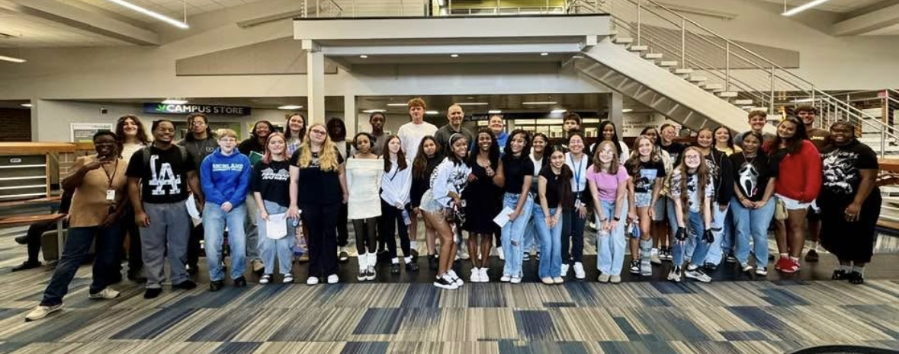
Cohort 2

Slide 16
Math & Sciences
Dean: Andy Hynds
Transfer Disciplines: Astronomy, Biology, Chemistry, Earth Science, Economics, Engineering, Math, Physics, Physical Education, Sequestration
Total Faculty: 14 Full-Time Faculty, 14 Adjunct Faculty
Other Staff: Administrative Assistant, Dual Credit Coordinator

Slide 17

TLC
Revised the Canvas Instructor Resources course to be the hub for faculty professional development and training resources
Working on implementing a full systemized implementation of Dropout Detective a data tracking, analytic tool to help identify and prevent student dropout
Creating of a TLC accountability dashboard

Slide 18
Applied Science & Technology
Dean: John Oliver
Disciplines: Accounting, Agribusiness, Automotive, Business, Computer Science, Culinary Arts, Diesel Medium/Heavy Truck, Engineering Technology, HVAC, Horticulture, Hospitality, Network Technology, Software Applications Programming, Welding
Total Faculty: 10 Full-Time Faculty 18 Adjunct Faculty
Other Staff: Administrative Assistant, Director of Agricultural Programs (2 FT direct reports), Culinary Arts Director (3 FT direct reports)

Slide 19
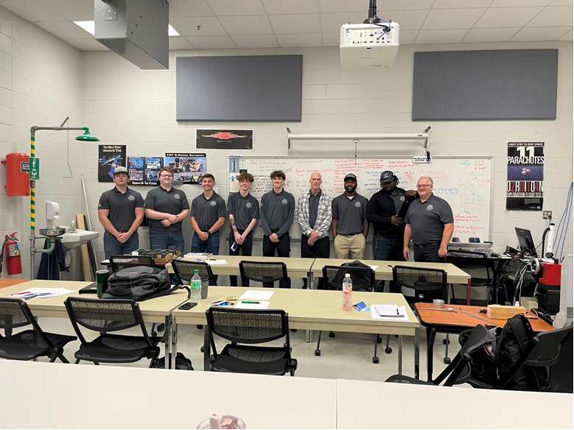
Applied Science & Technology
Automotive Technology and HVAC have doubled enrollment in introductory courses thanks to the partnership between Tamika Thomas and CEJA.
Nine Richland Agriculture Students were selected into the C2A3 ASPIRE (Accelerating Students Participation in the Rural Economy) program
1st Engineering ENGR 110 has been offered at TCCI
We launched our first student cohort in a five-semester AAS Earn-and-Learn program, combining classroom learning with real-world experience

Slide 20
Questions

