Slide 1

Monitoring Report
Facilities, Information Technology, and Campus Police
Presented by: Joe Feinstein
Senior Vice President, Technology & Operations

Slide 2
Board Ends Alignment
Because of Richland’s commitment to well-maintained and modern facilities, students will learn in safe, accessible, and technologically equipped environments that enhance their educational experience and success.
Because of Richland’s responsible management of its physical assets, the college will ensure that facilities are efficiently utilized, environmentally sustainable, and supportive of current and future academic, workforce, and community needs.
Because of Richland’s strategic investment in campus infrastructure, the community will benefit from welcoming spaces that promote engagement, collaboration, and lifelong learning.

Slide 3

Main Campus:
Facilities & Grounds
Total Size: 398,439 square feet of facilities, situated on a 155-acre campus.
Sustainability: Investments in geothermal, wind, and electrical & water conservation.
Age: Ranging from 40 to 1 year old, the median facility age is 17 years (factoring in remodeling activities)

Slide 4
Facilities: Current Projects
Master Plan Phase II (West Wing, First Floor)
Fire Alarm Upgrades
CSI Building Drainage & Exterior
Parking Lot & Sidewalk Repairs
Strategic Plan: Lighting Improvements

Slide 5
Facilities: Future Planning
Master Plan II
Workforce Training
Health Professions

Slide 6
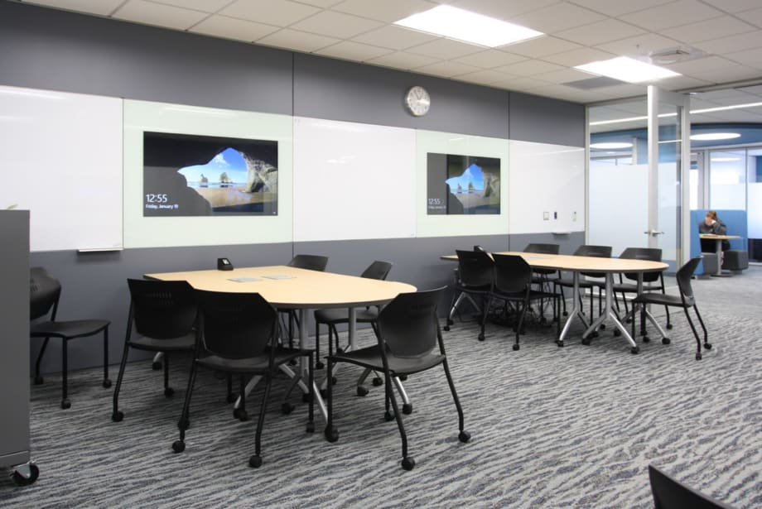
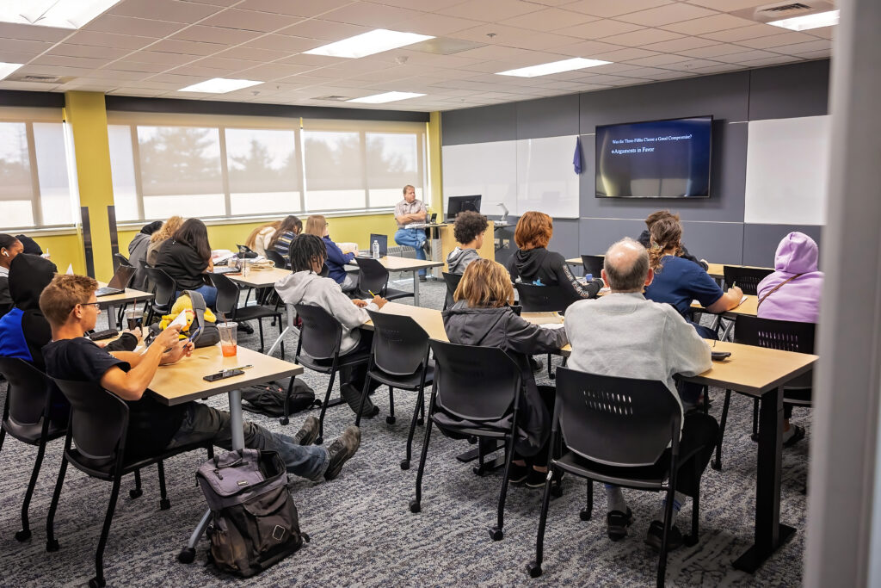
Facilities & IT
Convergence
Active Learning Classrooms: Spaces designed to support student-driven experiences
Smart Classrooms: Traditional lecture spaces outfitted with modern technology.
Modular Design: Walls & furniture designed to expect technology reconfigurations over time

Slide 7
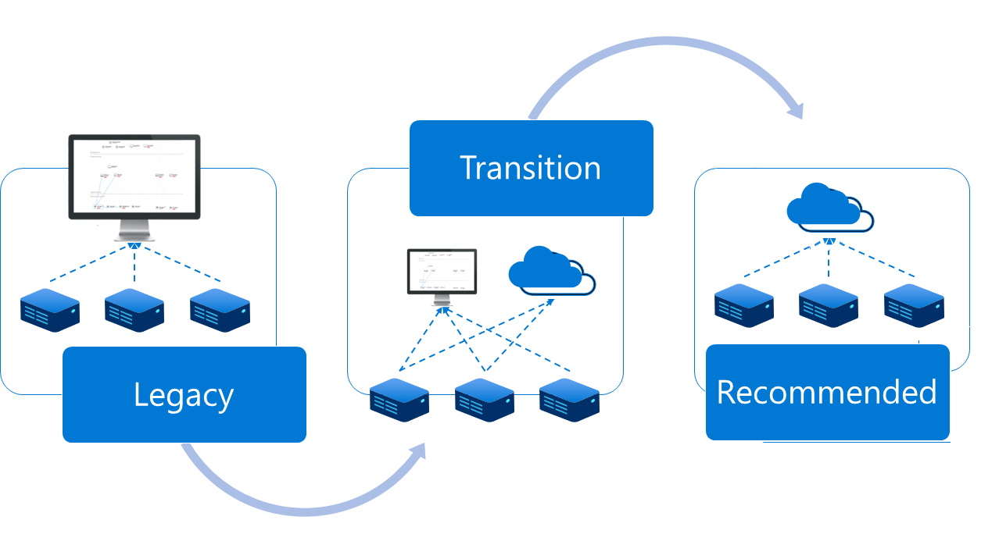
Information Technology: Cloud Migrations
Office 365 / Outlook
Canvas LMS
Jenzabar One

Slide 8

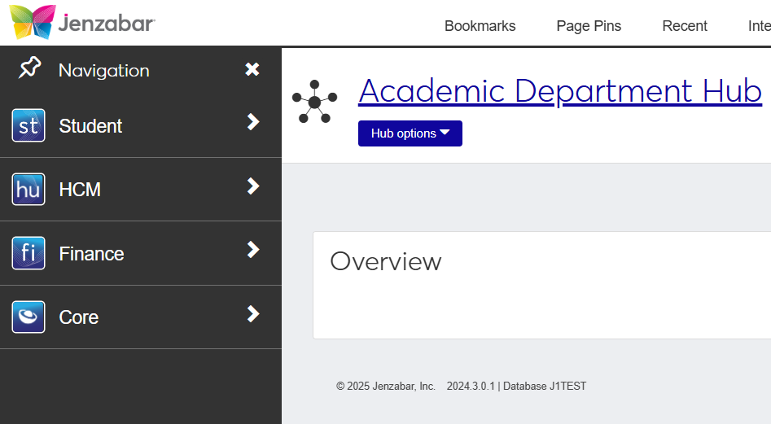
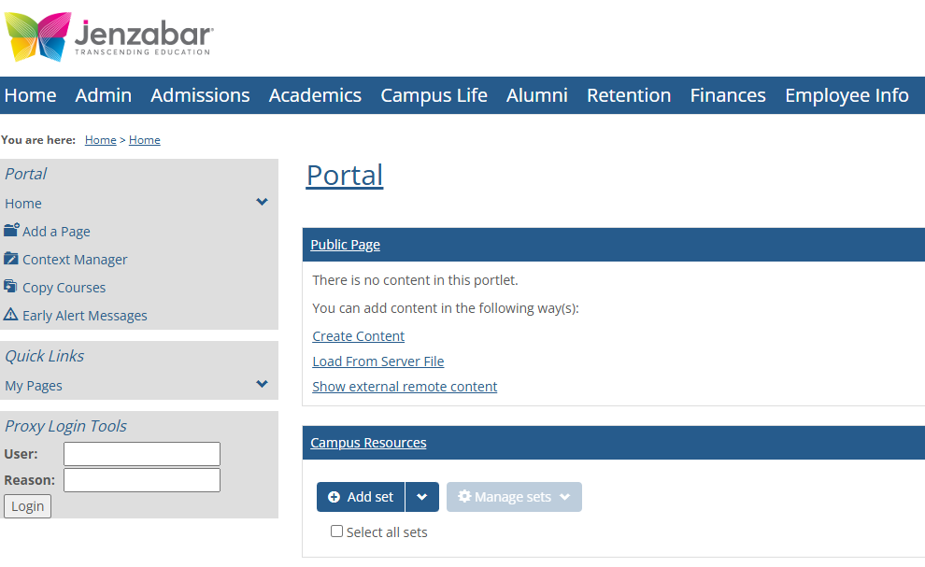
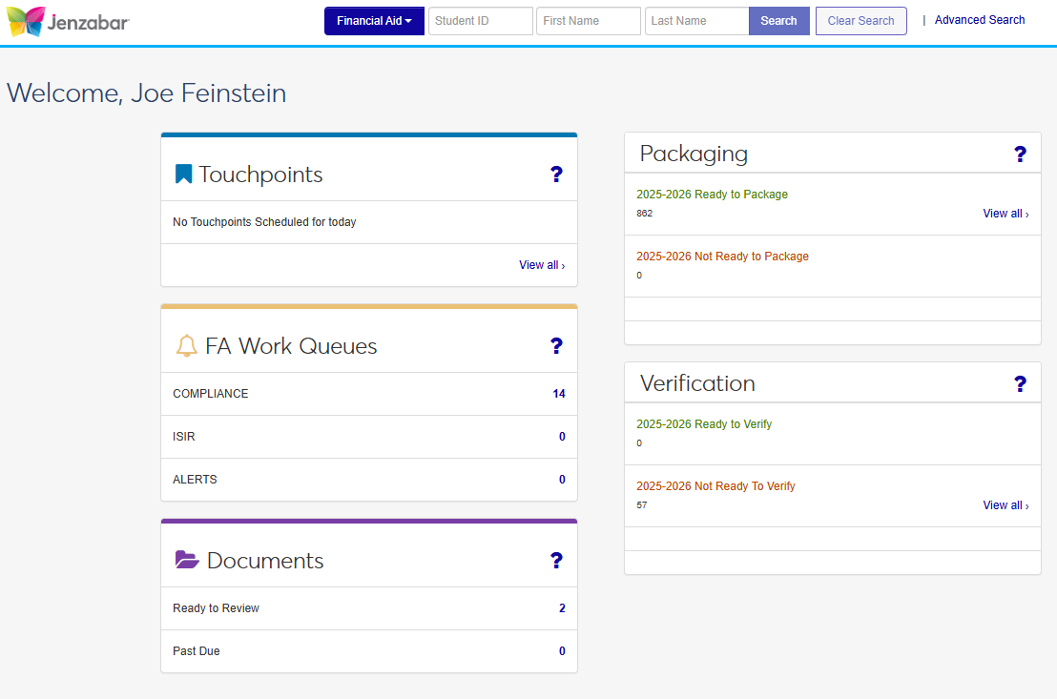
Jenzabar One

Slide 9

Q & A

