Slide 1


Slide 2

Institutional Advancement
What is Institutional Advancement?
The Institutional Advancement Division at Richland Community College encompasses the Foundation, the Office of Grants & Sponsored Programs, Marketing, and Campus Events. Together, these departments connect Richland’s mission—to empower individuals through learning and to forge partnerships that grow communities—with the vision of being the best and first choice for education.
Our work ensures resources are secured, stories are told, relationships are strengthened, and opportunities are created for students and the community.

Slide 3

End Statement Alignment
Whether through a scholarship that removes a financial barrier, a grant that supports innovative workforce training, a campaign that amplifies our story, or an event that connects students and community partners, Institutional Advancement is helping to shape the future of our students and our community. This collective impact is evident through the following End Statements:
Because of Richland, students will have opportunities to successfully pursue training and education at and beyond the community college.
Because of Richland’s partnerships with the community, the economic and business climate in our service area will be significantly enhanced.

Slide 4

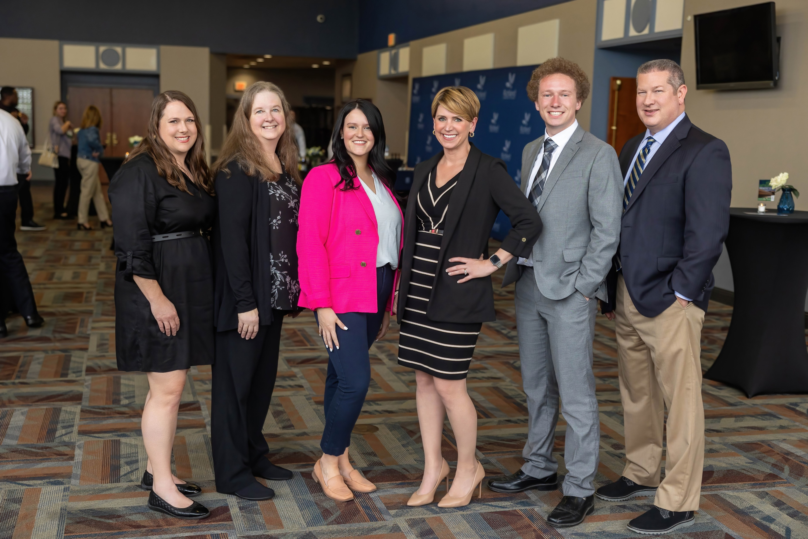

Our Team
Foundation
Julie Melton
Vice President, Institutional Advancement
Foundation Executive Director
Debbie Ellison
Executive Assistant, Institutional Advancement & Foundation
Brian Silotto
Director of Major & Planned Giving
Loren McGinnis
Assistant Director, Annual Giving & Alumni Engagement
Tara Mata
Assistant Director, Advancement Services & Scholarships
William Soquet
Donor Information & Database Coordinator

Slide 5
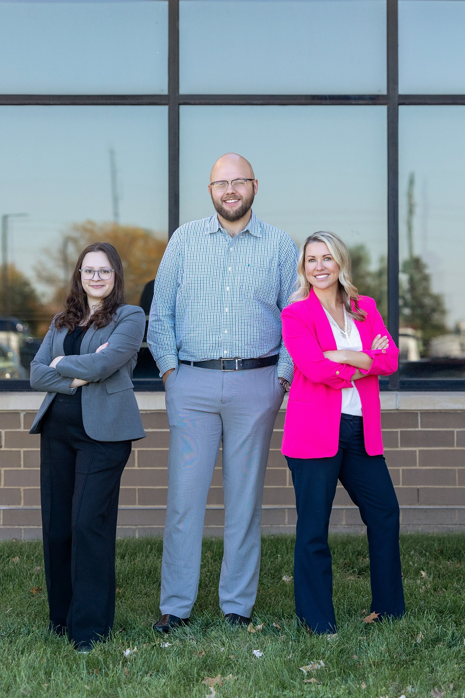
Our Team
Marketing
Samantha Bright
Director of Marketing & Communications
Emma Roark
Content Writer & Communications Coordinator
Wade Ripple
Lead Creative Designer
Jason Waks
Creative Design Specialist
Campus Events
Carrie Ringer
Campus Events Coordinator

Slide 6
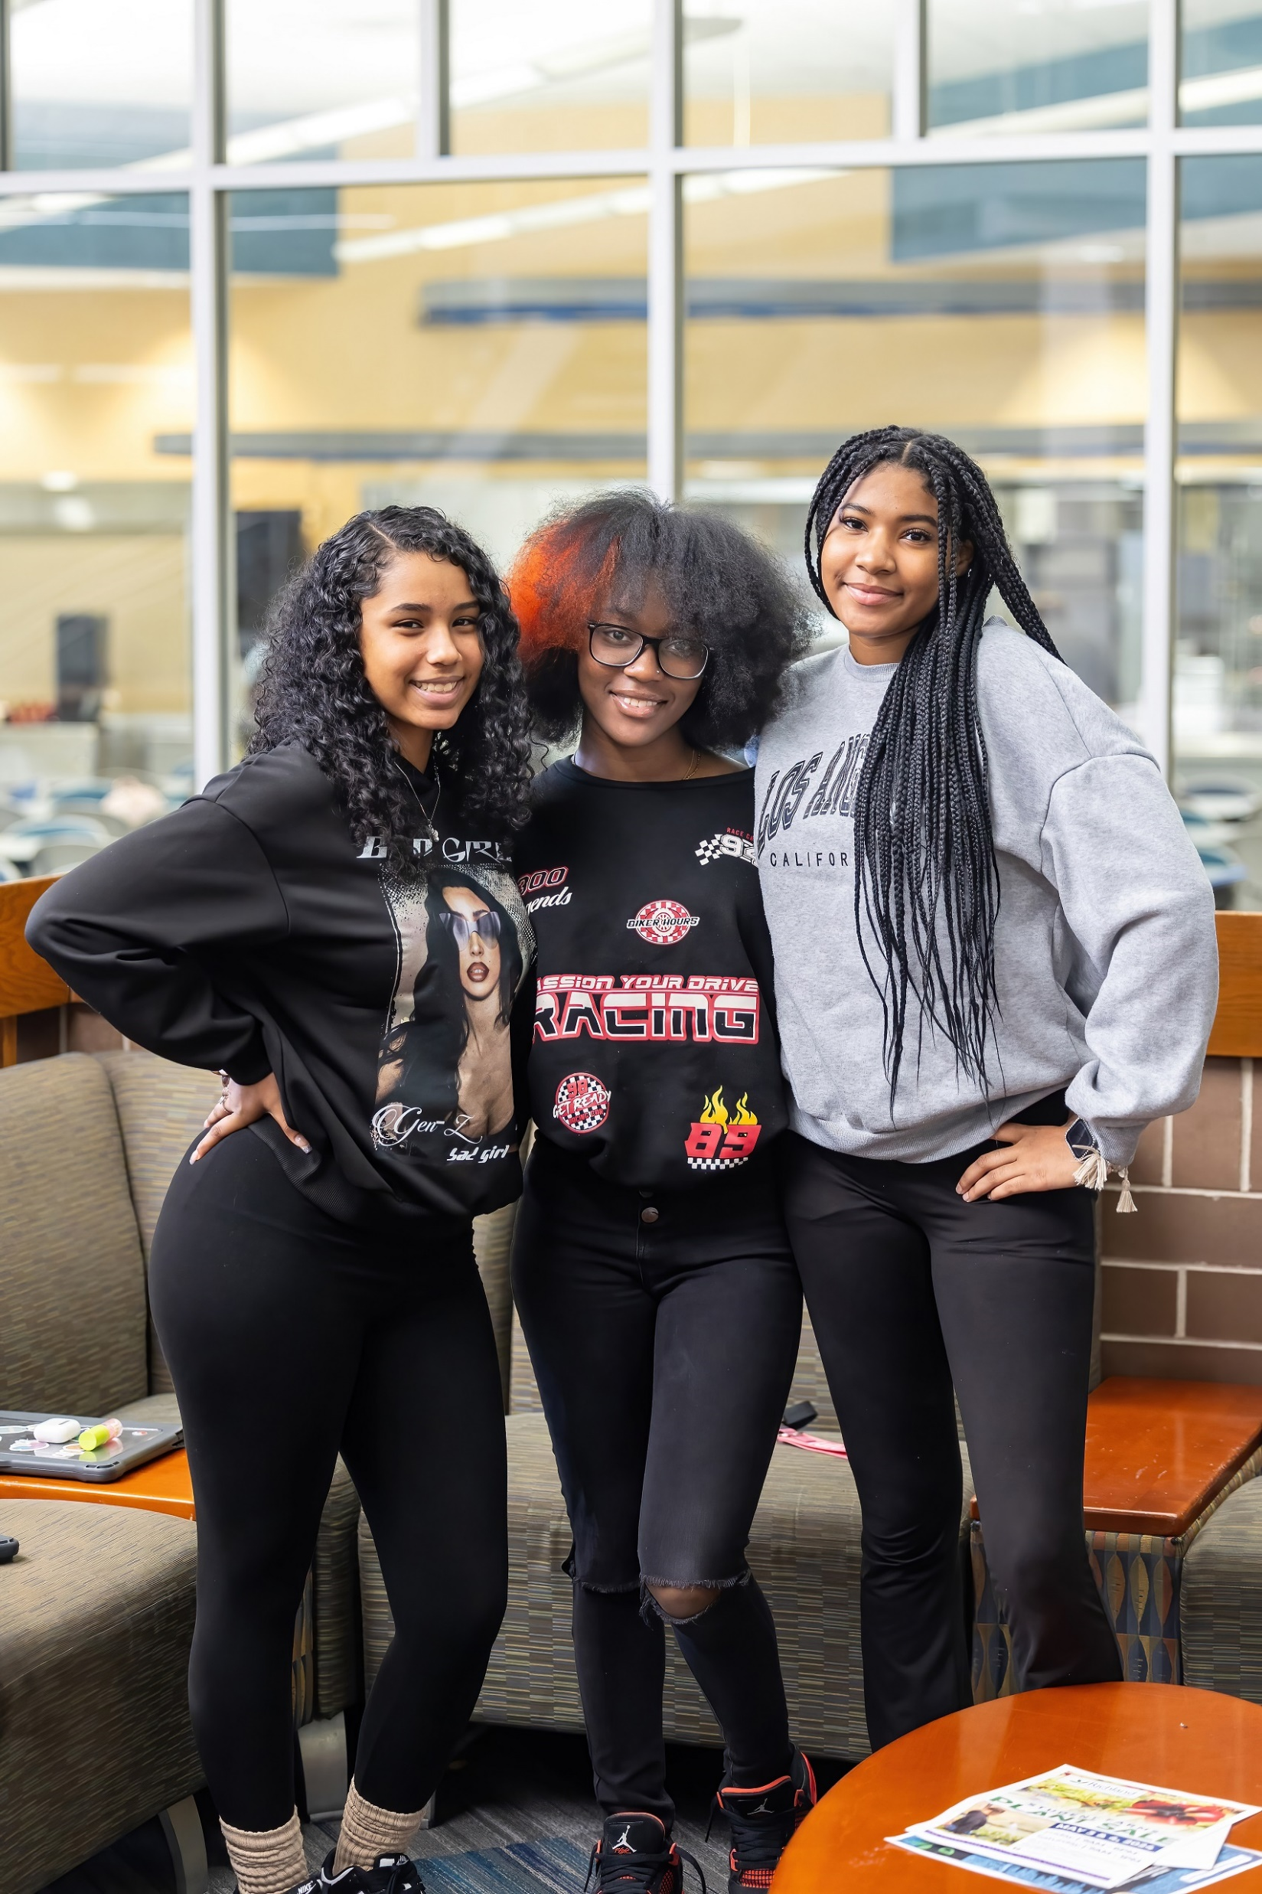
Our Team
Office of Grants &
Sponsored Programs
Tiffany Quinze-Nolan
Director of Grants & Sponsored Programs
Jodi Schoen
Grant Coordinator
Abby Hendren
Grant Coordinator
*Grants Team all new this year - not pictured

Slide 7

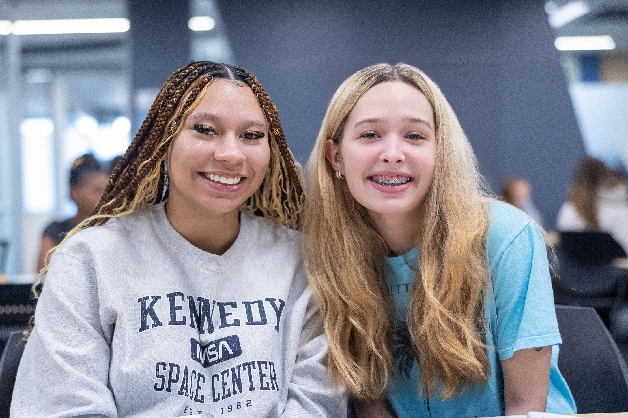
Foundation Mission
The mission of Richland Community College Foundation is to support and advance the development activities that provide enhancements to Richland Community College
and its students.

Slide 8
FY25 Foundation Financials
Total Assets
As of June 30, 2025: $28,110,607
As of June 30, 2024: $27,748,373
Annual Revenue
FY25: $2,170,274
FY24: $2,146,717
Number of Donors
FY25: 341
FY24: 489
Investments
As of June 30, 2025: $26,142,662
As of June 30, 2024: $24,956,816
Board Giving
FY25: 100%
FY24: 94%
Number of Gifts
FY25: 2841
FY24: 3228

Slide 9
Foundation Board of Directors
Board Officers
Jason Herman, Chair
Tamar Kutz, Vice Chair
Matt Fairchild, Treasurer
Dr. Marci Rockey, Secretary
Stacey Young, Past Chair
Honorary & Student Directors
Myung Kim, Honorary Director
Kathleen Black, Student Director
Board Members
Todd Applegate
Stephen Clevenger
Josh Dubbelde
Dennis Flaherty
Dr. Larry Gray
Lisa Kitchens
Tamar Kutz
Johnette Mitchell
Mirinda Rothrock
Kylee Roney
Travis Roach
Amy Steck
Trent Thompson
Matt Whitehead

Slide 10
Foundation FY25 Results
The Foundation exceeded its $2 million annual fundraising goal, raising $2,170,274, which is 8.5% above goal.
We awarded over $1.83 million in scholarships, assisting over 1,050 students—an all-time high. Student scholarship applications rose to 2,226, surpassing the target of 1,972—a 13% increase year over year.
Launched and awarded $108,000 in Dual Credit Scholarships, expanding access for high school students to earn college credit and jumpstart their academic journey.
Our Foundation Endowment now stands at $26.1 million, continuing our upward trajectory.
Achieved 100% giving from both the Foundation Board and the Board of Trustees, demonstrating unified leadership commitment to our donors.

Slide 11
Foundation FY26 Priorities
Begin Campaign Planning by establishing a timelines & projects that align with the four proposed funding priorities of: Workforce Development, Early College, Student Support & Capacity Building.
Conduct a Foundation Operational Audit & Program Assessment to determine campaign readiness and help establish goals and objectives that will lead to greater sustainability and fundraising success.
Continue to build our operational & database health by developing, updating and implementing processes & procedures that will lead to high functioning workflow.
Develop collateral materials that will support campaign planning, fundraising efforts and stewardship practices.

Slide 12

Student Testimonials

Slide 13
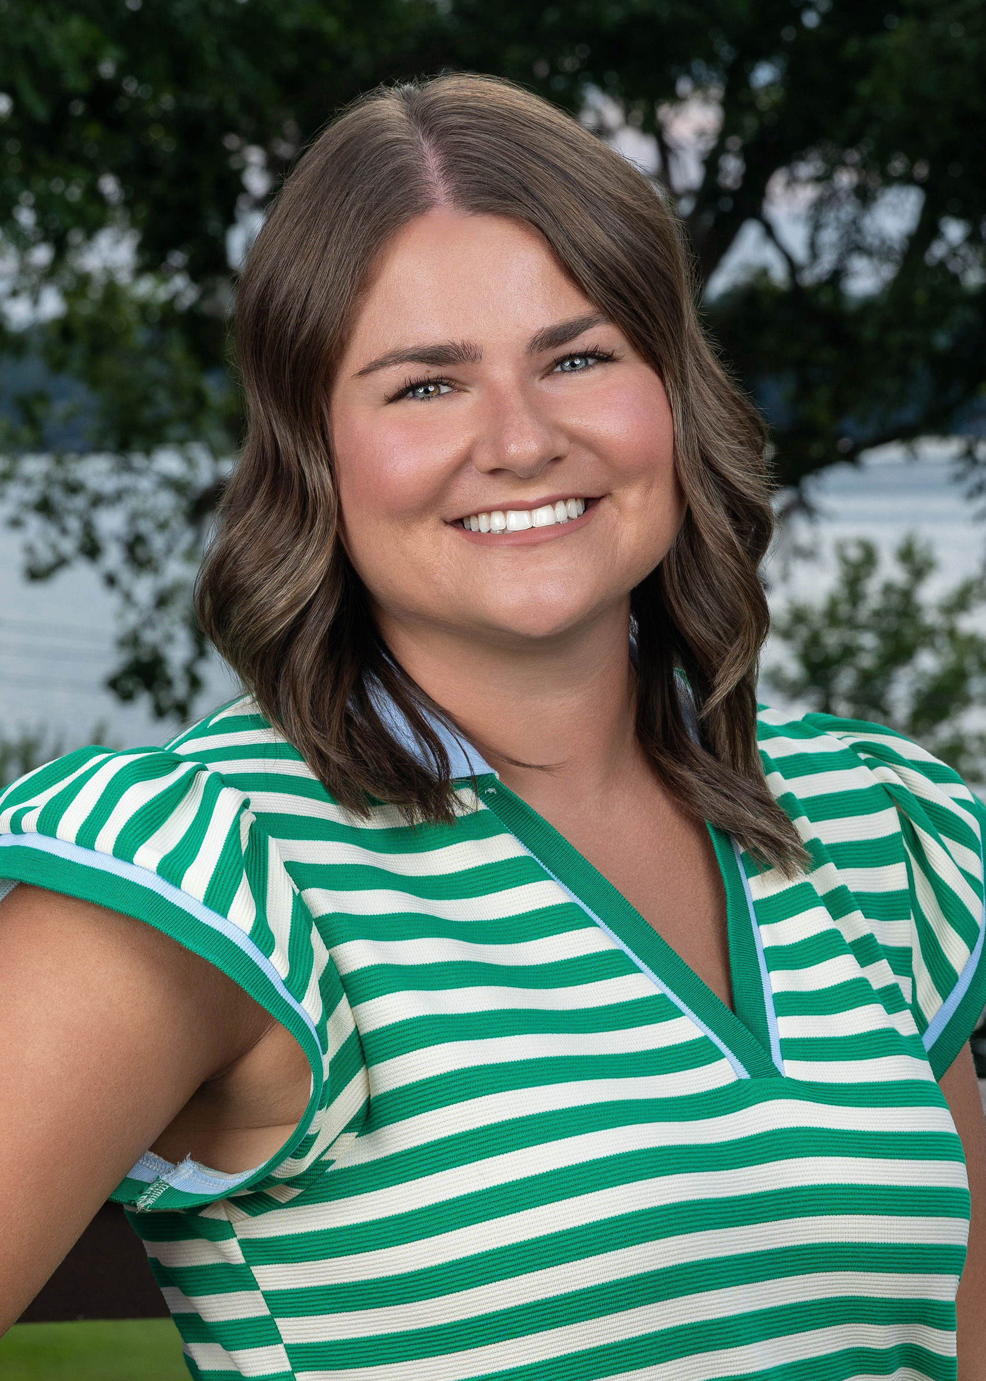
I am writing to express my deepest gratitude for your generous scholarship support. Your investment in my education is not only helping to ease the financial burden of returning to school, but it is also allowing me to pursue a long-held dream: transitioning from teaching into the nursing field.
Leaving my full-time position as a Life Skills Special Education teacher was not a decision I made lightly. Teaching students with special needs has been one of the greatest honors of my life, and the compassion, patience, and communication skills I’ve developed in the classroom are ones I will carry with me into my future as a nurse. I am passionate about continuing to serve others, and I truly believe nursing is where I am meant to be.
As a former Student Trustee on the Board of Trustees at Eastern Illinois University, I’ve learned how to be a strong advocate and leader. I’m excited to apply those skills in my new role as Student Director while navigating this next chapter as a full-time nursing student.
Thank you again for your generosity. Your support means more than words can express, and it’s making a lasting difference in my journey.
With gratitude,
Kathleen Black, Foundation Student Director

Slide 14

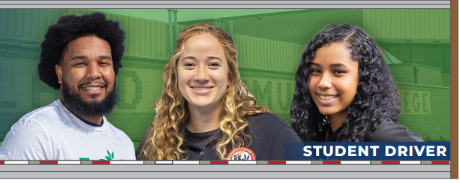
2025 Marketing Initiatives
CDL Truck & Trailer Wraps
New Website Implementation
Completion of Rack Cards
Monthly Program/Campus Spotlights
Farm Progress Show
Promotion of Transfer Pathways, including the AES Degree 3+1 with NIU
Starlight Partnership – MCLETC Video & The Sprout Podcast
Employee & Student Monthly Newsletter
Annual Media Buys

Slide 15

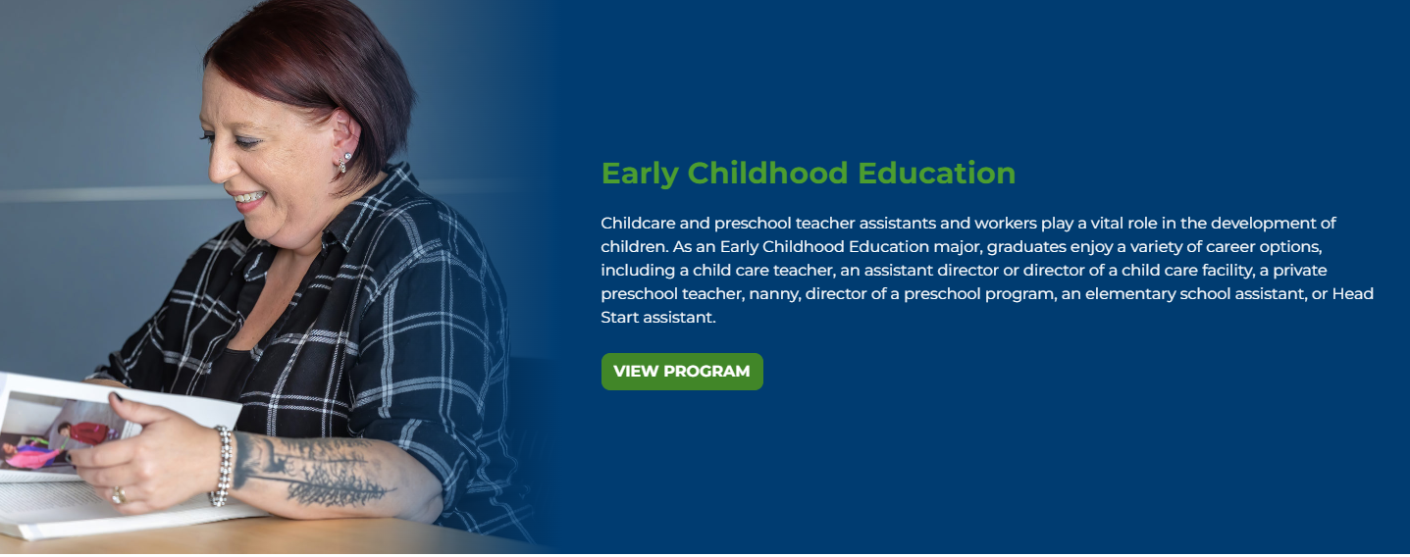
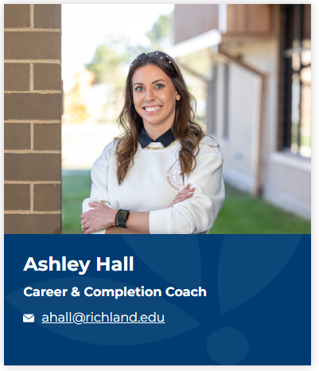

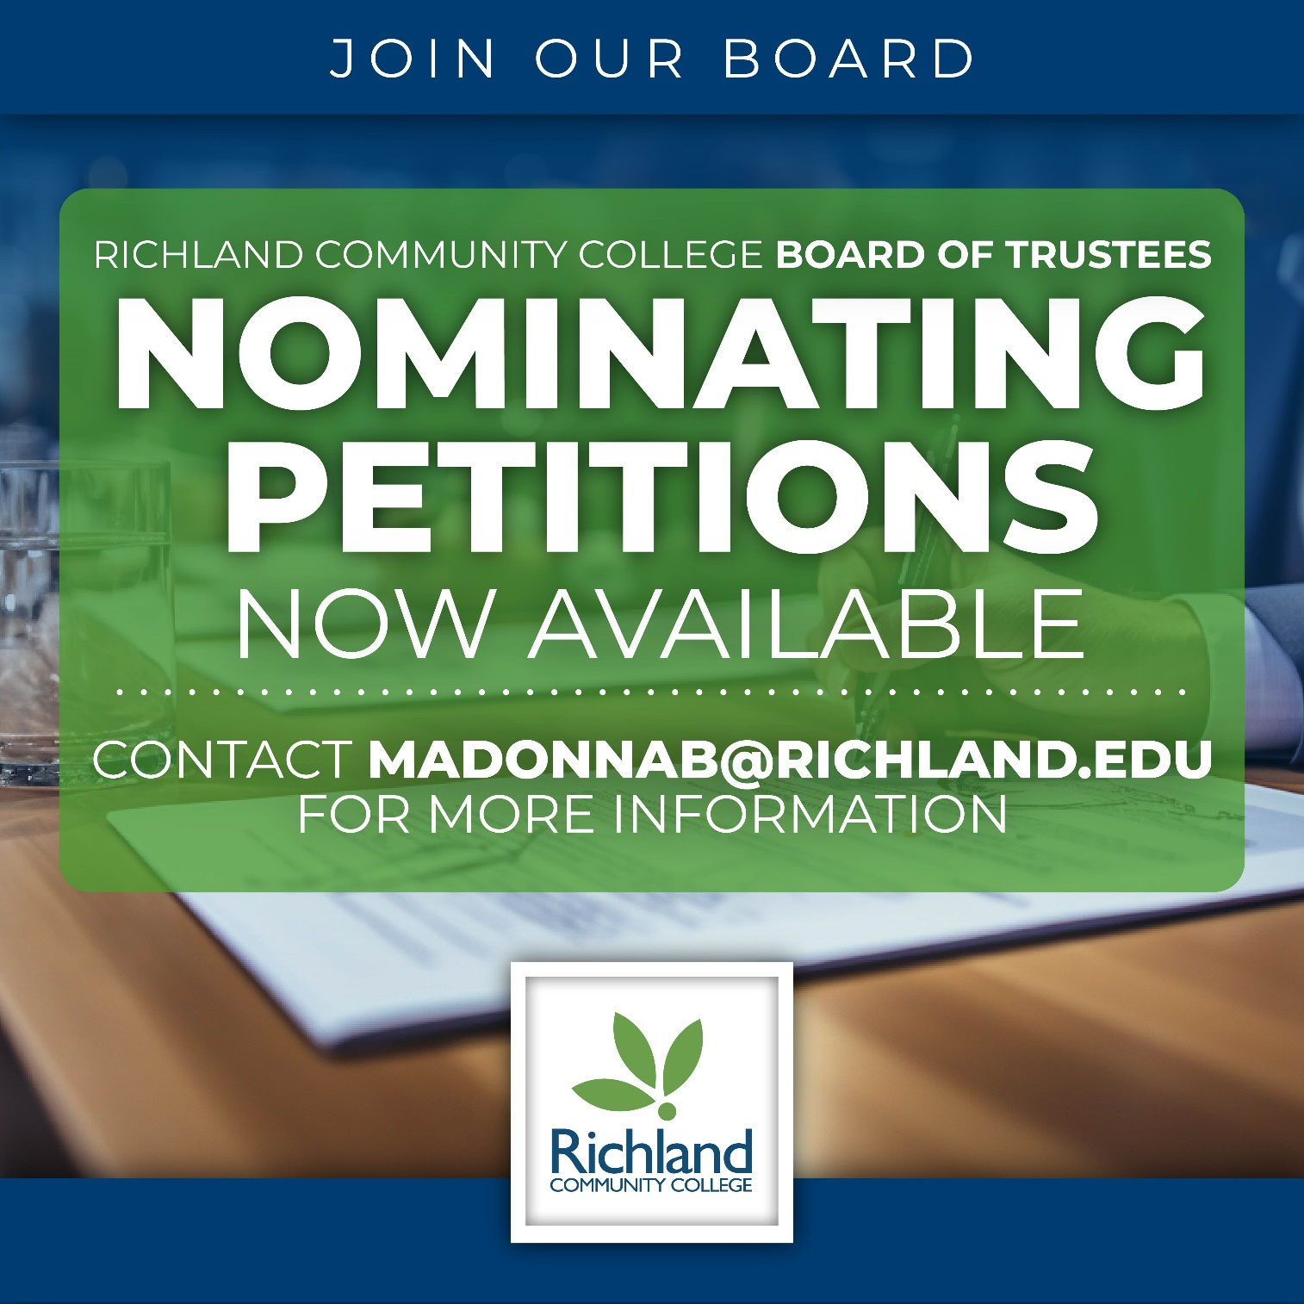





Slide 16
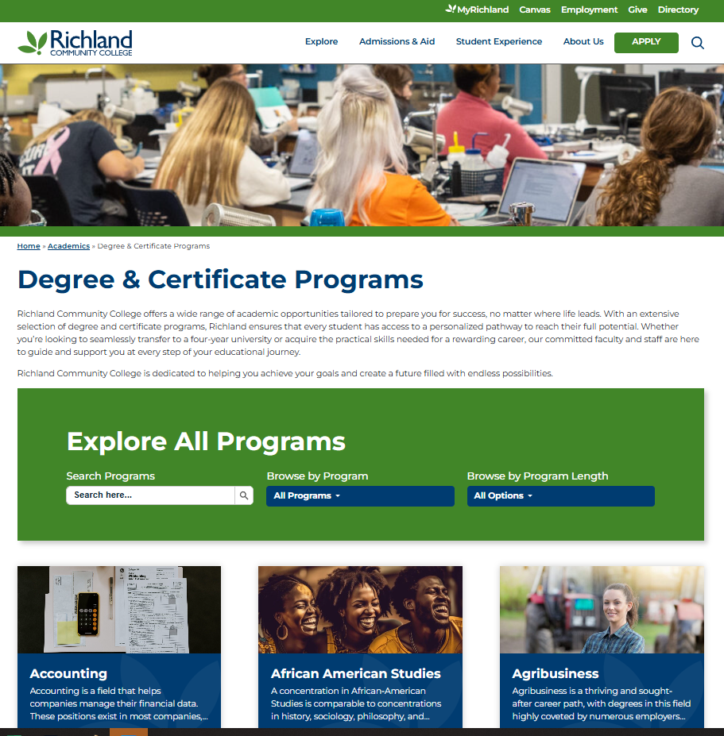
Marketing Analytics
Website – 39K Active Users
Top Visited Pages – 1st Quarter FY26
Main Page
Directory
Academic > Programs & Degrees
Apply & Enroll
Social Media
August 11 – September 7
Facebook: 198.9K views; 85 New Follows; 3.9K interactions
Instagram: 13.5K views, 20 New Follows; 201 Interactions

Slide 17
Office of Grants & Sponsored Programs
Active Grant Portfolio
32 Awards with a total funding value of $29.8M across academics, workforce, and student success.
Priorities for FY26
Build Infrastructure & Accountability: Our focus this year is to establish procedures, checklists, and training to ensure grants are managed with consistency and accountability.
Streamlining the Process: Our Grants team will develop a narrative templates, budget models, and a new Grants Handbook, which will help be grant ready and stay competitive for external funding.
Align with Institutional Priorities: Our Grants team, in coordination with the Foundation, will determine funding gaps and priorities to target opportunities.

Slide 18
New Grant Applications
EDA Disaster Supplement & DCEO Federal Match
Richland is preparing a $7.3 million federal request to the EDA to expand its Commercial Driver’s License (CDL) Training Program. The project includes construction of a 7,000-square-foot instructional facility, the addition of simulation labs, and a 100,000-square-foot outdoor training yard—resources that will significantly increase program capacity and student success. This opportunity is the first of multiple phases aimed at building long-term capacity to meet regional workforce demands.
Clean Energy Career and Technical Education Pilot Program
Up to $750K expand early college access in manufacturing, engineering, and clean energy. We will develop a MECE Early College Pathway for regional high school students which will align with CEJA, our work with T/CCI and the expansion of the Prep Academy.

Slide 19
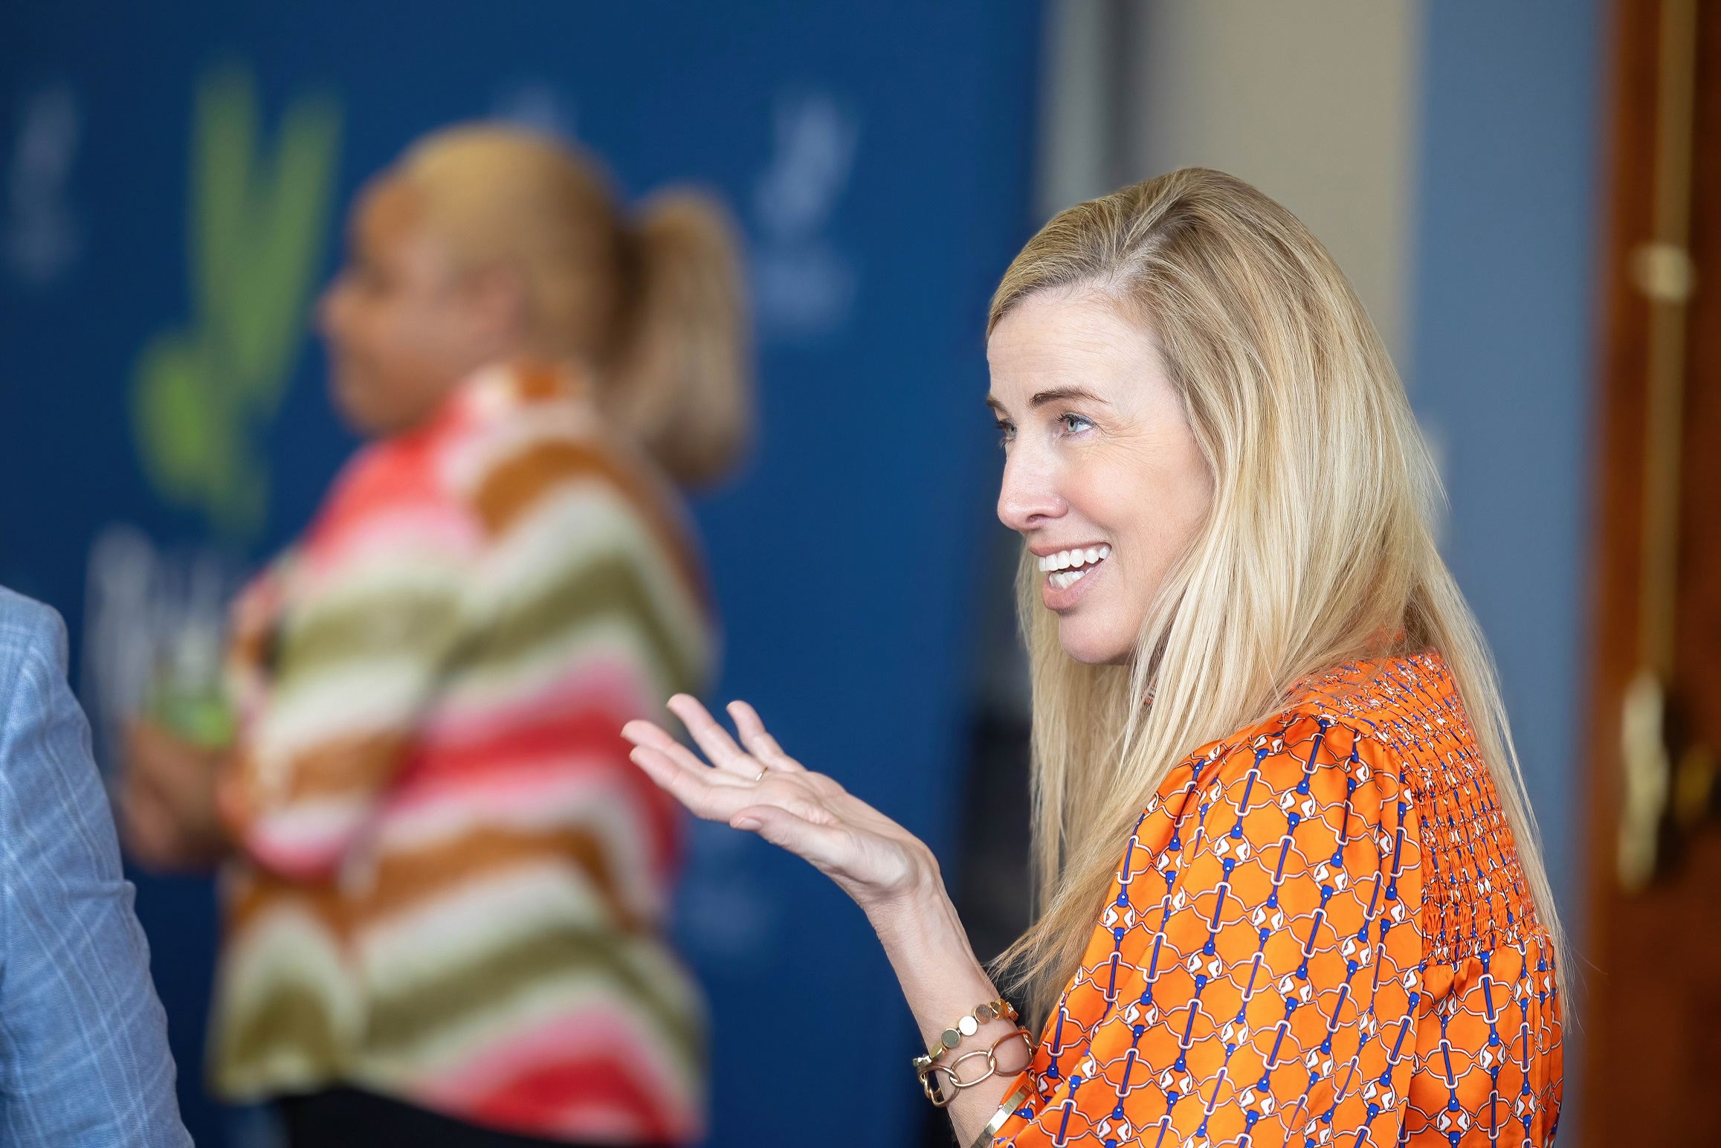
Campus Events Overview
Richland Community College hosts 280+ events annually:
50% dedicated to student recruitment and engagement—welcoming prospective students and supporting their success.
38% designed to serve and strengthen partnerships across our community.
12% supporting Foundation initiatives and employee engagement, reinforcing our culture of giving and collaboration.

Slide 20
Campus Events & Facility Rental Initiatives
Phase 1
New facility rental processes were implemented on August 1 to ensure all activities conducted on our campus reflect the College’s mission, make efficient use of resources, and provide meaningful value to both internal and external stakeholders.
Obligations of External Users
New Pricing & Fee (cost-recovery model)
Phase 2
Beginning this fall, as part of phase 2, we are asking individuals planning events for external audiences to complete a Post-Event Evaluation to help us gather feedback, assess event needs, and continuously improve our processes. Gathering this information help us ensure a consistent, high-quality experience for all guests and supports better planning and use of resources for future events.

Slide 21
End Statements – Closing Thoughts
Institutional Advancement ensures that the following end statements are not just aspirations, but realities—visible in every scholarship awarded, every grant secured, every story told, and every event hosted.
Because of Richland, students will have opportunities to successfully pursue training and education at and beyond the community college.
Because of Richland’s partnerships with the community, the economic and business climate in our service area will be significantly enhanced.
And if approved by the Board of Trustees, because of Richland’s efforts to expand and diversify funding, students will benefit from increased affordability, reduced financial barriers, and enhanced support through scholarships, grants, and community partnerships.

Slide 22
Questions?

