Slide 1
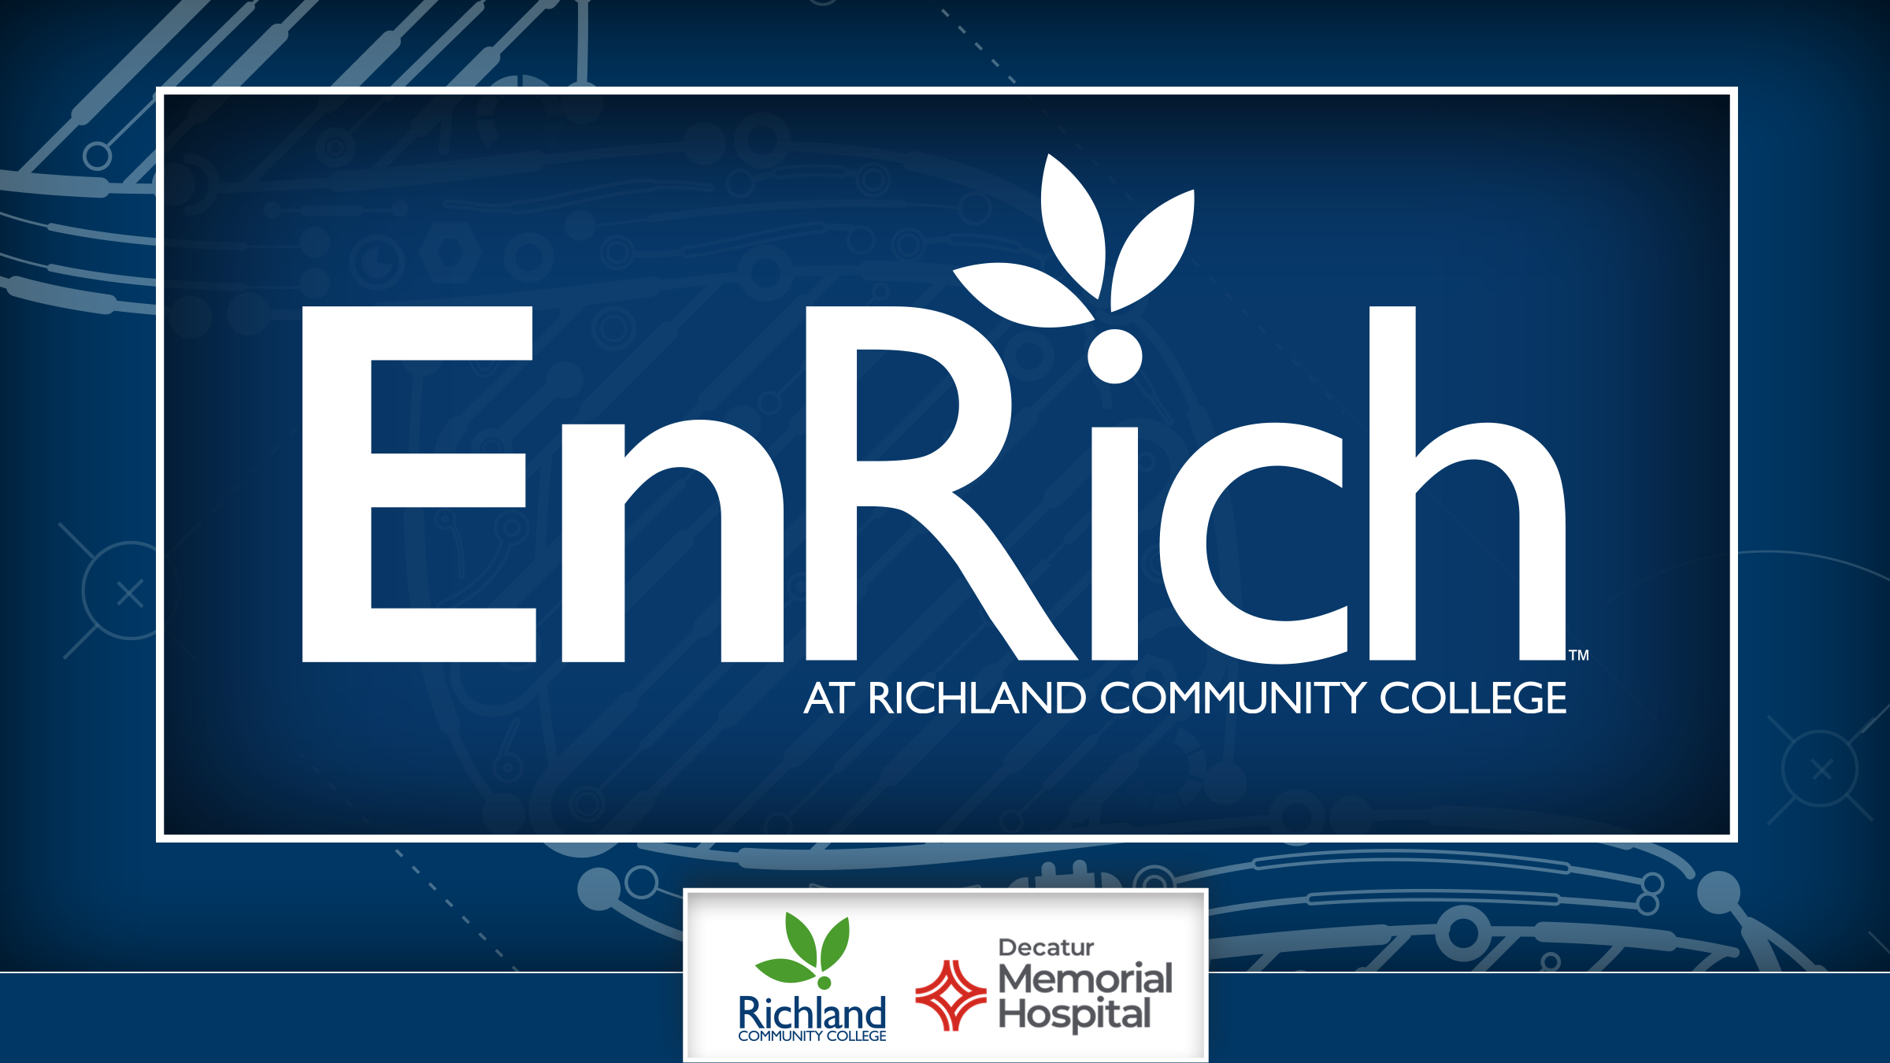



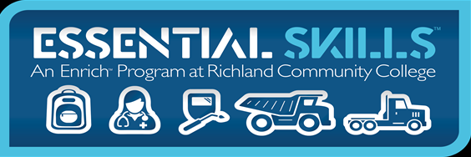
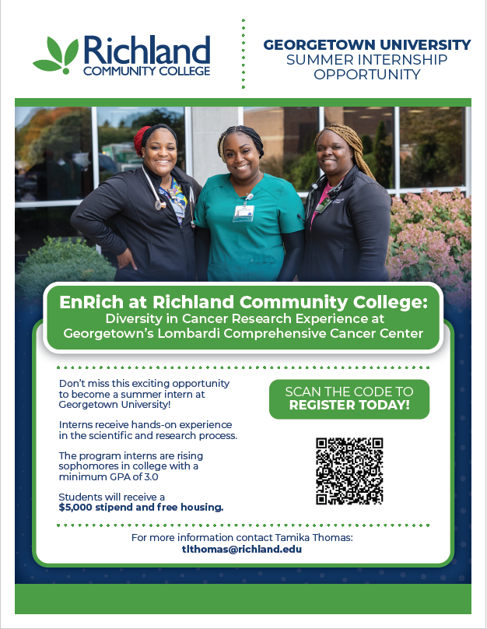
The EnRich at Richland Community College and the Diversity in Cancer Research (DICR) Experience at Georgetown’s Lombardi Comprehensive Cancer Center:
CREATED BY RICHLAND COMMUNITY COLLEGE. ALL RIGHTS RESERVED 2021.

Slide 2

Collaboration for Student Opportunity – EnRich at Richland Community College is partnering with Georgetown’s Lombardi Comprehensive Cancer Center to provide students with a prestigious 10-week cancer research internship in Washington, D.C.
Hands-on Research Experience – Selected students will work closely with faculty mentors on cutting-edge cancer research projects, gaining invaluable laboratory and clinical experience.
Professional Development – Interns will participate in workshops, seminars, and networking events to enhance their scientific knowledge and career prospects in biomedical research and STEM fields.
CREATED BY RICHLAND COMMUNITY COLLEGE. ALL RIGHTS RESERVED 2021.

Slide 3
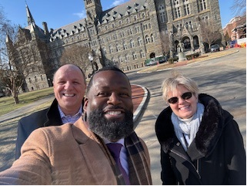
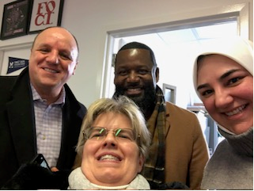
Presentation & Public Speaking Skills – Each intern designs and delivers a final research presentation to an audience of faculty, students, and members of the American Cancer Society.
Academic Year Mentorship – Interns receive continued virtual mentorship after the summer program, fostering long-term professional growth and research opportunities.
Competitive Selection Process – EnRich will nominate a pool of 5-10 eligible students, from which Georgetown’s DICR selection committee will choose one participant for the pilot program.
CREATED BY RICHLAND COMMUNITY COLLEGE. ALL RIGHTS RESERVED 2021.

Slide 4


Financial Support – Interns receive a $5,000 stipend and free housing, with travel costs covered either through Georgetown or the student’s home program at Richland.
Diverse & Inclusive Opportunity – The program strongly encourages students from backgrounds underrepresented in biomedical research to apply, promoting equity in STEM education.
Access to Georgetown’s Resources – Interns gain access to Georgetown’s research facilities, libraries, and networking events, enriching their academic and professional experiences.
Pathway to Advanced Education & Careers – Many past participants have gone on to graduate school, medical school, or research careers, making this an exceptional steppingstone for EnRich students.
CREATED BY RICHLAND COMMUNITY COLLEGE. ALL RIGHTS RESERVED 2021.

Slide 5
QUESTIONS
CREATED BY RICHLAND COMMUNITY COLLEGE. ALL RIGHTS RESERVED 2021.

