Slide 1


Slide 2

Board Ends Alignment
Because of Richland, students will acquire the knowledge and skills needed to succeed in and contribute to a diverse and global community and to exercise their rights and responsibilities as citizens
Because of Richland, students who graduate with applied (A.A.S.) degrees will be prepared to be skilled, successful employees in the workplace
Because of Richland, students will have opportunities to successfully pursue training and education at and beyond the community college

Slide 3

National Final Fall Enrollment Trends 2025 Report
In fall 2025, there were over 19.4 million postsecondary enrollments —16.2 million undergraduate and 3.2 million graduate students.
Compared to 19.2 million students last fall, this is a 1.0 percent increase in total postsecondary enrollment
Growth in undergraduate enrollment was driven by a 3.0 percent increase in community college enrollment, compared to a 1.4 percent increase at public 4-year colleges.
Enrollment in undergraduate certificate and associate degree programs continues to grow at a faster pace than bachelor’s program

Slide 4
Enrollment Metrics
Headcount -The total number of individual students enrolled, regardless of how many classes or credits they take.
Headcount measures access and reach.
Credit Hours -The total number of credit hours students are taking (e.g., 12 credits = full-time).
Credit hours measure engagement and instructional demand.

Slide 5
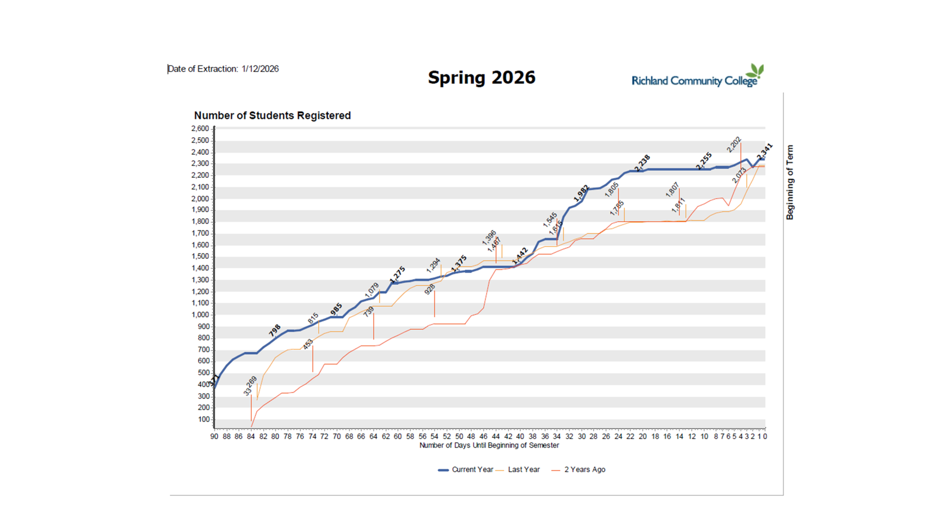
Enrollment Growth

Slide 6
Enrollment Growth
Cost & Affordability
Accessibility & Proximity
Sense of Belonging & Community
Workforce Programs Tied to Local Industry
Partnerships with Employers
Dual Credit / Early College Expansion

Slide 7

Student Age Distribution
Fall 2018 (Inner Circle)
Under 18: 24.4%
18-19: 23.3%
20-24: 30.9%
25-34: 22.9%
Fall 2025 (Outer Circle)
Under 18: 37.7%
18-19: 16.7%
20-24: 30.9%
25-34: 16.8%

Slide 8


Student Types
Notes:
Percentage of faculty and Staff up by 25% as well but still lagging behind the student population at 15%

Slide 9

Racial and Ethnic Breakdowns

Slide 10
Early College Population
Fall 2018

Slide 11

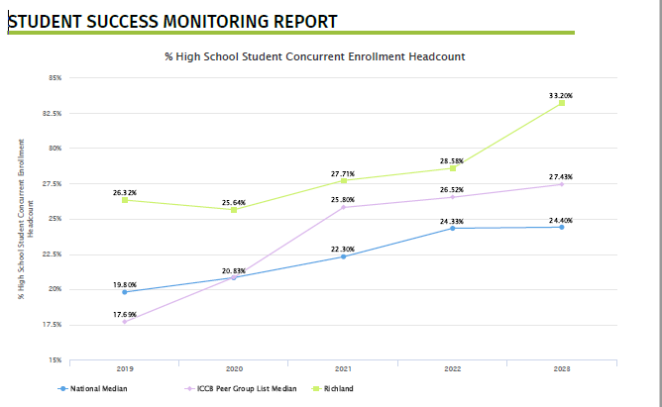
% of High School Student Concurrent Enrollment Headcount

Slide 12

Full-Time / Part-Time
80% Part-time in FA2025 compared to 67% in FA2018

Slide 13
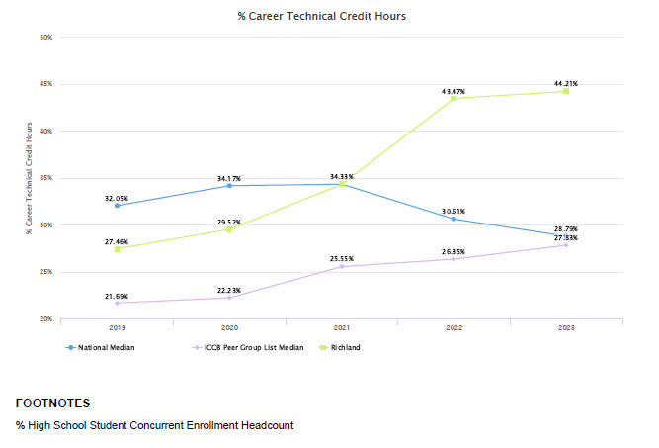
% Career Technical Credit Hours

Slide 14
Micro-Credentials & Micro-Pathways
Micro-Pathway Model
Degrees and certificates are broken into stackable milestones
Students earn credentials with labor-market value along the way
Enables rapid response to regional workforce needs
Example Pathway
Micro-Credential → Short Certificate → Degree

